Slide 1
King Saud University College of Business Administration Department of Health Administration Masters` Program
PA 507 – Introduction to Public Health
First Semester 1437/ 1438
Mohammed S. Alnaif, Ph D. alnaif@ksu.edu.sa

Slide 2
Study Design
Learning Objectives
Identify and define the primary research designs used in public health epidemiology.
Describe how experimental and observational research studies differ and the strengths of each.
Calculate and interpret a relative risk for cohort studies and an odds ratio for case – control studies.
Define the elements of causal inference in evaluating the relationship between an exposure and a health outcome.
Evaluate observational research for causal inference of risks and health outcomes.

Slide 3
Study Design
Research Methods is a systematic and principled way of obtaining evidence (data, information) for solving health care problems.
Other methods of known used in the health science:
Authority
Rationalism
Intuition

Slide 4
Study Design
Basis of scientific method:
Scepticism (the notion that any proposition or statement, even those by great authorities, is open to doubt and analysis)
Determinism (the notion that events in the world occur according to regular laws and causes not as a result of caprices)
Empiricism (the notion that enquiry ought to be conducted through observation and experiments). Stimulated by the rise of experimental science, it developed in the 17th and 18th centuries

Slide 5
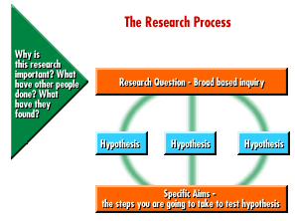
Study Design
Hypotheses are propositions about relationships between variables or differences between groups that are to be tested.

Slide 6
Study Design

Slide 7
Study Design
Theories are sets of logically related or linked ideas (abstractions) about how the world or some process works.
The fundamental building blocks of a theory are concepts. In other words theories consist of a series of statements (propositions) about a relationships between concepts.
A variable is simply a property that may vary from case to case. Example, a room temperature, height, weight.

Slide 8
Study Design
Study Design
You now know how to assess changes in health over time and how to compare measures across populations.
You can determine whether infant mortality is higher in Jeddah than it is in Riyadh and whether this trend is changing over time.
You may recall this is known as descriptive epidemiology.

Slide 9
Study Design
Study Design
But why is there a difference in infant mortality, and what factors increase or decrease the risk of death in the first year after birth?
Through research , we will cover the basics of quantifying the relationship between exposure (independent variable) and outcome (dependent variable) within a population, or what is known as analytic epidemiology.

Slide 10
Study Design
Study Design
As mentioned before, the purpose of analytic epidemiology is to identify and quantify risk factors for health outcomes.
However, a single study is rarely enough to make us confident in this relationship, and different studies may have different results.
Therefore, criteria exist to assess whether there is a cause and effect relationship between two variables.
It is important to understand the criteria for causal inference no matter what your career goals are because, as a consumer, you must make decisions based on evidence presented by sources such as the media, industry, and health care providers.

Slide 11
Study Design
Study Design
In epidemiology there are several common categories of quantitative study designs.
These types of studies rely on measures that can be described by discrete numbers.
For example, age and months of employment are two pieces of information that have specific numbers associated with them.

Slide 12
Study Design
Study Design
For other topics with less obvious links to numbers, we can create categories of answer choices and assign them a number, making them into categorical variables.
For example, we might ask people to rate their general health using a 5 - point scale in which 1 represents poor health and 5 represents excellent health.
In this way, we are able to quantify measures that seem subjective or are not intuitively numerical.
In contrast, qualitative study designs collect rich, descriptive information that does not fit into clearly defined categories

Slide 13
Study Design
Study Design
Within quantitative studies, there are two broad categories: observational and experimental studies.
In observational studies, the researcher does not intervene in any way regarding the subjects’ exposures or actions; he or she simply observes them.
These studies are then analyzed based on the experiences of the subjects and assessment of their outcomes.

Slide 14
Study Design
Study Design
In experimental studies, the researcher does intervene, controlling subjects’ exposures. Study participants are divided into groups, and each participant receives the exposure randomly prescribed to that group.
Perhaps the most commonly reported type of experimental study is the randomized trial, of which drug trials may be most familiar.
In these trials, study participants may be given a placebo (an inactive pill), an established drug, or a new drug to compare their effectiveness.

Slide 15
Study Design
Major types of quantitative
epidemiologic studies
Observational Studies
Aggregate-level unit of observation
Ecological
Person-level unit of observation
Cross-Sectional
Longitudinal
Cohort
Case-Control
Experimental Studies
Community trials
Field trials
Clinical trials

Slide 16
Study Design
Observational Study
An observational study is one in which the researcher simply observes people and collects information about their behaviors and health choices to determine whether these factors influence their chances of having a particular health outcome.
The researcher does not assign research participants to any particular exposure group but instead follows people and allows them to make their own choices about whether or not they are exposed to various activities or substances.

Slide 17
Study Design
Observational Study
Observational studies are useful in public health because it would not be ethical to assign to people many exposures in which we are interested.
For example, low birth weight is a public health problem because infants born small are at an increased risk of a number of poor health outcomes, including mortality.
We do not fully understand all the causes of low birth weight, so research is ongoing to identify risk factors for low birth weight.
Some of the exposures that may cause low birth weight include cigarette smoking, drug use (legal or illegal) during pregnancy, and certain pesticides.

Slide 18
Study Design
Observational Study
Clearly, it would not be ethical to expose pregnant women or anyone else, to these substances intentionally.
For this reason, we must use an observational study design, one in which we look at the birth weight of infants born to women who have been exposed to these various substances of their own accord, and compare their infants’ health to the health of infants born to women who were not exposed to these substances.
You may be thinking that women who smoke during pregnancy may be different from women who do not smoke during pregnancy in ways that influence their chances of giving birth to a low birth weight infant.

Slide 19
Study Design
Observational Study
This concern, the possibility of confounding, is a common one in observational studies and must be carefully accounted for when analyzing data from this type of study.
A confounder is a third variable that can make it appear (sometimes incorrectly) that an observed exposure is associated with an outcome. In other words, a confounder is an unobserved exposure associated with the exposure of interest and is a potential cause of the outcome of interest.
Confounders lead to bias that distorts the magnitude of the relationship between two factors of interest.

Slide 20
Study Design
Observational Study
In all observational studies, it is vital to measure possible confounders such as health conditions and health behaviors, which are other exposures that may be related to the outcome of interest.
Because the investigator is not controlling exposures in observational studies, participants may engage in activities or behaviors that contribute to the development of the outcome, and this must be distinguished from the exposure of interest in the study.
In other cases the confounder might be strongly related to the outcome

Slide 21
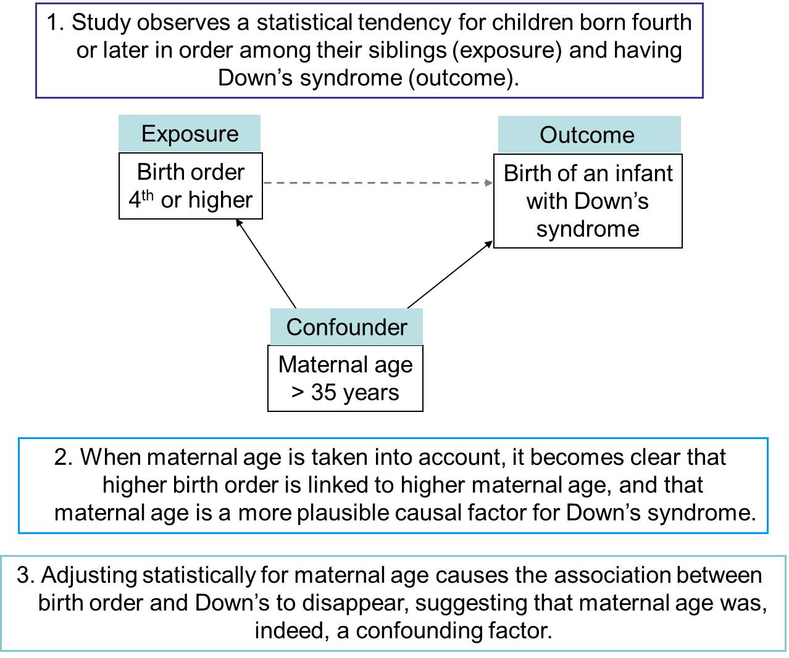
Confounders

Slide 22
Study Design
Observational Study
The first two types of observational study designs we will discuss, ecological and cross - sectional studies, often make use of readily available data.
We will see below that both types of studies can have design flaws that may make them more useful as descriptive studies than as analytic studies.
The next set of observational studies we will discuss, cohort studies and case – control studies, are the most common classes of analytic epidemiological studies conducted in public health, and they have design features that make them superior to most ecological and cross - sectional studies.

Slide 23
Study Design
Observational Study
Ecological Studies
Ecological studies vary from all the other observational studies we will discuss in one important way: they make use of group - level data rather than individual - level data.
This means that instead of collecting information from individuals about an exposure and an outcome of interest, in an ecological study we have summary exposure and outcome information for the entire population.
In ecological studies, we are comparing entire groups: the average level of exposure for the group is correlated to the group’s average outcome.

Slide 24
Study Design
Observational Study
Ecological Studies
In these studies, the independent variable (x or exposure) is the percentage of people exposed in the group, and the dependent variable (y or outcome) is the rate or risk of disease in the group.
The unit of analysis in ecological studies is the group rather than the individual. By nature, these studies must be interpreted at the group rather than the individual level.
In fact, there is a term that refers to making individual – level inferences based on group - level (ecological) data: ecological fallacy.

Slide 25
Study Design
Observational Study
Ecological Studies
The ecological fallacy occurs for a number of reasons.
First, it may be that although a population looks as though it has high exposure, it may be only a group of individuals within the population who have the exposure, and they may or may not be the same individuals with the outcome of interest.
Second, there may be confounders (other factors) that are not measured in the data that coincide with the exposure of interest. (see the attached example)

Slide 26
Study Design
Ecological Studies
Ecological studies typically are better for generating hypotheses than testing them, as illustrated by the example above.
There is a correlation between PM concentration in the air and asthma attacks in Riyadh, and we can now generate a hypothesis and test it using individual - level studies.
Ecological studies often are a good first stage in an analytic strategy because easily accessible data may be available from a public source such as a hospitals or government agency.
Although public health focuses on populations, group - level data are often not the best source of data for uncovering cause and effect relationships between exposures and outcomes.

Slide 27
Study Design
Observational Study
Cross - Sectional Studies
As the name implies, cross - sectional studies collect information at a single time point, providing a snapshot of a population at a given time.
These studies collect information about both exposure and outcome at a single point in time.
Often, cross - sectional studies include data obtained from surveys or interviews that occur only once or data obtained from a publicly available source such as a government agency.

Slide 28
Study Design
Observational Study
Cross - Sectional Studies
Cross - sectional studies are useful as basic prevalence studies, providing information about the amount of a health problem in a population.
These types of cross - sectional studies would be considered descriptive, designed to provide information about the person, place, and time variables of a health outcome, but not designed to identify risk factors for that outcome.

Slide 29
Study Design
Observational Study
Cross - Sectional Studies
Perhaps the biggest flaw associated with cross - sectional data is a temporal sequence issue or the order of exposure and outcome in time.
Because data on exposure and outcome are collected simultaneously, there can be a problem distinguishing which came first in a cross - sectional study.
For example, if we use a cross - sectional design to investigate whether clinical depression increases the risk of being overweight, we would not be assured that depression preceded overweight; the relationship could, in fact, be the reverse.

Slide 30
Study Design
Observational Study
Cross - Sectional Studies
Finally, cross - sectional studies do not provide the full experience of individuals across time; they do not capture future disease and sometimes may exclude past disease.
This is the nature of prevalence studies. It is not a problem per se, but it should be noted when using cross - sectional studies in analytic work.
Figure 5.3 illustrates this point. In the figure, the lines may represent a survey assessing exposure or outcome.
In either case, it is clear that if we collect data at only one time point, as occurs in cross - sectional studies; we may not sample people during the period of exposure or outcome.

Slide 31
FIGURE 5.3 Generic Cross - sectional Study Design Showing the Various Points in Exposure or Disease Process at which Individuals May Be Surveyed
Unexposed
Exposed
Point at which exposure occurs
Time
Data Collected

Slide 32
Study Design
Observational Study
Cross - Sectional Studies
Let us assume that the figure shows data for obesity, defined as a BMI of 30 or higher.
Solid lines indicate time periods during which a person is not obese, and dotted lines indicate time periods during which a person is obese.
If we collect our cross - sectional data at the point indicated by the vertical line, we will calculate an obesity prevalence of 2 in 6, or 33.3%.
However, we see that one person was obese at an earlier point in his life, and another person will become obese later in life.
Also, one of the two people included in our prevalence estimate fluctuates over time between being classified as obese and not obese.

Slide 33
Study Design
Observational Study
Cohort studies may be the most intuitive of the observational studies. If told to observe a group of people to determine the relationship between an exposure and an outcome, one would naturally choose two groups, a group exposed and a group not exposed to the substance or event of interest, and then would follow those groups over time to look at the occurrence of the outcome. This describes a cohort study.

Slide 34
Study Design
Observational Study
In a cohort study, we compare the occurrence of a health outcome in persons who are exposed and persons who are not exposed.
The follow-up may be prospective (into the future) or retrospective (in the past), sometimes called historical cohorts.
Observational studies are always called cohorts if the study participants are divided into groups based on their exposure status (Figure 5.4). Cohort studies begin with individuals who all are free of the outcome of interest.

Slide 35
FIGURE 5.4 Generic Scheme of Cohort Study Design in which All Participants Are Free of the Outcome at the Beginning of the Study.
Outcome
Exposed
No Outcome
Outcome
Unexposed
No Outcome
Study begins
Follow-up period
Study ends
Time

Slide 36
Study Design
Cohort Studies
Cohort studies begin with individuals who all are free of the outcome of interest.
Thus in a cohort study, we have an exposed group and an unexposed group, and we follow them over time to compare the development of the outcome of interest, or incidence of the outcome.
In a cohort study, the investigator often begins by identifying the exposed group, for example, people who are engaged in a behavior such as smoking or people who are exposed to a chemical compound such as arsenic.
The unexposed group should be drawn from the same population as those exposed. (Recall that population in this sense will be defined by the researcher and may include attributes such as place of residence, demographic characteristics, or other factors.)

Slide 37
Study Design
Cohort Studies
Ideally, the unexposed comparison group should resemble the exposed members of the cohort in every way except exposure, but in practice this rarely occurs.
Perhaps the clearest potential problem in the evidence of exposure – disease relationships from cohort studies is that the differences between the exposed and unexposed people might be related to the outcome you are studying and may confound your answer.
If there are important differences between the exposed and unexposed members of the cohort and these differences are causal factors for the outcome of interest, the association of interest will be confounded.

Slide 38
Study Design
Cohort Studies
Measurement of all potential confounding factors in a cohort study is a must.
Methods exist to control the effects of confounding, which we will discuss later, but an unmeasured confounder is an uncontrollable confounder.
Sometimes it is possible to compare the risk or rate of disease among those exposed to some known risk or rate rather than construct an unexposed group for the cohort.
For example, we might compare the risk of asbestosis (an asbestos - related lung disease) among a special group of occupationally exposed workers to the risk of asbestosis among the general population.

Slide 39
Study Design
Analyzing Cohort Studies
In both cohort studies and case–control studies, the basic analysis begins with the construction of a (2 × 2) table.
These tables have two rows, one for the exposed and one for the unexposed subjects, and two columns, one for those with the outcome and one for those without the outcome.
The number of people who fall into each row by column category are represented by the letters a, b, c, and d as shown in Table 5.1.
Table 5.1 Generic 2 × 2 Table
 | Outcome | No Outcome
Exposed | a | b
Unexposed | c | d

Slide 40
Study Design
Analyzing Cohort Studies
In cohort studies, the relative risk (RR) is calculated as the measure of effect or the measure of excess risk, the amount by which exposure increases (or decreases) the risk of the outcome.
The relative risk is sometimes called the risk ratio or rate ratio, is the incidence in the exposed group divided by the incidence in the unexposed group; thus we are comparing the rate of new disease among the exposed and the unexposed groups.
RR= | a/(a+b)
 | c/(c+d)

Slide 41
Study Design
Analyzing Cohort Studies
If the RR equals 1.0, there is no difference in risk of the outcome based on exposure. In other words, someone with the exposure of interest is equally as likely to develop the outcome as someone without the exposure of interest.
If the RR is greater than 1.0, we say the exposure increases the risk of outcome. For example, if smoking was the exposure and lung cancer the outcome, and we calculate an RR of 4.3, we would say smokers are 4.3 times as likely as nonsmokers to be diagnosed with lung cancer.
Likewise, if the RR is less than 1.0, the exposure is protective against the outcome.

Slide 42
Study Design
Analyzing Cohort Studies
In another scenario (Table 5.2 a), we may be looking at seat belt use during a crash as the exposure and traumatic brain injury (TBI) as the outcome.
If we calculate an RR of 0.6 in this study, we would say that individuals wearing a seat belt at the time of a crash were 0.6 times as likely (less likely) to have a TBI compared to individuals who were not wearing a seat belt during a crash.
We can also invert the rows of a 2 × 2 table and reverse the interpretation of the relative risk. (Table 5.2 a).

Slide 43
Table 5.2 a and b Two - by - two Tables with Data and Relative Risk (RR) Calculations for a Hypothetical Cohort Study Investigating whether Wearing a Seat Belt during a Crash (exposure) Is Associated with Traumatic Brain Injury (TBI; outcome)
a |  | TBI | No TBI
 |  | 50 95 | 300 305
RR= | 50/(50+300) | = 0.60 (less likely or protected)
 | 95/(95+305)
b |  | TBI | No TBI
 |  | 95 50 | 305 300
RR= | 95/(95+305) | = 1.7 (more likely or increased risk)
 | 50/(50+300)

Slide 44
Study Design
Analyzing Cohort Studies
In some cases, it is easier to explain a relationship or more useful to report a result with an RR greater than 1.0.
In part (b) we see this alternate approach, listing the unexposed group in the first row and the exposed group in the second row.
Note that the RR in part (b) is simply the inverse of the RR obtained in part (a).
The appropriate interpretation of the RR in (b) is that individuals who were not wearing a seat belt at the time of a crash were 1.7 (1/0.6) times more likely to have a TBI compared to individuals who were wearing a seat belt at the time of a crash.
The data provide the same information, but one explanation may be easier for the audience or the public to understand.

Slide 45
Study Design
Analyzing Cohort Studies
Also note that identical numbers of individuals in the exposed and unexposed groups in a cohort study are not required.
Often, the frequency of exposure will influence the number of subjects who can be identified, and this may result in an imbalance in numbers.
There are statistical measures that can show whether a study has a sufficient number of subjects to detect significant differences in risk; however, these are beyond the scope of this course.

Slide 46
Study Design
Case – Control Studies
A case control study is defined as an epidemiological approach in which the researcher starts by picking up cases who have already developed a particular disease or outcome of interest , and a comparison group (controls) of subjects who except for the fact that they have not developed the particular disease, are otherwise similar to the case.

Slide 47
Study Design
Case – Control Studies
In case – control studies, participants are selected based upon their outcome status, and exposure frequencies (or levels) are compared between groups (Figure 5.5).
People with the outcome are called cases, and people without the outcome are called controls.
In other words, case – control studies compare the exposure histories of ill persons to those of persons who are at risk of developing the illness.

Slide 48
Study Design
Case – Control Studies
THREE QUALITIES NEEDED IN CONTROLS
Key concept: Comparability is more important than representativeness in the selection of controls
The control must be at risk of getting the disease.
The control should resemble the case in all respects except for the presence of disease.
Cases emerge within a study base. Controls should emerge from the same study base, except that they are not cases

Slide 49
FIGURE 5.5 Generic Scheme of a Case – control Study Design in which Participants with and without the Outcome are Identified (cases and controls, respectively).
Exposed
Outcome
Cases
Unexposed
Exposed
Unexposed
No outcome
Cases
The exposure status for each individual is then assessed, either through an interview or through historical records, if available

Slide 50
Study Design
Case – Control Studies
In order to successfully conduct a case – control study, it must be possible to identify members of the population who are at risk for the outcome; in other words, controls from the population from which the cases arose must be found.
Alternatively, one could use a group of controls whose exposure histories represent that of the population at risk. It must also be possible to measure the history of exposure in a valid way in both cases and controls. If these two conditions are met, and if the condition under study, the cases, are not too common, a case – control study will provide the same result as a properly done cohort study.

Slide 51
Study Design
Establishing Case and Control Definitions
Cases The criteria for selecting individual cases in a case – control study must be objective.
Specific diagnostic criteria or other parameters should be defined prior to case selection to limit bias in the results of the study.
Bias is a systematic difference in the results of a study from what in fact is occurring.
Bias occurs for a variety of reasons including problems in the way subjects were selected for a study, the measurements used in the study, or the analysis of the data.

Slide 52
Study Design
Establishing Case and Control Definitions
The criteria for case selection must have high sensitivity and specificity (accuracy) in order to minimize misclassification.
Sensitivity in this case refers to the ability to correctly identify people who have the outcome (labeling cases as cases), and specificity means that people without the outcome are correctly identified as not having the outcome (labeling controls as controls).
Misclassification, categorizing someone as a case when he or she is not or improperly classifying a control as a case, can attenuate, or dampen, the results of the study.

Slide 53
Study Design
Establishing Case and Control Definitions
In epidemiological studies, attenuation results in the RR or odds ratio (OR) estimate moving closer to 1.0 (the level of no effect or association).
By extension, the case – control study design may be a poor choice for some conditions with broad case definitions or for syndromes that include several heterogeneous kinds of cases.
However, if the exposure – outcome relationship is strong enough, case – control studies may still offer the advantage of
smaller sample sizes than cohort studies,
larger numbers of suspect exposures from the same outcome examined, and
a shorter study period, allowing completed follow - up of the subjects.

Slide 54
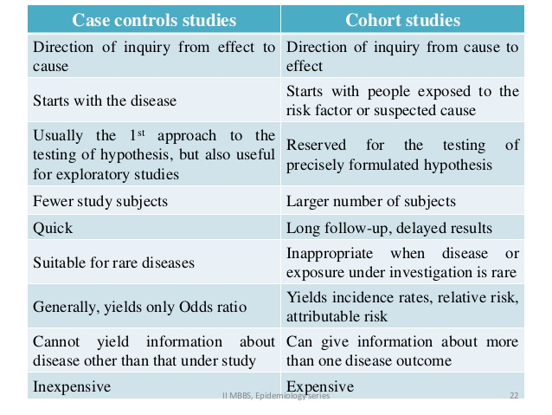
Case – Control Studies vs Cohort Studies

Slide 55
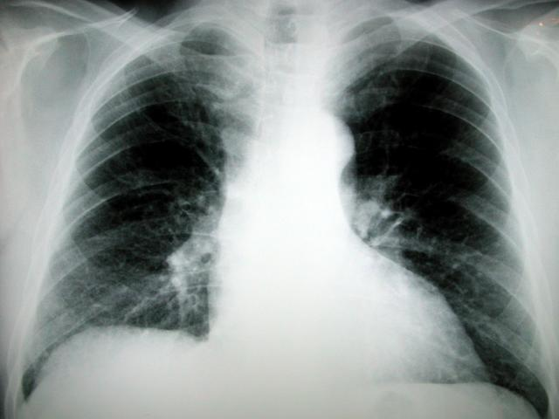
Case – Control Studies vs Cohort Studies
Selection of subjects based on exposure (cohort) or disease (case-control) status?
Hypothesis. Does cigarette smoking cause lung cancer?
Cohort. Identify smokers (E+) and non-smokers (E-) ⇒ assess and compare lung cancer rates
Case-control sample. Identify lung cancer cases (D+) and non-cases (D-) ⇒ assess and compare smoking histories (E+/E-)
Source: Epidemiology Kept Simple

Slide 56
Study Design
Analyzing Case – Control Studies
In case – control studies, we begin analysis by setting up a 2 × 2 table, just as we did with cohort studies.
However, in case – control studies, we must use the odds ratio (OR) approximation to the relative risk, as shown in Table 5.6.
The interpretation of the OR is similar to the RR, except we are talking about the odds of an outcome rather than the risk of an outcome.
For example, if we calculate an OR of 2.9 for competitive running (exposure) and knee replacement (outcome), we would say the odds of having a knee replacement for competitive runners was 2.9 times the odds of knee replacement in noncompetitive runners.

Slide 57
Table 5.6 Generic Example of a 2 × 2 Tables and Formula for Odds Ratio (OR)
Exposed Unexposed |  | a c | b d
OR= | a x d
 | b x c

Slide 58
Study Design
Analyzing Case – Control Studies
The reason we cannot calculate a relative risk in case – control studies is that we do not have a measure of incidence.
Recall that in a case – control study we select people based on the presence (case) or absence (control) of the outcome, so the researcher is artificially establishing the number of cases and controls: rarely does the distribution match the actual incidence of the outcome in the underlying population.
Because we cannot measure incidence in a case – control study, we must instead calculate the odds of an event occurring in each exposure group. If the outcome is rare, often defined as occurring in 5 percent of the population or less, the OR will closely approximate the RR (called the rare disease assumption ).

Slide 59
Study Design
Analyzing Case – Control Studies
As in all observational studies, analysis of case – control studies must include rigorous assessment and control of confounding variables.
There are some additional issues of which to be keenly aware in case – control studies as well, and recall bias is one of the most notable.
Recall bias occurs if cases and controls remember past exposures differently, with cases potentially having more recently considered their exposures because of the diagnosis or event that makes them a case.
Recall bias does not necessarily imply that cases over report exposure because they attribute their outcome to a particular exposure; rather, cases may in fact recall their exposures more accurately than do controls.

Slide 60
Study Design
Analyzing Case – Control Studies
Recall bias - In a case-control study data on exposure is collected retrospectively. The quality of the data therefore, is determined to a large extent on the patient's ability to accurately recall past exposures.
Recall bias may occur when the information provided on exposure differs between the cases and controls. For example an individual with the outcome under investigation (case) may report their exposure experience differently than an individual without the outcome (control) under investigation. That is, cases may tend to have a better recall on past exposures than controls.
Recall bias may result in either an underestimate or overestimate of the association between exposure and outcome.
Methods to minimize recall bias include:
Collecting exposure data from work or medical records
Blinding participants to the study hypothesis.

Slide 61
Study Design
Analyzing Case – Control Studies
As we noted earlier, one of our major concerns in an observational design, including case – control studies, is confounding.
To deal with confounding we sometimes use a matched case – control study design. In this practice, one control subject is identified who matches a case on a factor or factors, such as age, gender, race, or hospital admission date.
When a factor is matched, it can no longer be investigated as an exposure because the researcher has manipulated its distribution to be equal across cases and controls.

Slide 62
Study Design
Analyzing Case – Control Studies
As we noted earlier, one of our major concerns in an observational design, including case – control studies, is confounding.
To deal with confounding we sometimes use a matched case – control study design. In this practice, one control subject is identified who matches a case on a factor or factors, such as age, gender, race, or hospital admission date.
When a factor is matched, it can no longer be investigated as an exposure because the researcher has manipulated its distribution to be equal across cases and controls.
One benefit of matching is that more than one control may be matched to each case to decrease the number of cases needed to achieve adequate statistical power (also known as minimizing type 2 errors.

Slide 63
CHOOSING AN OBSERVATIONAL STUDY DESIGN
Choice of an Observational Study Design
Characteristic | Favors
Frequency of exposure is: High Low | Cohort All (especially case – control)
Frequency of outcome is: High Low Expensive to ascertain in specific individuals | Cohort Case – control Case – control
Unable to accurately assess prior exposure given presence of outcome (e.g., recall bias is serious, altered biological state) | Cohort
Availability of Follow - up mechanism Exposure records | Cohort All (especially cohort)
Duration between exposure and outcome Long Short | Case – control Cohort

Slide 64
Study Design
Experimental Studies
As we discussed, observational studies are appropriate for many questions, especially when we cannot ethically assign exposures, for example, randomly assigning car seat use to test whether they protect infants in vehicle crashes.
In contrast, in experimental studies the researcher assigns study participants to a particular exposure group (exposed or unexposed).
Experimental studies have a number of strengths, namely that they limit confounding.
There are a number of types of experimental studies. Here we will discuss only randomized controlled trials and community trials.

Slide 65
Study Design
Experimental Studies
The aim or goal is to determine how changes in the Independent variable affect some outcome the dependent variable
By controlling the timing or amount of the intervention or which subjects get it and which ones do not, the chances are minimized that other factors outside of the researcher's control could have affected the results.
A control group consist of subjects that undergo exactly the same conditions as the group receiving the treatment, the casual effect of which being investigated.
In field research in applied clinical setting we include control groups in the design to ensure internal validity

Slide 66
Study Design
Experimental Studies
Internal Validity
In a study internal validity is the ability of the researcher to attribute differences in the groups or participants to the independent variable
Assignment of subjects into groups
Matched groups, Matched subjects are formed, that a pair of experimental and control subjects are chosen to be similar as possible in terms of certain key variables, such as age, sex, race, socioeconomic status, number of hospital admissions, or diagnosis
Then one member of the pair is randomly assigned to one group and the other member to the other group. This ensures that the two groups have similar characteristics

Slide 67
Study Design
EXTERNAL VALIDITY OF EXPERMENTS
External validity refers to the extent to which the results of an investigation can be generalized to other samples or situations
THREATS TO VALIDITY
Hawthorne Effect: An effect which results in the improvement of subjects performances through being observed and/or social contact. It is the same as the Placebo effect
The Rosenthal effect: The expectancy effects, the phenomenon where the expectation of the researchers in a study influence the outcome. It is the same as the Placebo effect

Slide 68
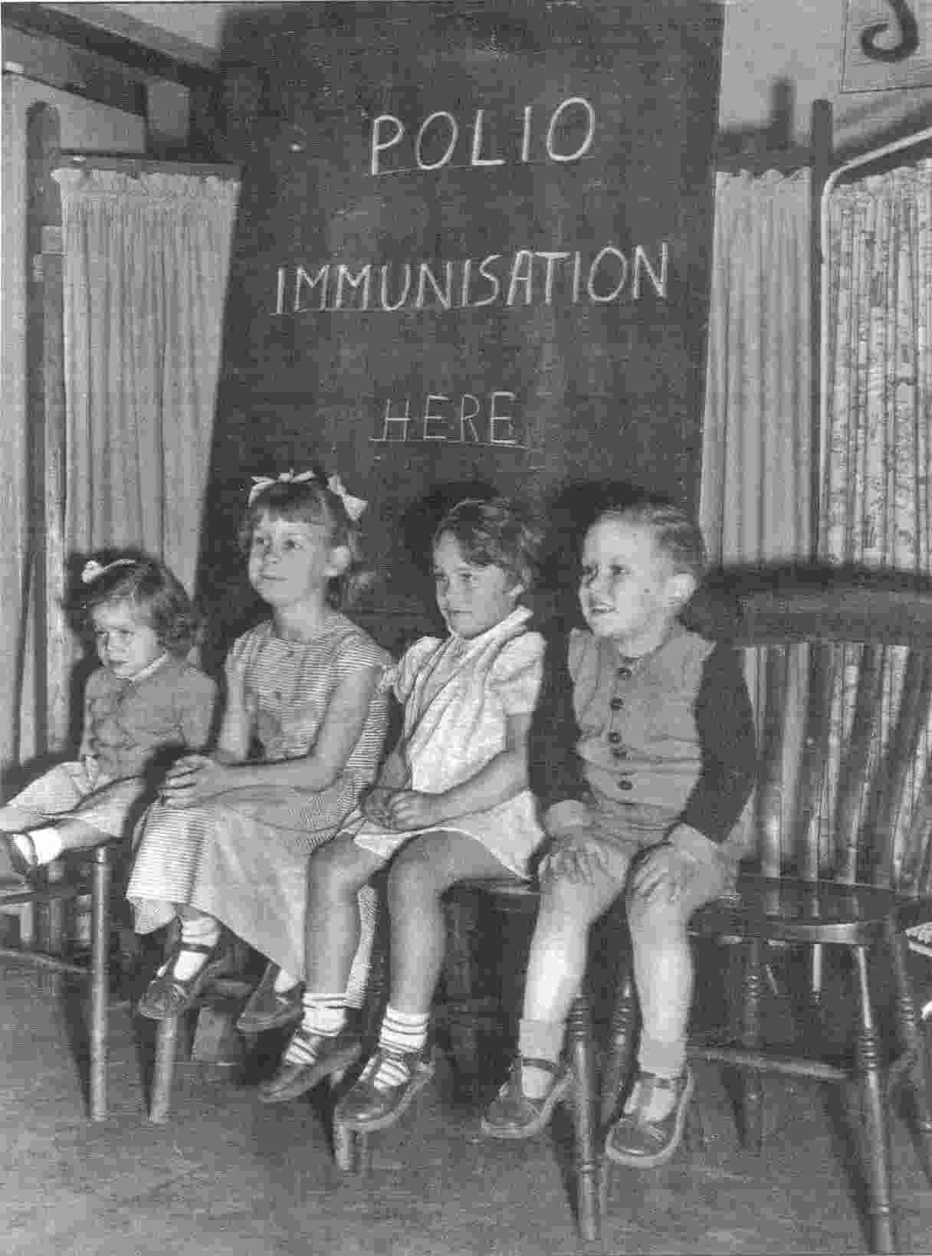
Study Design
Epi Experiments (“Trials”)
Trials - from the French trier (to try)
Clinical trial – test therapeutic interventions applied to individuals (e.g., chemotherapy trial)
Field trial – test preventive interventions applied to individuals (e.g., vaccine trial)
Community trial – test interventions applied at the aggregate level (e.g., fluoridation of public water trial)
Source: Epidemiology Kept Simple

Slide 69
Study Design
Randomized Controlled Trials
Often termed the gold standard of epidemiological studies, randomized controlled trials (RCTs) provide strong evidence of cause and effect when designed and conducted well.
These studies are called randomized because study subjects are assigned at random, without respect to demographic or other factors, to a specific exposure group.
Each subject has the same probability of being assigned to a given exposure group.
The random nature of this assignment serves to distribute potential confounding factors across each exposure group equally.
If confounding factors are similar across exposures, then any difference in the outcomes can be attributed to the exposure itself.

Slide 70
Study Design
Randomized Controlled Trials
In practice, it is often necessary to control for confounding even after randomization because the randomization process is not perfect and some confounding factors may not have been equally distributed between exposure groups.
The word controlled refers to the characteristic that RCTs have a standard or control group to which the new or hypothesized better treatment is compared.
The control group may be individuals who receive no treatment at all when that is ethically appropriate. Often in pharmaceutical trials, the control group is given an inactive substance that looks like the treatment, which is called a placebo.

Slide 71
Study Design
Randomized Controlled Trials
In some RCTs, the study does not compare nothing and something but rather compares the current standard of care and a new method of care. In this case, the control group receives standard care and the treatment group receives the new method.
In addition to these features, many RCTs have some level of blinding, or concealing the subject’s exposure status.
A single - blind study is one in which the study participant does not know whether he or she is in a treatment or control group.
In a double - blind study, neither the participant nor the investigator knows whether the subject is in a treatment or control group.
By blinding those involved in the study, it is more likely that all participants will be assessed in the same way, decreasing the opportunity for misclassification or bias.

Slide 72
Study Design
Randomized Controlled Trials
RCTs may target any of the three levels of prevention. Those studies that aim at primary prevention (preventing a disease from occurring) often are called preventive trials.
Preventive trials may include testing the efficacy (ability to produce an effect) of a vaccine in healthy individuals, for example.
Intervention trials are those that test the impact of drugs or other efforts to reduce the severity of a disease in individuals who are at high risk of the outcome (secondary prevention).
Finally, therapeutic trials are designed to improve outcomes once an individual has a disease (tertiary prevention).

Slide 73
Study Design
Randomized Controlled Trials
In therapeutic trials, it is unlikely that subjects would receive no treatment; rather, standard care may be compared to additional levels of treatment or intervention.
An example of a therapeutic trial might be one that tests ways to help smokers stop smoking (the outcome of interest).
If we were working in a clinic setting, the standard of care might be to recommend a smoking cessation class offered by health educators and to provide a free or low - cost nicotine substitute, such as a nicotine patch or chewing gum.
The new treatment might add a prescription medication that is believed to help with cravings, and the standard group might receive either no new drug or a placebo that looks like the new drug.

Slide 74
Study Design
Randomized Controlled Trials
As in observational studies, before beginning an RCT the investigator must define the population of interest and select a representative sample from this population to participate in the experiment.
Often, RCTs have very specific inclusion and exclusion criteria that may limit the population to which the results can be generalized.
For example, in a study investigating the effectiveness of a cholesterol-lowering drug, researchers may exclude individuals with existing conditions such as heart disease or hypertension.
Even though this exclusion may allow a more precise biological estimation of the effect of the drug, the results may be applied only to the population of people with high cholesterol and no existing heart disease or hypertension.

Slide 75
Study Design
Randomized Controlled Trials
In recent years, it has become common and even required in some countries, that post-marketing surveillance, or drug monitoring after agency approval, occurs for drugs newly introduced to the market.
As with other surveillance activities, post-marketing surveillance can provide useful time - trend data and may alert researchers, clinicians, and pharmaceutical producers to unexpected side effects associated with a drug.

Slide 76
Study Design
Randomized Controlled Trials
RCTs can have limitations, the most important of which is the ability to use these studies in public health research. In many cases, it is unethical to randomize individuals to the exposure of interest. For example, one cannot randomize women to illegal drugs during pregnancy to understand the impact of drug use on the risk of birth defects. .
Another ethical consideration in RCTs is the local standard of care. Some RCTs are conducted in developing countries, in part because the outcome of interest may occur more frequently there.
This is not necessarily unethical, unless the results of the trial will not be of use to the population on which the trial was conducted.

Slide 77
Study Design
Randomized Controlled Trials
RCTs often are time and cost intensive. As with prospective cohort studies, RCTs require follow - up to assess the outcome, sometimes for many years. In addition, RCTs may require intense medical care or procedures, such as frequent visits and laboratory tests.
The issues of noncompliance and loss to follow-up are important in RCTs: discarding participants because they do not take their drugs as instructed or do not comply with the intervention may compromise the very benefits of the randomization of exposures and make them more like observational studies.

Slide 78
Study Design
Community Trials
The major difference between RCTs and community trials is the unit of analysis.
In community trials, as in ecological studies, the unit of analysis is a group rather than an individual.
The community under study represents a larger population, such as a school district, a city, or a county. These trials may test an etiological hypothesis or the impact of a program or intervention.
In a community trial, one or more communities serve as the intervention group and another community or communities serves as the control. As in all epidemiological studies, the intervention and control groups should be as similar as possible, except for the exposure status, and they should represent the same underlying population.

Slide 79
Study Design
Community Trials
Community trials are different from ecological studies in that the exposure is manipulated by the investigator rather than occurring naturally.
The process of a community trial is similar to that of an RCT except groups are assigned to an exposure rather than individuals.
Whenever possible, allocation to intervention or control should be done at random in community trials.
Once the treatment group is assigned, the intervention begins, and the groups are followed over time to evaluate changes in the outcome of interest.
The outcome may be the incidence of disease, the use of specific medical care, or the prevalence of a preventive health behavior.

Slide 80
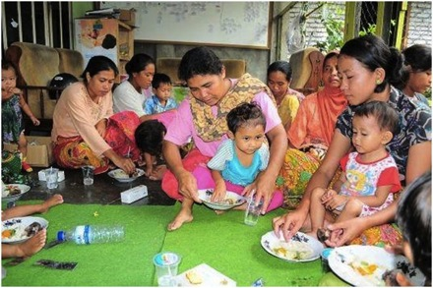
Illustrative Example Vitamin A Community Trial
450 Sumatran villages with high childhood mortality rates
Exposure = Vitamin A supplementation program vs. no intervention
Random allocation of intervention: 229 treatment villages, 221 control villages
Source: Epidemiology Kept Simple

Slide 81
Study Design
Causal Inference
We noted that experimental study designs are considered the gold standard in epidemiological research.
These studies provide strong evidence of cause and effect because the exposures are not self - selected by study participants. For this reason, confounding is likely to be less of an issue, and any relationship we observe between exposure and outcome is likely to be a causal one.
By design, experimental studies also are prospective in nature so that in a well – designed trial we begin with people who are free of the outcome and follow them over time to assess whether the experimental and control groups have different rates of incident outcome.

Slide 82
Study Design
Causal Inference
When we move to observational studies, we need to consider more carefully if we feel confident about making a causal inference, a statement about the exposure causing the outcome, based on the evidence.
In assessing causation, it is important to not only consider studies individually but also to look for patterns of evidence.
In simple terms, causal inference requires that we examine the research and ask the following: how good is the scientific evidence?
Authors list the elements of causation somewhat differently and with greater details and examples.
However, there are five basic criteria to consider when assessing causal inference in the absence of definitive experiments, as summarized in Table 5.9.

Slide 83
Table 5.9 Criteria for Assessing Causal Inference in Observational Epidemiological Studies
Criterion | Definition
Temporal sequence | Time sequence: the exposure occurs before the outcome.
Strength of association | The association between exposure and outcome is strong based on magnitude or size of the OR or RR.
Dose - response | A gradient in exposure results in a gradient in outcome; for example, increasing levels of exposure result in increasing levels or risk of the outcome.
Plausibility | Biologically (or socially, behaviorally), there is an explanation, a pathway, for the exposure causing the outcome.
Consistency | The association between exposure and outcome is present in a variety of settings and study designs.

Slide 84
THANK YOU

