Slide 1
King Saud University College of Business Administration Department of Health Administration Masters` Program
PA 507 – Introduction to Public Health
First Semester 1437/ 1438
Mohammed S. Alnaif, Ph D. alnaif@ksu.edu.sa

Slide 2
EPIDEMIOLOGY INTRODUCTION AND BASIC CONCEPTS
Learning Objectives
Define epidemiology and describe what epidemiologists do within the area of public health.
Outline historical developments important to the field of epidemiology.
Identify the exposure and outcome in a public health research question.
Describe the difference between descriptive and analytic epidemiology.
Identify counts, proportions, and rates in reported data.
Calculate the incidence rate or the prevalence of a health event in a population.

Slide 3
EPIDEMIOLOGY INTRODUCTION AND BASIC CONCEPTS
Epidemiology
Derived from the Greek words meaning study upon populations (epi = upon, demos = people, ology = study).
This derivation does not convey what is studied or the nature of that study and is effectively the same as demography which is the study of the characteristics of populations, such as size, growth, density, distribution, and vital statistics.

Slide 4
EPIDEMIOLOGY INTRODUCTION AND BASIC CONCEPTS
Epidemiology is the study of the distribution and determinants of health-related states or events (including disease), and the application of this study to the control of diseases and other health problems.
Various methods can be used to carry out epidemiological investigations: surveillance and descriptive studies can be used to study distribution; analytical studies are used to study determinants.

Slide 5
EPIDEMIOLOGY INTRODUCTION AND BASIC CONCEPTS
Epidemiology deals with the study of the causes, distribution, and control of disease in populations.
Rather than focusing on the health of an individual person or a patient, epidemiologists focus on the health of groups of people.
The field of epidemiology is a relatively young one, although the methods of statistics and other branches of mathematics, along with general scientific inquiry, form its basis.

Slide 6
EPIDEMIOLOGY INTRODUCTION AND BASIC CONCEPTS
Epidemiology can be used in two broad ways:
to describe where, when, and to whom a health event occurs or
to quantify the amount of risk associated with a particular exposure or behavior.
Epidemiologists use a variety of measures to describe the health of populations and to identify risk factors for health outcomes and disease, including counts, proportions, and rates.

Slide 7
EPIDEMIOLOGY INTRODUCTION AND BASIC CONCEPTS
Thus epidemiologists are concerned with understanding health outcomes not in individuals, but in populations, or groups of people.
Typically, an epidemiologist investigates the relationship between two things: the exposure and the outcome of interest.
In statistics, the exposure would be called the independent variable; it is the health behavior, toxic substance, or other event or material a person encounters or experiences.

Slide 8
EPIDEMIOLOGY INTRODUCTION AND BASIC CONCEPTS
Epidemiology
The outcome, on the other hand, is the dependent variable.
In epidemiology, we are interested in understanding how the exposure changes the chance someone will experience the outcome.
An outcome can be a disease or other health outcome, or it could be a health behavior.
For example, if an epidemiologist is interested in whether smoking causes lung cancer, smoking is the exposure and lung cancer is the outcome.

Slide 9
EPIDEMIOLOGY INTRODUCTION AND BASIC CONCEPTS
Epidemiology
Likewise, an epidemiologist may investigate whether eating a specific type of food (exposure) causes infection with Salmonella (outcome).
The research question determines whether a given behavior or health outcome is the exposure or outcome.
In some cases, smoking could be an outcome. Perhaps an epidemiologist is interested in looking at whether teens in rural areas are more likely to start smoking compared to teens in urban areas. In that case, rural residence is the exposure and smoking is the outcome.

Slide 10
EPIDEMIOLOGY INTRODUCTION AND BASIC CONCEPTS
Epidemiology
An outcome does not have to be a disease state; it can be any health event or health outcome of interest to the investigator.
Likewise, outcomes do not have to be negative.
An outcome may be a positive health behavior, such as eating the recommended five servings of fruits or vegetables per day, or it may be a positive health outcome, such as giving birth to a baby who is considered normal weight.

Slide 11
EPIDEMIOLOGY INTRODUCTION AND BASIC CONCEPTS
Epidemiologists may work to identify the causes of disease, also known as disease etiology.
An underlying assumption is that diseases and health outcomes are multifactorial, or caused by many different variables or factors.
These factors may be physical, such as a virus or bacteria; they may be inherent or individual, such as genetic components or demographic characteristics; or they may be environmental, including neighborhood characteristics or governmental policies.

Slide 12
EPIDEMIOLOGY INTRODUCTION AND BASIC CONCEPTS
Epidemiologists, like other public health professionals, conceptualize health outcomes using the social ecological model described in Chapter 2.
In addition to explaining disease etiology, epidemiologists commonly work to identify factors that increase or decrease a person’s likelihood of having a particular health outcome.
This leads to a second underlying assumption in epidemiology: health outcomes are not randomly distributed in a population.

Slide 13
EPIDEMIOLOGY INTRODUCTION AND BASIC CONCEPTS
Epidemiology
In other words, the multiple factors that cause a disease are measurable and identifiable.
If health events occurred at random, the prevention work of public health would be futile.
We know, however, that there are a multitude of variables that can be linked to health outcomes.
Epidemiologists seek to find these variables so that they and other public health professionals can work to intervene and prevent poor health in populations.

Slide 14
EPIDEMIOLOGY INTRODUCTION AND BASIC CONCEPTS
Epidemiology
Epidemiologists also may study how a disease progresses over time, or its natural history, from onset, through treatment, and possibly to death.
Furthermore, some epidemiologists work to compare different ways of preventing a health outcome or treating a disease to determine which methods are most effective.
Finally, epidemiologists work to determine and describe how much of a health event or health outcome occurs in a population and also among whom it is more common.

Slide 15
EPIDEMIOLOGY INTRODUCTION AND BASIC CONCEPTS
Epidemiology
Ultimately, epidemiology is concerned with improving the health of populations.
Therefore, a final area in which epidemiologists may work is promoting or developing public health policies that are based on the data epidemiologists collect and analyze.

Slide 16
EPIDEMIOLOGY INTRODUCTION AND BASIC CONCEPTS
Epidemiology is often considered the key scientific underpinning of public health practice.
Its functions are:
To discover the agent, host, and environmental factors which affect health, in order to provide the scientific basis for the prevention of disease and injury and the promotion of health.
To determine the relative importance of causes of illness, disability, and death, in order to establish priorities for research and action.

Slide 17
EPIDEMIOLOGY INTRODUCTION AND BASIC CONCEPTS
Epidemiology is often considered the key scientific underpinning of public health practice.
Its functions are:
To identify those sections of the population which have the greatest risk from specific causes of ill health, in order that the indicated action may be directed appropriately.
To evaluate the effectiveness of health programs and services in improving the health of the population.

Slide 18
EPIDEMIOLOGY INTRODUCTION AND BASIC CONCEPTS
Descriptive Epidemiology can identify patterns among cases and in populations by time, place and person.
From these observations, epidemiologists develop hypotheses about the causes of these patterns and about the factors that increase risk of disease.
In other words, epidemiologists can use descriptive epidemiology to generate hypotheses, but only rarely to test those hypotheses. For that, epidemiologists must turn to analytic epidemiology.

Slide 19
EPIDEMIOLOGY INTRODUCTION AND BASIC CONCEPTS
Analytic epidemiology is concerned with the search for causes and effects, or the why and the how.
Epidemiologists use analytic epidemiology to quantify the association between exposures and outcomes and to test hypotheses about causal relationships.
Epidemiology provides sufficient evidence to take appropriate control and prevention measures.

Slide 20
Two Broad Types of Epidemiology
DESCRIPTIVE EPIDEMIOLOGY
ANALYTIC EPIDEMIOLOGY
Examining the distribution of a disease in a population, and observing the basic features of its distribution in terms of time, place, and person.
Typical study design:
community health survey (approximate synonyms - cross-sectional study, descriptive study)
Testing a specific hypothesis about the relationship of a disease to a putative cause, by conducting an epidemiologic study that relates the exposure of interest to the disease of interest.
Typical study designs: cohort, case-control

Slide 21
EPIDEMIOLOGY INTRODUCTION AND BASIC CONCEPTS
Some Basic Concepts
Perhaps the worst epidemic to ever inflict humanity was the outbreak of bubonic plague, or the Black Death, that swept through Europe in the middle of the fourteenth century.
Yet as terrible as these figures are, two points are readily apparent.
First, not everyone was affected. Even in Florence, Italy, the death rate was nearly 70 percent, but of course 30 percent of the populace was not affected.
Second, the plague was not always present. It came in waves during a period of few years, disappearing in the winter and reappearing in the spring, until it finally faded from the scene.

Slide 22
EPIDEMIOLOGY INTRODUCTION AND BASIC CONCEPTS
Some Basic Concepts
The question this raises is why
Why some people and not others?
Why in 1347 and not the previous year?
Why in the warm moths but not winter?
Why humans and not dogs, and on and on?
Let's take a look at some of the factors that might provide an explanation for some of these questions by using the plague and other disorders as models
Agent, Person, Place, and Time

Slide 23
EPIDEMIOLOGY INTRODUCTION AND BASIC CONCEPTS
Agents
It seems as every time we open the newspaper, or watch TV we're greeted with news that something else is going to kill us.
There are only certain things that are necessary etiologic factors for diseases- what epidemiologist calls Agent. Lilienfeld groups agents into four categories:
Nutritive agents
Chemical agents
Physical agents
Infectious agents.

Slide 24
EPIDEMIOLOGY INTRODUCTION AND BASIC CONCEPTS
Nutritive agents
Some nutritive agents can cause disease by an excess of them and others by deficiency.
Too much cholesterol, for example may lead to coronary heart disease; too much salt may lead to hypertension; too much calcium may lead to kidney stones.
On the other hand too little calcium can lead to osteoporosis.
Chemical agents
Chemical agents may consist of allergens,
Example paint, cleaning agents, various food dyes; or poison
Example arsenic, carbon monoxide, overdose of tricyclic antidepressant.

Slide 25
EPIDEMIOLOGY INTRODUCTION AND BASIC CONCEPTS
Physical agents
Ionizing radiation or ultraviolet light would be considered among the physical agents that can lead to health problems.
Infectious agents
Perhaps the most well-known agents to health workers are infectious agents such as viruses (mumps, measles, Ebola virus and acquired immunodeficiency syndrome [AIDS]), bacteria (tuberculosis [TB], rheumatic fever, and syphilis), protozoa (malaria), or rickettsia (typhus, rocky mounting spotted fever).

Slide 26
EPIDEMIOLOGY INTRODUCTION AND BASIC CONCEPTS
Person
The first step in understanding a health outcome often includes descriptive epidemiology, which depicts the health event by person, place, and time variables.
Person, or “who” variables, include the demographic characteristics age, sex, and race or ethnicity.
For example, a health outcome may occur only among women, or it may affect children under the age of five more often than any other age group.
It may impact people of a certain race, ethnicity, or country of origin more frequently than other groups.

Slide 27
EPIDEMIOLOGY INTRODUCTION AND BASIC CONCEPTS
Person
Agents are necessary to cause disease but they are not sufficient. Not everyone who is stung by a bee develops an anaphylactic reaction, and two people could be enjoying the same meal in in the same restaurant, but only one may spend the rest of the night in the emergency room.
It is obvious that people differ in terms of their susceptibility or response to the agents; this is what we call person or host factors.

Slide 28
EPIDEMIOLOGY INTRODUCTION AND BASIC CONCEPTS
Person
Year of birth is somewhat different from age although the two are obviously related; your year of birth will put you in a birth cohort.
What you and your birth cohort experience is determined in part by when you were born.
Other host factors are modified or acquired with time, such as age itself and immunologic experience, whether achieved naturally through prior exposure, or artificially through inoculation.

Slide 29
EPIDEMIOLOGY INTRODUCTION AND BASIC CONCEPTS
Person
A third class of person factors is more transitory, like time-limited comorbid conditions, fatigue, or nutritional status.
Such factors affect the person ability to survive an illness.
Finally, some host factors depend on our behavior – what we call lifestyle whether we exercise, how we make use of health services, what we eat, and so on.

Slide 30
EPIDEMIOLOGY INTRODUCTION AND BASIC CONCEPTS
Place variables tell the “where” of the health outcome.
Are rural populations more likely to experience the outcome compared to urban dwellers?
Perhaps an illness strikes in settings where many people come into close contact, such as schools, prisons, or nursing homes.
A physical factor such as a river or a salt marsh may be the center of a cluster of outcomes.
All of these examples illustrate the use of place variables in describing a health outcome.

Slide 31
EPIDEMIOLOGY INTRODUCTION AND BASIC CONCEPTS
Place
Geographically restricted or widespread (pandemic)
Relation to water or food supply.
Multiple clusters or one.
It is obvious that place, which is also referred to as environment, is rarely a direct factor in its own right. Rather, it reflects a host of other factors that are distributed geographically.
The challenge to epidemiologist is, once having found differences in the prevalence of some disorder from one place to another, to discover what it is about the environment that gives rise to these variations.

Slide 32
EPIDEMIOLOGY INTRODUCTION AND BASIC CONCEPTS
Environment (Place)
Crowding
Atmosphere
Modes of communication – phenomena in the environment that bring host and agent together, such as:
Vector is any agent (animal, or microorganism) that carries and transmits an infectious pathogen into another living organism.
Vehicle An inanimate intermediate in the indirect transmission of a pathogen from a reservoir or infected host to a susceptible host; vehicles include foods, clothing, and instruments.
Reservoir Any person, animal, plant, soil or substance in which an infectious agent normally lives and multiplies.

Slide 33
EPIDEMIOLOGY INTRODUCTION AND BASIC CONCEPTS
TIME
Finally, time, or “ when ” variables, provide information about trends in a health outcome across years or seasons, and in the case of infectious diseases, time variables may be used to help identify the source of an infection based on the timing of reported symptoms.
Diseases such as influenza are cyclical in nature and commonly occur during specific seasons.
Tracking the timing of influenza cases may alert public health officials to an early start to a flu season or to a possible epidemic or pandemic strain of the virus.

Slide 34
EPIDEMIOLOGY INTRODUCTION AND BASIC CONCEPTS
TIME
In other cases, there may be a point in time after which the outcome of interest became increasingly common.
For example, a contaminated potato salad at a company picnic may lead to an outbreak of Salmonella. In this example, we might describe the outbreak epidemiology in reference to the day of the picnic and track and identify those who began exhibiting symptoms thereafter.
In epidemiology, it is useful to monitor trends over time to understand the nature of health outcomes and to evaluate whether interventions or control strategies are having an impact because the time of their implementation is known.

Slide 35
EPIDEMIOLOGY INTRODUCTION AND BASIC CONCEPTS
Analytic epidemiology
Analytic epidemiology goes a step beyond a description of a health problem or health outcome and seeks to identify risk factors or protective factors for the outcome.
A risk factor is any personal attribute, environmental exposure, or other feature of a person or his or her environment that increases the likelihood that he or she will experience a given health outcome.
Protective factors are any of the same types of variables that reduce the chance a given outcome will occur.

Slide 36
EPIDEMIOLOGY INTRODUCTION AND BASIC CONCEPTS
Analytic epidemiology
Often, we use the term risk factor to include characteristics that impact the likelihood of a given outcome, whether positively or negatively.
In order to identify and quantify risk factors, we design epidemiological studies.
There are many types of studies, some of which will be detailed in the next chapter, but all studies share some basic characteristics.

Slide 37
EPIDEMIOLOGY INTRODUCTION AND BASIC CONCEPTS
Analytic epidemiology
Research studies begin with a question, such as one of the following:
Are caregivers less likely than non-caregivers to have recommended cancer screenings?
Are children whose parents wear bicycle helmets more likely to regularly wear a bicycle helmet compared to children whose parents do not use bicycle helmets?
These research questions each include an exposure, the independent variable of interest, and an outcome, the dependent variable of interest.

Slide 38
EPIDEMIOLOGY INTRODUCTION AND BASIC CONCEPTS
Analytic epidemiology
In the first question, caregiving is the exposure and cancer screenings are the outcome.
In the second question, parents’ helmet use is the exposure and children’s helmet use is the outcome.
The researcher next examines similar work that has been completed (literature review) on the topic and forms a hypothesis, a statement of the investigator’s expectation of the relationship between exposure and outcome.
Hypotheses are propositions about relationships between variables or differences between groups that are to be tested.

Slide 39
EPIDEMIOLOGY INTRODUCTION AND BASIC CONCEPTS
Basic Epidemiological Measures
Epidemiology deals largely with numbers, or quantitative data.
There are many ways to express numbers of health events, and epidemiologists have a set of measures they typically use to report health numerically.
You probably are familiar with many of these already, although the terminology for some measures may be new to you.

Slide 40
Epidemiologic Measurements Used to Describe Disease Occurrence
Measures of disease frequency in mathematical quantity
Count
Proportion (percentage)
Rate
Ratio
Measures of disease frequency in epidemiology
Prevalence
Incidence

Slide 41
Epidemiologic Measurements Used to Describe Disease Occurrence
Count
One simple way to report health data is to provide a count.
For example, in 2015 there were 219 cases of Measles reported in Saudi Arabia. Although this simple count does provide some information about Measles in Saudi Arabia, it would be much more helpful if we had additional information, a denominator, to go along with this count.

Slide 42
Epidemiologic Measurements Used to Describe Disease Occurrence
Importance of Denominator
a Numerator
b Denominator
Example
• 500 cases of dengue fever in Jeddah
• 120 cases of dengue fever in Abha
Which city is more infected with dengue fever ?
• Jeddah: 500/2,000,000 = 0.25/1,000
• Abha: 120/300,000 = 0.4/1,000

Slide 43
Epidemiologic Measurements Used to Describe Disease Occurrence
Counts
Simplest & most basic measure – absolute number of persons who have disease or characteristic of interest.
Useful for health planners & administrators: for allocation of resources (e.g. quantity of beds needed by a community)
Count of No. cases of a disease, is used for surveillance of infectious disease for early detection of outbreaks.

Slide 44
Epidemiologic Measurements Used to Describe Disease Occurrence
Basic Epidemiological Measures
RATES, RATIOS, AND PROPORTINS
In epidemiology, the occurrence of a disease or condition can be measured using rates and proportions. We use these measures to express the extent of these outcomes in a community or other population.

Slide 45
Epidemiologic Measurements Used to Describe Disease Occurrence
Basic Epidemiological Measures
RATES, a rate is a measure of the frequency with which an event occurs in a defined population over a specified period of time.
Because rates put disease frequency in the perspective of the size of the population, rates are particularly useful for comparing disease frequency in different locations, at different times, or among different groups of persons with potentially different sized populations; that is, a rate is a measure of risk.

Slide 46
Epidemiologic Measurements Used to Describe Disease Occurrence
Basic Epidemiological Measures
RATES, RATIOS, AND PROPORTINS
In epidemiology, the most important tool for measuring disease is the rate, but we also use ratios and proportions.
A ratio expresses the relationship between two numbers in the form x : y or x/y

Slide 47
Epidemiologic Measurements Used to Describe Disease Occurrence
Basic Epidemiological Measures
A ratio is the relative magnitude of two quantities or a comparison of any two values.
In a ratio the value of a variable, such as sex (x = female, y = male), may be expressed so that x and y are completely independent of each other, or x may be included in y
Female/male or x/y

Slide 48
Epidemiologic Measurements Used to Describe Disease Occurrence
Proportion
Rates tell us how fast the disease is occurring in a population.
Proportions tell us what fraction of the population is affected.
A proportion is the comparison of a part to the whole. It is a type of ratio in which the numerator is included in the denominator.

Slide 49
Epidemiologic Measurements Used to Describe Disease Occurrence
Proportion
By dividing the number of cases of Measles in 2015 by the number of Saudi residents in 2015, we get the proportion of Saudi residents who had Measles in 2015:
Proportion of Saudi population with Measles in 2015: 7 in 1,000,000
219 | X 100,000 | = 0.69/100,000
31,521,418

Slide 50
Epidemiologic Measurements Used to Describe Disease Occurrence
Proportion
A proportion is a specific type of ratio, in which x is a portion of the whole, x + y, in a proportion the numerator is always included in the denominator.
Female/(male + female) or x/(x + y)
Proportions tell us what fraction of the population is affected.
X
X + Y

Slide 51
Epidemiologic Measurements Used to Describe Disease Occurrence
Basic Epidemiological Measures
A rate is a special form of proportion that includes specification of time. In health care rates are often used to measure an event over time.
Number of cases or events in a specified period | x k
Number of cases or population at risk during the same period

Slide 52
Epidemiologic Measurements Used to Describe Disease Occurrence
Rate
When the term rate is used, the denominator includes a measure of time during which the events in the numerator occurred.
For example, a mortality rate is the number of deaths for a given change in time, typically one year.
Mortality rates are perhaps the most common rates used in public health.

Slide 53
Epidemiologic Measurements Used to Describe Disease Occurrence
Rate
The infant mortality rate is the number of infants who die within the first year of life per 1,000 live births.
Thus the infant mortality rate does not include infants who die in utero or infants who are not alive at birth, or stillborn.

Slide 54
Epidemiologic Measurements Used to Describe Disease Occurrence
Rate
The infant mortality rate is widely considered to be a useful measure of the overall health and development of a nation.
Death in the first year of life reflects prenatal and postnatal health care practices, the nutritional status of mothers and infants, and the prevalence of serious birth defects or health conditions at birth, and other factors.

Slide 55
Epidemiologic Measurements Used to Describe Disease Occurrence
Rate
Post-neonatal mortality rate is defined as those infant deaths in which the infant is more than 27 days and less than one year of age
While neonatal deaths frequently arise out of conditions originating in the prenatal period, post-neonatal deaths are more likely to reflect the socio-economic conditions of the home (e.g. quality of care and nutrition), as well as infectious diseases and other causes.

Slide 56
Epidemiologic Measurements Used to Describe Disease Occurrence
POPUALTION BASED MORTALITY MEASURES
Infant Mortality Rate
Infant Mortality Rate = | Number of deaths under one year of age during a given time interval | X 1000
 | Number of live births during the same time interval

Slide 57
Epidemiologic Measurements Used to Describe Disease Occurrence
POPUALTION BASED MORTALITY MEASURES
Infants Mortality Rate / 1000 SAUDI live birth in 2014
Infant Mortality Rate = | 9477 | X 1000 | = 14
 | 676,948

Slide 58
Epidemiologic Measurements Used to Describe Disease Occurrence
Rate
Neonatal mortality rate: The number of children under 28 days of age who die, divided by the number of live births in that year.
The Neonatal mortality rate is often broken down into early and late mor­tality rates. The Early Neonatal Mortality rate is neonatal deaths 0-7 days. The late neonatal mortality rate is neonatal deaths 8-27 days.

Slide 59
Epidemiologic Measurements Used to Describe Disease Occurrence
POPUALTION BASED MORTALITY MEASURES
Neonatal Mortality Rate
Neonatal Mortality Rate = | Number of deaths under 28 days during a given time interval* | X 100
 | Number of live births during the same time interval

Slide 60
Epidemiologic Measurements Used to Describe Disease Occurrence
POPUALTION BASED MORTALITY MEASURES
Neonatal Mortality Rate / 1000 SAUDI live birth in 2014.
Neonatal Mortality Rate = | 5550 | X 1000 | = 8.2
 | 676948

Slide 61
Epidemiologic Measurements Used to Describe Disease Occurrence
Rate
Post neonatal Mortality Rate: The number of deaths from 28 days up to and not including one year of age during a given time interval.
Divided by the number of live births during the same time interval less neonatal deaths.

Slide 62
Epidemiologic Measurements Used to Describe Disease Occurrence
POPUALTION BASED MORTALITY MEASURES
Post neonatal Mortality Rate
Post neonatal Mortality Rate = | Number of deaths from 28 days up to and not including one year of age during a given time interval | X 100
 | Number of live births during the same time interval less neonatal deaths

Slide 63
Epidemiologic Measurements Used to Describe Disease Occurrence
POPUALTION BASED MORTALITY MEASURES
Post-Neonatal Mortality Rate / 1000 SAUDI live birth in 2014.
Post-Neonatal Mortality Rate = | 3927 | X 1000 | = 5.8
 | 676948

Slide 64
Epidemiologic Measurements Used to Describe Disease Occurrence
Rate
When a rate is expressed as its actual value, it is called a crude rate example, the infant mortality rates.
The crude mortality rate is the mortality rate from all causes of death for a population during a specified time period.
The denominator is the population at the mid-point of the time period.

Slide 65
Epidemiologic Measurements Used to Describe Disease Occurrence
POPUALTION BASED MORTALITY MEASURES
Crude Death Rate
The crude death rate is a measure of the actual observed mortality in a given population. Summary rate of the actual number of observed events in a population over a given time period (e.g. all cancer deaths in 2000)
* Number of death from all causes for a population during a specified time period.
** the population at the mid-point of the time period.
Crude Death Rate = | Number of deaths* | X 1000
 | Estimated midinterval population**

Slide 66
Epidemiologic Measurements Used to Describe Disease Occurrence
POPUALTION BASED MORTALITY MEASURES
Crude Death Rate / 1000 SAUDI live birth in 2014.
Crude Death Rate = | 120004 | X 1000 | = 3.9
 | 30,770,375

Slide 67
Epidemiologic Measurements Used to Describe Disease Occurrence
Crude Death Rate
Crude rates provide an accurate picture of rates of an event, disease, or death in a population, but in some cases it is useful and preferable to calculate an adjusted rate, especially when comparing across populations or over time. Table 4.1 illustrates the difference between crude and adjusted mortality rates.
Table 4.1
Year | Number of Deaths | Crude mortality rates (Per 1000) | Age - adjusted Mortality Rate (per 1000)
2006 | 94715 | 4 | 18.6
2014 | 120004 | 3.9 | 14

Slide 68
Epidemiologic Measurements Used to Describe Disease Occurrence
Crude Death Rate
Table 4.1 first shows the importance of expressing numbers as rates as well as counts and also the difference between a crude rate and an adjusted rate.
Based on the data in the table, there were over 25000 more deaths in 2014 than there were in 2006.
You may know that the population of the Saudi Arabia increased substantially from 2006 to 2014, so this increase in the number of deaths may not be surprising.

Slide 69
Epidemiologic Measurements Used to Describe Disease Occurrence
Crude Death Rate
In fact, once we express the counts as rates (column three), we see that the difference in the number of deaths is in large part a function of the different population sizes in the two years.
When expressed as a mortality rate per 1000 residents, the Saudi Arabia mortality rate in 2006 looks similar to the mortality rate in 2014.
The 2014 rate even is slightly lower, a positive sign indicating that perhaps public health and other measures are reducing the number of deaths in the Saudi Arabia over time.

Slide 70
Epidemiologic Measurements Used to Describe Disease Occurrence
POPUALTION BASED MORTALITY MEASURES
Specific Rate:
Rates for specific segments/groups of the population (e.g. sex, age, race, cause of death, cancer site).
Adjusted rate:
Used to compare rates for entire populations, taking into account differences in variables we consider as influencing outcomes (age, gender, race)

Slide 71
Epidemiologic Measurements Used to Describe Disease Occurrence
POPUALTION BASED MORTALITY MEASURES
Specific Rate:
Rates for specific segments/groups of the population (e.g. sex, age, race, cause of death, cancer site).
* (e.g. sex, age, race, cause of death, cancer site).
** the population at the mid-point of the time period.
Age-specific death rate = | Number of deaths of a specified age group* | X 1000
 | Estimated midinterval population of that age group**

Slide 72
Saudi Male Deaths During 2015 for two different age groups by regions

Slide 73
Epidemiologic Measurements Used to Describe Disease Occurrence
POPUALTION BASED MORTALITY MEASURES
Specific Rate:
Rates for specific segments/groups of the population (e.g. sex, age, race, cause of death, cancer site).
* (e.g. sex, age, race, cause of death, cancer site).
** the population at the mid-point of the time period.
Cause Specific Death Rate = | Total number of deaths due to a specific cause during a given time interval* | X 1000
 | Estimated midinterval population**

Slide 74
Epidemiologic Measurements Used to Describe Disease Occurrence
POPUALTION BASED MORTALITY MEASURES
Two methods to adjust rates:
Direct Method:
AAR (age-adjusted rate)
Indirect Method:
SMR (standardized mortality ratio)

Slide 75
Epidemiologic Measurements Used to Describe Disease Occurrence
Adjust Rates:
An alternative to calculating adjusted rates is to stratify data based on a variable of interest.
Stratification is the separation of data into categories. It means to “break-up” the data to see what it tells you.
It’s most frequent use is when diagnosing a problem and identifying which categories contribute to the problem being solved.
Stratifying data can sometimes show relationships that might not otherwise be seen.
Stratification is a simple tool to understand and to use. Basically, stratification is the sorting of data according to certain criteria or variables.
Underlying patterns within the strata may be completely different than the combined total.

Slide 76
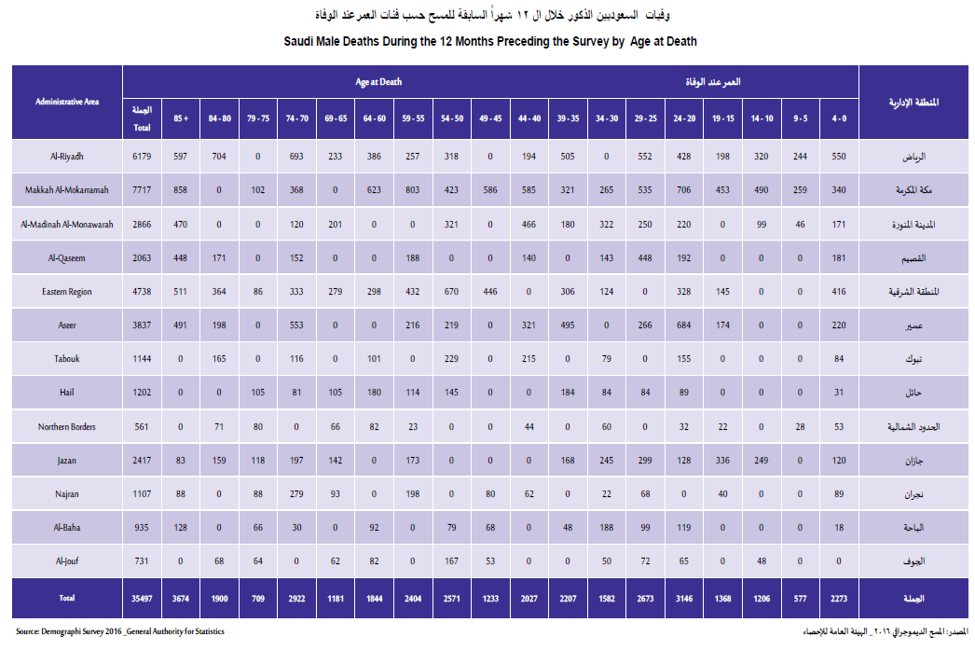

Slide 77
Epidemiologic Measurements Used to Describe Disease Occurrence
POPUALTION BASED MORTALITY MEASURES
Proportionate Mortality Ratio = | Total number of deaths due to a specific cause during a given time interval* | X 100
 | Total number of deaths from all causes during the same time interval
Proportionate Mortality Ratio of Neoplasms to Total number Deaths Reported to MOH | 1975 | X 100 | = 4.2%
 | 47201
=

Slide 78
Epidemiologic Measurements Used to Describe Disease Occurrence
Birth rate is the number of live births in a geographic area in a defined period, usually one year, relative to some specific population. For the crude birth rate, it is the average total population or the midyear population in the area during the period.
Crude Birth Rate = | Number of live births* | X 1000
 | Estimated midinterval population**
Crude Birth Rate in Saudi Arabia in 2014 = | 676948 | X 1000 | = 22
 | 30,770,375

Slide 79
Epidemiologic Measurements Used to Describe Disease Occurrence
Fertility rate is the number of children a woman would give birth to in her lifetime based on the current age-specific live birth rate.
Fertility Rate = | Number of live births* | X 1000
 | Estimated number of females aged 15-44 (WHO uses 10-49) at midinterval **

Slide 80
Epidemiologic Measurements Used to Describe Disease Occurrence
Cause Fatality Rate The proportion of people who die from a specified disease among all individuals diagnosed with the disease over a certain period of time.
Case fatality rate typically is used as a measure of disease severity and is often used for prognosis (predicting disease course or outcome), where comparatively high rates are indicative of relatively poor outcomes.
It also can be used to evaluate the effect of new treatments, with measures decreasing as treatments improve.
Cause Fatality Rate = | Total number of deaths assigned to a specific disease during a given time interval* | X 100
 | Total number of cases of the disease during the same time interval

Slide 81
Epidemiologic Measurements Used to Describe Disease Occurrence
Maternal Mortality Rate is the death of a woman while pregnant or within 42 days of termination of pregnancy, irrespective of the duration and site of the pregnancy, from any cause related to or aggravated by the pregnancy or its management but not from accidental or incidental causes.
Complications during pregnancy and childbirth are a leading cause of death and disability among women of reproductive age in developing countries. The maternal mortality ratio represents the risk associated with each pregnancy, i.e. the obstetric risk.
* is the death of a woman while pregnant or within 42 days of termination of pregnancy
Maternal Mortality Rate = | Number of deaths assigned to pregnancy related causes during a given time interval* | X 100
 | Number of live births during the same time interval

Slide 82
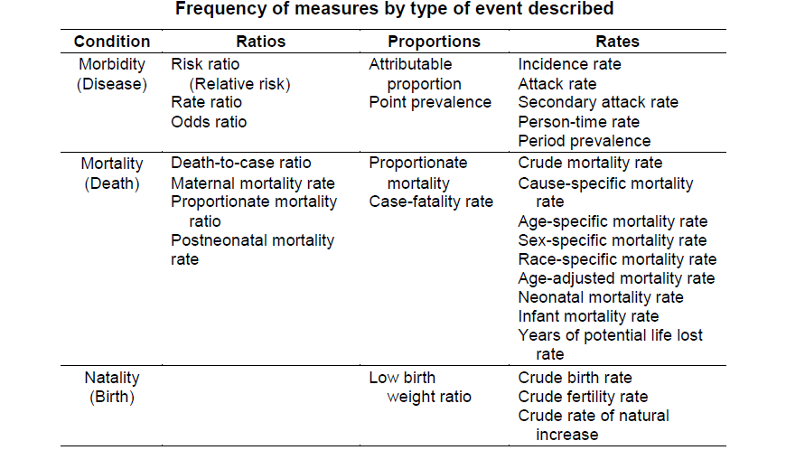

Slide 83
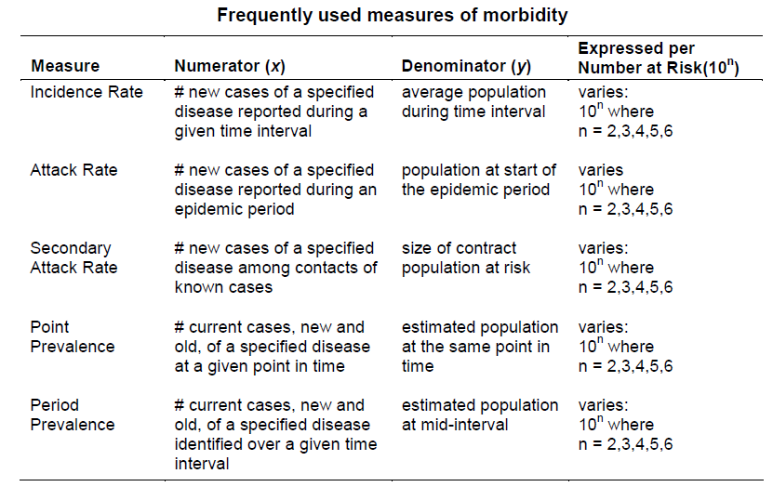

Slide 85
Epidemiologic Measurements Used to Describe Disease Occurrence
Basic Epidemiological Measures
There are various ways to express epidemiological data, and each method conveys a different piece of information.
It is important to consider the circumstances in which data are used to determine whether a count or a rate is the best expression of the information and whether crude or adjusted data should be reported.

Slide 86
Epidemiologic Measurements Used to Describe Disease Occurrence
Prevalence, sometimes referred to as prevalence rate, is the proportion of persons in a population who have a particular disease or attribute at a specified point in time or over a specified period of time.
The term prevalence is used to describe the amount or frequency of a health outcome that exists in a population at a certain point or over a certain period of time.
Prevalence is defined as the number of existing cases divided by the total population at risk of the health outcome a given point in time.

Slide 87
Epidemiologic Measurements Used to Describe Disease Occurrence
Prevalence
Point prevalence refers to the prevalence measured at a particular point in time. It is the proportion of persons with a particular disease or attribute on a particular date.
Period prevalence refers to prevalence measured over an interval of time. It is the proportion of persons with a particular disease or attribute at any time during the interval.

Slide 88
Epidemiologic Measurements Used to Describe Disease Occurrence
Quantifying Disease Frequency: Prevalence, Incidence, and Risk
The prevalence rate is the proportion of persons in a population that have a particular disease at a specific point in time or over a specific period of time.
Prevalence Rate = | All new and preexisting cases of a specific disease during a given time interval* | X 100
 | Total population at risk during the same time interval

Slide 89
Epidemiologic Measurements Used to Describe Disease Occurrence
DIABETES IN SAUDI ARABIA - 2015
415 million people have diabetes in the world and more than 35.4 million people in the MENA Region; by 2040 this will rise to 72.1 million.
There were 3.4 million cases of diabetes in Saudi Arabia in 2015. Prevalence of diabetes in adults in Saudi Arabia in 2015.
Prevalence of diabetes in adults in Saudi Arabia in 2015 | Total cases of adults (20-79 years) with diabetes 3,487,300 | X 100 | = 17.6
 | 19,847,000 Total adult population (20-79 years)
=

Slide 90
Epidemiologic Measurements Used to Describe Disease Occurrence
Quantifying Disease Frequency: Prevalence, Incidence, and Risk
Incidence is the number or frequency of new health outcomes or health events over time.
Incident cases of disease are those of persons who are free of the health outcome at the beginning of a defined time period and who subsequently develop the disease or experience the health event during a specified observation time.
Usually, each person is counted only once when calculating incidence, even if she or he experienced two or more disease events during the observation period.

Slide 91
Epidemiologic Measurements Used to Describe Disease Occurrence
Quantifying Disease Frequency: Prevalence, Incidence, and Risk
The reason we count only the first event when calculating incidence is because subsequent events may not be independent of the first.
In other words, it often is true that having one health event, such as a myocardial infarction (heart attack), is a risk factor for having another heart attack.

Slide 92
Epidemiologic Measurements Used to Describe Disease Occurrence
Quantifying Disease Frequency: Prevalence, Incidence, and Risk
In contrast to prevalence, incidence is expressed as a rate; it includes a measure of time. Specifically, the incidence rate includes the number of new cases of disease (numerator) divided by the amount of time during which these cases arose (denominator):
Incidence Rate = | Total number of new cases of a specific disease during a given time interval* | X 100
 | Total population at risk during the same time interval

Slide 93
Epidemiologic Measurements Used to Describe Disease Occurrence
Quantifying Disease Frequency: Prevalence, Incidence, and Risk
It is important when calculating measures such as prevalence and incidence to include in the denominator only the population at risk.
A person is at risk for the disease if it is biologically plausible for him or her to develop it in the immediate future.
If you calculate the incidence of ovarian cancer in a community, the denominator should include only individuals who have ovaries.
Thus we would exclude men and any women who have had their ovaries removed.

Slide 94
Epidemiologic Measurements Used to Describe Disease Occurrence
Quantifying Disease Frequency: Prevalence, Incidence, and Risk
Whether a person is at risk for a given outcome may change over time.
At risk does not necessarily imply at high risk relative to others. Rather, it means that there is a nonzero chance of developing the outcome.
Not at risk means an individual is considered to have a zero chance of developing the outcome.
Some diseases or diagnoses last throughout an individual’s life, such as AIDS or Alzheimer’s disease.
Once a person develops such an outcome, the person is no longer considered to be at risk.

Slide 95
Epidemiologic Measurements Used to Describe Disease Occurrence
Quantifying Disease Frequency: Prevalence, Incidence, and Risk
Other outcomes or infections are not lifelong but rather leave the individual no longer susceptible to a recurrence, for example, mumps or other infectious diseases that confer lifelong immunity.
These people would be treated the same as those who do not recover from an outcome; they are no longer at risk and are not counted in the denominator of a prevalence or incidence measure.

Slide 96
Epidemiologic Measurements Used to Describe Disease Occurrence
Quantifying Disease Frequency: Prevalence, Incidence, and Risk
Other outcomes can affect an individual multiple times, including urinary tract infection, the common cold, depression, or angina pectoris (chest pain).
Therefore, it is important to consider the attributes of the health outcome when deciding who is included in the population at risk.

Slide 97
Epidemiologic Measurements Used to Describe Disease Occurrence
Prevalence and incidence are frequently confused.
Prevalence refers to proportion of persons who have a condition at or during a particular time period, whereas incidence refers to the proportion or rate of persons who develop a condition during a particular time period.
So prevalence and incidence are similar, but prevalence includes new and pre-existing cases whereas incidence includes new cases only.
The key difference is in their numerators.
Numerator of incidence = new cases that occurred during a given time period
Numerator of prevalence = all cases present during a given time period.

Slide 98
For more information about Epidemiology and these measures refer to the book Principles of Epidemiology in Public Health Practice https://www.cdc.gov/csels/dsepd/ss1978/SS1978.pdf
THANK YOU

