Slide 1
King Saud University College of Business Administration Department of Health Administration Masters` Program
PA 507 – Introduction to Public Health
First Semester 1437/ 1438
Mohammed S. Alnaif, Ph D. alnaif@ksu.edu.sa

Slide 2
Biostatistics
LEARNING OBJECTIVES
Discover the ﬁeld of biostatistics and learn about its history.
Recognize sources of bias in the collection and analysis of epidemiological data.
Become familiar with a few basic descriptive statistical methods, both numerical and graphical.
Interpret logistic regression analyses that adjust for confounding of an odds ratio.
Apply what you have learned about biostatistics to the investigation of the two case studies.

Slide 3
Biostatistics
What is Biostatistics?
Using the tools of statistics, biostatisticians help answer pressing research questions in medicine, biology and public health, such as whether a new drug works, what causes cancer and other diseases, and how long a person with a certain illness is likely to survive.

Slide 4
Biostatistics
What is Biostatistics?
Biostatisticians use their quantitative skills to team with experts in other fields, from biologists and cancer specialists to surgeons and geneticists. But they are not mere number-crunchers.
They play pivotal roles in designing studies to ensure enough data and the right kind of information are collected.
Then they analyze, evaluate and interpret the results – accounting for variables, biases and missing data along the way.

Slide 5
Biostatistics
Common Biostatistical Terms
Data
Measurements or observations of variable
Variable
A characteristic that is observed or manipulated
Can take on different values
Independent variables
Precede dependent variables in time
Are often manipulated by the researcher
The treatment or intervention that is used in a study.

Slide 6
Biostatistics
Common Biostatistical Terms
Dependent variables
What is measured as an outcome in a study.
Values depend on the independent variable
Parameters
Summary data from a population
Statistics
Summary data from a sample.

Slide 7
Biostatistics
Biostatistics is the theoretical, methodological, and applied science of collecting, organizing, summarizing, presenting, analyzing, and interpreting data for the purpose of advancing health science and health policy.
Biostatistics has its beginnings as early as 1662, when John Graunt investigated death records of London parishes in an attempt to answer questions such as, what percentage of children die before six years of age?

Slide 8
Biostatistics
In 1854, John Snow famously plotted households with deaths due to cholera on a graph of the London water supply and then correctly interpreted these data to claim a causal connection.
The source of water predicted who died of cholera.
One of the most important principles of biostatistics is the necessity of a clearly posed scientific question (asking the right question) to guide meaningful data collection and analysis.

Slide 10
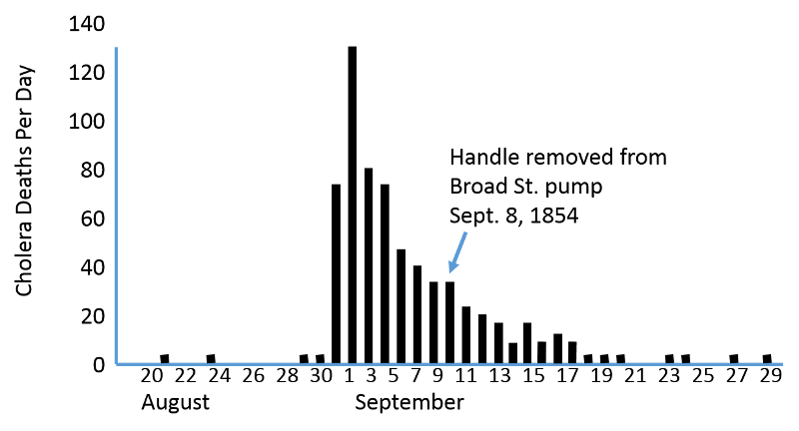

Slide 11
Biostatistics
Random samples
Subjects are selected from a population so that each individual has an equal chance of being selected.
Random samples are representative of the source population.
Non-random samples are not representative
May be biased regarding age, severity of the condition, socioeconomic status etc.

Slide 12
Biostatistics
Sometimes we are limited in our ability to address the question due to practical constraints or barriers to data collection, such as ethical constraints preventing us from forcing people to participate in observational studies or barring us from undertaking some kinds of randomized clinical trials.
Furthermore, health researchers and policy makers may be limited by the biostatistical techniques familiar to them.

Slide 13
Biostatistics
Therefore, it is common and desirable for public health researchers to develop a collaborative relationship with biostatisticians, who make it their business to learn, research, develop, and apply a large variety of statistical techniques appropriate for health data.
Additionally, biostatisticians will rank among the best critics of published data analyses due to their highly trained analytical minds and their constant exposure to a myriad of research designs and analytical strategies for investigating a wide spectrum of health questions.

Slide 14
Biostatistics
Biases in Collecting and Analyzing Epidemiological Data.
The first, selection bias, is bias that results when the sampled participants are not a representative probability sample of the population of interest.
A probability sample is one in which the chance of selecting any given subset of the population is known.
The simplest form of a probability sample is a simple random sample, in which any subset of size n has an equal chance of being selected from a population of size N.

Slide 15
Biostatistics
Biases in Collecting and Analyzing Epidemiological Data.
Intuitively, a simple random sample will be a representative sample of the population because it does not increase the chance that any one group will be included; for example, it is not over - representing older people, or healthier people, or men.
Researchers are often left with no option but to use a convenience sample, which is not a probability sample, let alone a representative sample.

Slide 16
Biostatistics
Biases in Collecting and Analyzing Epidemiological Data.
The second source of bias in the randomized clinical trial context is that of measurement error; that is, some participants are documented to be following the treatment protocol, but they are not, in fact, following it.
For example, a participant may have discontinued treatment after a short period due to adverse side effects or may have switched to an alternative treatment.
When these participants are analyzed as if they were following the treatment protocol, the analysis is biased due to measurement error.

Slide 17
Biostatistics
Biases in Collecting and Analyzing Epidemiological Data.
Related to this, another known source of bias is called recall bias, in which participants cannot correctly recall the answer to one or more survey questions.
Recall bias is a special case of measurement error, as is interviewer bias, which is due to improper data collection methods used by a survey interviewer, such as asking a question while displaying an obvious opinion or prejudice as to the desirable answer.
To avoid this bias, interviewers should be trained well and have good communication skills.

Slide 18
Biostatistics
Biases in Collecting and Analyzing Epidemiological Data.
The third source of bias that plagues many randomized clinical trials is bias due to missing data.
A participant in the trial will have missing outcome data if he or she drops out of the study before the outcome is measured.
Sporadic missing data can also occur at any time in the study if the participant refuses to answer a question (participants often refuse to answer questions about their income for example), data on a participant are lost, or the participant is too sick to attend a scheduled laboratory or clinical visit.

Slide 19
Biostatistics
Biases in Collecting and Analyzing Epidemiological Data.
A biostatistician can aid in implementing statistical analyses that adjust for this selection bias.
One important source of bias in observational studies that does not hamper ordinary clinical trials is bias due to confounding (in this case selection bias).
Confounding of an exposure or treatment effect can occur when participants who happen to be exposed or treated are not comparable with participants who happen to be unexposed or untreated due to a fundamental difference that may also affect the outcome.

Slide 20
Biostatistics
Biases in Collecting and Analyzing Epidemiological Data.
Confounding is considered to be such an insidious form of bias that randomized clinical trials are recognized as the gold standard for evidence – based research, despite their own limitations, which we have only partly summarized here; that is, methods for adjusting for confounding bias are considered to be inadequate relative to the validity of results from randomized clinical trials (meaning that RCT will have a more valid outcome).

Slide 21
Biostatistics
Biases in Collecting and Analyzing Epidemiological Data.
In short, consumers of health advice based on either observational studies or randomized clinical trials should be wary.
In fact, one good reason for citizens to learn more about biostatistics is to be able to read and understand the statistical methods used for health study design and analysis, as well as their limitations due to various sources of bias, including but not limited to those we have just described.
Citizens who are more informed about biostatistical methods will, arguably, be better equipped to gauge relative health hazards and benefits and make better personal choices.

Slide 22
Biostatistics
Biases in Collecting and Analyzing Epidemiological Data.
Health scientists plan to collect as much data as possible in their research study design in order to adjust for various sources of bias.
For example, data on important confounders such as age, gender, and health status are necessary in order to adjust for confounding bias due to these factors.
When the data used for bias adjustment are collected as part of the research study, the bias adjustment is termed internal adjustment.

Slide 23
Biostatistics
Biases in Collecting and Analyzing Epidemiological Data.
However, it is often impossible to collect all the data that would be required for full bias adjustment.
In these cases, knowledge or opinions or data gathered outside of the research study can be used for external bias adjustment.
One method of external bias adjustment is that of a sensitivity analysis, in which data pertaining to the bias are fabricated and the analysis is redone.

Slide 24
Biostatistics
Basic Descriptive Statistical Methods
In all data analyses, the first and most important step is to fully describe the data collected.
Data description can be numerical, such as presentation of frequencies (numbers of people within certain categories), means (averages), or odds ratios, or graphical, such as histograms, line graph, and pie graph.

Slide 25
Biostatistics
Basic Descriptive Statistical Methods
Data description can focus on one measurement at a time, which is called a univariate description (because a measurement is sometimes termed a variable), or on two measurements at a time (bivariate description), or on many measurements at a time (multivariate description).

Slide 26
Biostatistics
Basic Descriptive Statistical Methods (DSs)
DSs a way to summarize data from a sample or a population
DSs illustrate the shape, central tendency, and variability of a set of data
The shape of data has to do with the frequencies of the values of observations
Central tendency describes the location of the meddle of the data
Variability is the extent values are spread above and below the middle values. a.k.a. dispersion

Slide 27
Biostatistics
Basic Descriptive Statistical Methods (DSs)
DSs can be distinguished from inferential statistics
DSs are not capable of testing hypotheses
Inferential Statistics
It helps you observe and analyze a sample of the data.
It is used to generalize and make judgments.
Inferential statistics are often used to compare the differences between the treatment groups.

Slide 29
Biostatistics
Inferential Statistics
Inferential statistics use measurements from the sample of subjects in the experiment to compare the treatment groups and make generalizations about the larger population of subjects.
Inferential statistics can tell us, with a certain degree of confidence, if there is a true difference between two pathways, or if the difference is likely due to chance outcomes.
It's also used to determine the likelihood of a true relationship between two or more variables.

Slide 30
Biostatistics
DSs Measure of Central Tendency
A measure of central tendency is a summary statistic that represents the center point or typical value of a dataset.
These measures indicate where most values in a distribution fall and are also referred to as the central location of a distribution.
You can think of it as the tendency of data to cluster around a middle value.

Slide 31
Biostatistics
DSs Measure of Central Tendency
In statistics, the three most common measures of central tendency are the mean, median, and mode.
Each of these measures calculates the location of the central point using a different method.
The mean, median and mode are all valid measures of central tendency, but under different conditions, some measures of central tendency become more appropriate to use than others.

Slide 32
Biostatistics
DSs Measure of Central Tendency
The mean (or average) is the most popular and well-known measure of central tendency.
The mean is equal to the sum of all the values in the data set divided by the number of values in the same data set.
A researcher can use the mean to describe the data distribution of variables measured as intervals or ratios.

Slide 33
Biostatistics
DSs Measure of Central Tendency
The median is the value at the middle of a distribution of data when those data are organized from the lowest to the highest value.
This measure of central tendency can be calculated for variables that are measured with ordinal, interval or ratio scales.
2, 3, 4, 6, 8, 9, 11, 14, 15, 16, 25

Slide 34
Biostatistics
DSs Measure of Central Tendency
The mode is the measure of central tendency that identifies the category or score that occurs the most frequently within the distribution of data.
In other words, it is the most common score or the score that appears the highest number of times in a distribution.
The mode can be calculated for any type of data, including those measured as nominal variables, or by name.
4, 2, 3, 4, 6, 8, 4, 2, 6, 3, 4, 25, 13, 7, 2, 6

Slide 35
Biostatistics
DSs Measure of Central Tendency
A normal distribution is symmetric from the peak of the curve, where the mean is.
It means that most of the observed data is clustered near the mean, while the data becomes less frequent when it is far away from the mean.
When plotted on a graph, the resultant graph appears as bell-shaped where the mean, median and mode are of the same values and appear at the peak of the curve.

Slide 36
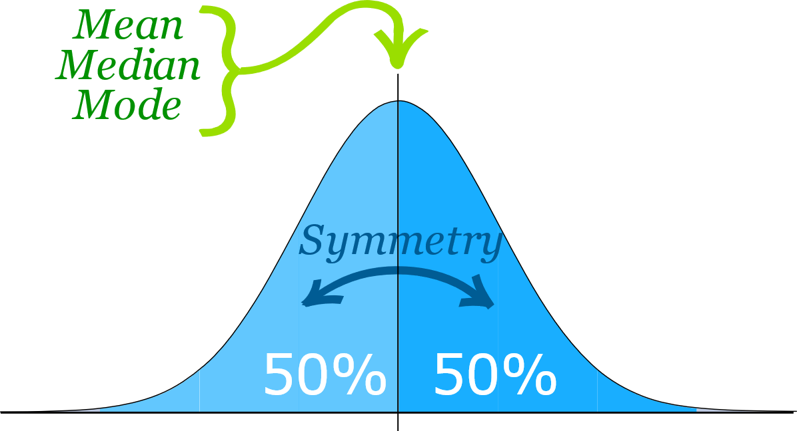

Slide 37
Biostatistics
DSs Measure of Central Tendency
Properties of a normal distribution
The mean, mode and median are all equal.
The curve is symmetric at the center (i.e. around the mean, μ).
Exactly half of the values are to the left of center and exactly half the values are to the right.
The total area under the curve is = 1.

Slide 38
Biostatistics
DSs Measure of Central Tendency
Parameters of Normal Distribution
The two main parameters of a (normal) distribution are the mean and standard deviation.
The parameters determine the shape and probabilities of the distribution.
The shape of the distribution changes as the parameter values.

Slide 39
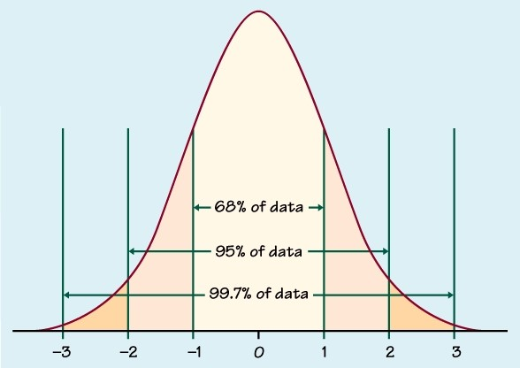
The standard deviation measures the dispersion of the data points relative to the mean

Slide 40
Biostatistics
DSs Measure of Central Tendency
Standard Deviation
The standard deviation measures the dispersion of the data points relative to the mean.
It determines how far away from the mean the data points are positioned and represents the distance between the mean and the observations
This means that 68.27% of the scores lie within 1 standard deviation of the mean, means that 95.45% of the scores lie within 2 standard deviation of the mean, means that 99.73% of the scores lie within 3 standard deviation of the mean.

Slide 41
Biostatistics
DSs Measure of Central Tendency
The mean is the most common measure of central tendency used by researchers and people in all kinds of professions.
A researcher can use the mean to describe the data distribution of variables measured as intervals or ratios.
These are variables that include numerically corresponding categories or ranges (like race, class, gender, or level of education), as well as variables measured numerically from a scale that begins with zero (like household income or the number of children within a family).

Slide 42
Biostatistics
DSs Measure of Central Tendency
Skewed Data
Data that are skewed to the right (positively skewed) have a long tail that extends to the right.
In this situation, the mean and the median are both greater than the mode.
Data that are skewed to the left (negatively skewed) have a long tail that extends to the left.
In this situation, the mean and the median are both less than the mode.

Slide 43
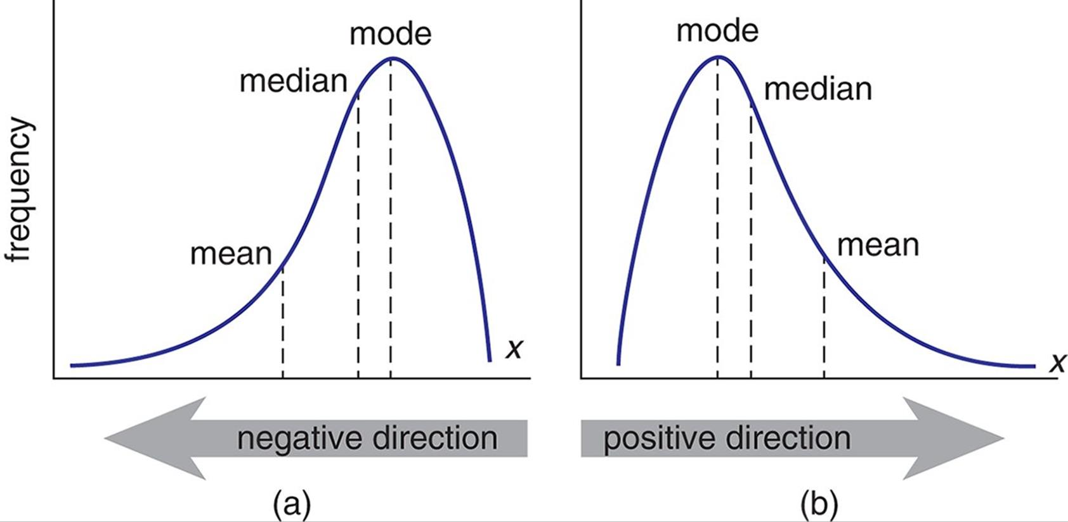
The measure of how asymmetric a distribution can be is called skewness

Slide 44
Biostatistics
The Level of Measurement
There are numerous ways to describe and analyze your data, depending upon their level of measurement.
The level of measurement of your variable describes the nature of the information that the variable provides.
There are two main types of variables: categorical and continuous.

Slide 45
Biostatistics
The Level of Measurement
Categorical variables are those that have discrete categories or levels.
Categorical variables can be further defined as nominal, dichotomous, or ordinal.
Continuous variables are measured numerically, and have an infinite number of possible values.

Slide 46
Biostatistics
The Level of Measurement
A continuous variable is considered ratio if it has a meaningful zero point (i.e., as in age or distance).
A continuous variable is considered interval if it can be measured along a continuum that has fixed values between two points, but does not have a meaningful zero-point (e.g., temperature measured in Fahrenheit or Celsius).

Slide 47
Biostatistics
The Level of Measurement
The level of measurement of your variables influences what analyses you can conduct.
The table below presents some example combinations of levels of measurement, and the suggested analysis to conduct.
The nominal level of measurement is the lowest of the four ways to characterize data.
Data at the nominal level is qualitative. Colors of eyes, yes or no responses to a survey, and favorite breakfast cereal all deal with the nominal level of measurement.

Slide 49
Biostatistics
The Level of Measurement
Ordinal Level of Measurement
The next level is called the ordinal level of measurement.
Data at this level can be ordered, but no differences between the data can be taken that are meaningful.
You can order things so that A is higher than a B, but without any other information, there is no way of knowing how much better an A is from a B.

Slide 50
Biostatistics
The Level of Measurement
Interval Level of Measurement
The interval level of measurement deals with data that can be ordered, and in which differences between the data does make sense.
Data at this level does not have a starting point.
The Fahrenheit and Celsius scales of temperatures are both examples of data at the interval level of measurement.
Data at this level does lack one type of comparison, it is not correct to say that 90 degrees Celsius is three times as hot as 30 degrees Celsius.

Slide 51
Biostatistics
The Level of Measurement
Ratio Level of Measurement
The fourth and highest level of measurement is the ratio level. Data at the ratio level possess all of the features of the interval level, in addition to a zero value.
Due to the presence of a zero, it now makes sense to compare the ratios of measurements.
Phrases such as "four times" and "twice" are meaningful at the ratio level.
Distances, in any system of measurement, give us data at the ratio level. A measurement such as 0 feet does make sense, as it represents no length. Furthermore, 2 feet is twice as long as 1 foot.

Slide 52
Biostatistics
Logistic Regression Analyses
Regression is a statistical measurement used in epidemiology, and other disciplines that attempts to determine the strength of the relationship between one dependent variable (usually denoted by Y) and a series of other changing variables (known as independent variables).
Regression takes a group of random variables, thought to be predicting Y, and tries to find a mathematical relationship between them.

Slide 53
THANK YOU

