Slide 1
Hemoglobin and anemia
BCH 471

Slide 2
Objectives
Quantitative determination of hemoglobin in a blood sample.

Slide 3
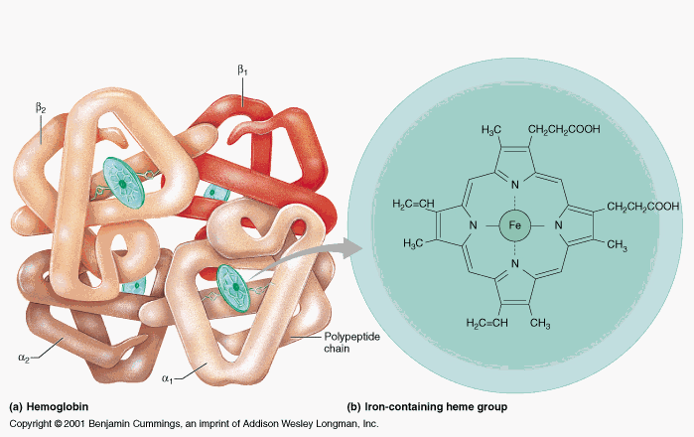
Hemoglobin structure
Hemoglobin (Hb) is a porphyrin–iron (II) protien in RBCs that transport oxygen from the lungs to the rest of the body and carbon dioxide back to the lungs.
Hb is made up of 4 subunits of globin protein , with a heam (iron containing group).

Slide 4
Hemoglobin Synthesis
The circulation blood of normal adult contain about 750 g of Hb and of this about 7 – 8 g are degraded daily.
This amount has to be newly synthesized each day because:
The globin part of Hb can be reutilized only after catabolism into its constituent amino acid.
The free heam is broken down into bile pigment which is excreted.
Iron alone is reutilized in the synthesis of Hb.
The rate of Hb synthesis (Rate of RBC formation) depends on
The amount of oxygen reaching the blood
Capacity of the blood to carry oxygen ,which in turn depend on the amount of circulating hemoglobin

Slide 6
Regulation of Hb Synthesis:
Hb synthesis is stimulated by anoxia or hypoxia, whether due to oxygen deficiency or due to anaemia.
Anoxia: means a total depletion in the level of oxygen, an extreme form of hypoxia or "low oxygen”
There is a strong evidence that the marrow response to the stimulus of hypoxia is dependent upon erythropoietin.
Erythropoietin is a glycoprotein hormone formed in kidney in response to decrease oxygen carrying capacity (hypoxia or anoxia), in order to stimulate the erythropoiesis

Slide 7
Tissue hypoxia
Kidney secrete erythropoietin into blood
Increase erythropoiesis
Increase number of RBC
Increase oxygen carrying capacity
Return to homeostasis when oxygen is delivered to kidney , this cause negative feedback inhibition to stop the secretion of erythropoietin

Slide 8
The role of some factor affecting on the native of haemoglobin:
Vitamins and cofactor: Biotin (B7), pantothenic acid (B5), folic acid (B9), coenzyme A and pyrodixal phosphate are essential for haem synthesis .
Trace metals : Only copper and cobalt are known to play a role .
(Copper is playing a role in the absorption of iron while Cobalt is essential constituent of vitamine B12 (Cobalamin) )
Glucose -6-phsphatase dehydrogenase (G6PD)

Slide 9
Anemia :
It is in general decrease in the amount of RBC or the normal amount of Hb in blood. It can also be defined as a lowered ability of the blood to carry oxygen.
Causes:
Genetics
Acquired
RBC membrane Defect
Megaloblastic Anemia
Iron-Deficiency Anemia

Slide 10
Iron-deficiency anemia:
Deficiency of iron is essentially due to blood loss with failure to replace the iron stores because of :
Dietary deficiency or
Increase requirement or
Defective absorption.
Megaloblastic Anemia:
This may be due to deficiency of folic acid or cobaltamin (Vit. B12)
RBC membrane defects:
In this condition there is a defect of the erythrocyte membrane and an abnormality in the soduim pumps.
The best-known disorders are hereditary spherocytosis and hereditary elliptocytosis.

Slide 11
Estimation of blood haemoglobin:
Principle:
The ferrouse (Iron II) in each haem in RBC is oxidized by ferricyanide to Fe(III)-methaemoglobin .
A cynide group (CN⁻) is then attached to the iron atom (because it is positively charge) by reaction with KCN to give the brown cyanomethamoglobin (stable) which can be estimated quantitatively
Normal Hb conc.: for men: 14 - 18 g/dl, for women : 12 - 16 g\dl
Level of Hb is associated with polycythemia and dehydration
⬇ Level of Hb is associated with aneamia

Slide 12
Method
Pipette into clean dry test tubes
Hb conc (g/dl) = 29.4 x Abs of test
Blank | Test
2 ml | 2 ml | Hemoglobin reagent
_____ | 0.01 ml ( 10µl) | Blood sample
Mix, allow to stand at room temperature for 3 min and read the absorbance at 540 nm against hemoglobin reagent

Slide 13
Quantitative Determination of G6PD Deficiency in Hemolysed RBC sample
Objectives:
Quantitative determination of glucose 6-phosphate dehydrogenase (G6PD) activity in erythrocytes (hemolysate).

Slide 14
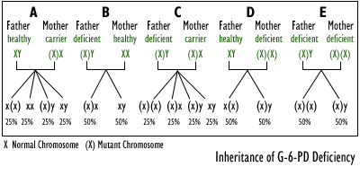
Introduction
G6PD deficiency is an inherited X-linked recessive trait that predisposes to hemolytic anemia with jaundice.

Slide 15
RBCs are constantly challenged by oxidants (free radicals) generated by the conversion of oxyhaemoglobin to deoxyhaemoglobin and by peroxides generated by phagocytosing granulocytes.
G6PD is an enzyme required to protect cells from damage by oxidation.
It is responsible for the conversion glucose in the pentose phosphate pathway (PPP) to form 6-phosphogluconate , this pathway provide NADPH which is used to produce reduced glutathione (GSH).
GSH is necessary for cell integrity by neutralizing free radicals that cause oxidative damage.

Slide 16
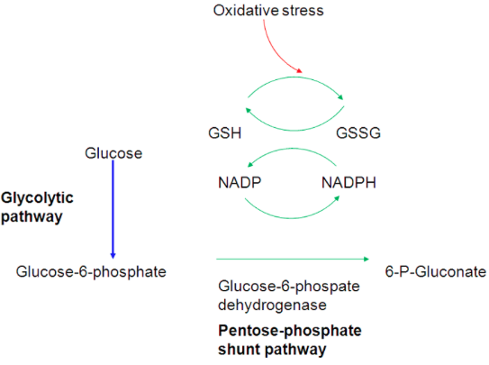

Slide 17
Normal RBCs can increase generation of NADPH in response to oxidative stress; this capacity is impaired in patients with G6PD deficiency.
Failure to withstand oxidative stress due to G6PD deficiency, leads to decreased level of NADPH ,therefor Hb is oxidized by free radicals to met-Hb, which aggregates together causing hemolysis.
Oxidative stress can result from infection and from chemical exposure to medication e.g. antimalarial drug, and certain foods e.g., fava beans

Slide 18
Principle
Erythrocytes are lysed (by saponin) and their content is released
Glucose + NADP⁺ G6PD 6-Phosphogluconate + NADPH + H⁺
The rate of formation of NADPH is a measure of the G6PDH activity and it can be followed by means of the increase in the Absorbance at 340 nm.
Note: A red cell hemolysate is used to assay for deficiency of the enzyme, while serum is used for evaluation of enzyme elevations.

Slide 19
Method of G6PDH
Pipette into clean and dry test tubes
Reagent | Volume
G6PDH Buffer | 3 ml
NADP reagent | 100 μl
Sample | 50 μl
Mix and incubate for 5 min at 25°C, the add
G6PDH Substrate | 50 μl
Mix and read absorbance every min for 3 min against distilled water and calculate ΔA/min

Slide 20
Results
ΔA/min=[(A3-A2)+(A2-A1)]/2 | Abs 340 nm |  | Time
 |  | A1 | 1 min
 |  | A2 | 2 min
 |  | A3 | 3 min

Slide 21
Calculations
G6PD Activity in mU/erythrocytes/ml of blood ( P )= ΔA/min x 30868
Note: If the erythrocytes count per ml of blood is 5 X 10⁹
Then the G6PD activity in mU/ 10⁹ cells = P/5

Slide 22
Qualitative determination of hemoglobin S (HbS) in blood.
Objectives:
Qualitative determination of hemoglobin S (HbS) in blood using a phosphate solubility method.

Slide 23
Introduction
There are hundreds of Hb variants, and the most common are:
Hemoglobin A
It is normal hemoglobin that exists after birth and consist of (α2β2).
In normal adult 95% of Hb is present as HbA
Hemoglobin A2
It is a minor component of the hemoglobin found in red cells after
birth and consists of (α2δ2)
less than 3% of the total red cell hemoglobin.
Hemoglobin F
Hemoglobin F is the predominant hemoglobin during fetal development and consists of (α2γ2).

Slide 24
Example of an abnormal Hb
Hemoglobin S (HbS)
The alpha chain is normal, while the beta chain is mutated, giving the molecule the structure, α2βS2.
A point mutation in the Hb β gene is responsible for the sickling of RBCs seen in sickle cell anemia .The abnormality is due to Substitution of non polar valine for a charged Glutamic acid in position 6 in the β chain .

Slide 25
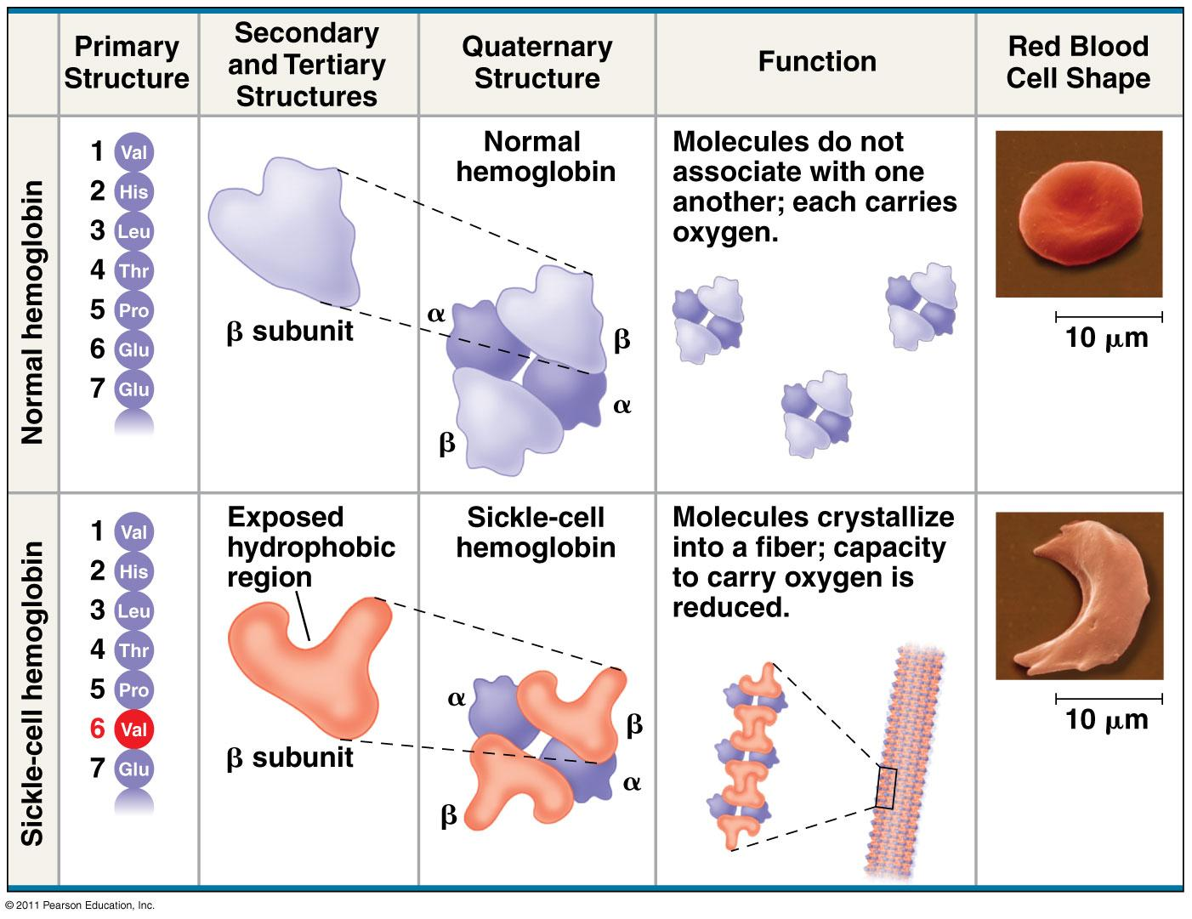

Slide 26
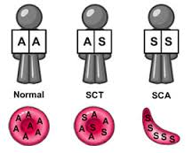
HbS can be inherited in the homozygous state (S/S) produce sickle cell anemia , or in heterozygous (A/S) ,also called sickle cell trait, usually don’t exhibit symptoms of the sickle cell anemia disease (unless under extreme hypoxia).
Individuals with HbS will be at high risk when exposed to conditions of low oxygen tension such as surgery, high altitude or athletics which may results in serious and fatal clinical complications.

Slide 27
Principle
Erythrocytes are lysed (by saponin) and the released hemoglobin is reduced (by dithionite) in phosphate buffer.
Reduced HbS is characterized by its very low solubility → So that in the presence of HbS, the solution become turbid and the lines behind the test tube will not be visible while, if no HbS was present the clear solution will permit the lines to be seen through the test tubes.

Slide 28
Method of HbS
Pipette into clean dry test tube
Reagent | Volume
Sickling solution | 2 ml
Patient sample (whole blood) | 0.02 ml (20 μl)
Mix by inversion and allow stand at room temperature for 5 to 10 min
Read the test by holding the test tube approximately 3 cm in front of a lined scale on the card.

Slide 29
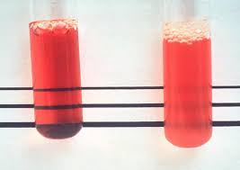
Results
_
+

