Slide 1
Heat Exchangers

Slide 2
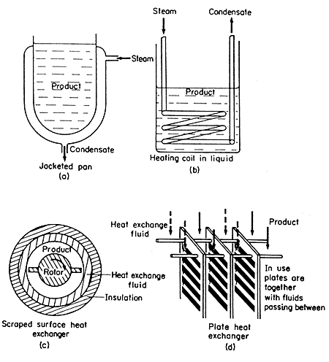
Heat exchange equipment

Slide 3
Heating and cooling are common in food operations
Pasteurization
Blanching
Evaporation
Drying
Sterilization
Freezing
Extrusion

Slide 4
Heat exchangers
Contact type
Steam infusion
Steam injection
Non contact type
Plate
Scraped Surface
Tubular
Shell and Tube

Slide 5
HE classification: type of medium used
Gas-Gas
Liquid-Gas
Liquid-liquid
HE classification: flow direction
Countercurrent .
Concurrent (parallel).
Countercurrent is more used than concurrent due to its higher efficiency.

Slide 6
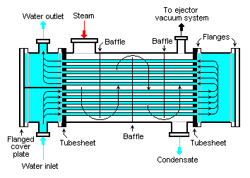
Examples of heat exchangers
Shell and tube heat exchangers

Slide 7
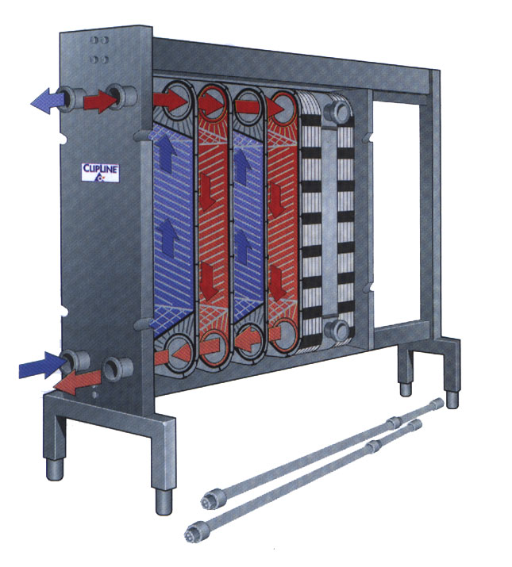
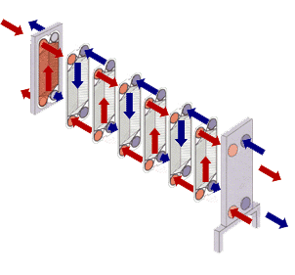
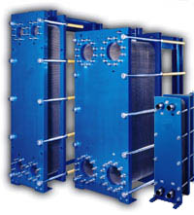
PLATES Heat Exchangers

Slide 8
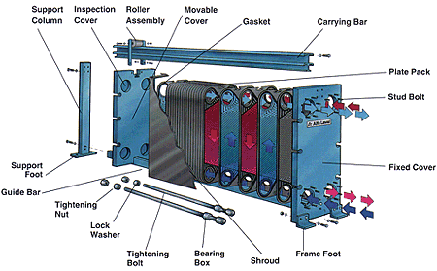

Slide 9
Plate thickness is 0.4 to 0.8 mm
Channel lengths are 2-3 meters
Plates are available in: Stainless Steel, Titanium, Titanium-Palladium, Nickel
PLATES

Slide 10
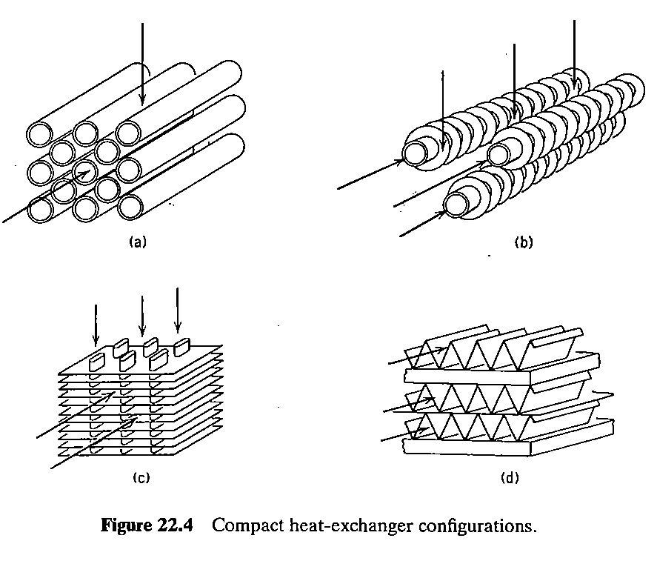

Slide 11
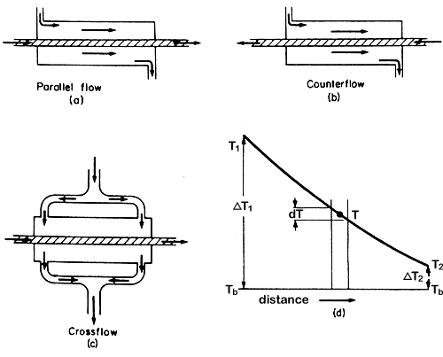
Double tube heat exchangers

Slide 12
One example of this type is the Double pipe heat exchanger.
In this type, the hot and cold fluid streams do not come into direct contact with each other.
They are separated by a tube wall or flat plate.

Slide 13
Principle of Heat Exchanger
First Law of Thermodynamic: “Energy is conserved.”
0
0
0
0
Control Volume
COLD
Qh
HOT
Thermal Boundary Layer
Cross Section Area

Slide 14
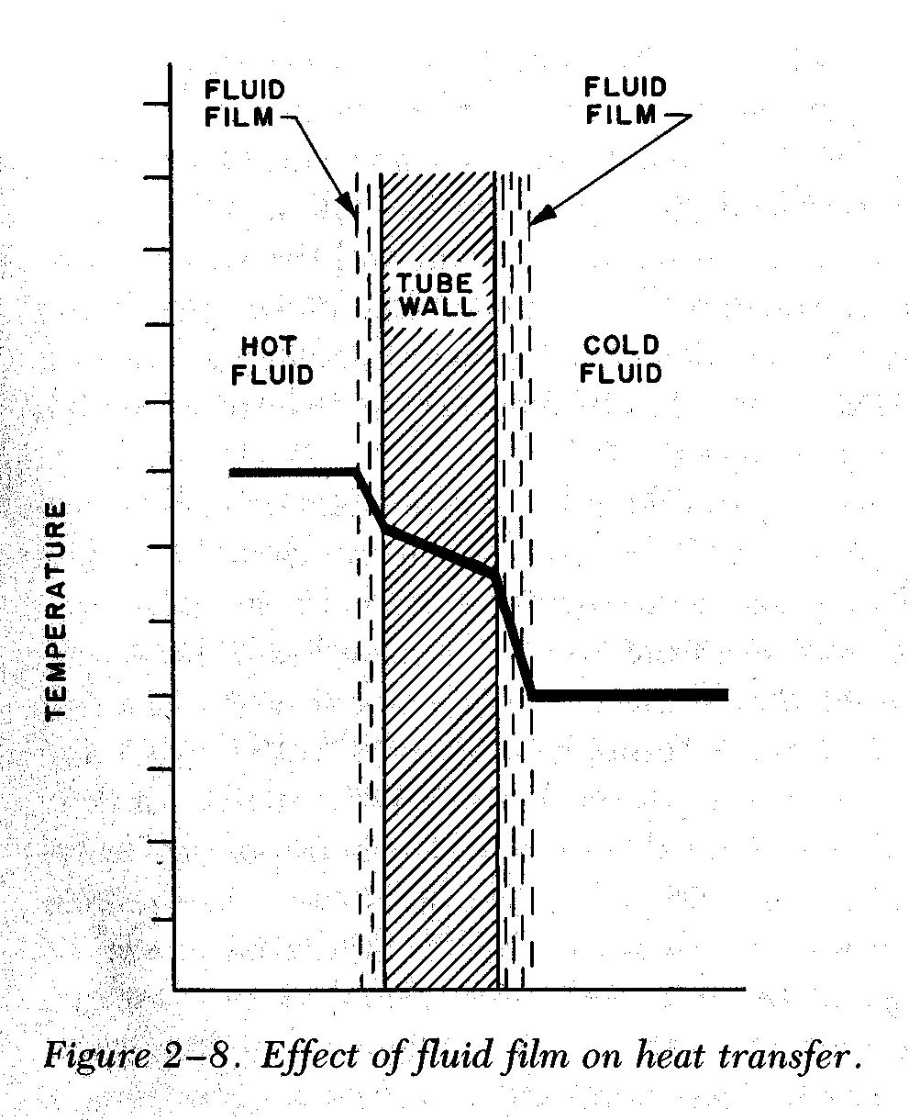
THERMAL
BOUNDARY LAYER
Region III: Solid – Cold Liquid Convection
NEWTON’S LAW OF CCOLING
Energy moves from hot fluid to a surface by convection, through the wall by conduction, and then by convection from the surface to the cold fluid.
T_{h}
T_{i,wall}
T_{o,wall}
T_{c}
Region I : Hot Liquid-Solid Convection
NEWTON’S LAW OF CCOLING
Q hot
Q cold
Region II : Conduction Across Copper Wall
FOURIER’S LAW

Slide 15
Region I : Hot Liquid – Solid Convection
U = The Overall Heat Transfer Coefficient [W/m.K]
Region II : Conduction Across Copper Wall
Region III : Solid – Cold Liquid Convection
+
r_{i}
r_{o}

Slide 16
Calculating U using Log Mean Temperature
Hot Stream :
Cold Stream:
Log Mean Temperature

Slide 17
Log Mean Temperature evaluation
CON CURRENT FLOW
1
2
∆
T
1
Wall
∆
T
2
∆ A
A
T
10
T
1
T
4
T
5
T
2
T
3
T
6
T
8
T
9
T
7
P
ara
ll
e
l
Fl
ow

Slide 18
Log Mean Temperature evaluation
COUNTER CURRENT FLOW
1
2
T₃
T₄
T₆
T₆
T₁
Wall
T₇
T₂
T₈
T₉
T₁₀
A
T
10
T
1
T
4
T
5
T
2
T
3
T
6
T
7
T
8
T
9
Co
un
t
e
r
- C
u
r
re
n
t
F
l
ow

Slide 19
Heat Exchangers: The Effectiveness – NTU Method

Slide 20
General Considerations
Computational Features/Limitations of the LMTD
(log mean Temperature difference) Method:
The LMTD method may be applied to design problems for
which the fluid flow rates and inlet temperatures, as well as
a desired outlet temperature, are prescribed.
For a specified H.E. type, the required size (surface area), as well as the other
outlet temperature, are readily determined.
If the LMTD method is used in performing calculations for which
both outlet temperatures must be determined from knowledge of the
inlet temperatures, the solution procedure is iterative.
For both design and performance calculations, the effectiveness-NTU
method (Number of Transfer Units) may be used without iteration.

Slide 21
Definitions
Heat exchanger effectiveness, 𝓔 ( ratio between actual and max heat transfer) :
Fluid Heat Capacity Rates
New Definitions:
Max possible heat transfer

Slide 22
Maximum possible heat rate:
Why is C_{min} and not C_{max} used in the definition of q_{max}?
to include maximum feasible heat transfer among the working fluids during calculation
Will the fluid characterized by C_{min} or C_{max} experience the largest possible
temperature change through the HX?

Slide 23
Heat exchanger effectiveness

Slide 24
Number of Transfer Units, NTU:
A dimensionless parameter whose magnitude influences H.E. performance:

Slide 25
Effectiveness – NTU Method
𝓔

Slide 26
Effectiveness – NTU Method
For Parallel Flow with C_{min} = C_{h}

Slide 27
Effectiveness – NTU Method
For Parallel Flow with C_{min} = C_{h}

Slide 28
Effectiveness – NTU Method
For Counterflow with C_{r} = C_{min}/C_{max}

Slide 29
Effectiveness – NTU Method
For Counter-flow with C_{r} = C_{min}/C_{max}

Slide 30
Design Calculations:
For all heat exchangers,
For C_{r} = 0, (phase change: condensation or evaporation) to all HE types.
Performance Calculations:
C_{r}

Slide 31
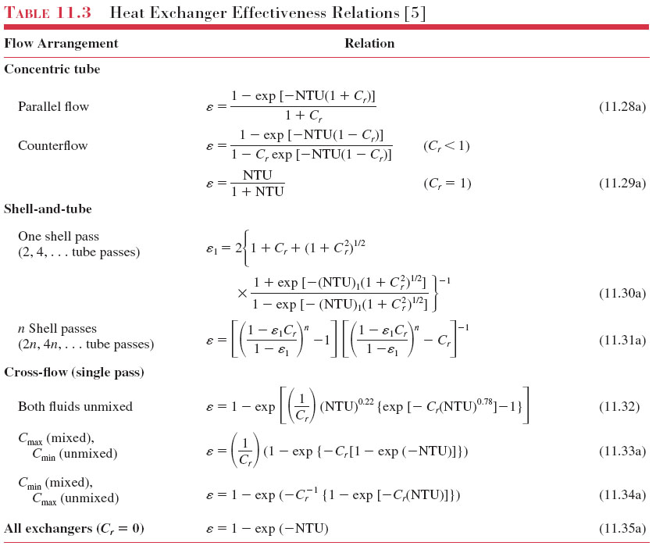

Slide 33
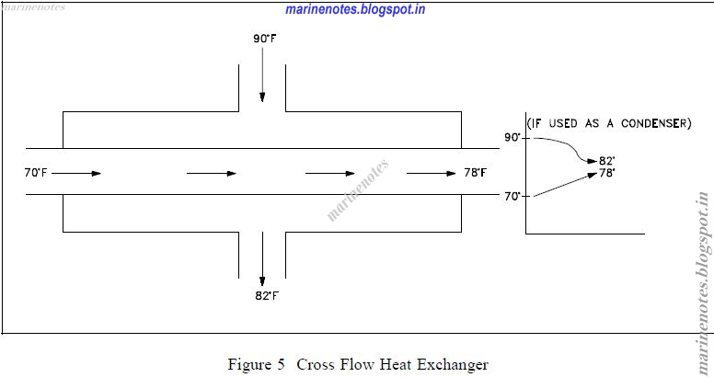
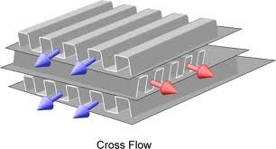
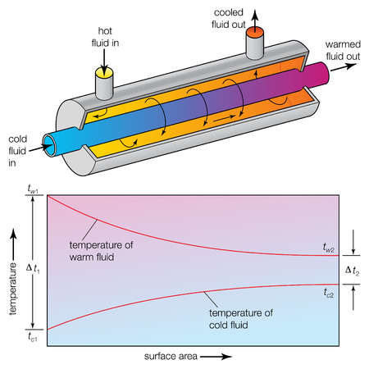
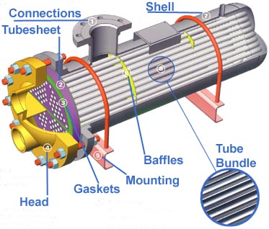

Slide 34
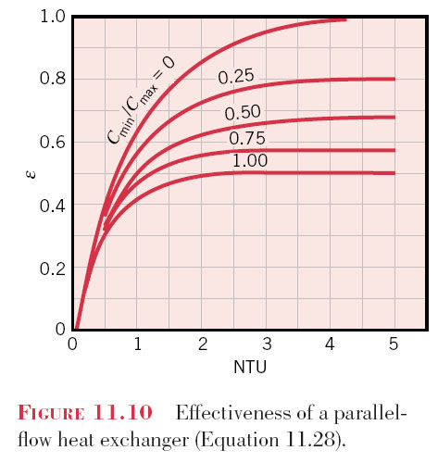
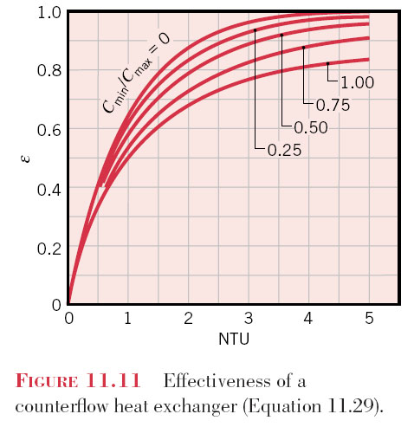
Effectiveness – NTU Method
Graphical Representations of Equations in Tables 11.3 & 11.4

Slide 35
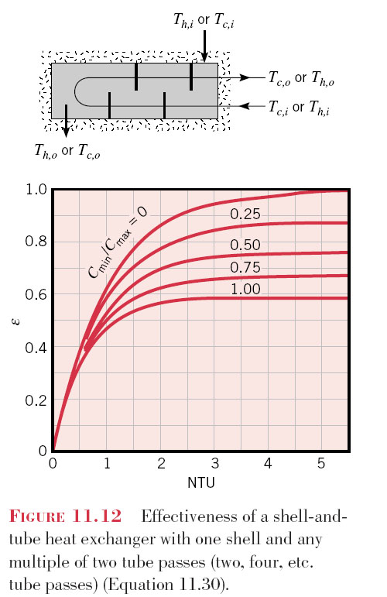
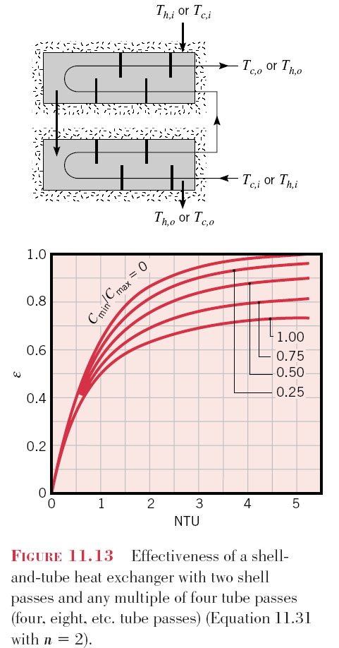
Effectiveness – NTU Method

Slide 36
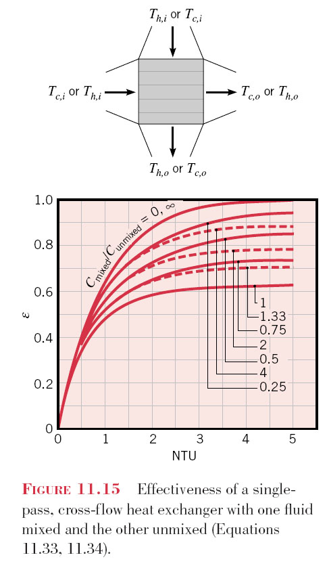
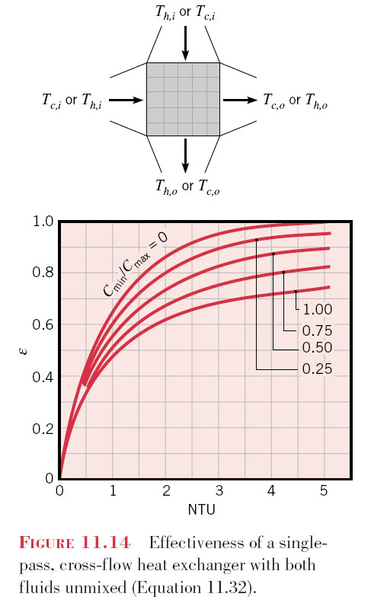
Effectiveness – NTU Method

Slide 37
Heat exchanger selection.
Thermal performance analysis (NTUs) for co- & counter-current exchangers.
Multi-pass exchangers (S&T).
Condensation & boiling.
Radiation.

Slide 38
General Procedure
Must calculate heat duty
Minimise cost subject to constraints
fluid inlet and outlet temperatures
allowable pressure drops
compatibility of materials (corrosion) and fluids (direct/indirect contact)
maintenance (repairs)
availability (can we get it easily?)
sensitivity to other conditions

Slide 39
General Considerations
Design pressures
Design temperatures
Heat duty / size range
Fluid type / compatibility
Boiling/condensation (“quality”)
Temperature driving forces
Allowable pressure drops
Fouling tendency
Space limitations

Slide 40
Fundamentals of Heat and Mass Transfer
THEODORE L. BERGMAN, FRANK P. INCROPERA, ADRIENNE S. LAVINE, DAVID P. DEWITT
http://books.google.com.sa/books?hl=ar&lr=&id=vvyIoXEywMoC&oi=fnd&pg=PR21&dq=table+11.3+heat+exchanger+effectiveness+relations&ots=8HqjQScVI8&sig=eA2YjAcHwA8A1ls-CFT6RNEU8hY&safe=on&redir_esc=y#v=onepage&q=table%2011.3%20heat%20exchanger%20effectiveness%20relations&f=false

