Slide 1
Health Communication

Slide 2
Objectives:
By the end of this lecture, you will be able to:
Define health communication
Recognize the importance of health communication
Identify the most important concepts related to health communication
Identify the most important health communication principles
Start developing cultural competency for successful health communication

Slide 3
Health Communication
Is the study and use of communication strategies to inform and influence individual and community decisions that enhance health.
Healthy People 2010

Slide 4
Function of health communication
Health communication includes the study and use of communication strategies to inform and influence individual and community knowledge, attitudes and practices (KAP) with regard to health and healthcare.

Slide 5
Effective Health Communication—Not Just for Physicians
Understanding and delivering effective health communication is the charge of all health care professionals from all parts of your organization
Physicians
Dentists
Nurses
Health educators
Social Workers
Front-office staff
Billing staff
Pharmacists

Slide 6
Importance of Health Communication
Effective health communication can lead to positive health outcomes
Better use of the health care system
Better medical outcomes
Improved patient-provider relationships.
Poor health communication can lead to negative outcomes
Low patients compliance
Low patient participation
Weak patient-provider relationships

Slide 7
FACTS
Up to 80% of patients forget what their doctor said as soon as they leave the doctor’s office
Nearly 50% of what patients remember is recalled incorrectly

Slide 8
Think…….
How many of the individuals you serve do you think remember what you say?
Are you sure?
How do you know?

Slide 9
Health communication overview
Health communication is a critical public health competency for all diseases and has become especially important in communicable diseases.
The surfacing of new infectious organisms, microbial resistance to therapeutic drugs, new environmental related phenomena and the new emerging diseases represent public health threats that can spread quickly and unexpectedly.

Slide 10
Purpose of Health Communication
Health Communication serves the following purposes :
Initiating actions
Making known needs and requirements.
Exchanging information, ideas, and beliefs
Creating understanding
Establishing relations.
Train and assist to adopt desired change and maintain it.

Slide 11
Some important concepts related to Health Communication
Health literacy
Health literacy can be defined as the capacity that an individual has to access and effectively use health-related information. Health education
Health education aims to influence a person’s knowledge, attitudes and behaviours connected to health in a positive way. Social marketing
Is the planning and implementation of programs designed to bring about social change using concepts from commercial marketing for the purpose of societal benefit rather than commercial profit.

Slide 12
Important concepts related to Health Communication (cont’)
Health advocacy Advocacy is one strategy to raise awareness and promote health and access to quality health care at the individual and community levels. Outbreak communication An effective outbreak communication can help to bring an outbreak under control as quickly as possible, with as little social disruption as possible.

Slide 13
Health Literacy
Health literacy involves a range of social and individual factors which are influenced by educational systems, health systems, culture, and language.

Slide 14
Why Learn About Health Literacy?
Findings from “Inadequate Functional Health Literacy Among Patients at Two Public Hospitals” 2009

Slide 15
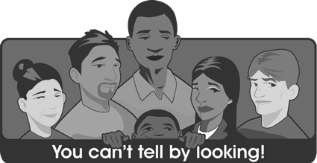
Identifying Limited Health Literacy
Every day there are patients who have trouble reading and understanding health information
Even people with adequate health literacy skills may have trouble understanding and applying health care information, especially when it is explained in unfamiliar technical terms

Slide 16
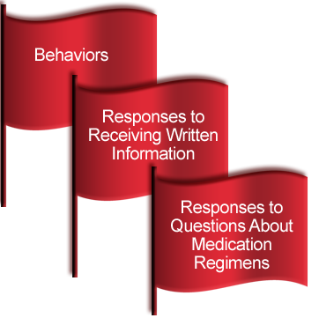
Tools and Techniques for Identifying Limited Literacy
RED FLAGS
Patient registration forms incomplete or inaccurately completed
Appointments frequently missed
Not following medication directions or procedures
Inability to describe how to take medications
Lack of follow-through with referrals to consultants
Help sought only when illness is advanced
May not be able to articulate symptoms or time course of illness

Slide 17
Tools and Techniques for Improving Communication
Slow Down!
Such patient-centered visits take no longer than “traditional” visits, in which the agenda is set by the health care provider.
Behaviors such as sitting rather than standing, listening rather than speaking, and speaking slowly, can help to reinforce the impression that you are focused on the patient.
Notes:
Not a lot of research but there is a consensus among health literacy and communication experts that the following basic methods can improve communication
Slow down
Use plain, nonmedical language
Show or draw pictures
Limit the amount of information provided, and repeat it
Produce easy-to-read written materials
Confirm the patient’s understanding of your message
Create a shame-free environment
Address the needs of patients with disabilities

Slide 18
Tools and Techniques for Improving Communication
Use Plain, Nonmedical Language
Most people have trouble understanding words used in health care. In others, a word may be familiar, but the person may not understand it in a health care context.
Words that providers use in their day-to-day conversations with colleagues may be unfamiliar to the majority of persons who are not medically trained.

Slide 19
Tools and Techniques for Improving Communication
PLAIN LANGUAGE!!!
Evidence indicates that all patients prefer easy-to-read materials to more complex or comprehensive materials.
Focus on instructions for key behaviors that the patient must put into action
Create materials for readability at the 6th- to 8th-grade level
Larger text (10- to 12-point) and fill it with blank space
Bullets and clear illustrations

Slide 20
PLAIN LANGUAGE EXAMPLES

Slide 21
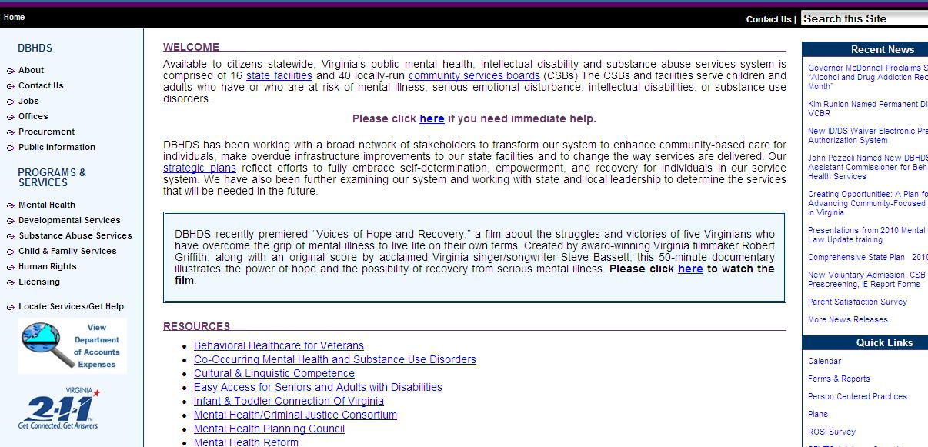
PLAIN LANGUAGE EXAMPLES

Slide 22
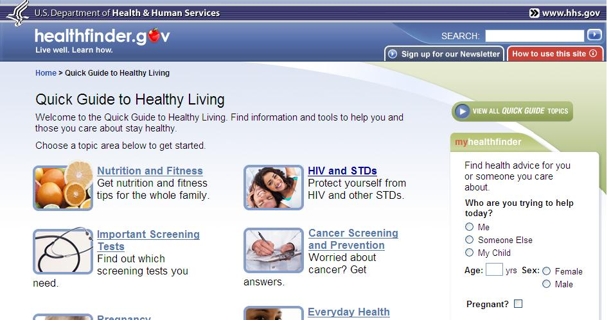
PLAIN LANGUAGE EXAMPLES

Slide 23
Education and Training
It is a proven fact that education and training to those who feel sick is absolutely a vital tool. When people are sick they are afraid of not getting better. Here education, training and communication work like a thrilling instrument.

Slide 24
Health Communication Principles
Accuracy: The content is valid and without errors of fact, interpretation, or judgment. Availability: The content (whether targeted message or other information) is delivered or placed where the audience can access it. Balance: the content presents the benefits and risks of potential actions

Slide 25
Health communication principles
Consistency: The content remains internally consistent over time and also consistent with information from other sources.
Cultural competence: The design, implementation, and evaluation process that accounts for special issues for select population groups and also educational levels and disability.
Evidence base: Relevant scientific evidence that has undergone comprehensive review and rigorous analysis to formulate practice guidelines, performance measure, review criteria, and technology assessments.

Slide 26
Health communication principles
Reach: The content gets to or is available to the largest possible number of people in the target population.
Interest: Involvement and active participation without aim to gain personal publicity. Ability to understand: The reading or language level and format (including multimedia) are appropriate for the specific audience.

Slide 27
Cultural Competency in Health communication
Cultural Bias is Everywhere
Research shows that individuals who are culturally different from their providers are less likely to:
Establish a connection and trust with providers
Receive sufficient information
Be encouraged to participate in medical decision-making

Slide 28
Culture and Health
Culture is also a central issue in people’s health care. A person's culture can affect:
How health care information is received
How rights and protections are exercised
What is considered to be a health problem
How symptoms and concerns about the problem are expressed
Who provides treatment for the problem
What types of treatment should be given

Slide 29
Cultural Factors Influencing Patient-Provider Communication
Nonverbal Communication Varies greatly among people, often leading to cross-cultural misunderstanding.
Facial Expressions
Head Movements
Hand and Arm Gestures
Personal Space
Touching
Eye Contact
Physical Postures
Notes:
Winking has very different connotations in different cultures. In some Latin American cultures, winking is a romantic or sexual invitation. In Nigeria, Yorubas may wink at their children if they want them to leave the room. Some Chinese consider winking to be rude
In Lebanon, the signal for "YES" may be a nod of the head. To signal "NO," a Lebanese may point his or her head sharply upward and raise the eyebrows
The "thumbs-up" gesture has a vulgar connotation in Iran
In some Muslim cultures, a woman may be alarmed if a man, even a male physician, stands or sits too close to her
In Latin America and Eastern Europe, light touching of the arm or a light kiss to the cheek is very common, even among people who have just met, whereas people from many Asian cultures may prefer less physical contact with acquaintances
Many Asians may be reluctant to make eye contact with an authority figure. For example, when greeting a Chinese, it is best to avoid prolonged eye contact, as a sign of respect and deference
In Argentina, standing with the hands on the hips suggests anger, or a challenge

Slide 30
Cultural Factors Influencing Patient-Provider Communication
Many cultures feel providers have a higher status and will therefore expect the provider to take charge. The patient may not wish to participate in making decisions about his/her treatment, and may appear passive in the process

Slide 31
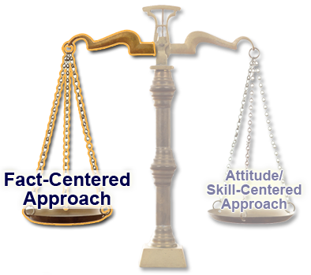
Developing Cultural Competency
Fact-Centered Approach
What to do: Gain cultural information about specific ethnic groups
How to do it: Learn culture-specific information, such as an ethnic group’s historical context, cultural concepts of illness and disease, health-seeking behaviors, health-oriented data and disease patterns, and so on.
Notes:
Approaches to developing cultural competency fall into two categories: fact-centered and attitude/skill-centered. The key to success is to balance the two approaches.

Slide 32
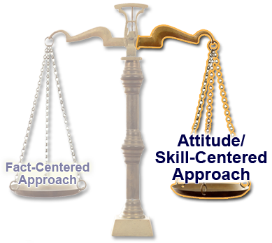
Developing Cultural Competency
Attitude/Skill-Centered Approach
What to do: Enhance communication skills and focus on the cultural values and beliefs of individuals (including yourself)
How to do it: Recognize and acknowledge your own biases; understand yourself and others in terms of culture; understand how race, ethnicity, gender, spirituality, and other issues play a role in delivery and in perceptions of health care; and acquire and apply culturally competent communication skills

Slide 33
An effective communication strategy should be based on:
Interpersonal skills: interpersonal skills are those skills that enable us to interact with another person, allowing us to communicate successfully with them,
Positive relationships with work colleagues and other professionals
You should be assertive and calm not aggressive during communication with patients and his family members.

Slide 34
An effective communication strategy should based on:
5.Language barriers are a common challenge. Overcome this dilemma with best possible way. Speak clearly and slowly during your communication with patients and his family members.
7. Define the basics purpose of your meeting with the patients. Be specific. NO long stories required. Give example if required.
8. Be careful of jargon. (Technical language with interacting with patients)

