Slide 1
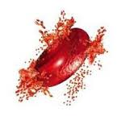
BCH 471
Hemolysing Agents
& Detection of Blood

Slide 2
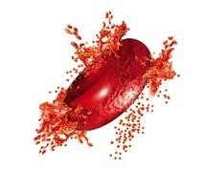
Blood Hemolysis
- Hemolysis (from the Greek Hemo: meaning blood, - lysis, meaning to break open)
- It is the breaking open of red blood cells and the release of hemoglobin and the red cell contents into the surrounding fluid (plasma)
- Hemolysis may occur in vivo or in vitro

Slide 3
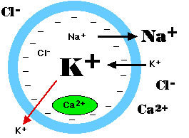
Hemolysis in vivo
- Conditions that can cause hemolysis include: Immune reactions, Infections, Medications. Toxins and poisons.
- Because the concentration of potassium inside red blood cells is much higher than in the plasma and so elevated potassium is usually found in biochemistry tests of hemolysed blood.

Slide 4
Hemolysis in vitro
▪Placing RBCs in a hypotonic solution
▪Improper technique during collection (eg.incorrect needle size, excessive suction)
▪pH imbalance (addition acid or base)
In this lab blood hemolysis will be done by using hypotonic solutions and pH imbalance.

Slide 5
When Blood Hemolysis Should Be Done?
▪Breaking down RBCs to release their content is often necessary for biochemistry
▪Estimation of hemoglobin
▪To obtain erythrocyte free preparation of leukocyte and platelet

Slide 6
Osmosis and Osmotic Pressure
Osmosis: It is the diffusion of water across a selectivity preamble membrane into a region of higher solute conc. Once an equilibrium is reached the flow of water stops
Osmotic pressure: If the pressure that generate from osmosis
Hypotonic
solution
Isotonic
solution
Hypertonic
solution

Slide 7
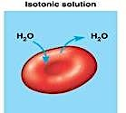
Isotonic Solution
▪A solution that has the same salt concentration as the normal cells of the body and the blood, having equal osmotic pressure.
▪Example of Isotonic solution is sodium chloride 0.9%, have the same osmotic
pressure as serum and they do not affect the membranes of the RBCs.
▪In hospitals, intravenous fluids are isotonic.

Slide 8
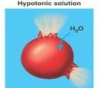
Hypotonic Solution
- In a hypotonic solution, there is a lower concentration of solute outside a cell, creating an environment with lower osmotic pressure than what is contained within the cell.
- The RBCs will burst or hemolyzed
- Any concentration of NaCl that is lower than 0.9%, will be considered hypotonic for cells
Solute inside the cell > Solute outside the cell

Slide 9
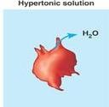
Hypertonic Solution
In a hypertonic solution, there is a higher concentration of solute outside a cell, creating an environment with higher osmotic pressure than what is contained within the cell.
The RBCs will be shrink
Any concentration of NaCl that is higher than 0.9%, will be considered hypertonic for cells
Solute inside the cell < Solute outside the cell

Slide 10
How to Calculate the Concentration of an Isotonic Solution of a Specific Substance
For example you want to know the concentration of NaCl that will make an isotonic solution
Osmolarity of RBC = 0.308 Osmolar → O=M x no.of dissociation partials
NaCl →Na+ +Cl- (no.of dissociation particles=2)
0.308 = M x 2 → M=0.154 M
-To calculate in w/v % expression → M=mole/V (in L)
No.of moles = 0.154 x 0.1 (100 ml, because you want it as %)
No.of moles = 0.0154 moles → No.of moles = Wt/Mwt Wt= 0.0154 x 58.5=0.9 g
=0.9 % → the concentration of NaCl that will make an isotonic solution

Slide 11
Method
Label 6 tubes (A→ F). Then, add 2 drops of RBCs suspended in saline into each tube
 | Tube A | Tube B | Tube C | Tube D | Tube E | Tube F
NaCl 0.45% | 5 ml
NaCl 1.2% |  | 5 ml
Sucrose 6% |  |  | 5 ml
NaOH 0.1M |  |  |  | 3 drops
HCl 0.1 M |  |  |  |  | 3 drops
Dis. Water |  |  |  |  |  | 5 ml
NaCl 0.9% |  |  |  | 5 ml | 5 ml
Wait 30 min
Observe wither hemolysis has taken place
What type of solution is distilled water considered?

Slide 12
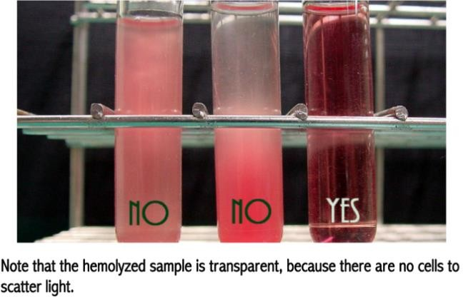
Results

Slide 13
Detection of Blood by Benzidine Test
It is often necessary to detect the presence of small quantities of blood in urine, stomach contents etc.
Principle
However, the test is not specific for blood as peroxidases present in milk, potatoes and pus, as well as the ions of Fe+3, Cu+2 and K+1 will give false positive results

Slide 14
Method
→ 3 ml of Sample + 2 ml Benzidine + 1 ml H₂O₂
Results

