Slide 1
Graphs
9.1 Graphs and Graph Models

Slide 2
Graphs and Graph Models
DEFINITION 1
A graph G = ( V , E) consists of V, a nonempty set of vertices (or nodes) and E, a set of edges.
Each edge has either one or two vertices associated with it, called its endpoints.
An edge is said to connect its endpoints.
A graph with an infinite vertex set is called an infinite graph.
a graph with a finite vertex set is called a finite graph.

Slide 3
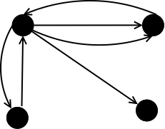
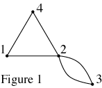
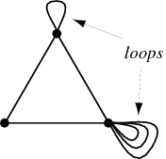
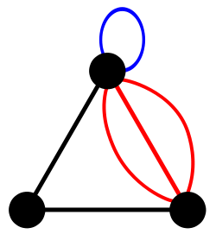
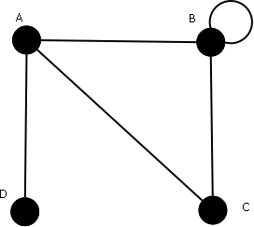
Simple graph: A graph in which each edge connects two different vertices and where no two edges connect the same pair of vertices.
Multiple graph: Graphs that may have multiple edges connecting the same vertices.
Loop is a closed curve whose initial and final vertices coincide.
Pseudographs : Graphs that may include loops, (and possibly multiple edges connecting the same pair of vertices).
a

Slide 4
Directed & Undirected Graphs
Definition2
A directed graph (or digraph) ( V,E) consists of a nonempty set of vertices V and a set of directed edges (or arcs) E.
Each directed edge is associated with an ordered pair of vertices.
The directed edge associated with the ordered pair (u ,v) is said to start at u and end at v.

Slide 5
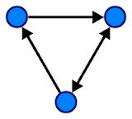
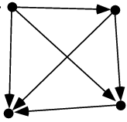
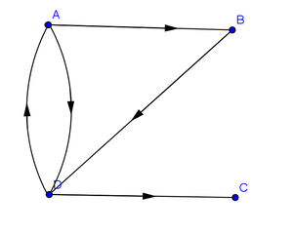
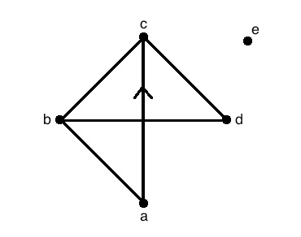
Types of Directed & Undirected Graphs
simple directed graph a directed graph that has no loops and has no multiple directed edges.
Directed multigraphs: directed graphs that may have multiple directed edges.
Edge of multiplicity m When there are m directed edges, each associated to an ordered pair of vertices (u,v).
Mixed graph: a graph with both directed and undirected edges.

Slide 6
Homework
Page 596
3
4
5
7
9

Slide 7
9.2 Graph Terminology and Special Types of Graphs

Slide 8
Basic Terminology
DEFINITION 1
Two vertices u and v in an undirected graph G are called adjacent (or neighbors) in G if u and v are endpoints of an edge of G .
If e is associated with {u,v}, the edge e is called incident with the vertices u and v.
The edge e is also said to connect u and v.
The vertices u and v are called endpoints of an edge associated with { u , v}.

Slide 9
The degree of a vertex
DEFINITION 2
The degree of a vertex in an undirected graph is the number of edges incident with it, except
that a loop at a vertex contributes twice to the degree of that vertex.
The degree of the vertex v is denoted by deg(v).
A vertex of degree zero is called isolated.
A vertex is pendant if and only if it has degree one.

Slide 10
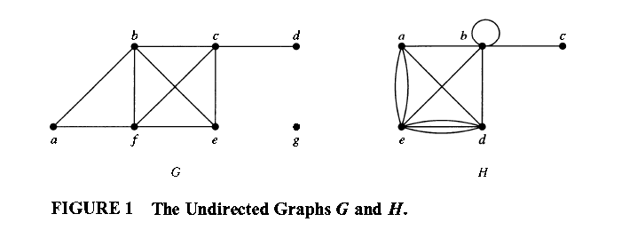
Example 1:
What are the degrees of the vertices in the graphs G and H displayed in Figure 1?
Solution:
In G:
deg(a) = 2 , deg(b) = deg(c) = deg(f ) = 4 , deg(d ) = 1 , deg(e) = 3 , and deg(g) = O.
In H:
deg(a) = 4, deg(b) = deg(e) = 6, deg(c) = 1 , and deg(d ) = 5 .

Slide 11
A vertex of degree zero is called isolated.
It follows that an isolated vertex is not adjacent to any vertex.
Vertex g in graph G in Example 1 is isolated.
A vertex is pendant if and only if it has degree one.
Consequently, a pendant vertex is adjacent to exactly one other vertex.
Vertex d in graph G in Example 1 is pendant.

Slide 12
THE HANDSHAKING THEOREM
THEOREM 1
Let G = (V, E) be an undirected graph with e edges. Then 2e = ∑_{vϵV} deg(v).
(Note that this applies even if multiple edges and loops are present.)

Slide 13
EXAMPLE 3
How many edges are there in a graph with 1 0 vertices each of degree 6?
Solution:
Because the sum of the degrees of the vertices is 6 · 1 0x6 = 60,
it follows that 2e = 60.
Therefore, e = 30.

Slide 14
THEOREM 2
An undirected graph has an even number of vertices of odd degree.

Slide 15
DEFINITION 3
When (u ,v) is an edge of the graph G with directed edges, u is said to be adjacent to v and v is said to be adjacent from u.
The vertex u is called the initial vertex of (u,v), and v is called the terminal or end vertex of (u,v).
The initial vertex and terminal vertex of a loop are the same.

Slide 16
In-degree & Out-degree (directed graph)
DEFINITION 4
In a graph with directed edges the in-degree of a vertex v, denoted by deg⁻ (v), is the number of edges with v as their terminal vertex.
The out-degree of v, denoted by deg⁺(v), is the number of edges with v as their initial vertex.
(Note that a loop at a vertex contributes 1 to both the in-degree and the out-degree of this vertex.)

Slide 17
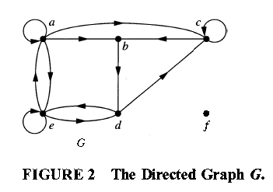
EXAMPLE 4
Find the in-degree and out-degree of each vertex in the graph G with directed edges shown in Figure 2 .
Solution:
The in-degrees in G are deg⁻(a)=2, deg⁻(b)=2, deg⁻(c)=3, deg⁻(d)=2, deg⁻(e)=3, and deg⁻(f)=0.
The out-degrees are deg⁺(a)=4, deg⁺(b)=1, deg⁺(c)=2,deg⁺(d)=2, deg⁺(e)=3, and deg⁺(f) =0.

Slide 18
THEOREM 3
Let G = (V,E) b e a graph with directed edges. Then:
∑_{vϵV} deg⁻(v)= ∑_{vϵV} deg⁺(v)=|E|.

Slide 19
Some Special Simple Graphs
EXAMPLE 5
Complete Graphs The complete graph on n vertices, denoted by K_{n} , is the simple graph
that contains exactly one edge between each pair of distinct vertices.
The graphs K_{n} , for n=1,2,3,4,5,6, are displayed in Figure 3.

Slide 20
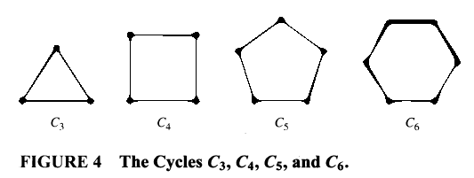
EXAMPLE 6
Cycles The cycle C_{n}≥3, consists of n vertices V₁, V₂ , . . . , V_{n} and edges { V₁, V₂} , { V₂ ,V₃ } , . . . , { V_{n-1} , V_{n}} , and { V_{n} ,V₁} .
The cycles C₃ ,C₄ , C₅ , and C₆ are displayed in
Figure 4.

Slide 21
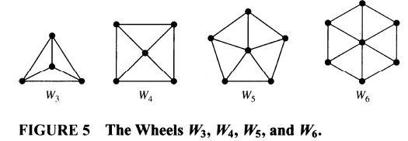
EXAMPLE 7
Wheels We obtain the wheel W_{n} when we add an additional vertex to the cycle C_{n} , for n≥3 , and connect this new vertex to each of the n vertices in C_{n} , by new edges.
The wheels W₃ , W₄ ,W₅ , and W₆ are displayed in Figure 5 .

Slide 22
How many vertices & edges in each type?
Type of the Simple Graph | Number of Vertices | Number of Edges
K_{n} | n | $$\frac{n(n−1)}{2}$$
C_{n} | n | n
W_{n} | n+1 | 2n

Slide 23
Bipartite Graphs
DEFINITION 5
A simple graph G is called bipartite if its vertex set V can be partitioned into two disjoint sets V₁ and V₂ such that every edge in the graph connects a vertex in V₁ and a vertex in V₂.
(so that no edge in G connects either two vertices in V₁ or two vertices in V₂).
When this condition holds, we call the pair (V₁,V₂) a bipartition of the vertex set V of G .

Slide 24
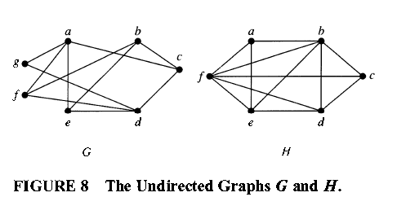
EXAMPLE 11
Are the graphs G and H displayed in Figure 8 bipartite?
Solution:
Graph G is bipartite because its vertex set is the union of two disjoint sets, {a ,b,d} and {c, e, j, g}, and each edge connects a vertex in one of these subsets to a vertex in the other subset.
(Note that for G to be bipartite it is not necessary that every vertex in {a ,b,d} be adjacent to every vertex in {c,e,j, g}. For instance, b and g are not adjacent.)
Graph H is not bipartite because its vertex set cannot be partitioned into two subsets so that edges do not connect two vertices from the same subset. verify this by (consider the vertices a , b, and j.)

Slide 25
Homework
Page 608
1
2
3
7
8
9
10
29(a,b,c)
37(a,b,d,e,f).

Slide 26
9.4 Connectivity

Slide 27
Paths
Informally, a path is a sequence of edges that begins at a vertex of a graph and travels from vertex to vertex along edges of the graph.
Definition 1
Let n be a nonnegative integer and G an undirected graph. A path of length n from u to v in G is a sequence of n edges e₁ , . . . , e_{n} of G such that e₁ is associated with {x₀, x₁}, e₂ is associated with {X₁ , X₂ } , and so on, with e_{n} associated with {x_{n-1} , x_{n} }, where X₀= u and X_{n}=v.
When the graph is simple, we denote this path by its vertex sequence X₀,X₁,…, Xn (because listing these vertices uniquely determines the path).
The path is a circuit if it begins and ends at the same vertex, that is, if u = v, and has length greater than zero.
The path or circuit is said to pass through the vertices X₁ , X₂ , . . . , X_{n-l} or traverse the edges e₁ , e₂ , . . . , e_{n} .
A path or circuit is simple if it does not contain the same edge more than once.

Slide 28
Remark:
in some books, the term walk is used instead of path, where a walk is defined to be an alternating sequence of vertices and edges of a graph, V₀, e₁,V₁, e₂,… , V_{n-1}, e_{n}, V_{n} , where V_{i-1}and V_{i} are the endpoints of e_{i} for i=1,2,…,n .
When this terminology is used, closed walk is used instead of circuit to indicate a walk that begins and ends at the same vertex,
and trail is used to denote a walk that has no repeated
edge (replacing the term simple path).
When this terminology is used, the terminology path
is often used for a trail with no repeated vertices.

Slide 29
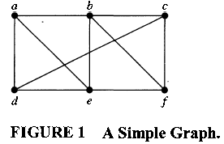
EXAMPLE 1
In the simple graph shown in Figure 1 , a,d,c,f,e is a simple path of length 4, because {a,d}, {d,c } , {c,f}, and {f,e} are all edges.
However, d,e,c,a is not a path, because {e,c} is not an edge.
Note that b, c, f, e, b is a circuit of length 4 because {b, c}, {c,f}, {f, e}, and {e, b} are edges, and this path begins and ends at b.
The path a, b, e, d, a, b, which is of length 5, is not simple because it contains the edge {a,b} twice.

Slide 30
DEFINITION 2
Let n be a nonnegative integer and G a directed graph.
A path of length n from u to v in G is a sequence of edges e₁,e₂,..,e_{n} of G such that e₁ is associated with (x₀ ,x₁ ), e₂ is associated with (x₁, x₂), and so on, with e_{n} associated with (x_{n-1},x_{n}), where x₀ = u and x_{n}= v.
When there are no multiple edges in the directed graph, this path is denoted by its vertex sequence x₀ , x₁ , x₂ , …, x_{n} .
A path of length greater than zero that begins and ends at the same vertex is called a circuit or cycle.
A path or circuit is called simple if it does not contain the same edge more than once.

Slide 31
Connectedness In Undirected Graphs
DEFINITION 3
An undirected graph is called connected if there is a path between every pair of distinct vertices of the graph.

Slide 32
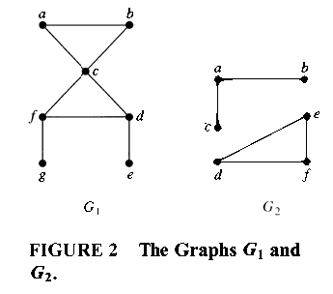
EXAMPLE 5
The graph G₁ in Figure 2 is connected, because for every pair of distinct vertices there is a path between them.
However, the graph G₂ in Figure 2 is not connected.
For instance, there is no path in G₂ between vertices a and d.

Slide 33
Homework
Page 629
1(a,b,c,d)
3

