Slide 1
Graphs
9.1 Graphs and Graph Models

Slide 2
Graphs and Graph Models
DEFINITION 1
A graph G = ( V , E) consists of V, a nonempty set of vertices and E, a set of edges.
Each edge has either one or two vertices associated with it, called its endpoints.
An edge is said to connect its endpoints.
A graph with an infinite vertex set is called an infinite graph.
a graph with a finite vertex set is called a finite graph.

Slide 3
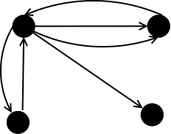
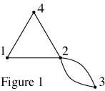
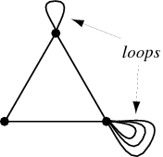
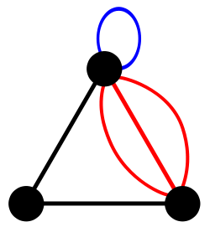
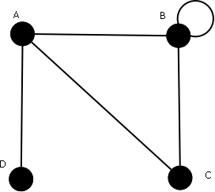
Simple graph: A graph in which each edge connects two different vertices and where no two edges connect the same pair of vertices.
Multiple graph: Graphs that may have multiple edges connecting the same vertices.
Loop is a closed curve whose initial and final vertices coincide.
Pseudographs : Graphs that may include loops, (and possibly multiple edges connecting the same pair of vertices).
a

Slide 4
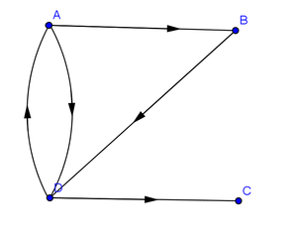
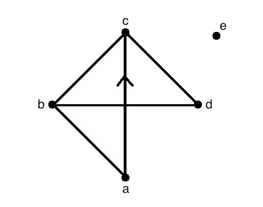
Type of Graph
1- Directed
2- Undirected Graphs
3-Mixed graph
a graph with both directed and undirected edges.

Slide 5
Homework
Page 596
3
4
5
7
9

Slide 6
9.2 Graph Terminology and Special Types of Graphs

Slide 7
Basic Terminology
DEFINITION 1
Two vertices u and v in an undirected graph G are called adjacent in G if u and v are endpoints of an edge of G .
The vertices u and v are called endpoints of an edge associated with { u , v}.

Slide 8
The degree of a vertex
DEFINITION 2
The degree of a vertex in an undirected graph is the number of edges incident with it, except
that a loop at a vertex contributes twice to the degree of that vertex.
The degree of the vertex v is denoted by deg(v).
A vertex of degree zero is called isolated.
A vertex is pendant if and only if it has degree one.

Slide 9
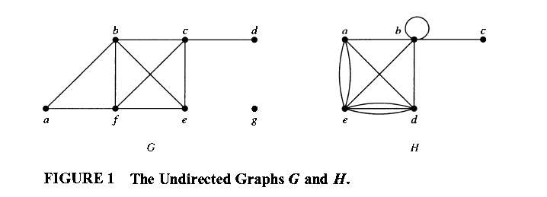
Example 1:
What are the degrees of the vertices in the graphs G and H displayed in Figure 1?
Solution:
In G:
deg(a) = , deg(b) = , deg(c) = , deg(f ) = ,
deg(d ) = , deg(e) = , and deg(g) = .
In H:
deg(a) = , deg(b) = , deg(e) = ,
deg(c) = , and deg(d ) = .

Slide 10
A vertex of degree zero is called isolated.
It follows that an isolated vertex is not adjacent to any vertex.
Vertex g in graph G in Example 1 is isolated.
A vertex is pendant if and only if it has degree one.
Consequently, a pendant vertex is adjacent to exactly one other vertex.
Vertex d in graph G in Example 1 is pendant.

Slide 11
THE HANDSHAKING THEOREM
THEOREM 1
Let G = (V, E) be an undirected graph with e edges. Then 2e = ∑_{vϵV} deg(v).
(Note that this applies even if multiple edges and loops are present.)

Slide 12
EXAMPLE 3
How many edges are there in a graph with 1 0 vertices each of degree 6?
Solution:

Slide 13
THEOREM 2
An undirected graph has an even number of vertices of odd degree.

Slide 14
DEFINITION 3
When (u ,v) is an edge of the graph G with directed edges, u is said to be adjacent to v and v is said to be adjacent from u.
The vertex u is called the initial vertex of (u,v), and v is called the terminal or end vertex of (u,v).
The initial vertex and terminal vertex of a loop are the same.

Slide 15
In-degree & Out-degree
DEFINITION 4
In a graph with directed edges the in-degree of a vertex v, denoted by deg⁻ (v), is the number
of edges with v as their terminal vertex.
The out-degree of v, denoted by deg⁺(v), is the
number of edges with v as their initial vertex.
(Note that a loop at a vertex contributes 1 to
both the in-degree and the out-degree of this vertex.)

Slide 16
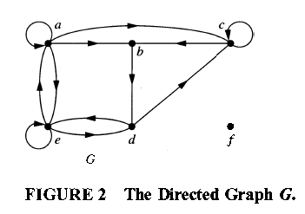
EXAMPLE 4
Find the in-degree and out-degree of each vertex in the graph G with directed edges shown in Figure 2 .
Solution:
The in-degrees in G are
deg⁻(a)= , deg⁻(b)= , deg⁻(c)= , deg⁻(d)= ,
deg⁻(e)= , and deg⁻(f)= .
The out-degrees are
deg⁺(a)= , deg⁺(b)= , deg⁺(c)= ,
deg⁺(d)= , deg⁺(e)= , and deg⁺(f) = .

Slide 17
THEOREM 3
Let G = (V,E) b e a graph with directed edges. Then:
∑_{vϵV} deg⁻(v)= ∑_{vϵV} deg⁺(v)=|E|.

Slide 18
Some Special Simple Graphs
EXAMPLE 5
Complete Graphs The complete graph on n vertices, denoted by K_{n} , is the simple graph
that contains exactly one edge between each pair of distinct vertices.
The graphs K_{n} , for n=1,2,3,4,5,6, are displayed in Figure 3.

Slide 19
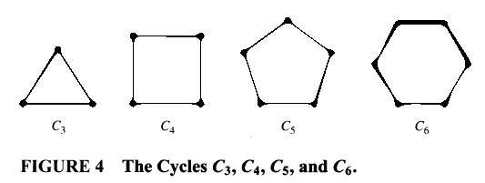
EXAMPLE 6
Cycles The cycle C_{n}≥3, consists of n vertices V₁, V₂ , . . . , V_{n} and edges { V₁, V₂} , { V₂ ,V₃ } , . . . , { V_{n-1} , V_{n}} , and { V_{n} ,V₁} .
The cycles C₃ ,C₄ , C₅ , and C₆ are displayed in
Figure 4.

Slide 20
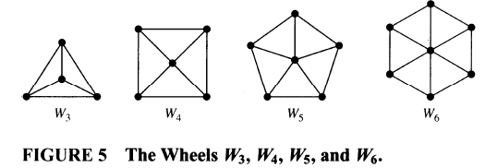
EXAMPLE 7
Wheels We obtain the wheel W_{n} when we add an additional vertex to the cycle C_{n} , for n≥3 , and connect this new vertex to each of the n vertices in C_{n} , by new edges.
The wheels W₃ , W₄ ,W₅ , and W₆ are displayed in Figure 5 .

Slide 21
Bipartite Graphs
DEFINITION 5
A simple graph G is called bipartite if its vertex set V can be partitioned into two disjoint sets V₁ and V₂ such that every edge in the graph connects a vertex in V₁ and a vertex in V₂ .
(so that no edge in G connects either two vertices in V₁ or two vertices in V₂).
When this condition holds, we call the pair (V₁,V₂) a bipartition of the vertex set V of G .

Slide 22
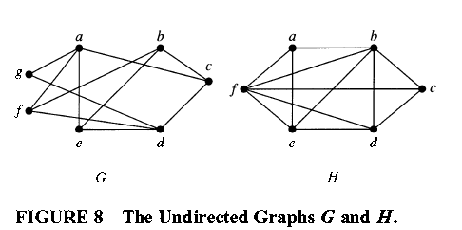
EXAMPLE 11
Are the graphs G and H displayed in Figure 8 bipartite?
Solution:
Graph G is bipartite
Graph H is not

Slide 23
Homework
Page 608
1
2
3
7
8
9
10
29(a,b,c)
37(a,b,d,e,f).

Slide 24
9.4 Connectivity

Slide 25
Paths
Informally, a path is a sequence of edges that begins at a vertex of a graph and travels from vertex to vertex along edges of the graph.
Definition 1
Let n be a nonnegative integer and G an undirected graph. A path of length n from u to v in G is a sequence of n edges e₁ , . . . , e_{n} of G such that e₁ is associated with {x₀, x₁}, e₂ is associated with {X₁ , X₂ } , and so on, with e_{n} associated with {x_{n-1} , x_{n} }, where X₀= u and X_{n}=v.
When the graph is simple, we denote this path by its vertex sequence X₀,X₁,…, Xn (because listing these vertices uniquely determines the path).
The path is a circuit if it begins and ends at the same vertex, that is, if u = v, and has length greater than zero.
The path or circuit is said to pass through the vertices X₁ , X₂ , . . . , X_{n-l} or traverse the edges e₁ , e₂ , . . . , e_{n} .
A path or circuit is simple if it does not contain the same edge more than once.

Slide 26
Remark:
in some books, the term walk is used instead of path, where a walk is defined to be an alternating sequence of vertices and edges of a graph, V₀, e₁,V₁, e₂,… , V_{n-1}, e_{n}, V_{n} , where V_{i-1}and V_{i} are the endpoints of e_{i} for i=1,2,…,n .
When this terminology is used, closed walk is used instead of circuit to indicate a walk that
begins and ends at the same vertex,
and trail is used to denote a walk that has no repeated
edge (replacing the term simple path).
When this terminology is used, the terminology path
is often used for a trail with no repeated vertices.

Slide 27
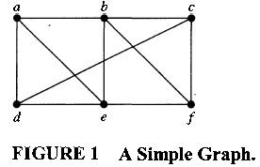
EXAMPLE 1
In the simple graph shown in Figure 1 ,
a,d,c,f,e is a ----------------------- of length .
d,e,c,a is ------------------
b, c, f, e, b is a --------------------- of length .
a, b, e, d, a, b, is ------------------ of length .

Slide 28
DEFINITION 2
Let n be a nonnegative integer and G a directed graph.
A path of length n from u to v in G is a sequence of edges e₁,e₂,..,e_{n} of G such that e₁ is associated with (x₀ ,x₁ ), e₂ is associated with (x₁, x₂), and so on, with e_{n} associated with (x_{n-1},x_{n}), where x₀ = u and x_{n} = v.
When there are no multiple edges in the directed graph, this path is denoted by its vertex sequence x₀ , x₁ , x₂ , …, x_{n} .
A path of length greater than zero that begins and ends at the same vertex is called a circuit or cycle.
A path or circuit is called simple if it does not contain the same edge more than once.

Slide 29
Connectedness In Undirected Graphs
DEFINITION 3
An undirected graph is called connected if there is a path between every pair of distinct vertices of the graph.

Slide 30
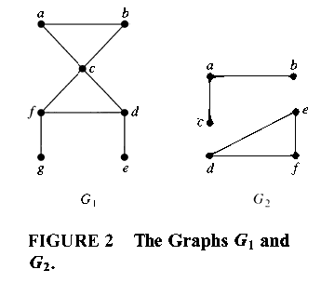
EXAMPLE 5
The Figure 2( graph G₁ , G₂ ) are connected

Slide 31
Homework
Page 629
1(a,b,c,d)
3

