Slide 1
BCH 447- Metabolism:
Marks
5 marks | Conducting the experiment
2 marks | Questions
15 marks | Report
13 marks | Quiz
Practical 15 Theoretical 10 | Midterm
Practical 25 Theoretical 15 | Final
Total marks= 100 marks
Mid term date: Wed 9/2/1438- 9/11/2017
Final date: Wed 22/3/1438-21/12/2017

Slide 2
Glycogen Isolation

Slide 3
- Objective:
To illustrate the method for isolating glycogen.

Slide 4
- Introduction:
Glycogen is the storage form of glucose in animals and human which is analogous to the starch in plants.
Glycogen is synthesized and stored mainly in liver and muscles.
The concentration of glycogen is higher in the liver than in muscle.
Various samples of glycogen have been measured at 1,700-600,000 units of glucose.
It is a very large, branched polymer of glucose residues that can be broken down to yield glucose molecules when energy is needed.

Slide 5
Structure of glycogen
In this structure of two outer branches of a glycogen molecule, the residues at the non reducing ends are shown in red and residue that starts a branch is shown in green. The rest of the glycogen molecule is represented by R.

Slide 6
- Principle of the experiment:
Liver grounded with TCA solution
Proteins and nucleic acids are precipitated
Glycogen remain in solution ( supernatant) with other water soluble substances
Glycogen is separated by precipitation with alcohol, polysaccharides are less soluble than sugars in aqueous alcohol.

Slide 7
- Why does the body store glycogen?
Glycogen is an important fuel reserve for several reasons.
The breakdown of glycogen and release of glucose increase the amount of glucose that is available between meals.
Hence, glycogen serves as a buffer to maintain blood-glucose levels.
Glycogen's role in maintaining blood-glucose levels is especially important because glucose is virtually the only fuel used by the brain, except during prolonged starvation.
Moreover, the glucose from glycogen is readily metabolized and is therefore a good source of energy for sudden activity.

Slide 8
Unlike fatty acids, the released glucose can provide energy in the absence of oxygen and can thus supply energy for anaerobic activity.

Slide 9
Isolation of glycogen ( part I)

Slide 10
- Procedure:
1. Weigh about 5.0 g of cold liver quickly to the nearest 0.1 g, transfer to a mortar, cut into small pieces, grind with about 0.5 g of clean cold sand and 10%TCA (1 ml per g tissue).
2. Centrifuge homogenate at 3,000 rpm for 5min at 4 ᵒC. Pour off supernatant into a 50 ml graduated cylinder.
3. Rinse out mortar with 5% TCA (using same volume as for 10% TCA already used). Add this rinsing fluid to the centrifuge tubes containing residue from first centrifugation. Stir up residue and re-centrifuge for another 5 min. at 3,000 rpm. Discard pellet. Add supernatant to that already collected.

Slide 11
4. Record total volume; add the equal volume of 95% ethanol, slowly with stirring, to supernatant. Allow to stand while precipitate settles. If it does not, add a little NaCl and warm cylinder in water bath at 37º C.
5. Centrifuge suspension at 3,000 rpm for 3 min. Discard supernatant. Dissolve pellet in centrifuge tubes in 5 ml water and re-precipitate by adding 10 ml of 95% ethanol. Re-centrifuge and discard supernatant.
6. Stir up pellet with 3 ml 95% ethanol, re-centrifuge and discard
supernatant. Now add 3 ml diethyl ether, stir up pellet, re-centrifuge and discard supernatant. This final pellet contains glycogen from the liver. Air -dry the glycogen in the tube and weight it.
7. Dissolve 32 mg glycogen in 4 ml phosphate buffer/NaCl.

Slide 12
** Measure the glycogen content by measure the empty centrifuge tube and measure the centrifuge tube that contain pellet .
Glycogen content (g) =
centrifuge tube that contain pellet - empty Centrifuge tube

Slide 13
Result:
Record total yield and glycogen content per 100 g liver.
Example:
Liver weight 10 g
The glycogen content 1.5 g
** the glycogen yield was 1.5 g
** the glycogen content per 100 g is
1.5 g 10 g liver
??g 100 g liver
= 1.5 X 100 / 10
= 15 g /100 g liver

Slide 14
Method:
1) Make glycogen solution :
Dissolve glycogen pellet in phosphate buffer
(32mg glycogen in 4 ml phosphate buffer)
- Example:
I have 3.52 g glycogen ??
A- 3.52g X 1000 = 3520 mg
B- 32mg 4 ml
3520mg ??? ml

Slide 15
Notes:
[1] In initial stage of isolation glycogen the Temperature should be decrease (Cold) and the PH low : because these condition important to inhibit the enzymatic hydrolysis of glycogen ( to protect the glycogen structure and getting good yield)
[2] The animal should be well fed to get more glycogen yield and prevent any stress for animal to prevent the consuming of glycogen .
[3] The roles of Trichloracetic acid (TCA) to precipitate large mol. And lower PH .
[4] Ethanol to precipitate glycogen.

Slide 16
Glycogen storage disease
Glycogen storage disease (GSD) type I is also known as von Gierke disease. von Gierke described the first patient with GSD type I in 1929.
In 1952, Cori and Cori demonstrated that glucose-6-phosphatase (G6Pase) deficiency was a cause of GSD type I.

Slide 17
Glycogen storage disease
A glycogen storage disease (GSD) is the result of an enzyme defect. These enzymes normally catalyze reactions that convert glycogen compounds to glucose.
Enzyme deficiency results in glycogen accumulation in tissues..
Most patients experience muscle symptoms, such as weakness and cramps, although certain GSDs manifest as specific syndromes, such as hypoglycemic seizures or cardiomegaly.

Slide 18
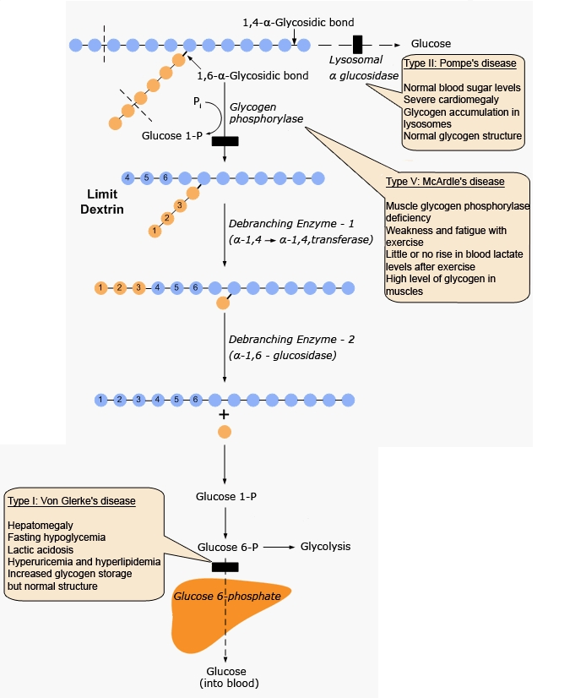
Glucose -6-phosphatase
defiency

Slide 19
Thank you

