Slide 1
Giardia lamblia
By : T. Moudy Bin Saleh

Slide 2
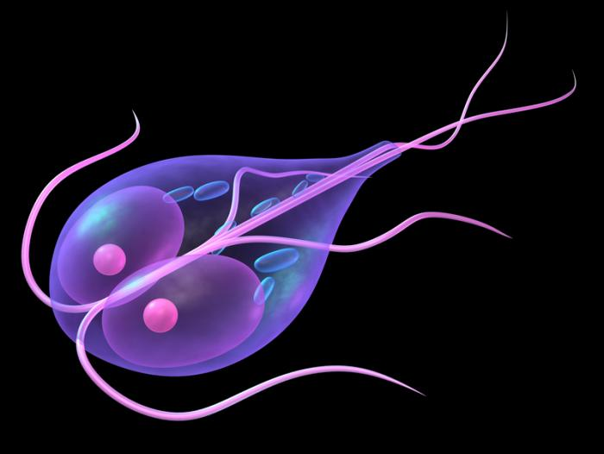
In general
Giardia lamblia, also known as Giardia intestinalis, is a flagellated parasitic microorganism, that colonizes and reproduces in the small intestine, causing giardiasis.
the parasite attaches to the epithelium by a ventral adhesive disc or sucker, and reproduces via binary fission.
Giardia infects humans, but it is also one of the most common parasites infecting cats, dogs and birds. Mammalian hosts also include dozens of species.

Slide 3
Scientific classification
Phylum: | Metamonada
Order: | Diplomonadida
Family: | Hexamitidae
Subfamily: | Giardiinae
Genus: | Giardia
Species : | G. Lamblia G. Intestinalis

Slide 4
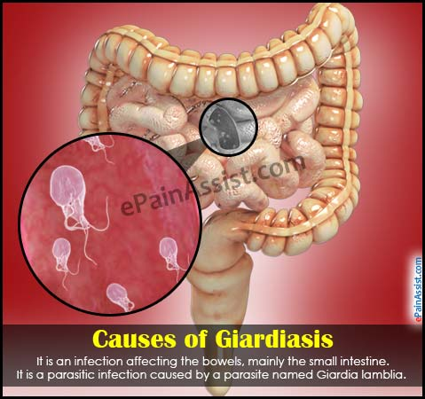
Giardiasis
It is a zoonotic disease popularly known as beaver fever.
About 10% of those infected have no symptoms. They may, however, still spread the disease.
When symptoms occur they may include diarrhea, abdominal pain, and weight loss.
it is one of the most common parasitic human diseases globally . In 2013, there were about 280 million people worldwide with symptomatic giardiasis.

Slide 5
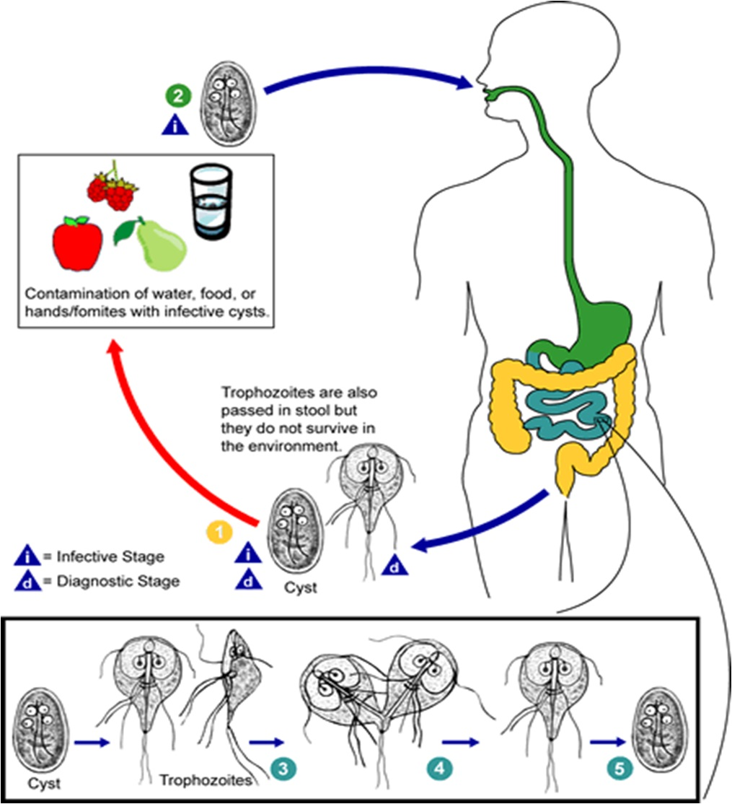
Life cycle

Slide 6
Risk factors
According to the researches , "Those at greatest risk are travelers to countries where giardiasis is common, people in child care settings, those who are in close contact with someone who has the disease.
n the United States, giardiasis occurs more often during the summer. This is believed to be due to a greater amount of time spent on outdoor activities and traveling in the wilderness.

Slide 7
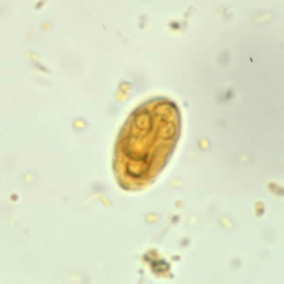
Cysts
Giardia cysts are oval to ellipsoid and measure 8-19 µm (average 10-14 µm). Mature cysts have 4 nuclei, while immature cysts have two. Nuclei and fibrils are visible in iodine-stained wet mounts.
Giardia cysts in a wet mount stained with iodine.

Slide 8
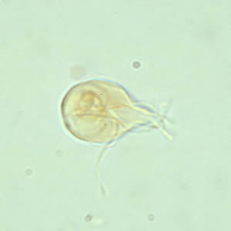
Trophozoites
Giardia trophozoites are pear-shaped and measure 10-20 micrometers in length. In permanent, stained specimens, 2 large nuclei are usually visible. The sucking disks (used for attaching to the host’s mucosal epithelium), median bodies, and flagella (8) may also be seen.
Giardia trophozoite in a wet mount stained with iodine.

Slide 9
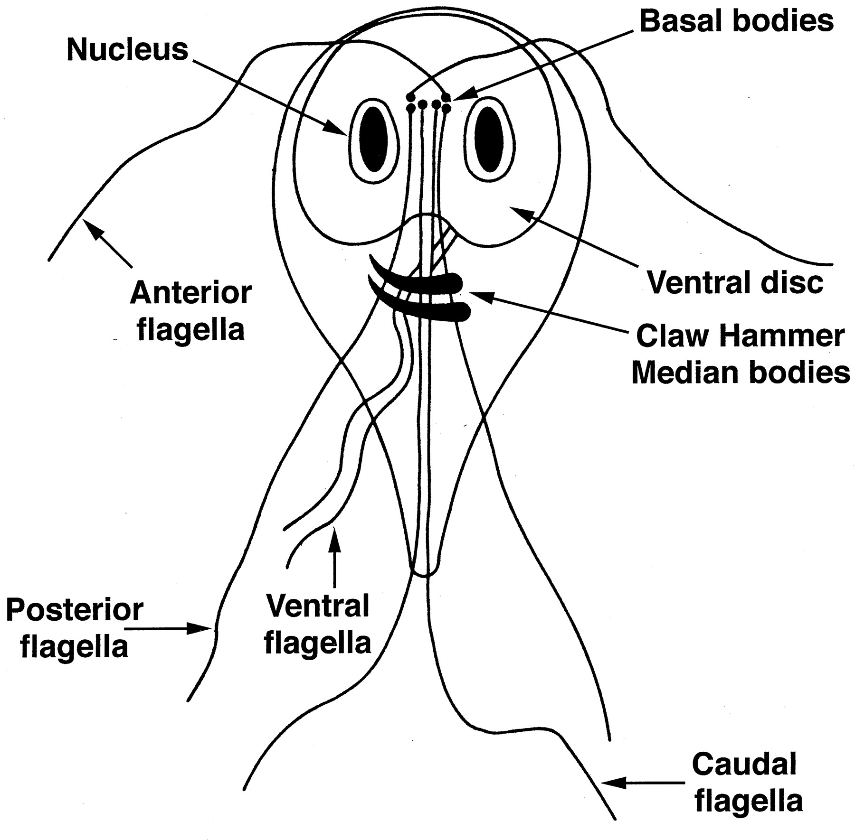
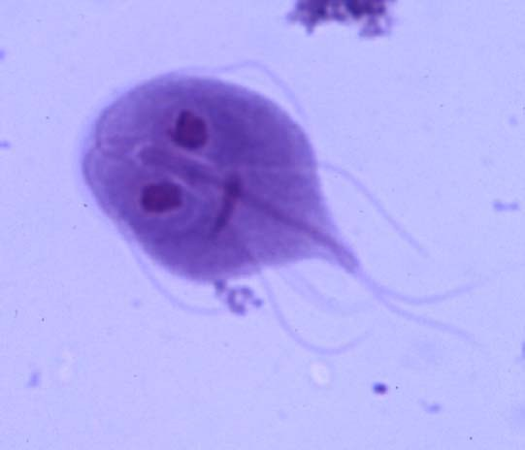
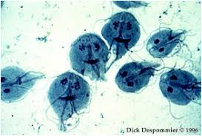
Under a normal compound light microscope, Giardia often looks like a "clown face“ , with two nuclei outlined by adhesive discs above dark median bodies that form the "mouth".

Slide 10
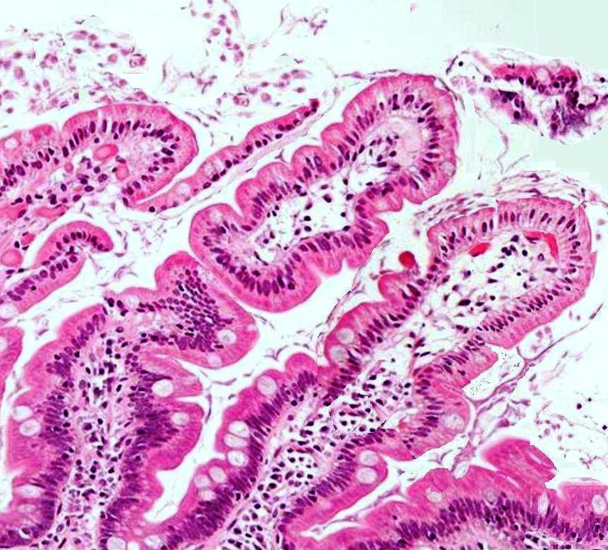
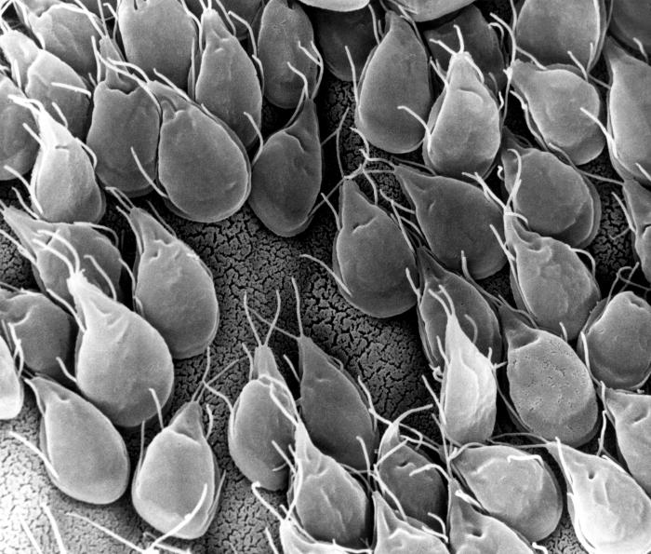
An SEM micrograph of the small intestine of a gerbil infested with Giardia reveals a mucosa surface almost entirely obscured by attached trophozoites.
The Giardia trophozoites between the cells (H & E 400x).

