Slide 1
Technical Reserves: A Practical Role for Actuaries
Ghazi Naceur
King Saud University
08 February 2017

Slide 2
Plan
General Concept
Technical Reserving for a (Re)insurance Company
Case Study

Slide 3
General Concept
  What is Reserving ?
  Claims reserves
  Premium reserves
  Statistical Data
  Case Study , Motor LOB

Slide 4
1. What is reserving ?
The inversion of cycle of production is characteristic of the insurance industry, in fact the (Re)insurance companies receives the premium before paying the claims (losses).
The aim of the insurance activity is to pay large amounts of losses to the insured, it usually happen that the premiums collected are not enough to cover the future claims cost.
In this context insurance/reinsurance companies has to keep a certain amount of the received premium untouched and reserve it for future payments of incurred claims.
There is two types of reserves :
  Claims reserves
  Premium reserves

Slide 5
2. Claims Reserves
2.1 Definition
The claims reserves are the amount of future payments (including expenses) related to claims that have occurred up to the valuation date.
2.2 Components of claim reserves
Outstanding claims amount that is known/reported.
Incurred But Not Reported (IBYNR) - losses that have occurred but not yet known/reported.
Incurred But Not Enough Reported (IBNER) - further development on known claims due inadequate case reserves or claims deterioration.
IBNYR and IBNER are usually combined under the name of IBNR and are estimated by Actuaries.

Slide 6
3. Premium Reserves
3.1 Definition
The premium reserves are the amount premium that should be allocated to the unexpired period of time up to valuation date ( accounting closing date) .
3.2 Components of premium reserves
Unearned premium reserves (UPR) - premiums that are set aside due to the corresponding period of contract cover has not yet lapsed.
Premium Deficiency Reserves (PDR) - is the reserve required to recognize the inadequacy of pricing and underestimation of the losses amount up to a valuation date.

Slide 7
4. Statistical data ( information)
4.1 Why do we need statistics and data?
Determine expected loss ratio and claims distribution.
Analyze claims development pattern /trends over the time.
Combine homogenous data that provides size and credibility for Actuarial analysis.
4.2 Types of information and statistical data
Historical losses and premium data – for long term , data will organized in triangles.
Current data - budget, business plan, profitability analysis.
Data about future - EPI, pipelines, late notifications, claims management.

Slide 8
4. Statistical data (Type & Mix)
Possible breakdown structure of the data
Line of business
Underwriting Year
Facultative VS treaty for reinsurance companies
Geographical regions (e.g. countries)
Attritional loss vs Large/CAT loss
Structure depends on data credibility and portfolio mix

Slide 9
4. Statistical data (Methods)
You are about to make a journey on the train that lasts 10 stations
Before you depart you are told that it will take 2 minutes to travel between stations
You set off…
…. And after 10 minutes you’ve only gone 2 stations
How long do you think your whole journey will take?
Possible Solutions :
Ignore any development
Ignore any prior knowledge & assume the new trend will continue
Use actual development and prior knowledge of the future
-> Bornhuetter Ferguson estimates of 26 minutes
= 10 + 8 x 2
= Actual to date + Expected Future
= (50 x 2/10) + (20 x 8/10)
= DFM x %Developed + Prior x (1 - % Developed)

Slide 10
5. Case Study : Motor LOB
A simple reserving exercise for Motor Class.
Reserving exercise performed as at financial year end.
Actual data used.
No breakdown; combination of treaty and facultative for all regions.

Slide 11
Case Study : Motor LOB
Gross Premiums

Slide 12
Case Study : Motor LOB
Claims triangle

Slide 13
Case Study : Motor LOB
Claims triangle

Slide 14
Case Study : Motor LOB
Chain ladder Method
For each UWY, development factor from time t-1 to t = claim incurred at time t / claim incurred at time t-1
= 6,884,371 / 6,444,862

Slide 15
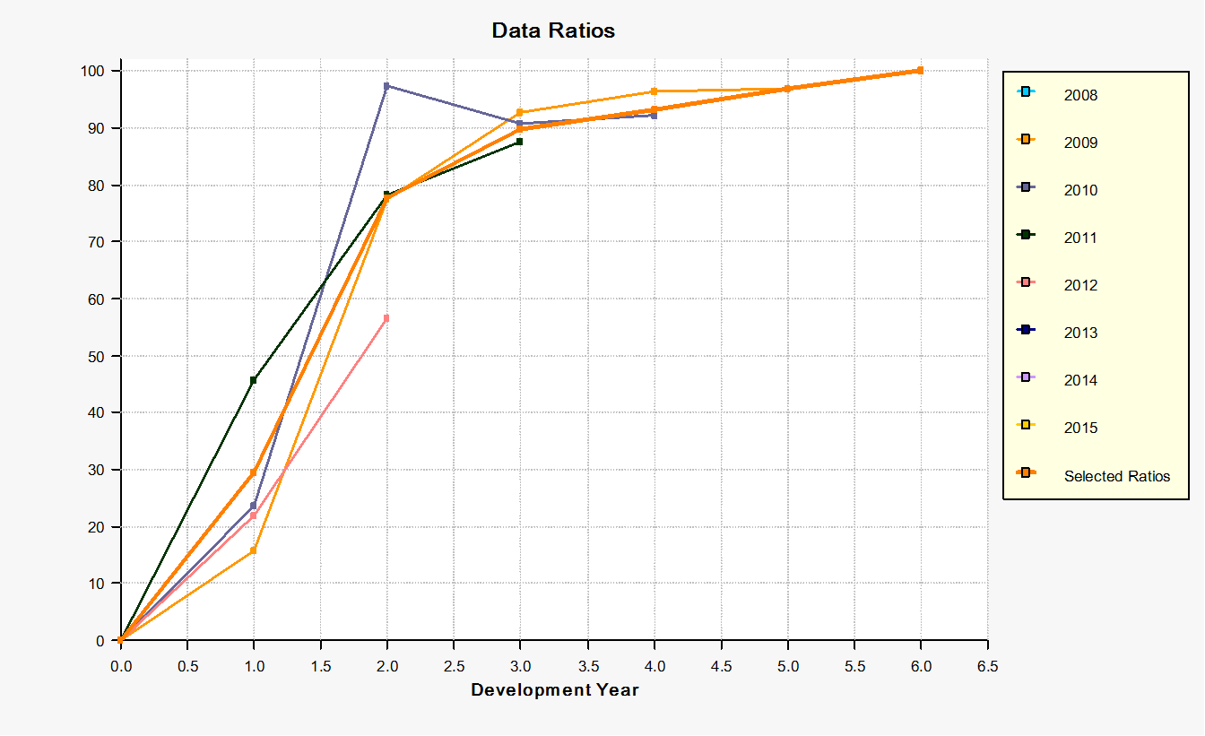
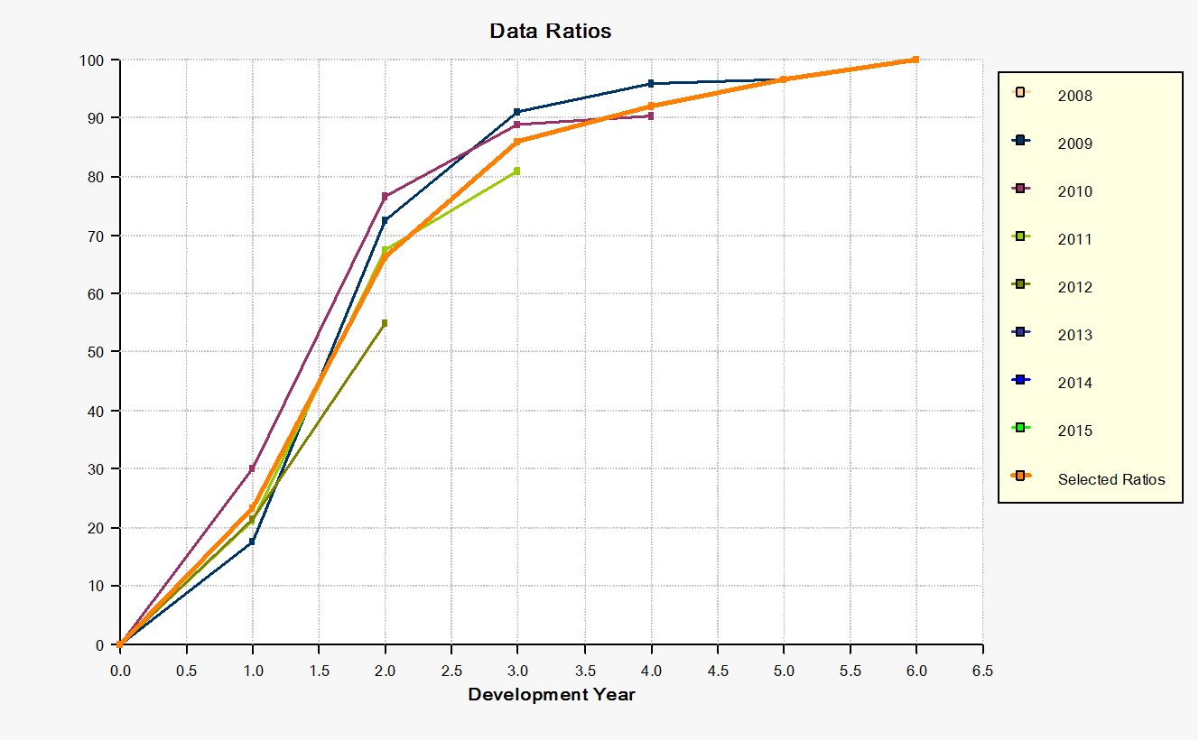
Case Study : Motor LOB
Chain ladder Method
% Reported – No split % Reported – Attritional

Slide 16
Case Study : Motor LOB
Ultimate Claims Selection

Slide 17
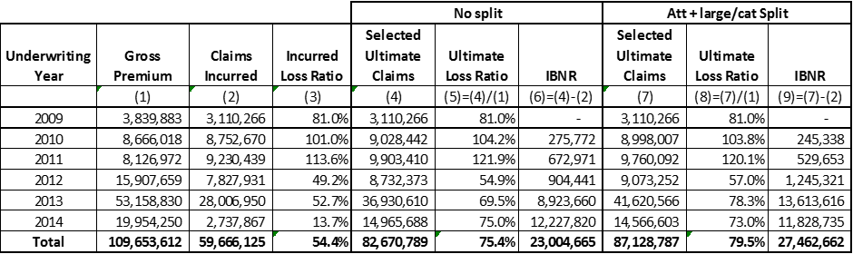
Case Study : Motor LOB
Results Year End

Slide 18
Any Questions
Thank you

