Slide 1
I
nstall Fonts in Photoshop

Slide 2
INSTALL FONTS: I present to you the strongest and rarest English and Arabic fonts group, they are carefully selected by me, I personally used in my designs own. This group includes all kinds of lines, including 57 lines, between traditional and modern lines. This collection contains most famous lines, including GE SS lines, Hacen lines, and Elgethy Est and more .. In case you want to download them, download it via this link: http://www.mediafire.com/download/2vb9pr4cejr22kl/font_extensions-ps.blogspot.com.RAR

Slide 3
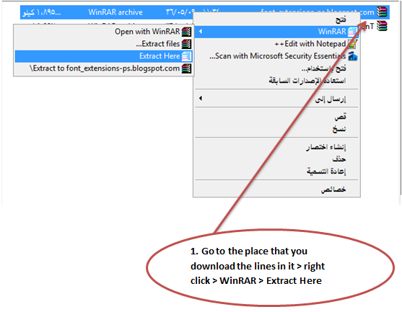
How to install Fonts ?!
After download the lines by the link ..

Slide 4
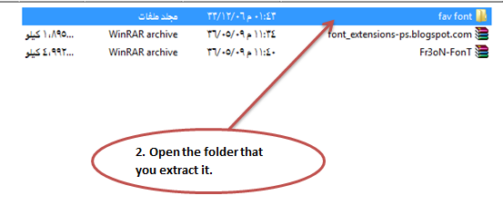

Slide 5
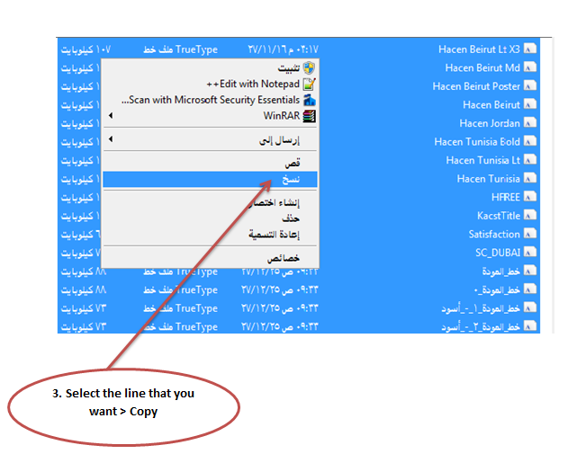

Slide 6
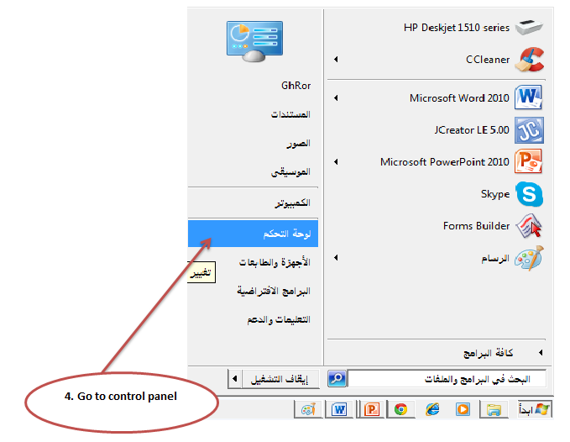

Slide 7
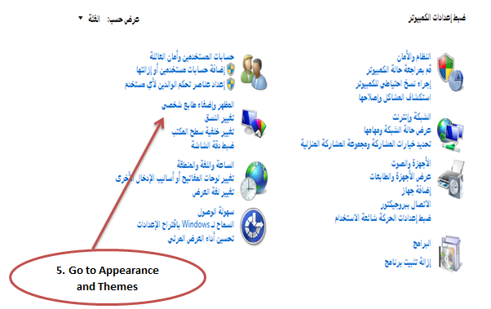

Slide 8
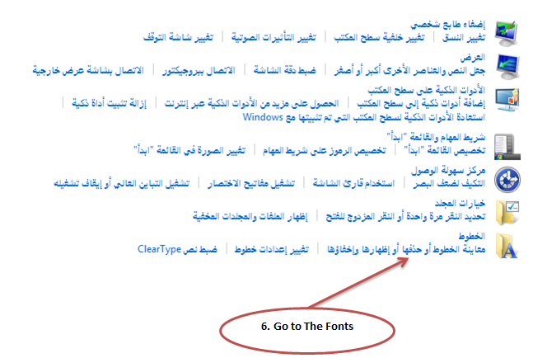

Slide 9
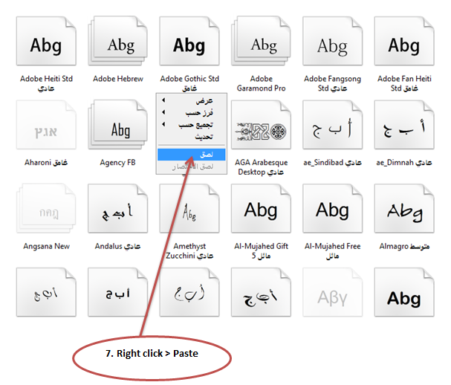

Slide 10
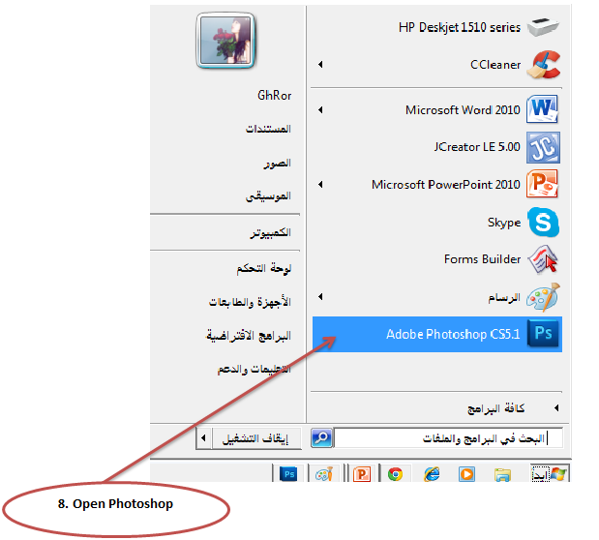
Use the Fonts that I install it
After install the fonts ..

Slide 11
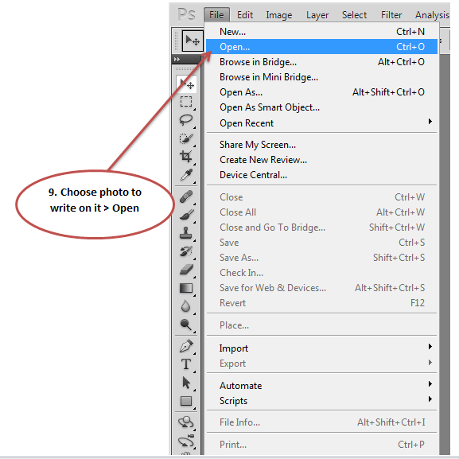

Slide 12
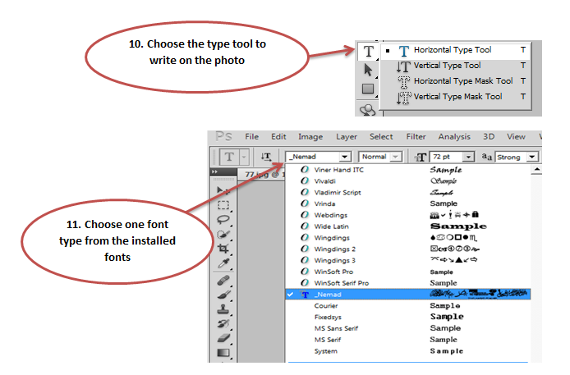

Slide 13
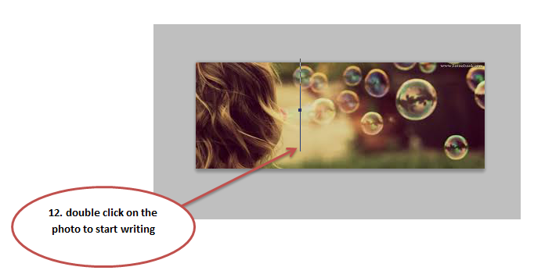

Slide 14
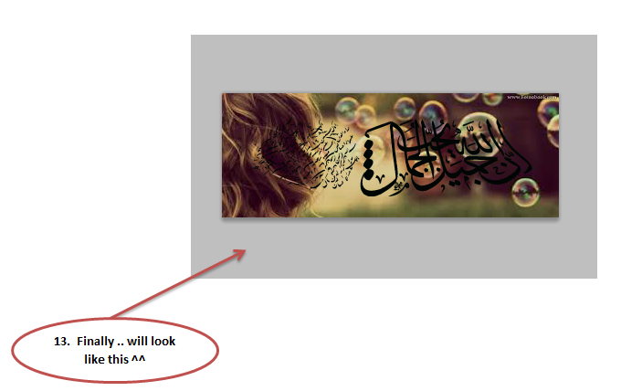

Slide 15
Thank you all for your attention
Please tell me about your opinions
^^

Slide 16
Student Name
432925481 | Ghada Ali Al-Saleam.

