Slide 1
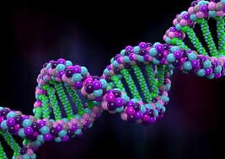
Introduction to Genetic
Prepared by:
Jawahir AL-Ghamdi Nouf khalid AL-Sultan.

Slide 2
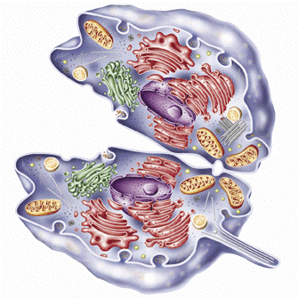
The Cell
Basic component of life.
Two main categories, prokarytic and eukaryotic cells.
Differences in the nucleus.

Slide 3
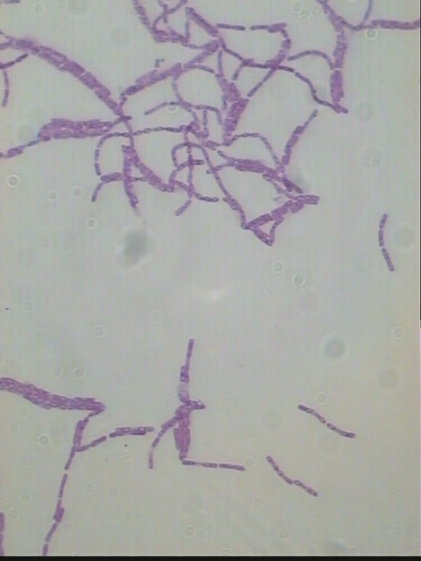
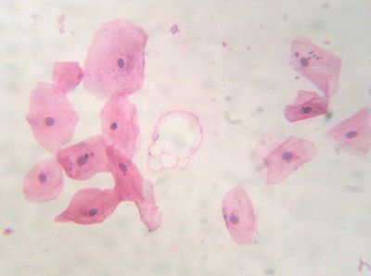
Prokaryotes:
No defined nucleus and a simplified
internal structure.
Eukaryotes:
Membrane limited nucleus and complicated internal structure.
Bacillus
Squamous epithelium
top view

Slide 4
Cell types
Two major types of cells are known according to the arrangement of the genetic material and the contents of the cytoplasm.
Prokaryotes
Eukaryotes
Pro=before, karyon=nucleus
Eu=true, karyon=nucleus
nucleus
Present
Not present
The region where the DNA is found is known as the nucleiod.
DNA is associated with proteins in a complex structure known as the chromatin.

Slide 5
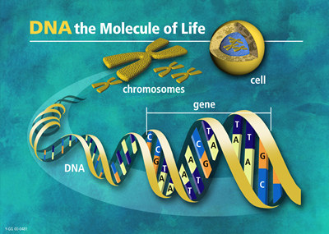
Genetic material is located in nucleus.
The genetic information is stored in Deoxyribonucleic acid, DNA.
DNA contains the information needed to build an individual.

Slide 6
What is genetics?
“Genetics is the study of heredity, the process in which a parent passes certain genes on to their children.
Notes:
Conduct a brief class discussion to assess students’ knowledge and assumptions about genetics, while providing the information to those students who may not have any prior knowledge.

Slide 7
Genetic Terminology
Heredity describes how some traits are passed from parents to their children.
The traits are expressed by genes, which are small sections of DNA that are coded for specific traits.
Genes are found on chromosomes.
Humans have two sets of 23 chromosomes one set from each parent.
Notes:
Have students volunteer their answers, and help students understand that the inherited traits are passed from one generation to the next as the parents’ chromosomes are copied and passed to their children.

Slide 8
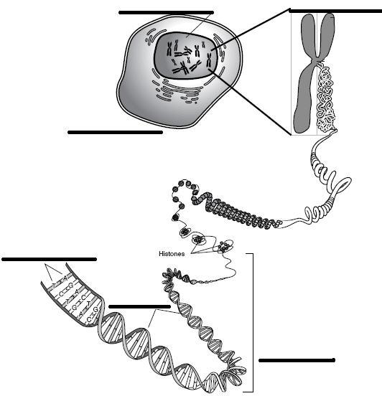
Genetic terms
Genetic Terminology
nucleus
chromosome
Cell
Nucleus
Chromosome
DNA (Deoxyribonucleic Acid) Double helix*
Genes
Base pair
cell
base pair
(double helix)
DNA
genes
Notes:
Have students volunteer the answers and clarify that “double helix” is the structure of DNA.

Slide 9
Chromosome
All living organisms consist of cells.
In each cell there is chromosomes.
Chromosomes are strings of DNA.
Chromosome consists of genes, blocks of DNA.
Each gene encodes a particular protein.

Slide 10
Chromosome
Genetic Terminology
Each gene has its own position in the chromosome.
This position is called locus.
Complete set of genetic material (all chromosomes(Ex. In human’s cell is 46)) is called genome.
Particular set of genes in genome is called genotype. Genotype – the genetic makeup of an organisms.
phenotype, its physical and mental features, such as eye color, intelligence etc.

Slide 11
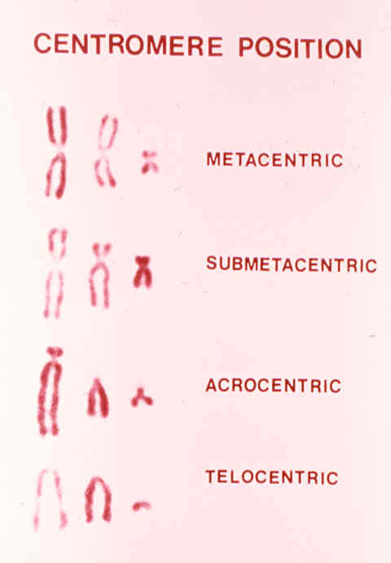
Chromosome structure
Chromosomes can vary considerably in size and shape
-Various features used for identification
Size, Centromere location, Banding patterns.
-Centromere location differs between chromosomes.
At the middle in a metacentric chromosome.
Near the middle in a submetacentric chromosome.
Near an end in an acrocentric chromosome.
At an end in a telocentric chromosome.

Slide 12
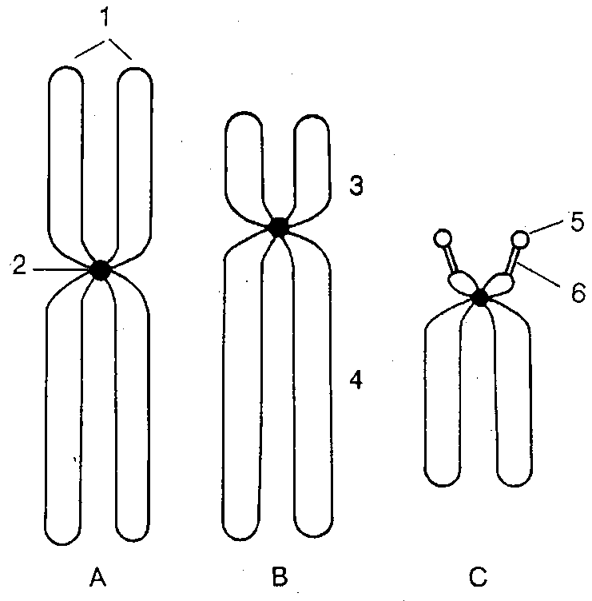
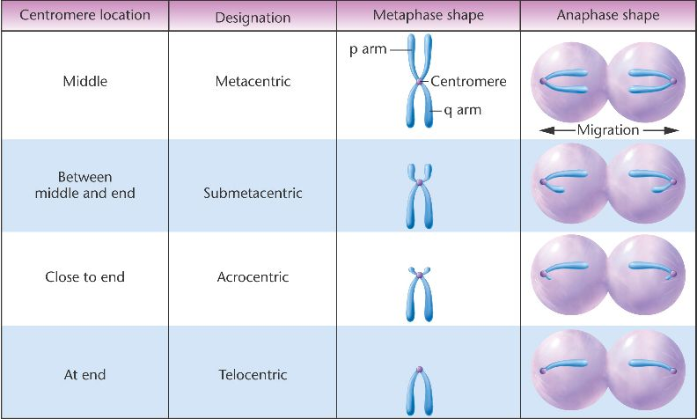
Shapes of chromosomes
1: Sister chromatids.
2: Centromere.
3:Short arm.
4: Long arm.
5: Satellite.
6: Secondary constriction.
A: metacentric, B: submetacentric, C: acrocentric

