Slide 1
ENGINEERING MANAGEMENT (GE 404)
بسم الله الرحمن الرحيم
Lecture #9
Project Management Organizational Structures
Notes:
This is a title slide.

Slide 2
Contents
Objectives of the Present Lecture
The Project Organization Structure
Types of Project Organizations Structures
Main Project Participants
Structures of Contractual Relationship between the Project Participants
Further Reading

Slide 3
Objectives of the Present lecture
To learn the ways through which organizational structure are defined
To explain the popular structures of contractual relationship between the project participants

Slide 4
The Project Organization Structure
One of the important decisions of project management is the form of organizations structure that will be used for the project.
A project organization is a structure that facilitates the coordination and implementation of project activities.
The structure defines the relationships among members of the project management and the relationships with the external environment.
The structure defines the authority by means of a graphical illustration called an organization chart.

Slide 5
Project Organization Chart
QHSE (Quality, Health, Safety, Environment): Four components of a responsible corporate management approach based on the belief that all accidents are caused by human error and are, therefore, preventable with better training and administration.

Slide 6
Objective of Project Organization
The main objective of Project organization is to establish the relationship among:
The work to be done
The people doing the work
The work place(s)

Slide 7
Defining the Organization
Within the firm
Involves internal organization of personnel
With other firms
Number of organizations involved
Relationship between the organizations
When each organization be involved in the project

Slide 8
Types of Project Organization Structures
Functional
Personnel organized by FUNCTION, i.e. electronics, software, operations, etc.
Project
Personnel organized by Projects, i.e. Ka Band receiver, Spectrometer, etc.
Matrix Organization
Personnel organized in BOTH ways

Slide 9
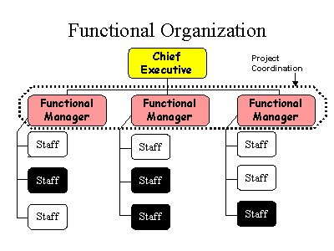
Functional Organization
Functional organization is a hierarchical organization where each employee has one clear superior, and staff are grouped by areas of specialization and managed by a person with expertise in that area
Black boxes indicate staff engaged in project activities

Slide 10
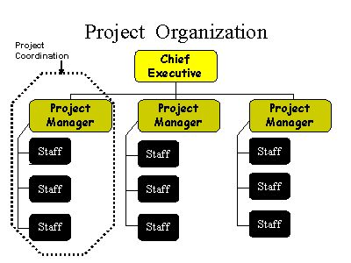
Project Organization
Project organization is any organizational structure in which the project manager has full authority to assign priorities, apply resources, and direct the work of persons assigned to the project.
Black boxes indicate staff engaged in project activities

Slide 11
A sample project organization
President
Human
Resources
Marketing
Finance
Design
Quality
Mgt
Production
Project 1
Project
Manager
Mechanical
Engineer
Test
Engineer
Technician
Project 2
Project
Manager
Electrical
Engineer
Computer Engineer
Technician

Slide 12
“Project organization” works best when
Work can be defined with a specific goal and deadline
The job is unique or somewhat unfamiliar to the existing organization
The work contains complex interrelated tasks requiring specialized skills
The project is temporary but critical to the organization
The project cuts across organizational lines

Slide 13
Characteristics of Project Organization
Often temporary structure
Uses specialists from entire company
Headed by project manager
Coordinates activities
Monitors schedule and costs

Slide 14
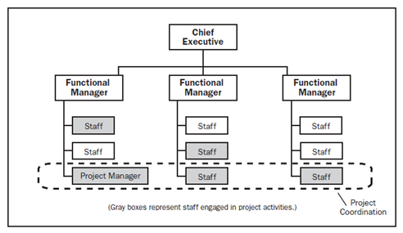
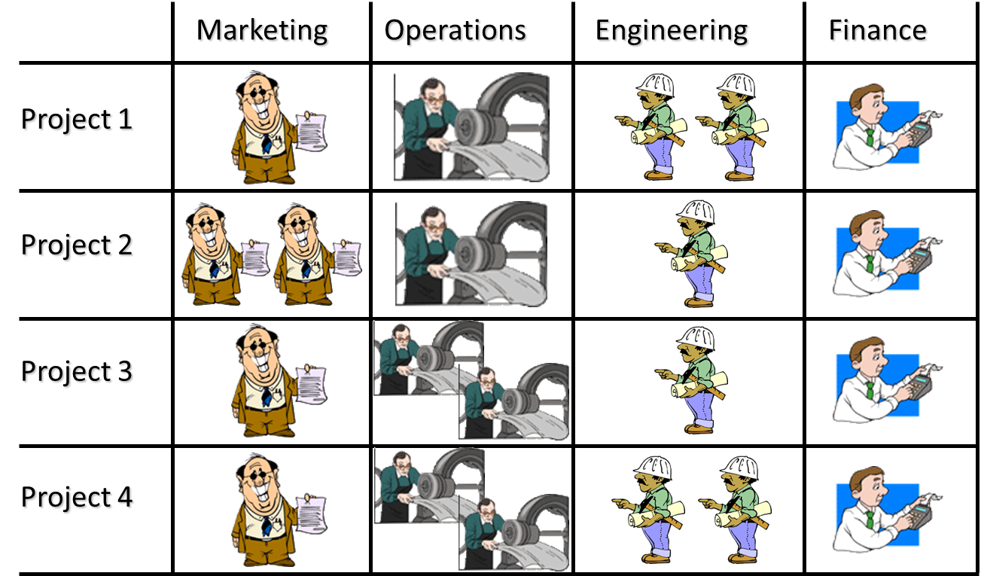
Matrix Organization
Matrix organization is any organizational structure in which the project manager shares responsibility with the functional managers for assigning priorities and for directing the work of persons assigned to the project
Each staff member is a member of 2 distinct organizations
Functional – Electronics, SDD, etc.
Project – PTCS, Ka Band Receiver, etc.

Slide 15
Types of Matrix Organization
Strong Matrix
Weak Matrix
Balanced Matrix

Slide 16
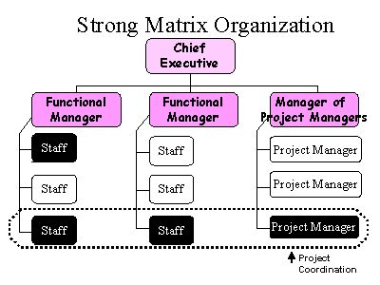
Strong Matrix Organization
Black boxes indicate staff engaged in project activities

Slide 17
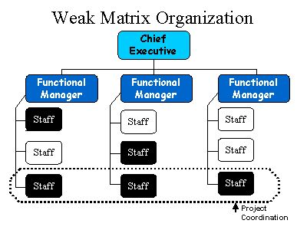
Weak Matrix Organization
Black boxes indicate staff engaged in project activities

Slide 18
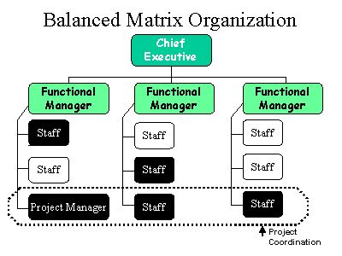
Balanced Matrix Organization
Black boxes indicate staff engaged in project activities

Slide 19
Balanced Matrix versus Strong Matrix Organization
Black boxes indicate staff engaged in project activities

Slide 20
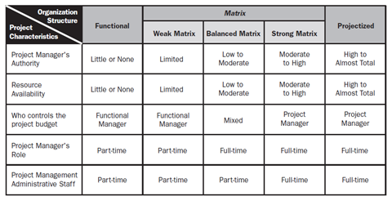
Summary

Slide 21
Main Project Participants
The Owner
Construction manager
The Contractor
General and subcontractors,
Material and equipment supplier
The Designer
Consultant and architecture/engineer (A/E)

Slide 22
Structures of Contractual Relationship between the Project Participants
Four principal structures of contractual relationship exist between the project participants:
Traditional
Owner-Builder
Turnkey
Professional Construction Manager

Slide 23
Traditional
This is employed for ordinary projects of moderate size and complexity.
In this, the owner often employs a designer (an architectural/engineering or A/E firm) which prepares the detailed plans and specifications for the constructor (a general contractor).
The general contractor is responsible for the construction itself even though the work may actually be undertaken by a number of specialty subcontractors.
The designer also acts on behalf of the owner to oversee the project implementation during construction.
Notes:
Oversee: supervise

Slide 24
Advantages and Disadvantages of Traditional Structure
Advantages
Disadvantages
Widely accepted and historically supported.
Using lump-sum the overall cost can be determined before awarding the contract.
Minimal involvement of the owner during construction.
Design-construct time can be reduced using phased construction.
Design may not benefit from construction expertise.
Overall design-construct time is usually the longest.
The owner and the designer are usually in an adversary position with general contractor (maximum vs. minimum quality).
Change orders will often end in disputes and may drive-up costs.

Slide 25
Owner-Builder
In this approach, owner acts as the general contractor on its own project, and is responsible for design and construction.
However, the owner may choose to subcontract a substantial portion of the project to outside consultants and contractors for both design and construction, even though it retains centralized decision making to integrate all efforts in project implementation.
Notes:
An owner-builder is a person who acts as the general contractor on their own project. Believe it or not, you have a legal right to build your own home. Many people believe you have to hire a general contractor for new construction projects, which is a misconception. As the general contractor, you hire the subcontractors, pay the bills, and get materials to the job site. You are responsible for securing all necessary permits, financing, and ultimately, making the project a success.

Slide 26
Advantages and Disadvantages of of Owner-Builder Structure
Advantages
Disadvantages
Justified when the volume of work is relatively large and relatively constant over a period of time.
The owner-builder can employ all techniques of the design-constructor, the professional construction manager, and the traditional approach.
Justified where the project management can be separated from operational management.
Time. Owner-builder structure, in general, requires more time.
Quality Control. Quality is difficult to maintain in such structures.
Getting Finance. Most lenders will not provide construction loans if the builder is an Owner-Builder. There are some very good reasons for this such as most people’s lack of experience, a lack of financial control and the risk that a project will be halted due to family or other personal issues.
Notes:
Projects require project management whereas operations requires business process management or operations management.
Operations Management is an ongoing organisational function that performs activities to produce products or supply services.
Projects are temporary and help the business to meet organisational goals and to respond quickly and easily to the external environment.
Organisations use projects to change operations, products and services to meet business need, gain competitive advantage and respond to new markets.

Slide 27
Turn-key
Some owners wish to delegate all responsibilities of design and construction to outside consultants in a turnkey project arrangement.
A contractor agrees to provide the completed facility on the basis of performance specifications set forth by the owner.
This approach is the direct opposite of the owner-builder approach in which the owner wishes to retain the maximum amount of control for the design-construction process

Slide 28
Advantages and Disadvantages of Turn-key Structure
Advantages
Disadvantages
Only one contract for the owner. Design, construction, and know-how are furnished by a single organization.
Minimal owner coordination -dealing with a single organization.
Appropriate for unknowledgeable owner.
Design-construct time can be reduced through using phased construction.
Construction expertise can be utilized during design phased construction.
Change orders are easy to handle.
Usually cost cannot be determined before construction.
If the project cost is fixed price, the overall quality and performance may be affected to ensure profit.
The owner may not be informed if there is a design or construction problems that may affect the schedule or the cost.

Slide 29
Professional Construction Manager
Professional construction management refers to a project management team consisting of a professional construction manager and other participants who will carry out the tasks of project planning, design and construction in an integrated manner.
A professional construction manager is a firm specialized in the practice of professional construction management which includes:
Work with owner and the A/E firms from the beginning and make recommendations on design improvements, construction technology, schedules and construction economy.
Propose design and construction alternatives if appropriate, and analyze the effects of the alternatives on the project cost and schedule.
Monitor subsequent development of the project
Coordinate procurement of material and equipment and the work of all construction contractors

Slide 31
Advantages of Professional Construction Manager
Advantages
Disadvantages
Special construction skills may be utilized at all stages of the project with no conflicts of interest between the owner and the designer.
Independent evaluation of costs, schedules, and overall construction performance, including similar evaluation for changes or modifications helps assure decisions in the best interest of the owner.
Full-time coordination between design and the construction contractors is available.
Minimum design-construction time can be achieved through use of phased construction.
The professional construction manager approach allows price competition from local contractors akin to the traditional lump-sum or unit-price methods.
Significant opportunities are provided for value engineering in the design, bidding, and award phases.
The most significant disadvantage of many Construction Management contracting arrangements is that significant portions of the total services for which the Construction Manager is remunerated are not subject to competitive bidding.
A second commonly seen disadvantage is the open-ended nature of many Construction Management contractual arrangements, which unnecessarily expose the Owner to the risk of unanticipated cost increases.

Slide 32
Further Reading
Read more about the Project Management Organizational Structures
from:
http://pmbook.ce.cmu.edu/02_Organizing_For_Project_Management.html

Slide 33
Thank You
Questions Please

