Slide 1
Resultants

Slide 2
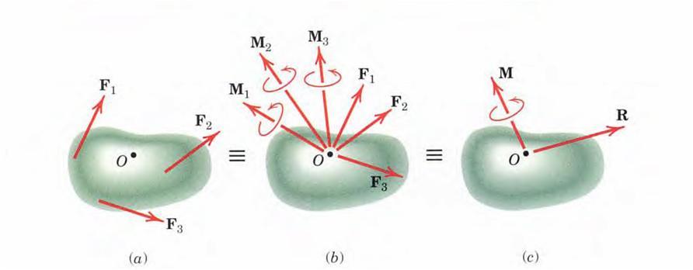
Resultants
In general any system of forces may be replaced by its resultant force R and the resultant couple M without altering the external effects of the system (on the rigid body to which the forces are applied).

Slide 3
Resultant Calculation

Slide 4
Wrench Resultant
When the resultant couple vector M is parallel to the resultant force R, the resultant is said to be a wrench.

Slide 5
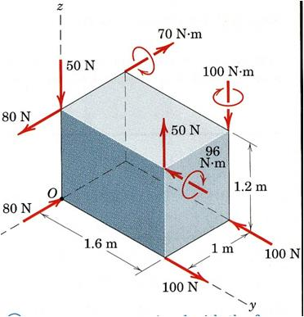
Problem-1
Determine the resultant of the force and couple system which acts on the rectangular solid.
x

Slide 6
Solution
In the present problem CCW moments about x, y, and z-axes will point towards the +ve x, y, and z-axes respectively.
x

Slide 7
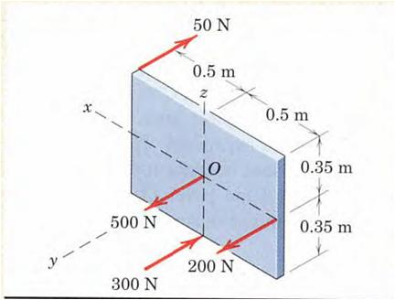
Problem-2
Determine the resultant of the system of parallel forces which act on the plate. Solve using vector approach.

Slide 8
Solution
As all the forces are parallel to y-axis there is no moment about y-axis.

Slide 9
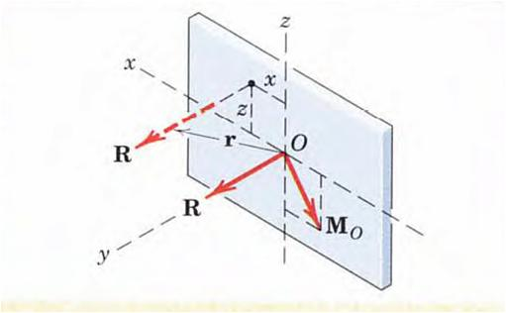
Placement of Single resultant force R
Hence x = -0.357 m, and z = 0.25 m are the coordinates through which the line of action of R must pass. The value of y may, of course, be any value, as permitted by the principle of transmissibility.

Slide 13
