Slide 1
Analysis of truss-Method of Joint

Slide 2
Methods of Analysis
Method of Joints
Method of Sections
The method of section has the basic advantage that the force in almost any desired member may be found directly from an analysis of a section which has cut the member.
In choosing a section of the truss, in general, not more than three members whose forces are unknown may be cut, since there are only three available equilibrium equations which are independent.
The method of joints utilizes the force equations of equilibrium for each joint.
Analysis normally begins at a joint where at least one force is known and not more than two forces are unknown for plane trusses (or not more than three forces are unknown for space trusses)

Slide 3
Problem -1
Compute the forces in all the members of the truss, shown here, using the method of joints.

Slide 4
Support Reactions
Support Reactions

Slide 5
Calculation of the Member forces
Note: For convenience, assume tension in all the members.
Remember! A member in compression “pushes” on the joint and a member in tension “pulls” on the joint.

Slide 6
Calculation of the Member forces
Member Forces
Joint A

Slide 7
Calculation of the Member forces
Member Forces
Joint B

Slide 8
Calculation of the Member forces
Member Forces
Joint C

Slide 9
Member forces
Member | L (m) | Forces (kN) | Nature
AB | 2.4 | 2.0 | Tension
BC | 1.8 | 0.0 | -
CD | 2.4 | 2.0 | Tension
DA | 1.8 | 1.5 | Tension
BD | 3.0 | -2.5 | Compression

Slide 10
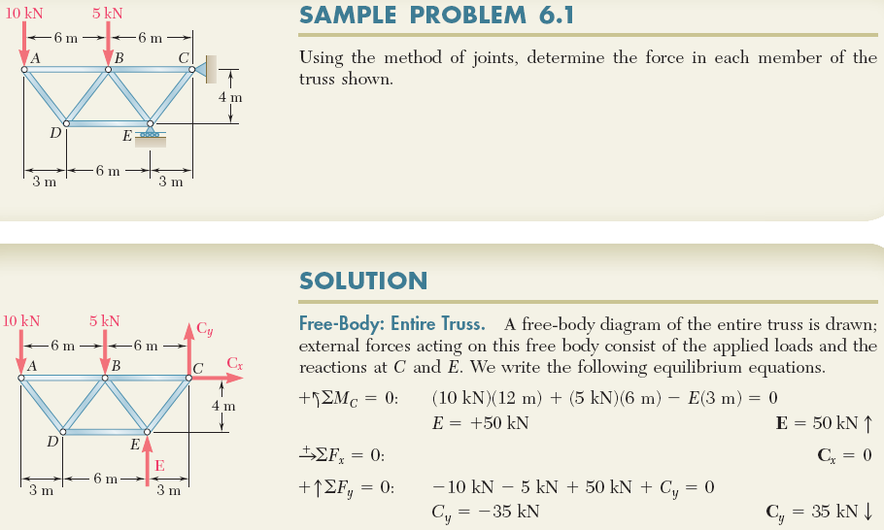
Example 1: Method of Joints – Plane Truss

Slide 11
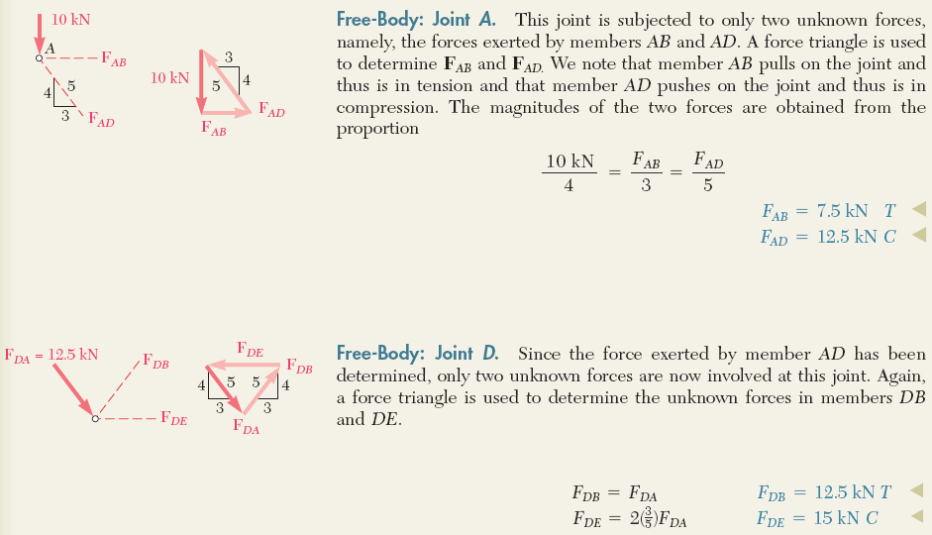
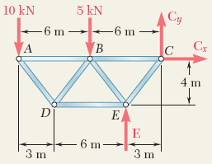
Example 1 (continued):
ENGINEERING MECHANICS : STATICS
Alternatively, ∑F_{x}=0 and ∑F_{y}=0 will give the same results
Alternatively, ∑F_{x}=0 and ∑F_{y}=0 will give the same results

Slide 12
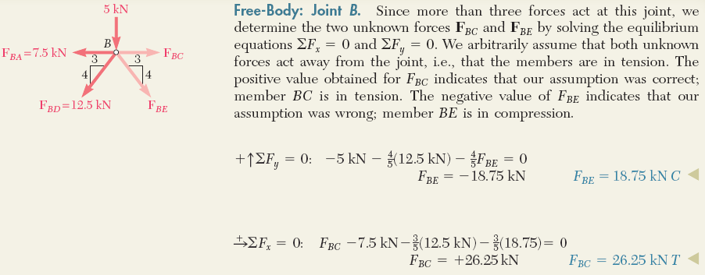
Example 1 (continued):
ENGINEERING MECHANICS : STATICS

Slide 13
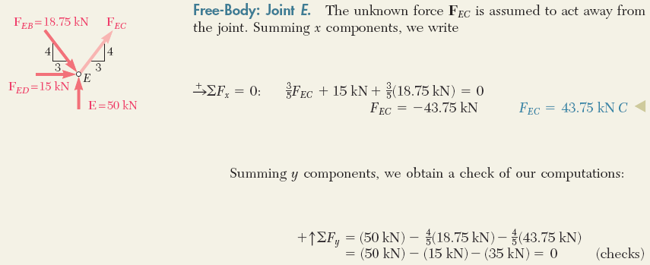
Example 1 (continued):

Slide 14
Zero Force Members
Case 1: If only two non-collinear members form a truss joint and no external load or support reaction is acting at the joint, the members must be zero force members.
BC and CD are zero force members.
WHY ?????

Slide 15
Zero Force Members (Contd.)
Case 2: If there is an external load at the joint, where two members are meeting, and it is acting in the direction of one of the members, another member will be a zero force member.
BC is a zero force members.
WHY ?????

Slide 16
Zero Force Members (Contd.)
Case 3: If three members form a truss joint for which two of the members are collinear, the third member is a zero force member provided no external force or support reaction is acting at the joint.
EF is a zero force member.
WHY ?????

Slide 17
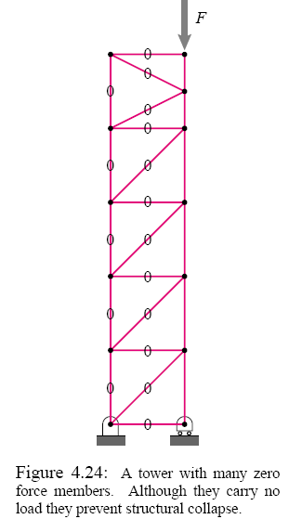
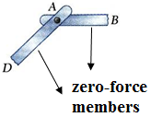
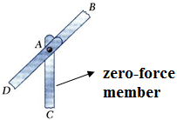
Zero-Force Members
ENGINEERING MECHANICS : STATICS
! Zero-force members are used to increase the stability and rigidity of the truss and to provide support for various loading conditions as well as to support the weight of the truss and to maintain the truss in the desired shape. Although they carry no load, they prevent structural collapse.

Slide 18
Problem-2
Identify zero force members in a truss shown.
Answer: BH and DF are zero force members.

Slide 19
Problem-3
For the truss shown in the Figure, identify all correct zero-force members.
60 kN
J
I
H
G
F
5 m
A
E
C
D
B
40 kN
5 m
5 m
5 m
5 m

Slide 20
Solution
60 kN
J
I
H
G
F
5 m
A
E
C
D
B
40 kN
5 m
5 m
5 m
5 m
AB and AJ are zero-force members.
JB, JI and IH are also zero-force members.
CH is a zero-force member
GD is a zero-force member
ED is a zero-force member

Slide 21
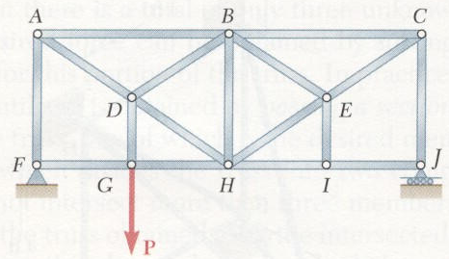
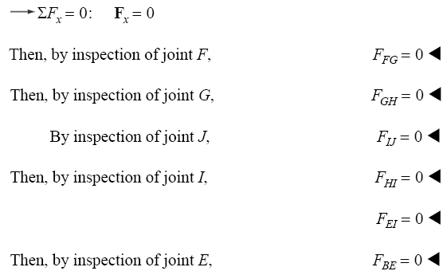
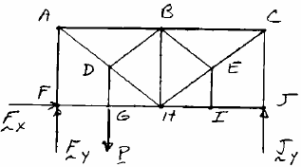
Example 2: Zero-Force Members
For the given loading, determine the zero-force members in the truss shown.

Slide 22
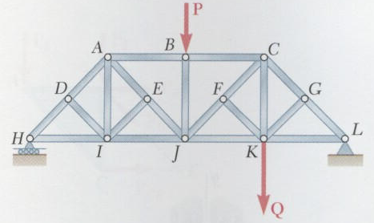
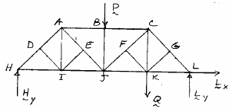
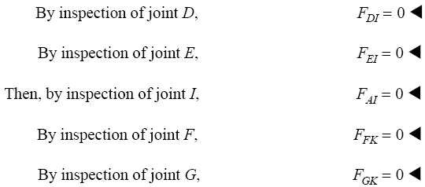
Example 3: Zero-Force Members
For the given loading, determine the zero-force members in the truss shown.

Slide 23
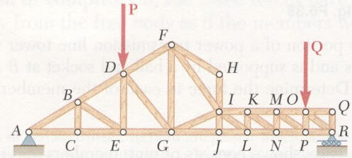
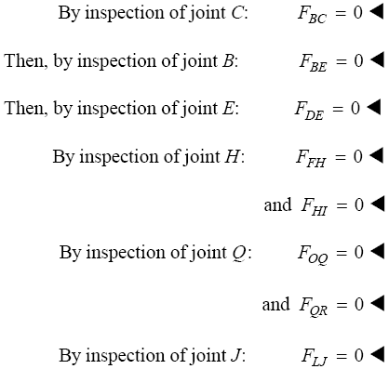
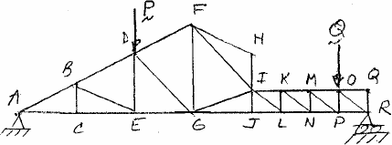
Example 4: Zero-Force Members
For the given loading, determine the zero-force members in the truss shown.

Slide 24
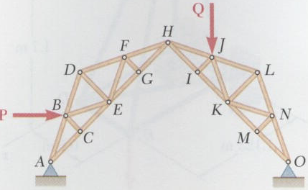
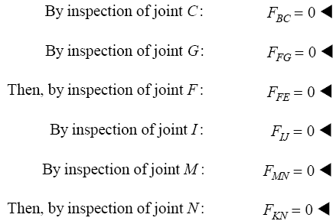
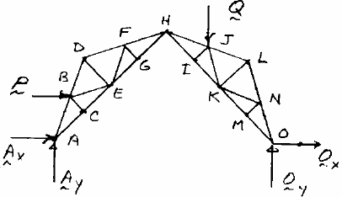
Example 5: Zero-Force Members
For the given loading, determine the zero-force members in the truss shown.

