Slide 1
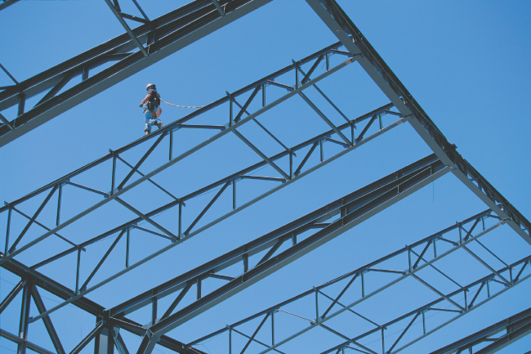
Structures-Trusses

Slide 2
Objectives
To introduce a truss-structure system
To define truss
To demonstrate the types of trusses

Slide 3
Introduction
For the equilibrium of structures which are made up of several connected parts, the internal forces as well the external forces are considered.
In the interaction between connected parts, Newton’s 3rd Law states that the forces of action and reaction between bodies in contact have the same magnitude, same line of action but opposite sense.
Three categories of engineering structures are considered:
  Trusses: formed from two-force members, i.e., straight members with end point connections.
  Frames: contain at least one multi-force member, i.e., member acted upon by 3 or more forces.
  Machines: structures containing moving parts designed to transmit and modify forces.
R_{Ay}
∑F_{x}=0: R_{Ax}=0

Slide 4
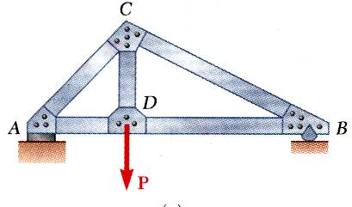
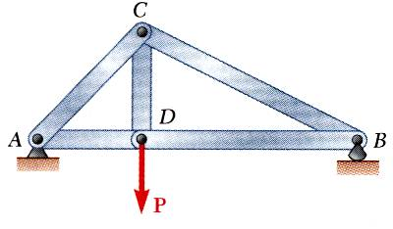
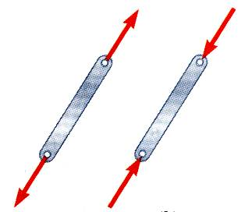
Definition of a Truss
A truss consists of straight members connected at joints. No member is continuous through a joint.
Most structures are made up of several trusses joined together to form a space framework. Each truss carries those loads which act in its plane and may be treated as a two-dimensional structure.
Bolted or welded connections are assumed to be pinned together. Forces acting at the member ends reduce to a single force and no moment. Only two-force members are considered.
When forces tend to pull the member apart, it is in tension. When the forces tend to compress the member, it is in compression.

Slide 5
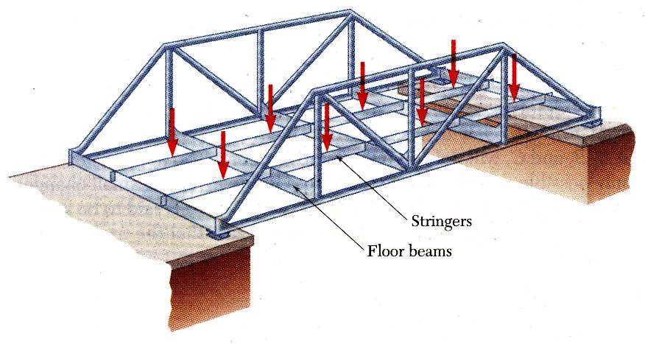
Definition of a Truss
Members of a truss are slender and not capable of supporting large lateral loads. Loads must be applied at the joints of truss.

Slide 6
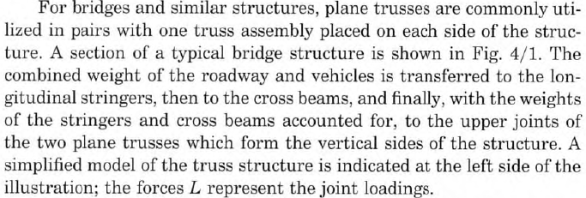
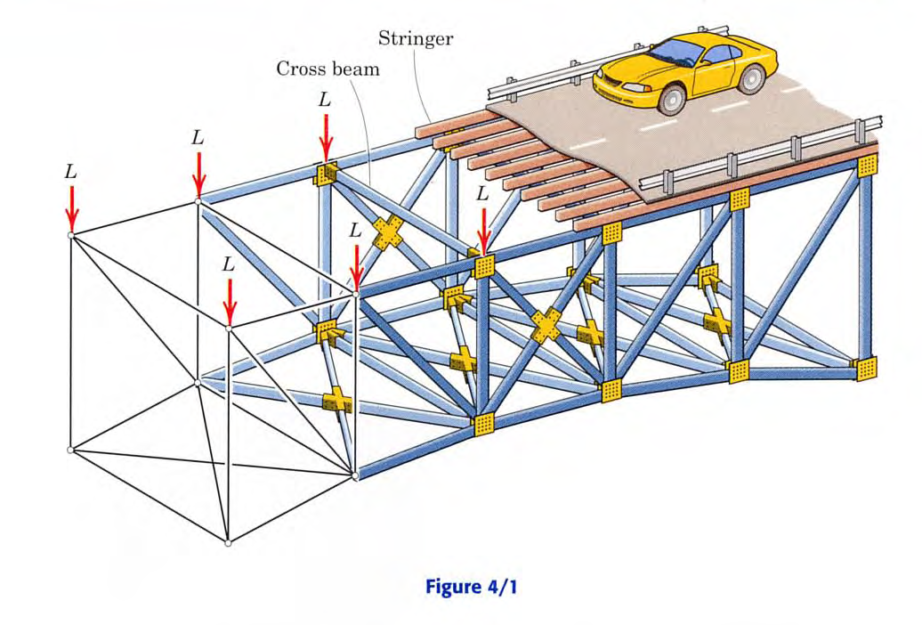
Definition of a Truss
6 - 6

Slide 7
Plane and Space Trusses
Plane Trusses: Plane trusses are composed of members that lie in the same plane and are frequently used for bridge and roof support.
Space Trusses: Space trusses are composed of members that extent in three dimensions and are suitable for derricks (a type of crane) and towers.

Slide 8
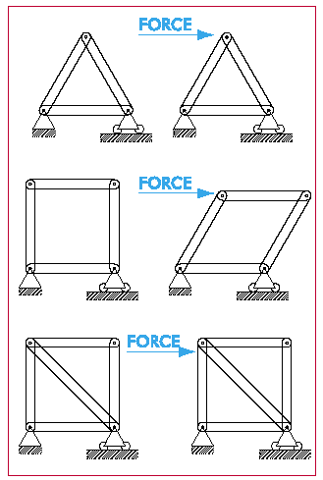
Truss Stability

Slide 9
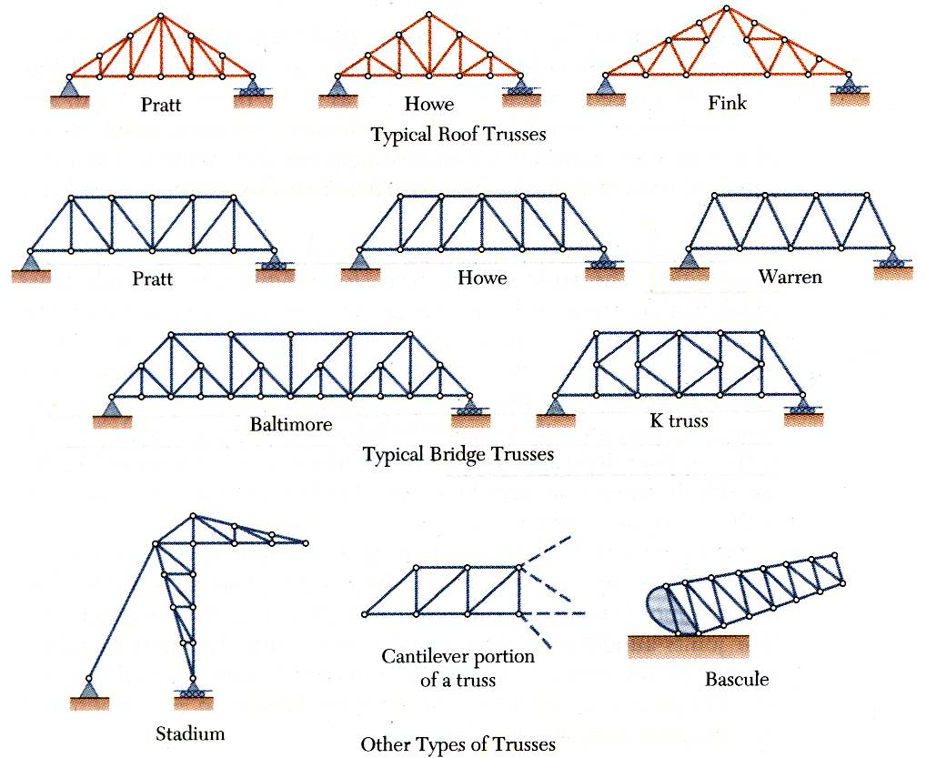
Types of a Trusses

Slide 10
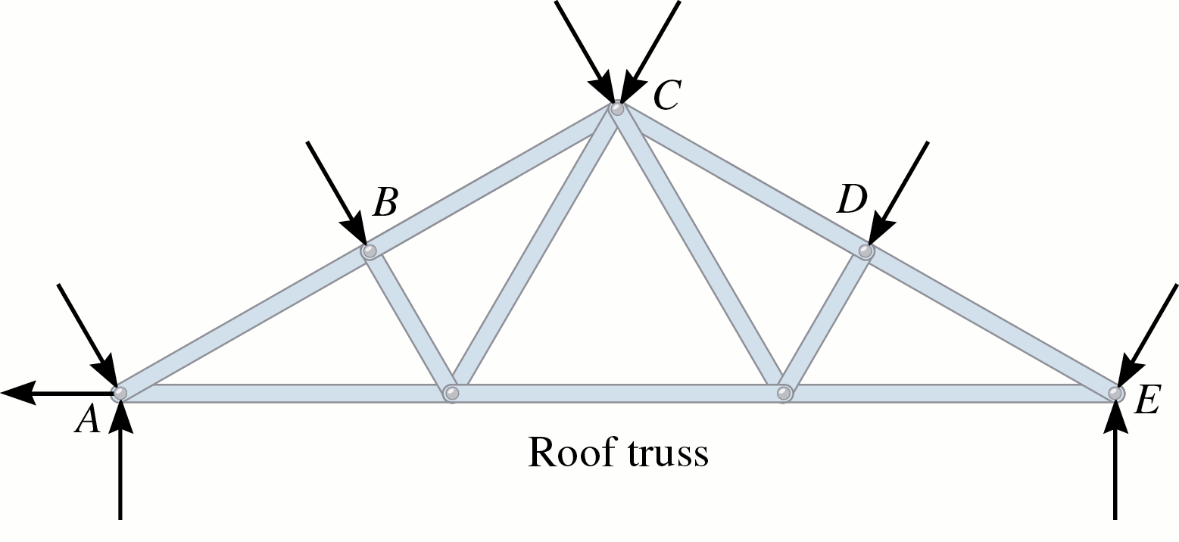
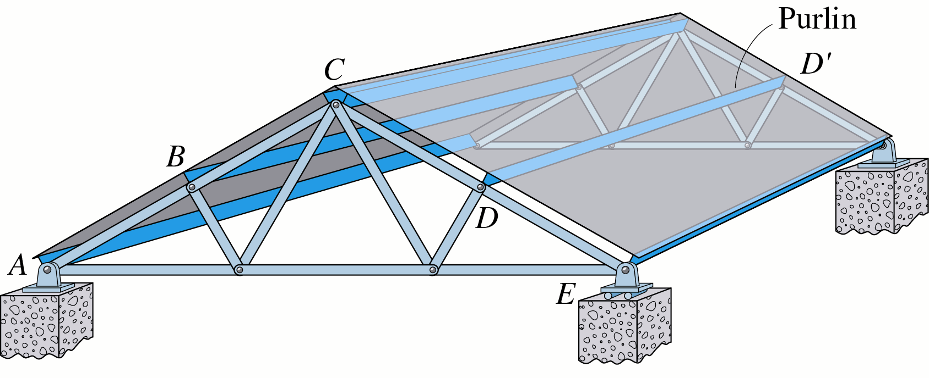
Examples of Trusses
The roof truss shown is formed by two planar trusses connected by a series of purlins.

Slide 11
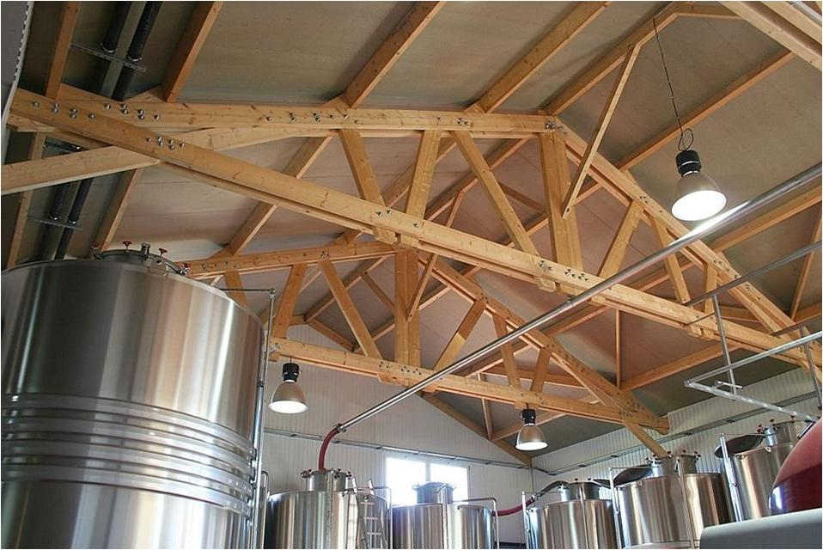
A wooden Roof Truss

Slide 12
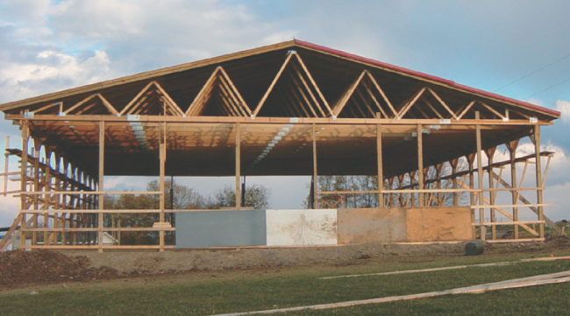
Examples of Trusses
Since roof trusses, such as those shown, require support only at their ends,
it is possible to construct buildings with large unobstructed floor areas.

Slide 13
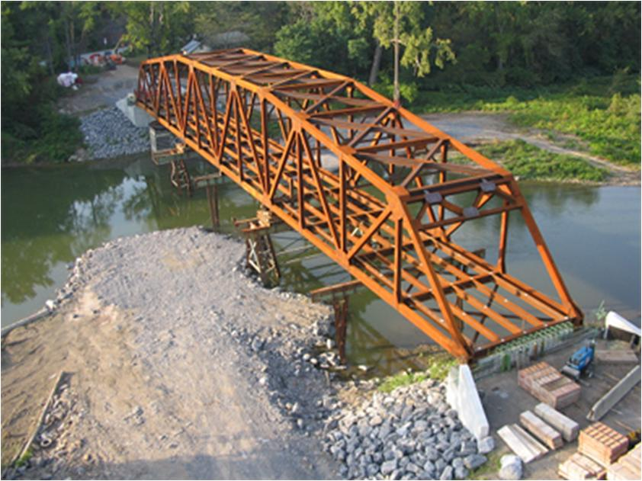
A Bridge Truss

Slide 14
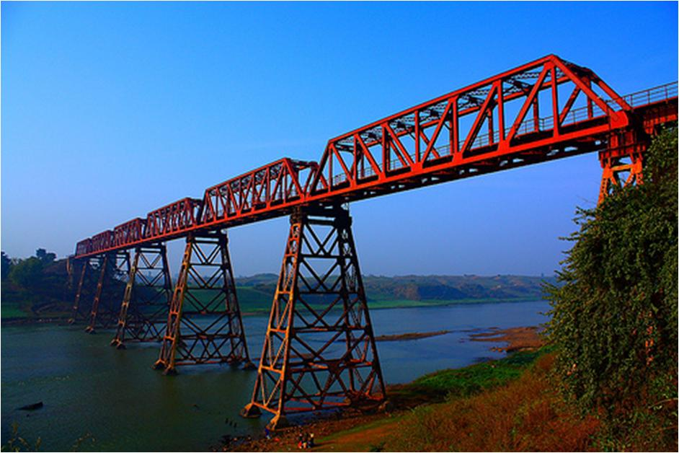
A railway Bridge Truss

Slide 15
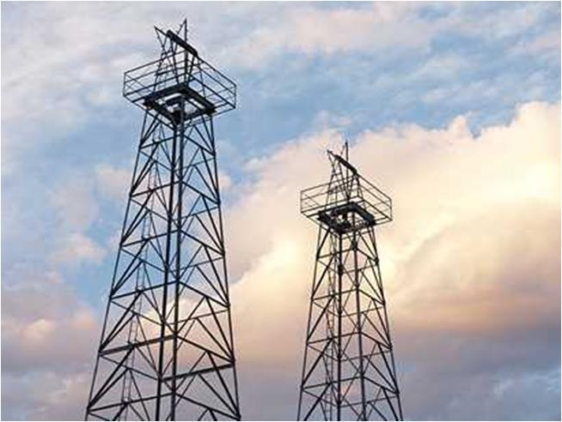
Space truss (towers)

Slide 16
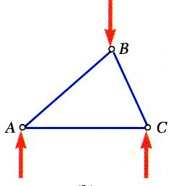
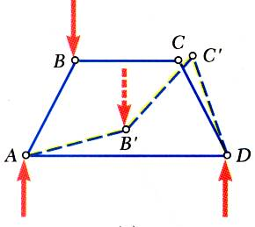
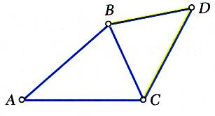
Simple Trusses
A rigid truss will not collapse under the application of a load.
A simple truss is constructed by successively adding two members and one connection to the basic triangular truss.
In a simple truss, m = 2n - 3 where m is the total number of members and n is the total number of joints.

Slide 17
Analysis of Simple Trusses
Assumptions
All members are two force members
Weight of the member is small compared with the force it supports.
The members are joined together by smooth pins.
All external forces are applied at the pin connections (e.g. in bridge trusses the deck is usually laid on cross beams which are supported at the joints)
T
T
C
C

Slide 18
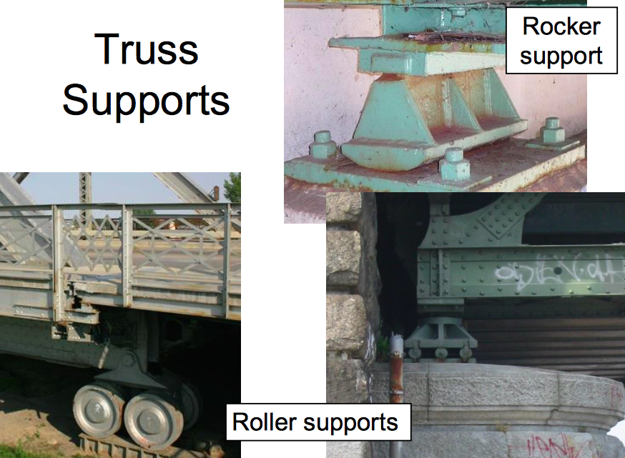

Slide 19
