Slide 1
Analysis of Frames

Slide 2

Two force members
A two-force member has forces applied at only two points on the member.
For any two-force member to be in equilibrium:
  The two forces acting on the member must have the same magnitude;
  Act in opposite directions; and
  Have the same line of action

Slide 3
Multi-force members
A multi-force member has forces (and/or couple moments) applied at more than two points on the member.

Slide 4
Frames and Machines
Frame or Machine: A structure is called a frame or machine if at least one of its individual members is a multi-force member.
Difference between Frame and Machine: Frames are structures which are designed to support applied loads and are usually fixed in position. Machines are structures which contain moving parts and are designed to transmit forces or couples from input values to output values.
In this course we will study only pin-connected frames.

Slide 5
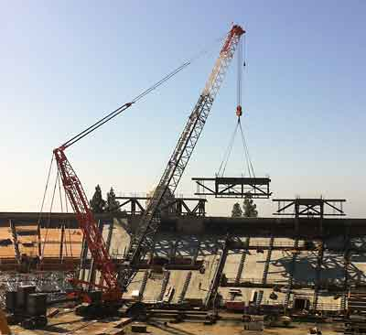
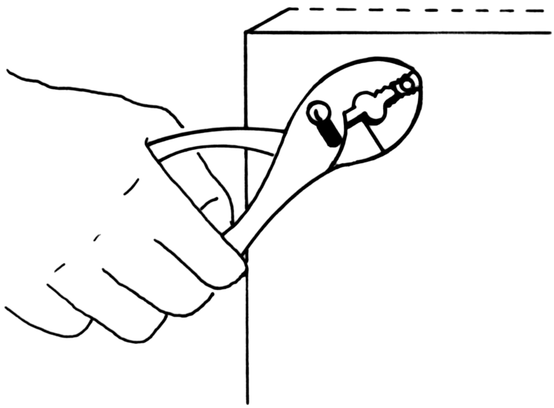
Frames and Machines (contd.)
These pliers act as simple machines. Here the applied force on the handle creates a much larger force at the jaws.
This large crane is a typical example of a frame.

Slide 6
How to solve frame problems
The forces acting on each member of a frame are found by isolating its each member with a free-body diagram and applying the equations of equilibrium.
Free body diagram of a member is drawn by drawing its outlined shape and showing all the forces and/or couple moments that act on it.
The principle of action and reaction must be carefully observed when we represent the forces of interaction on the separate free-body diagrams.

Slide 7
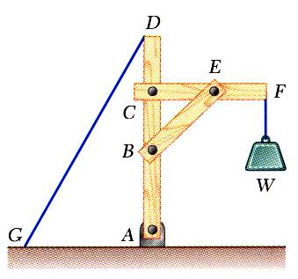
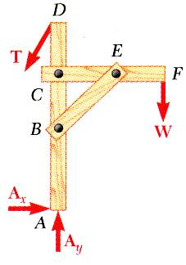
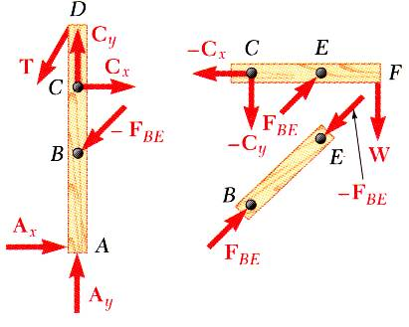
Analysis of Frames
Frames and machines are structures with at least one multiforce member. Frames are designed to support loads and are usually stationary (i.e. not moving). Machines contain moving parts and are designed to transmit and modify forces.
A free body diagram of the complete frame is used to determine the external forces acting on the frame.
Internal forces are determined by dismembering the frame and creating free-body diagrams for each component.
Forces on two force members have known lines of action but unknown magnitude and sense.
Forces on multiforce members have unknown magnitude and line of action. They must be represented with two unknown components.
Forces between connected components are equal, have the same line of action and opposite sense.
BE: two-force member
6 - 7

Slide 8
http://web.mst.edu/~bestmech/statics/sa/sa/6_4_2_1.htm

Slide 9
Problem-1
A two member frame is supported by the two pin supports at A and D as shown. The beam AB is subjected to a load of 4 kN at its free end. Draw the free body diagrams of each member and then determine
(i) The components of the reactions at the pin supports A and D
(ii) The force on the beam at C.

Slide 10
Solution (Free Body Diagrams)

Slide 11
Member AB
Number of unknown forces: 4 (A_{x}, A_{y}, C_{x}, C_{y})
Number of independent equilibrium equations: 3
Therefore, all the unknown forces can not be
determined by the equilibrium equations alone.
Solution (i)

Slide 12
Solution (ii)
Member CD
Number of unknown forces: 3 (D_{x}, D_{y}, C_{x}) (C_{y} has already been calculated)
Number of independent equilibrium equations: 3
Therefore, all the unknown forces can be
determined by equilibrium equations alone.

Slide 13
Problem -2
For the frame shown in the figure:
a. Draw the free body diagram (FBD) for each member.
b. Determine the horizontal and vertical components of the forces at pin B.
c. Find the reactions at the pin supports C and D

Slide 14
Solution (a): Free body diagrams

Slide 15
Solution (b): Forces at the pin B

Slide 16
Solution (c): Reactions at the pin supports C and D

Slide 17
Problem-3
For the frame shown in the figure, calculate the total force at pin B.

Slide 18
Solution

Slide 19
Solution (contd.)
Note: Member AB is a two force member. How?
(Hint: see the slide no. 4)

Slide 20
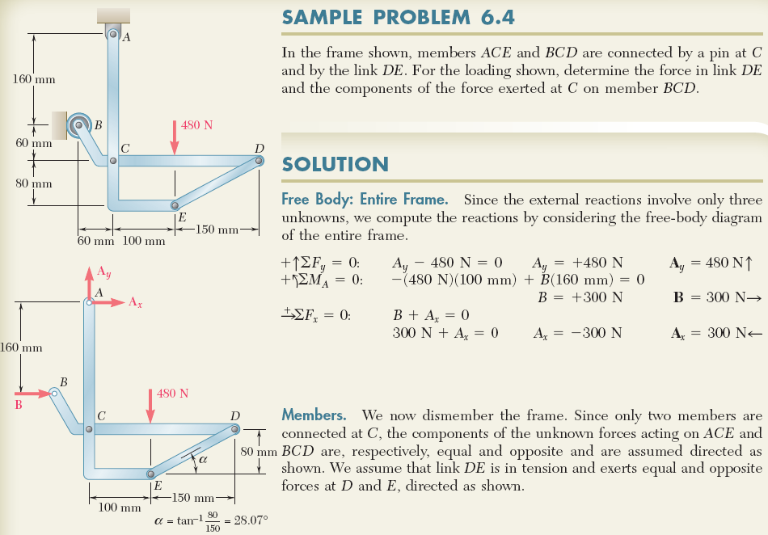
Example 8: Analysis of Frames
6 - 20

Slide 21
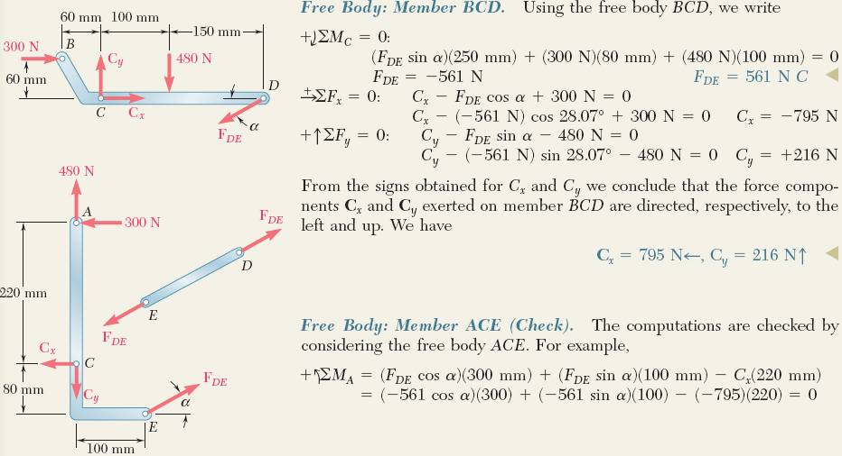
Example 8 (continued):
ENGINEERING MECHANICS : STATICS
two-force member
6 - 21

Slide 22
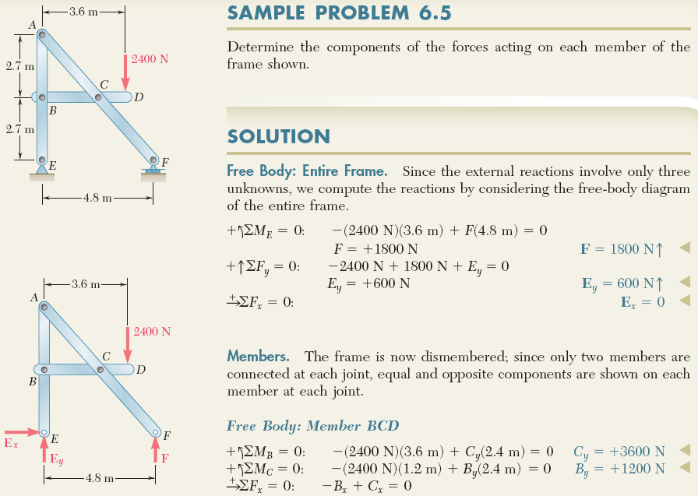

Example 9: Analysis of Frames
6 - 22

Slide 23

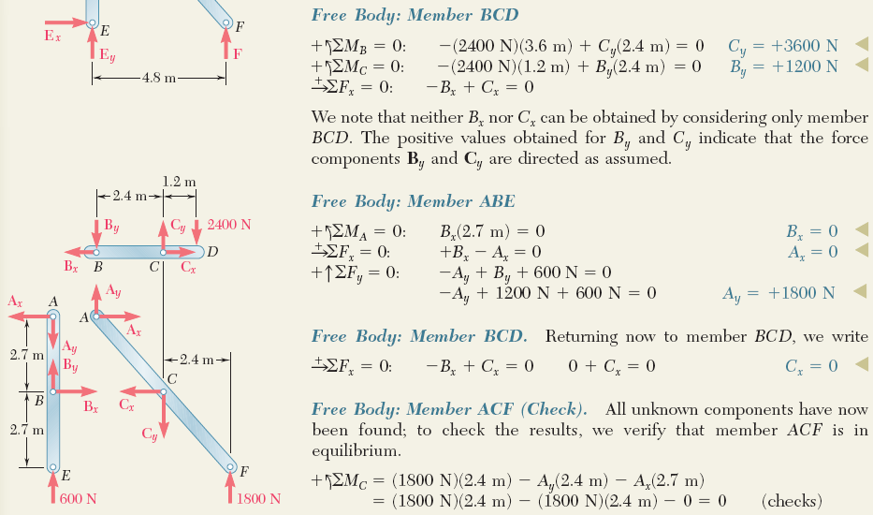
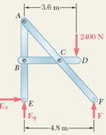
Example 9 (continued):
ENGINEERING MECHANICS : STATICS
i.e. B_{x}=C_{x}
6 - 23

Slide 24
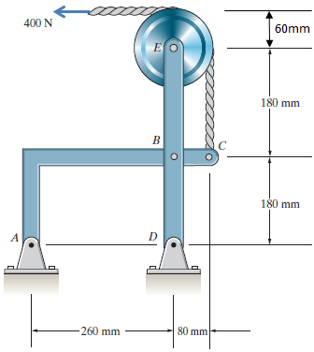
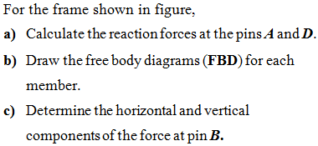
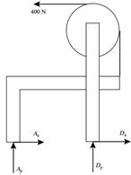

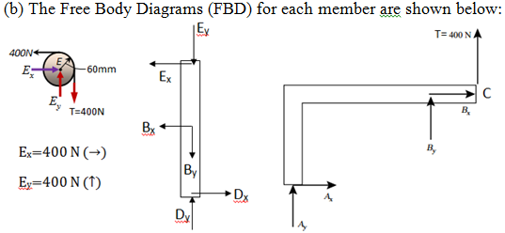
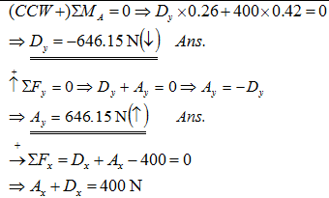
Example 10: Analysis of Frames
ENGINEERING MECHANICS : STATICS
6 - 24

Slide 25
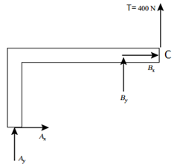
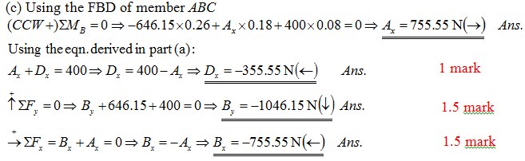
Example 10 (continued):
ENGINEERING MECHANICS : STATICS
If the total force at B is required, then
6 - 25

Slide 26
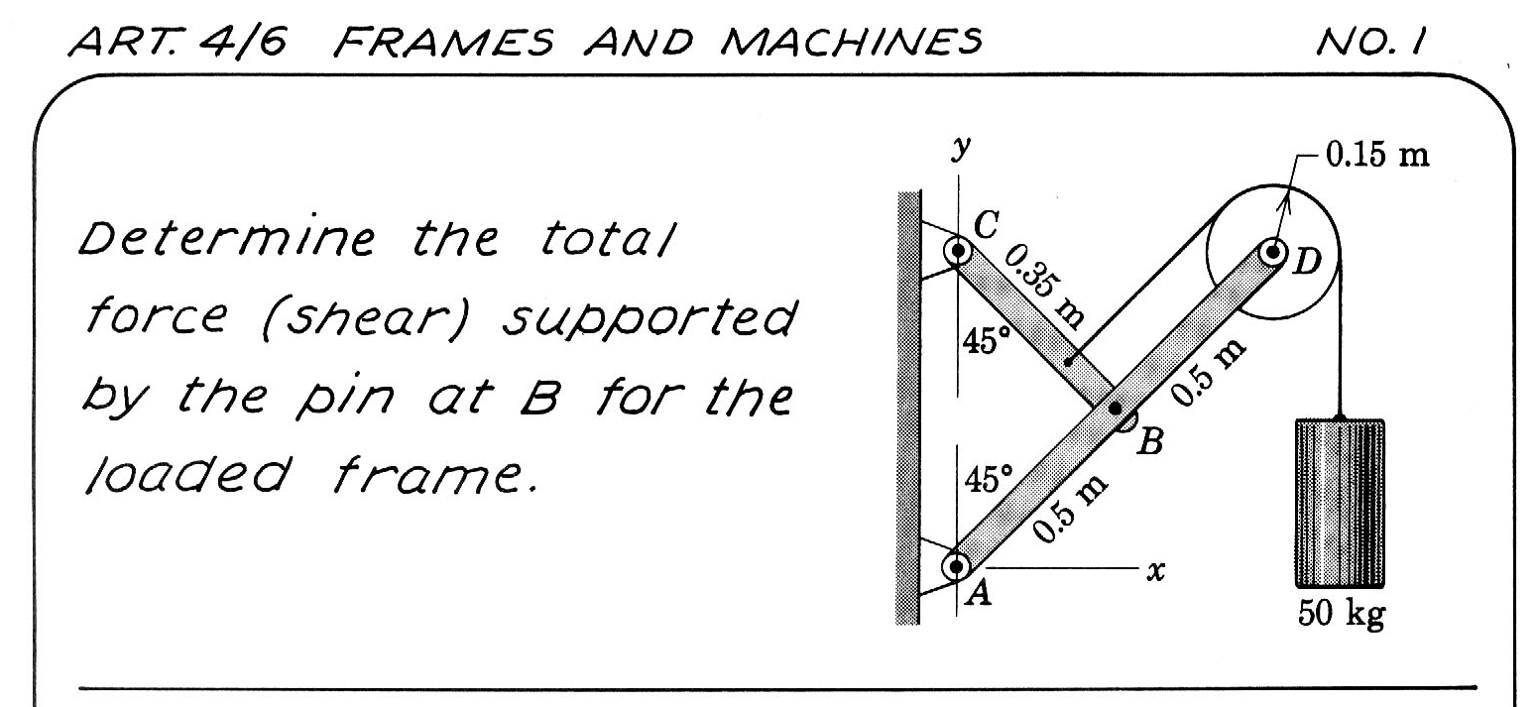

Slide 27
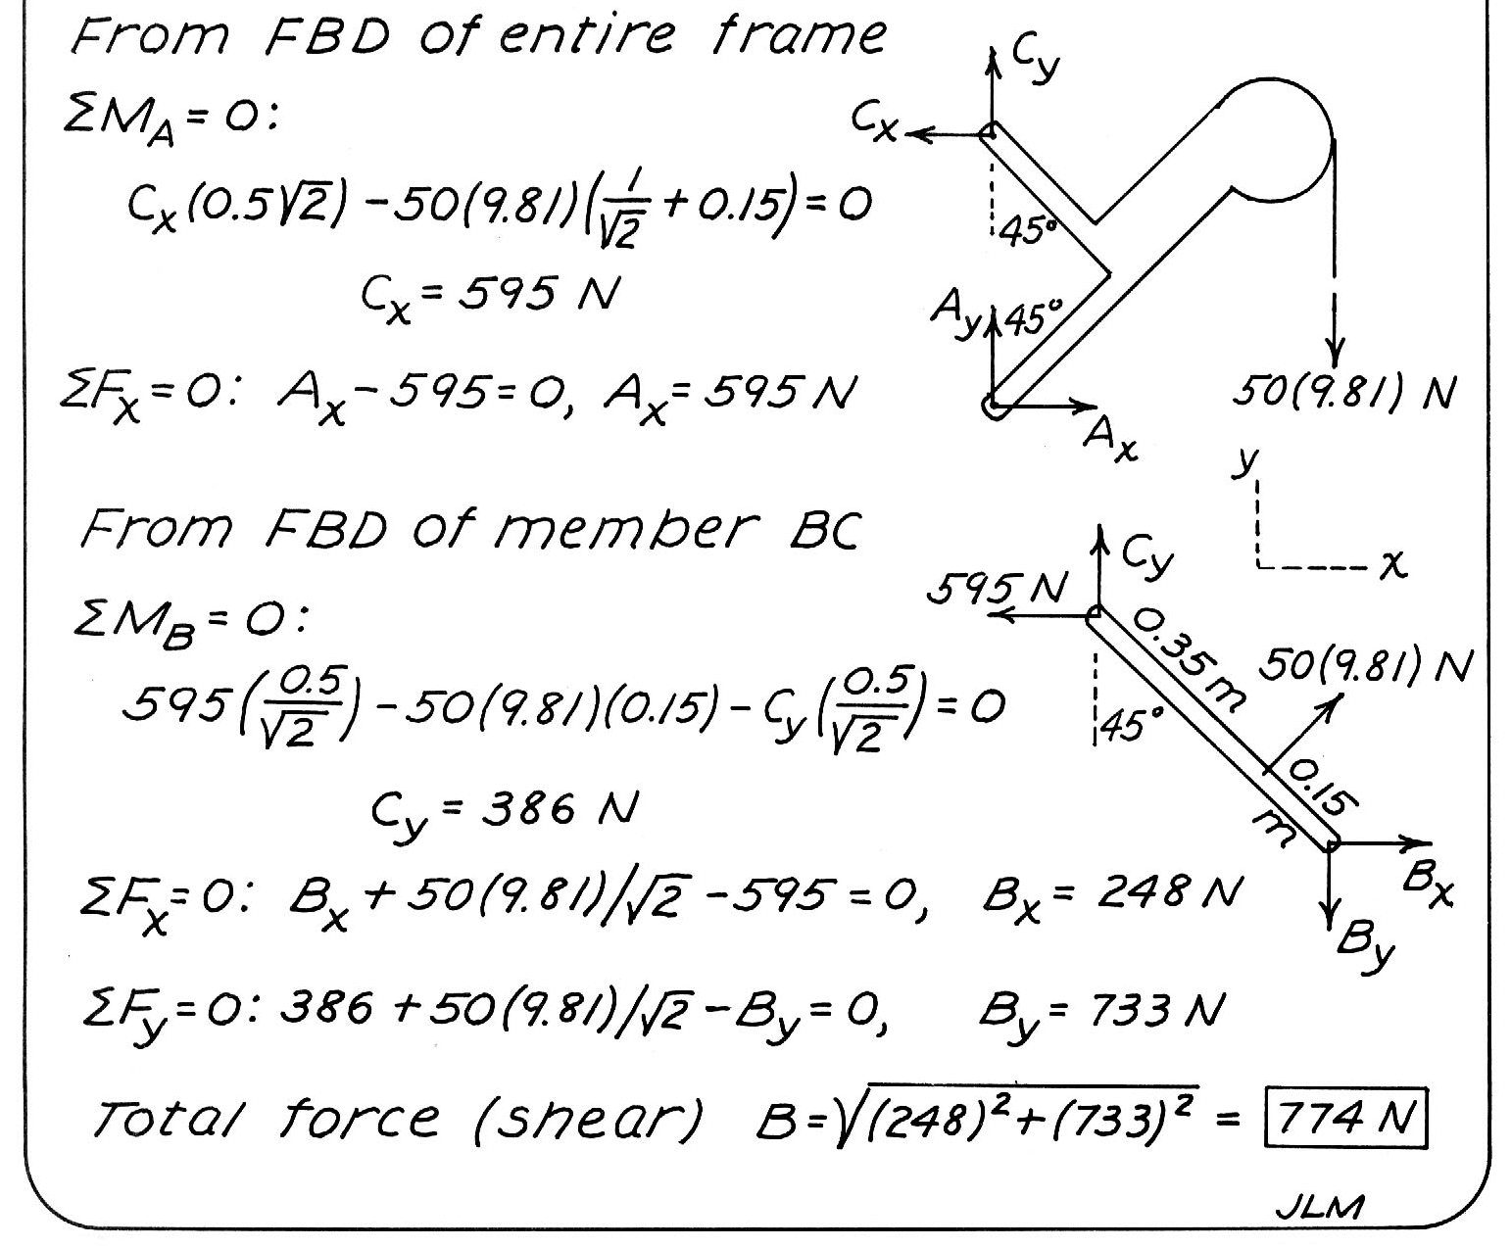

Slide 28
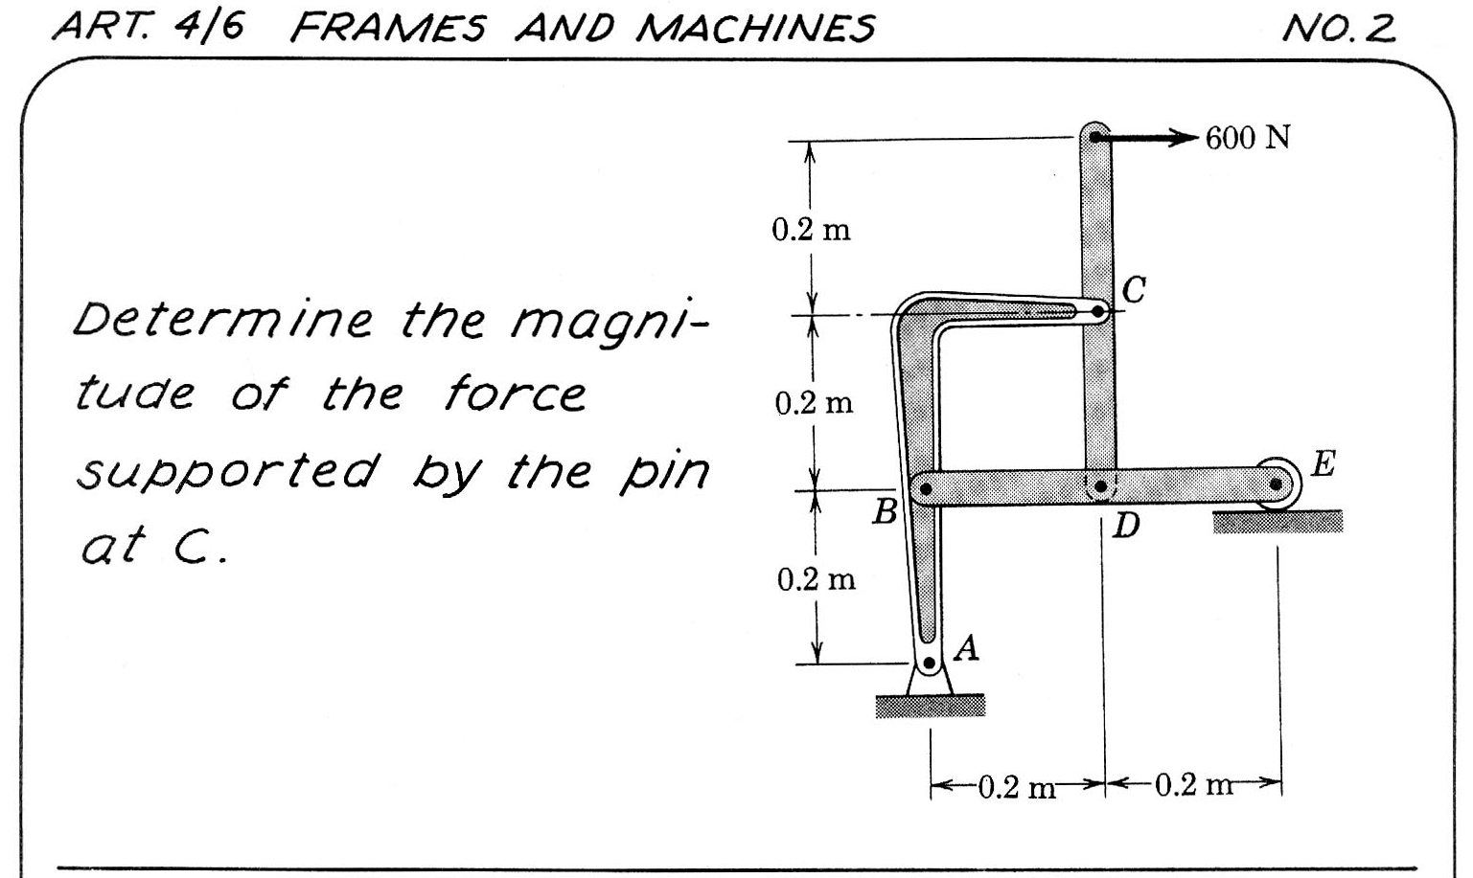
F

Slide 29
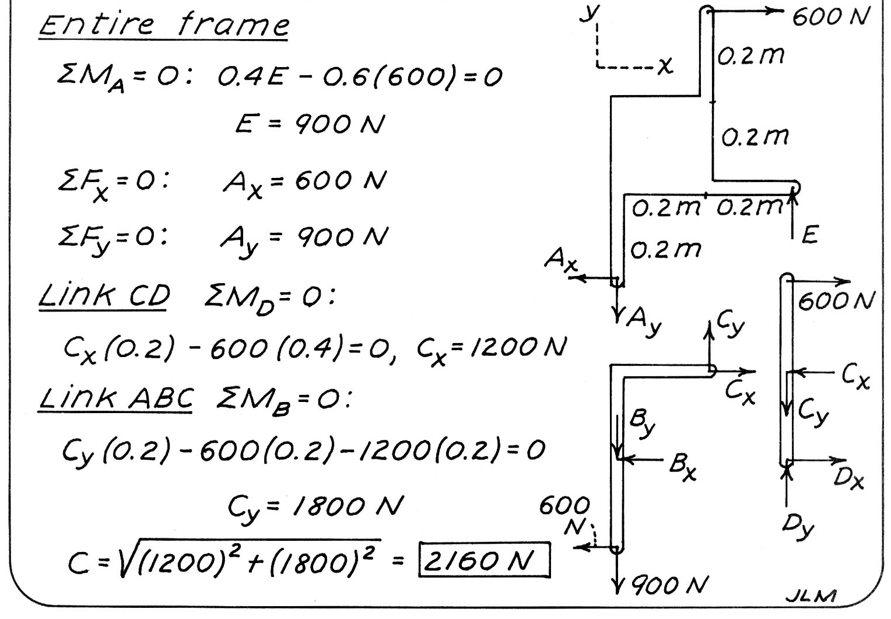
F
F
FD

Slide 30
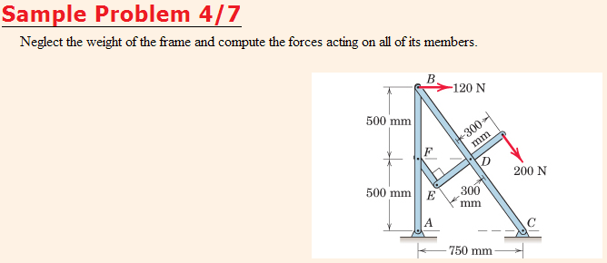
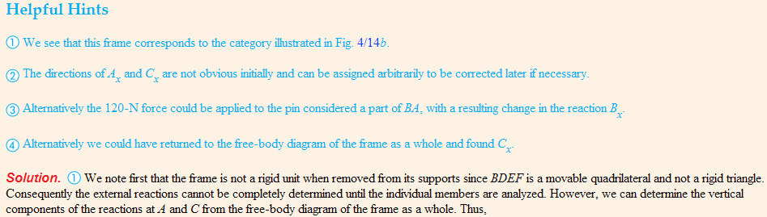
(i.e. nonrigid & collapsible by itself when removed from its supports)

Slide 31

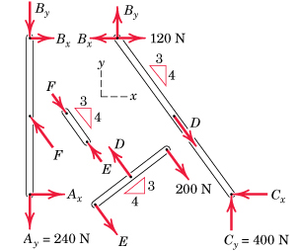
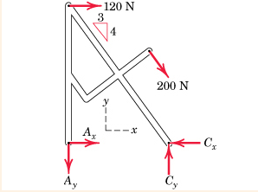
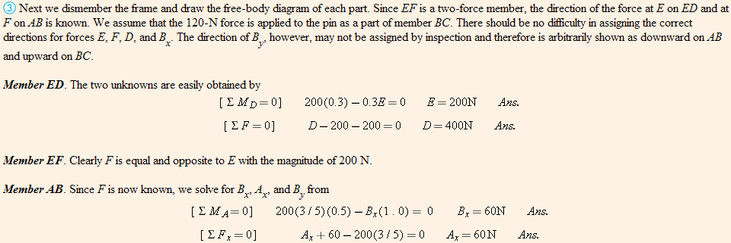
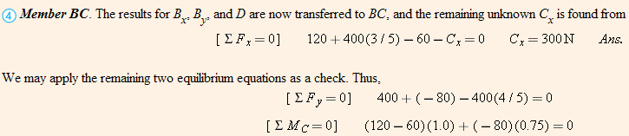
B
ΣF_{x}=0: A_{x}-C_{x}+120+200(3/5)=0
A_{x}-C_{x}= -240 N
F
D
E
(F=E=200 N)

