Slide 1
Examples

Slide 2
Relations Among Load, Shear and Bending Moment
5- 2

Slide 3
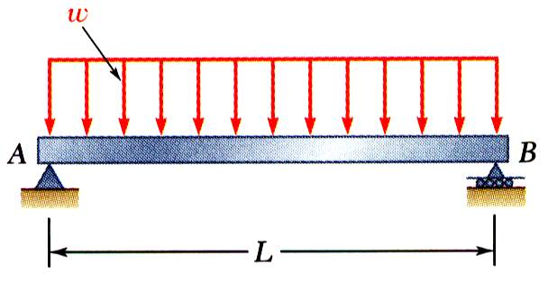
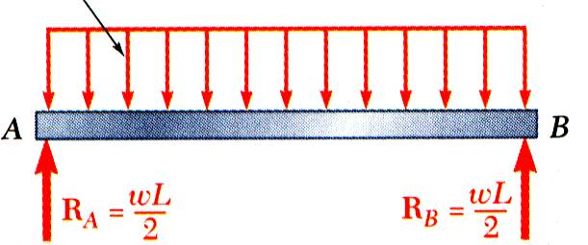
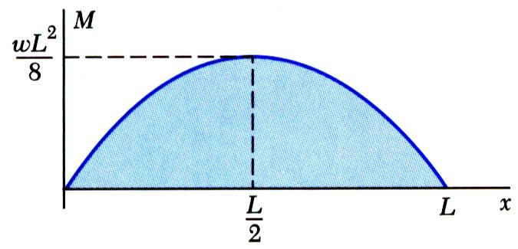
Relations Among Load, Shear and Bending Moment
Reactions at supports,
Shear curve,
Moment curve,
+
_
+
+
5- 3

Slide 4
ENGINEERING MECHANICS : STATICS
5- 4

Slide 5
Problem-1
Plot the shear and moment diagrams produced in the simple beam by the forces shown.
2 kN/m
4 kN
2.8 kN.m
A
B
1 m
1 m
1 m
1 m
1 m

Slide 6
Solution
Reactions:
2 kN/m
4 kN
2.8 kN.m
A
B
1 m
1 m
1 m
1 m
1 m

Slide 7
Desired sections
2 kN/m
4 kN
2.8 kN.m
A
B
1 m
1 m
1 m
1 m
1 m

Slide 8
SF and BM calculations
2 kN/m
2.8 kN.m
A
2.8 kN.m
A
A
x
x
2 m
x

Slide 9
SF and BM calculations
2 kN/m
4 kN
2 kN/m
2.8 kN.m
2.8 kN.m
A
A
1 m
1 m
1 m
1 m
1 m
1 m
1 m
x
x

Slide 10
SF and BM calculations (contd.)
x | 0 | .5 | 1.0 | 1.0 | 1.5 | 2.0 | 2.0 | 2.5 | 3.0 | 3.0 | 3.5 | 4.0 | 4.0 | 4.5 | 5.0
SF kN | 2.36 | 2.36 | 2.36 | 2.36 | 2.36 | 2.36 | 2.36 | 1.36 | 0.36 | 0.36 | 0.36 | 0.36 | -3.64 | -3.64 | -3.64
BM kNm | 0 | 1.18 | 2.36 | -0.44 | 0.74 | 1.92 | 1.92 | 2.85 | 3.28 | 3.28 | 3.46 | 3.64 | 3.64 | 1.82 | 0

Slide 11
Shear force and Bending Moment Diagrams
2 kN/m
4 kN
2.8 kN.m
A
B
1 m
1 m
1 m
1 m
1 m

Slide 12
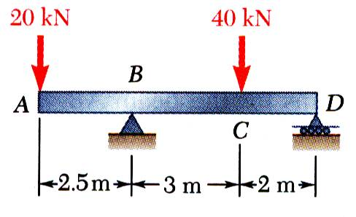
Sample Problem 2
SOLUTION:
Taking entire beam as a free-body, calculate reactions at B and D.
Find equivalent internal force-couple systems for free-bodies formed by cutting beam on the left and right sides of load application points.
Draw shear force and bending moment diagrams for the beam and loading shown.
Plot the results.
5- 12

Slide 13
Sample Problem 2 - Continued
SOLUTION:
Taking free-body of the entire beam, calculate the reactions at B and D (B_{y}=46 kN and D_{y}=14 kN).
Find equivalent internal force-couple systems at sections on both sides of load application points.
Similarly,
5- 13

Slide 14
Sample Problem 2 - Continued
Plot results.
Note that for a beam subjected to concentrated loads, shear force is of constant value between concentrated loads and bending moment varies linearly.
+
_
_
Remember Sign Convention
V
M
+
M
+
_
_
V
5- 14

Slide 15
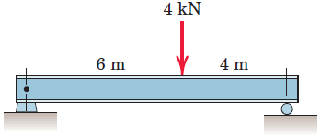
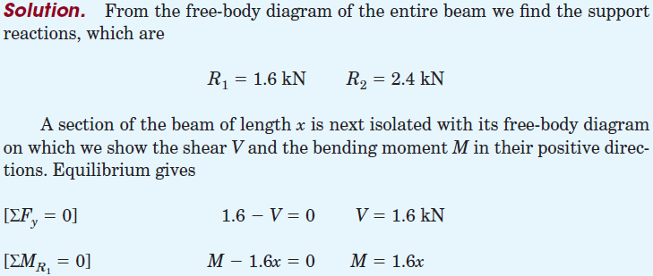
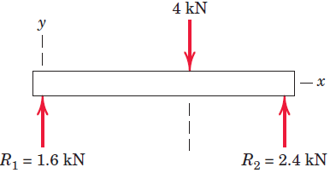
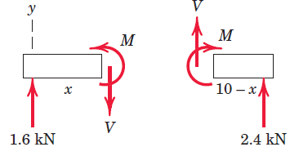
ENGINEERING MECHANICS : STATICS
Sample Problem 3
5- 15

Slide 16
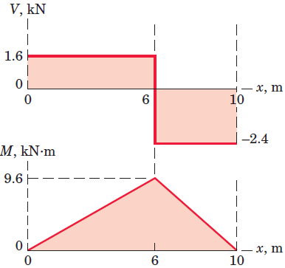
ENGINEERING MECHANICS : STATICS
Sample Problem 3 - Continued
0 m < x < 6 m
+
_
6 m < x < 10 m
+
+
5- 16

Slide 17
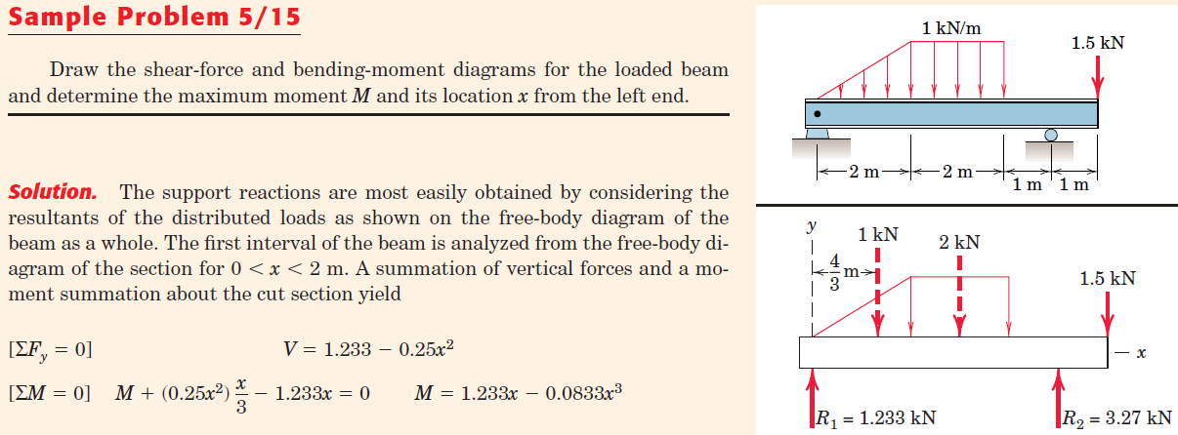
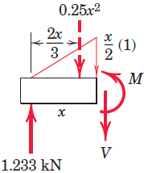
ENGINEERING MECHANICS : STATICS
Sample Problem 4
5- 17

Slide 18
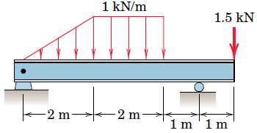
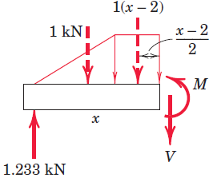
ENGINEERING MECHANICS : STATICS
Sample Problem 4 - Continued
5- 18

Slide 19
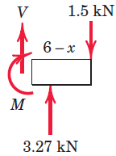
ENGINEERING MECHANICS : STATICS
Sample Problem 4 - Continued
5- 19

Slide 20
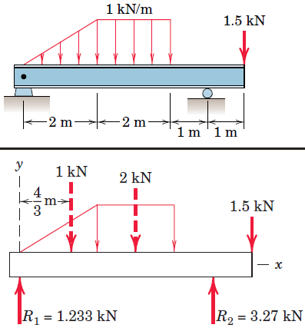
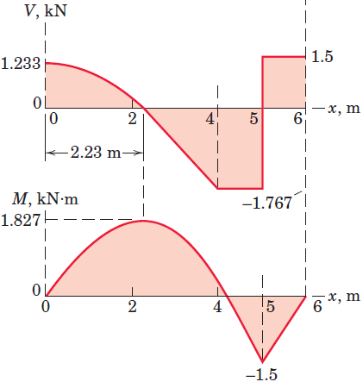
ENGINEERING MECHANICS : STATICS
Sample Problem 4 - Continued
0.233
1.799
At x=2 m , M=1.799 kN.m
At x=2.23 m, M=1.827 kN.m (maximum moment)
5- 20

Slide 21
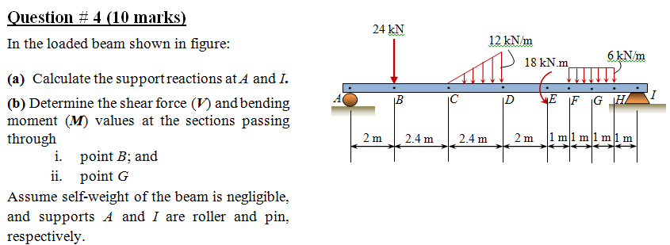
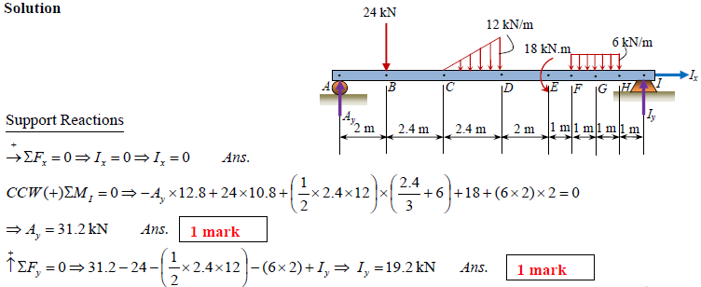
ENGINEERING MECHANICS : STATICS
Sample Exam Question
5- 21

Slide 22
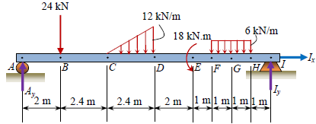
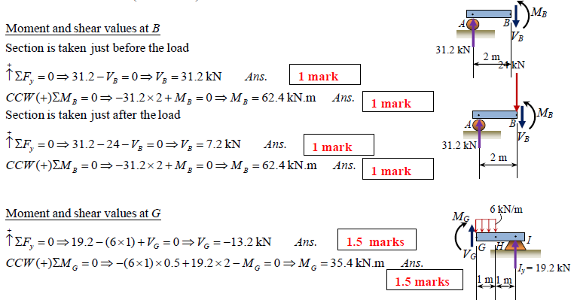
ENGINEERING MECHANICS : STATICS
Sample Exam Question
5- 22

Slide 23
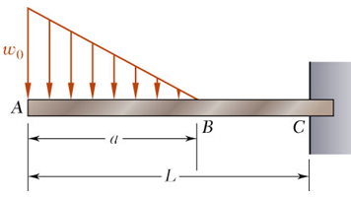
Sample Problem 6
SOLUTION:
The change in shear between A and B is equal to the negative of area under load curve between points. The linear load curve results in a parabolic shear curve.
With zero load, change in shear between B and C is zero.
The change in moment between A and B is equal to area under shear curve between points. The parabolic shear curve results in a cubic moment curve.
Sketch the shear force and bending-moment diagrams for the cantilever beam and loading shown.
The change in moment between B and C is equal to area under shear curve between points. The constant shear curve results in a linear moment curve.
5- 23

Slide 24
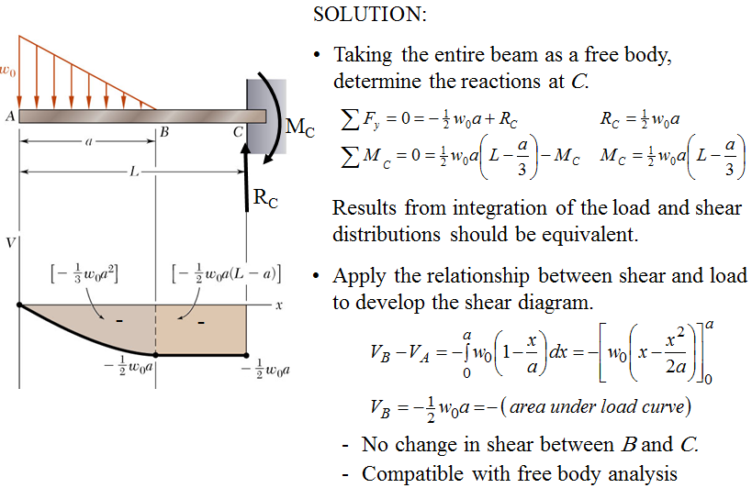
Sample Problem 6 - Continued
5- 24

Slide 25
Sample Problem 6 - Continued
5- 25

