Slide 1
STATICS (ENGINEERING MECHANICS-I)
بسم الله الرحمن الرحيم
Area moment of Inertia
Notes:
This is a title slide.

Slide 4
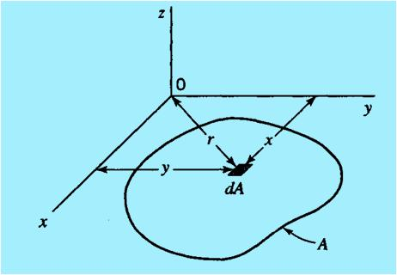
Rectangular and Polar moments of inertia

Slide 5
Relation between Rectangular and Polar Moments of Inertia
Unit of Area Moment of Inertia: L⁴ (e.g. m⁴, cm⁴, ft⁴, in⁴, mm⁴)

Slide 6
First Moment of Area

Slide 7
Second Moment of Area or (Area) Moment of Inertia
The Second Moment of Area is also called (AREA) MOMENT OF INERTIA

Slide 8
Note

Slide 9
Radius of Gyration
The radius of gyration is a measure of the distribution of the area from the axis in question. Higher radius of gyration means more area is distributed away from the axis.

Slide 10
Radius of Gyration (Contd.)

Slide 13
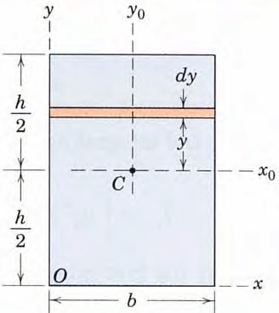
Moments of Inertia of the Rectangular Area
Determine the moments of inertia of the rectangular area about:
The centroidal axis x₀- and y₀- axes,
The centroidal polar axis z₀ through C,
The x-axis and y-axis, and
The polar axis z through O.

Slide 14
Contd.

Slide 15
Contd.

Slide 16
Examples

Slide 17
Problem-1
For the shaded area and the strip shown in the two figures, calculate the moment of Inertia and radius of gyration about the x-axis (i.e. I_{x} and r_{x})
y
y
3 m
3 m
y = x² / 12
y = x² / 12
6 m
x
x
6 m

Slide 18
Solution
y
3 m
y = x² / 12
6 m
x

Slide 19
Solution (Contd.)
y
3 m
y = x² / 12
x
6 m

Slide 20
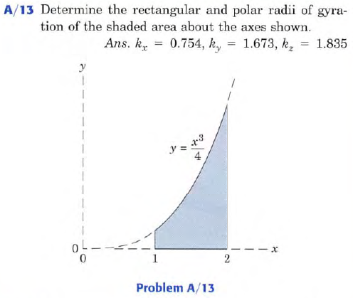

Slide 21
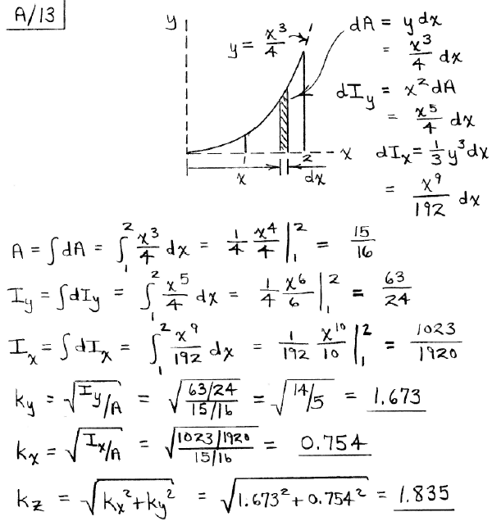

Slide 22
Determine the moment of inertia of the shaded area about the x-axis.
y
100 mm
20 mm
50 mm
20 mm
20 mm
170 mm
O
x

Slide 23
Solution
y
100 mm
20 mm
2
3
50 mm
20 mm
1
170 mm
20 mm
O
x

Slide 24
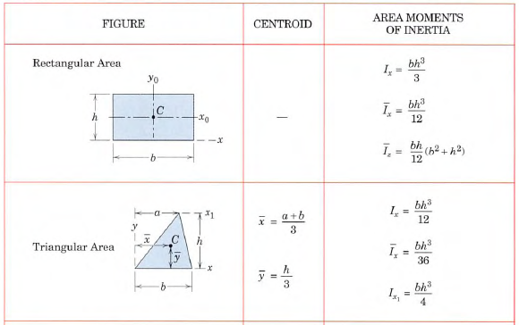

Slide 25
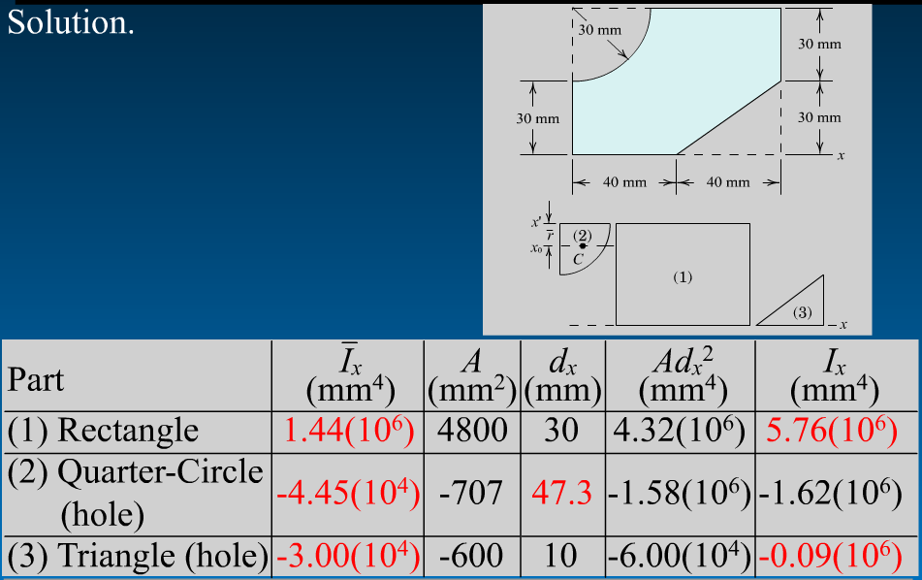
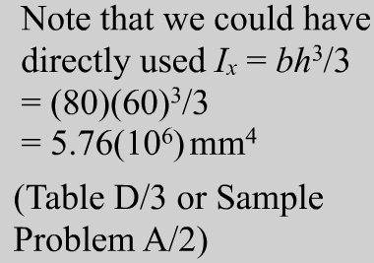
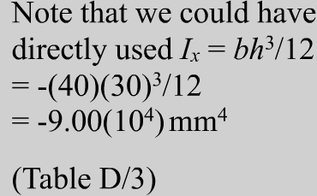
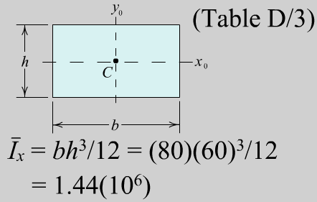
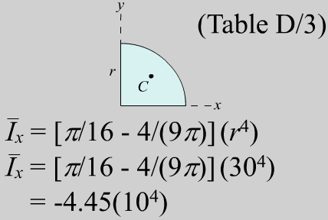
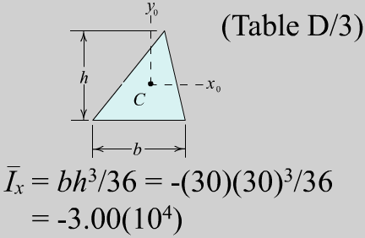
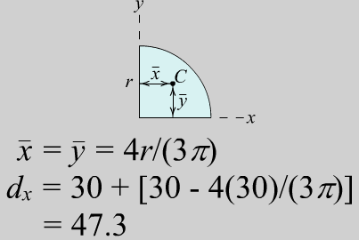
Sums 3490 4.05(10⁶)

Slide 27
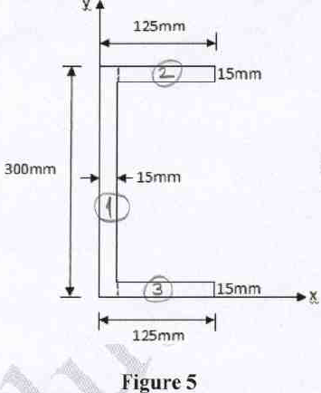
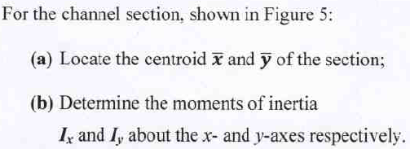
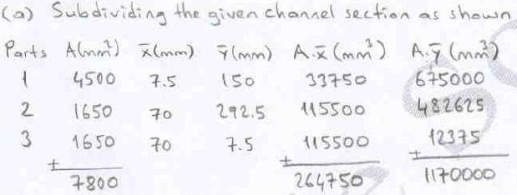
Sample Final Exam Question1:

Slide 28
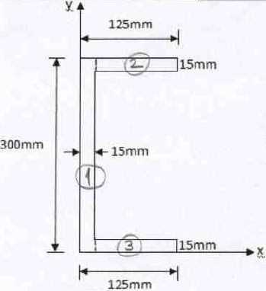
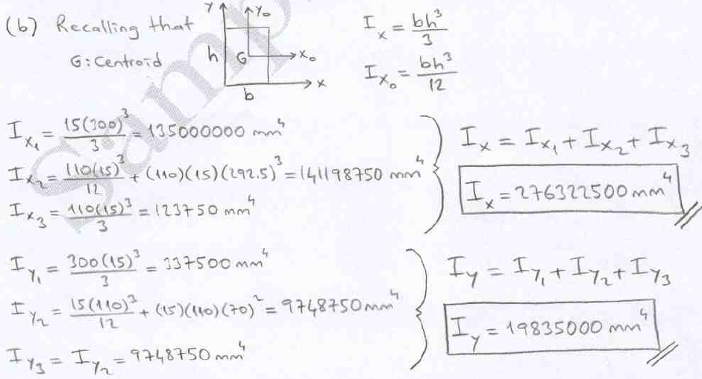
2

Slide 29
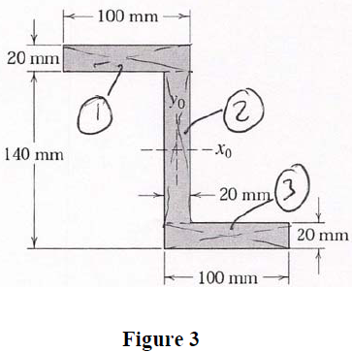
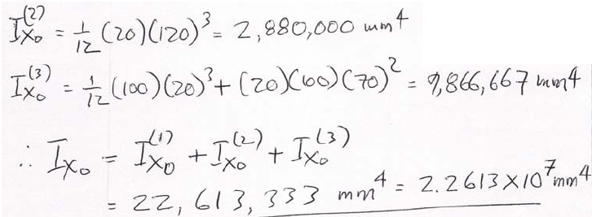
Sample Final Exam Question2:

Slide 30
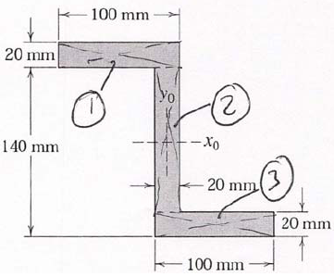
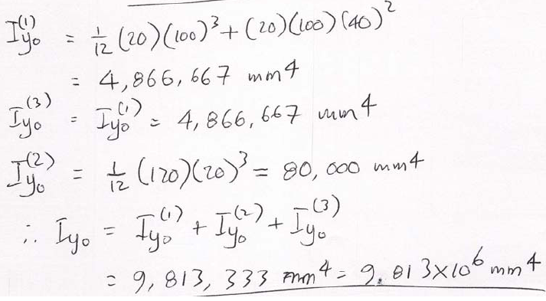

Slide 31
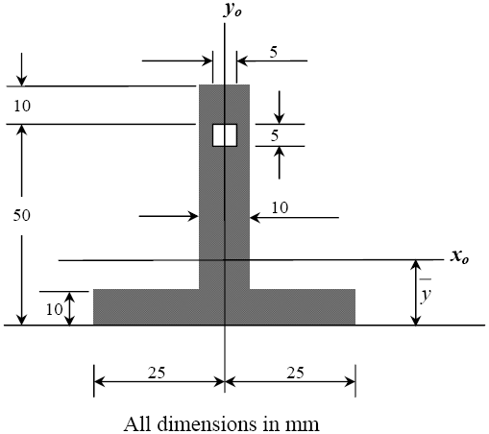
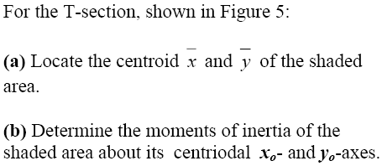
Sample Final Exam Question3:
4
19.29 mm

Slide 32
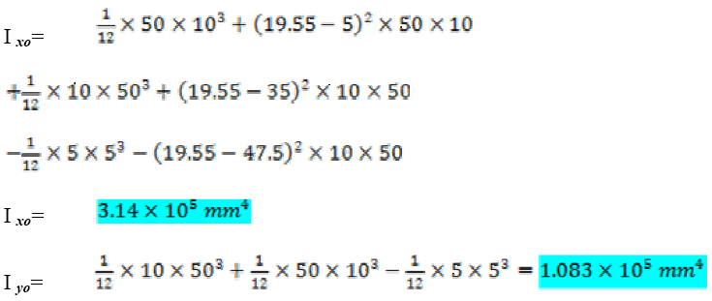
19.29
106268.72
19.29
227568.72
19.29
-19947.18
313890.26 mm⁴
108281.25 mm⁴

Slide 33
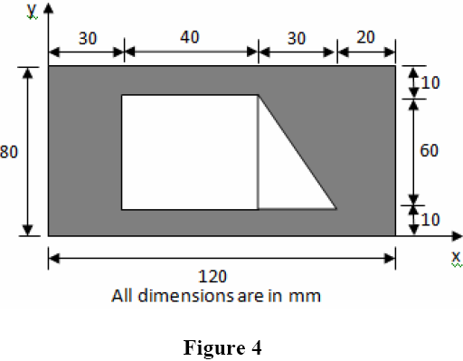
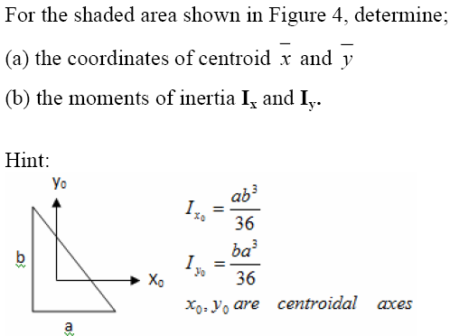
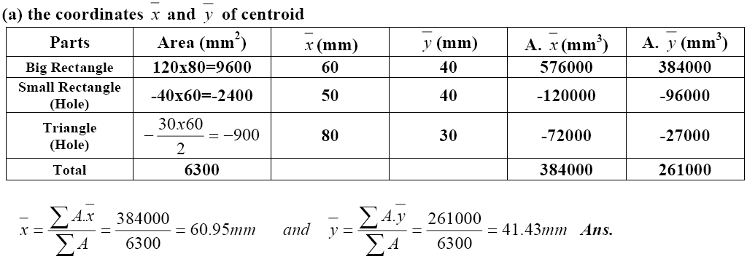
Sample Final Exam Question4:

Slide 34
