Slide 1

STATICS
(ENGINEERING MECHANICS-I)
بسم الله الرحمن الرحيم
Center of Gravity and Centroid
Notes:
This is a title slide.

Slide 2
Introduction
ENGINEERING MECHANICS : STATICS
The earth exerts a gravitational force on each of the particles forming a body. These forces can be replaced by a single equivalent force equal to the weight of the body and applied at the center of gravity for the body.
similar
The centroid of an area is analogous to the center of gravity of a body. The concept of the first moment of an area is used to locate the centroid.

Slide 3
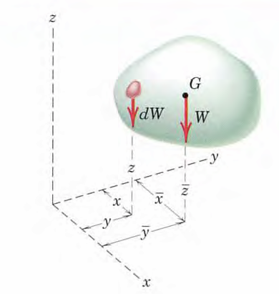
Center of Gravity
The point at which resultant of gravity forces act, is known as Center of Gravity.
A body is composed of an infinite number of particles of differential size.
If these particles have a weight dW, they will approximately form a parallel force system, and the resultant of this system is the total weight of the body W.
This weight will pass through a single point which is the center of gravity G.

Slide 4
Center of Gravity (Contd.)
The moment of the resultant force W about any axis equals to the sum of the moments of the weights dw about the same axis.

Slide 5
Center of Gravity versus Centroid
ENGINEERING MECHANICS : STATICS
Centroid is the point, where whole area of the plane is going to be act.
(mostly applicable for two dimensional problems)
Center of gravity is the point, where whole weight of the body is going to be act.
(mostly applicable for three dimensional problems)
There are two major differences between "center of gravity" and "centroid":
The term "center of gravity" applies to the bodies with mass and weight, while the term "centroid" applies to plane areas.
2) Center of gravity of a body is the point through which the resultant gravitational force (weight) of the body acts for any orientation of the body, while centroid is the point in a plane area such that the moment of the area, about any axis, through that point is zero.
5 - 5

Slide 6
Center of Mass
If gravity field is treated as uniform and parallel, g is constant.
This expression contain no reference to gravitational effects since g no longer appears. Therefore, it defines a unique point in the body which is a function solely of the distribution of mass. This point is known as the CENTER OF MASS, and clearly it coincides with the center of gravity as long as the gravity field is uniform and parallel.
It is meaningless to speak of the center of gravity of a body that is removed from the earth’s gravitational field, since no gravitational forces would act on the body. The body would, however, still possess its unique center of mass.

Slide 7
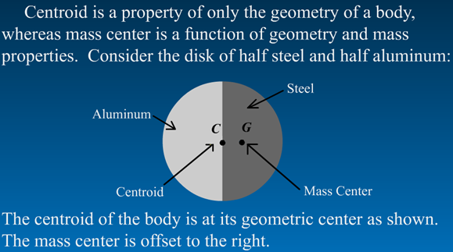
Centroid versus Center of Mass
ENGINEERING MECHANICS : STATICS
5 - 7

Slide 8
Centroid of a Volume
If density ρ of a body is uniform throughout:
This expression contain no reference to mass properties. Therefore, it defines a unique point in the body which is a function solely of the geometrical property of the body. This point is known as the CENTROID.
The term centroid is used when the calculation concerns a geometrical shape only. When speaking of an actual physical body, we use term center of mass.
If the density is uniform throughout the body, the positions of the centroid and center of mass are identical, whereas if the density varies, these two points will, in general, not coincide.

Slide 9
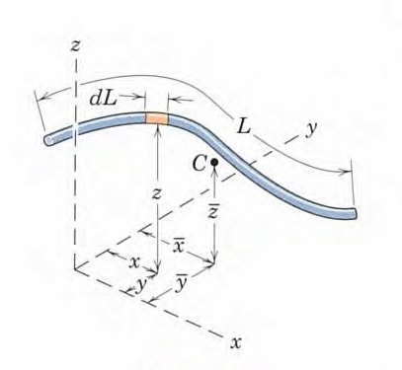
Centroid of a line (e.g. a rod)
If density ρ and cross section Area of a body is uniform throughout (e.g. in a rod)
It should be noted that, in general, the centroid C do not lie on the line.

Slide 10
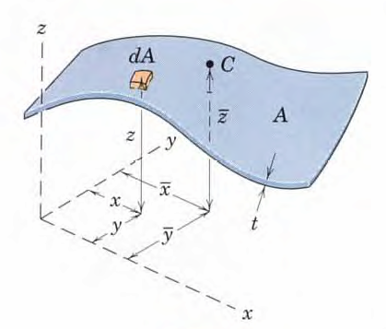
Centroid of an Area
If density ρ and thickness of a body is uniform throughout.

Slide 11
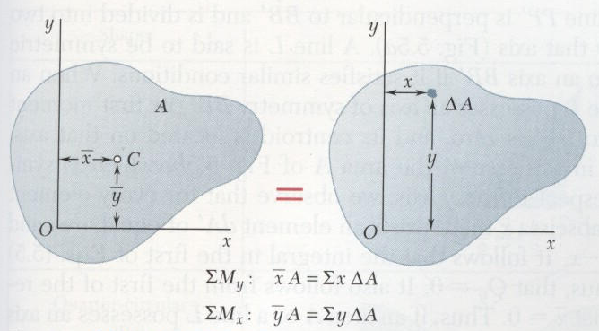
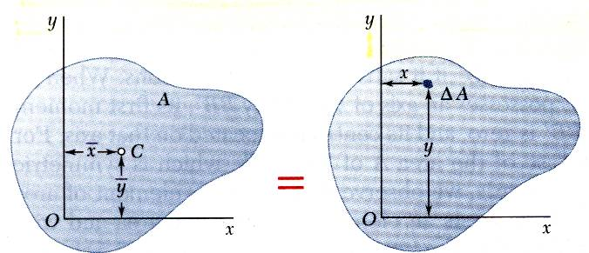
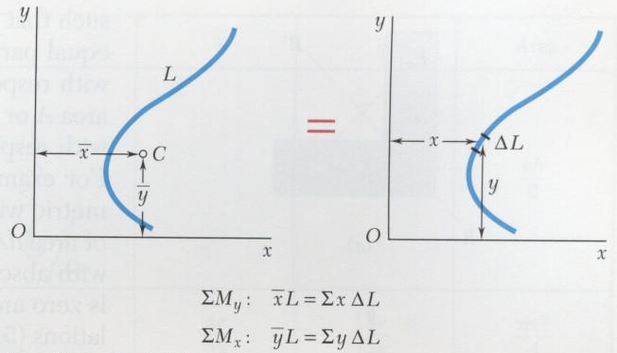
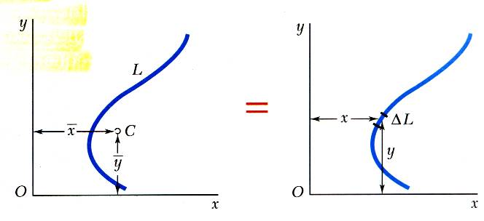
Centroids of Areas and Lines
ENGINEERING MECHANICS : STATICS
Centroid of an area
Centroid of a line

Slide 12
Note (for a regular shaped body)
Centroid of a line or area would lie somewhere on a line of symmetry.
If there are two (or more) lines of symmetries, centroid would lie on their intersection.
For a volume, centroid would lie on a plane of symmetry.
If there are two (or more) planes of symmetries in a volume, centroid would lie on a line created by their intersections.

Slide 13
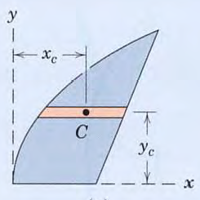
Centroidal coordinate of the element
Sometimes in the calculation of centroid it is more convenient to use the coordinate of the centroid of the element for the moment arm in expressing the moment of the differential element.
The moment of dA about y-axis = x_{c}dA
The moment of dA about x-axis = y_{c}dA
where x_{c} , y_{c} = x- and y- coordinates of the centroid C of the element.

Slide 14
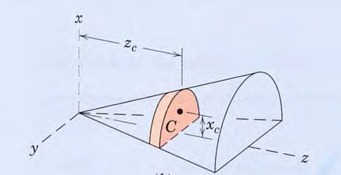
Contd.

Slide 15
Determining Centroid of an Object
ENGINEERING MECHANICS : STATICS
Centroids can be found using three methods:
Composites – If an object can be divided up into relatively simple shapes with known centroids, then the centroid of the entire object can be found using the weighted average of the centroids of the composites.
Integration – If the area, volume, or line of an object can be described by a mathematical equations, then the centroid can be determined through integration.
Solid modeling software – Software such as AutoCAD can be used to construct 3D models of objects. The software can also determine the centroid of the objects (as well as volumes, moments of inertia and other mass properties). This is not a required element of this course.
5 - 15

Slide 16
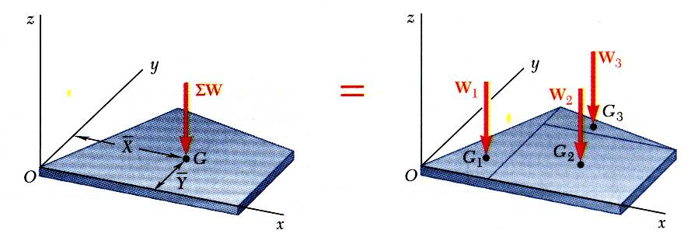
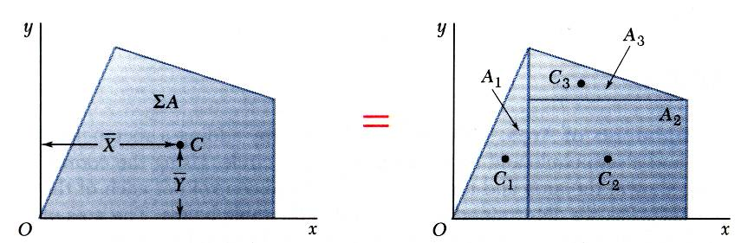
Composite Plates and Areas
ENGINEERING MECHANICS : STATICS
Composite plates
Composite area

Slide 17
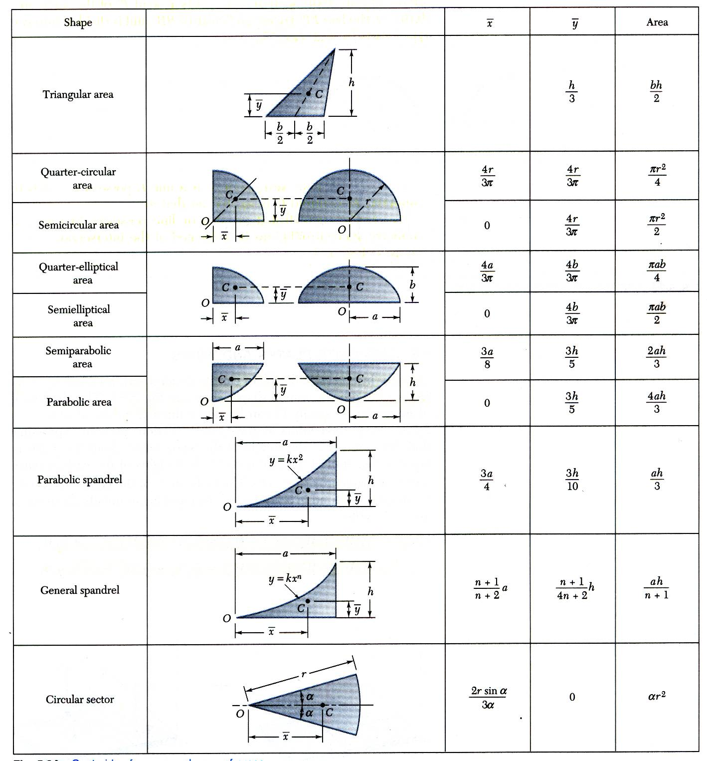
Centroids of Common Shapes of Areas
ENGINEERING MECHANICS : STATICS

Slide 18
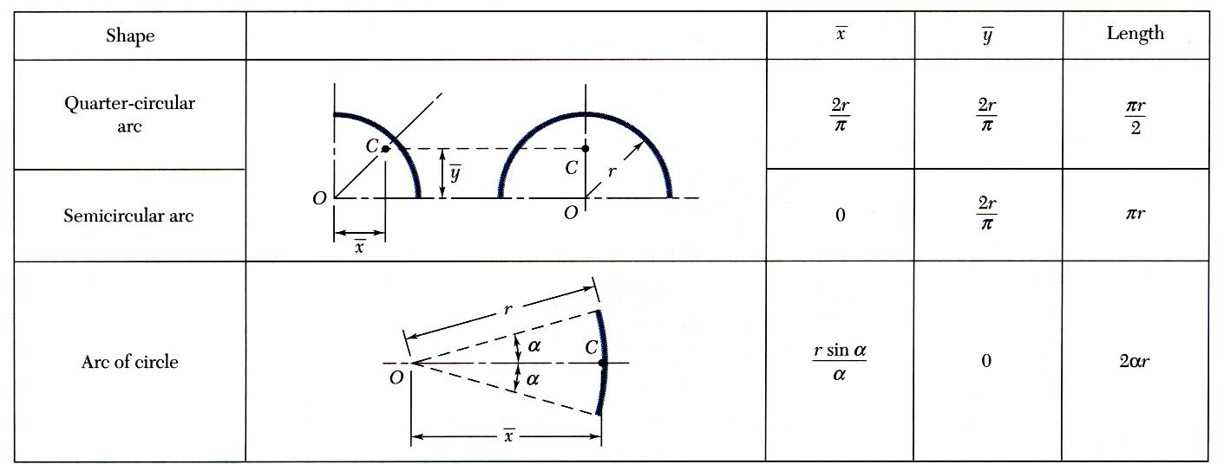
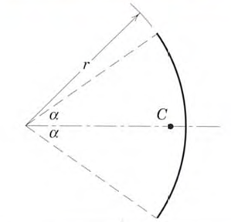
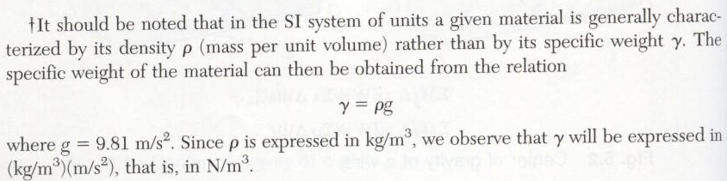
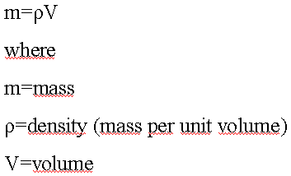
Centroids of Common Shapes of Lines

Slide 19
Examples

Slide 20
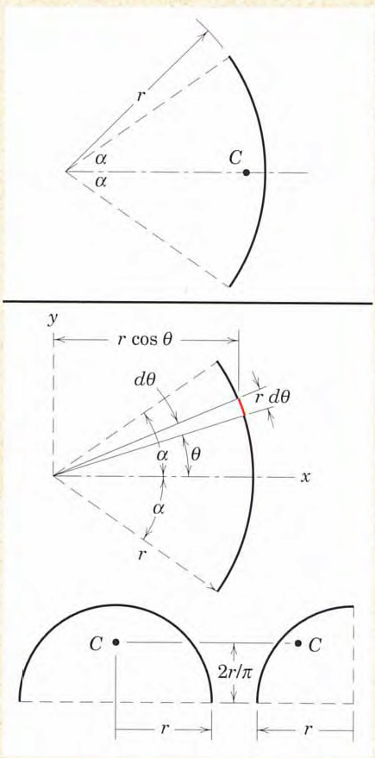
Problem-1
Locate the centroid of a circular arc as shown in the figure.

Slide 21
Solution

Slide 22
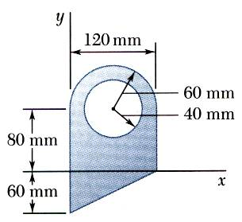
Sample Problem 1
ENGINEERING MECHANICS : STATICS
SOLUTION:
Divide the area into a triangle, rectangle, and semicircle with a circular cutout.
Calculate the first moments of each area with respect to the axes.
Find the total area and first moments of the triangle, rectangle, and semicircle. Subtract the area and first moment of the circular cutout.
For the plane area shown, determine the first moments with respect to the x and y axes and the location of the centroid.
Compute the coordinates of the area centroid by dividing the first moments by the total area.

Slide 23
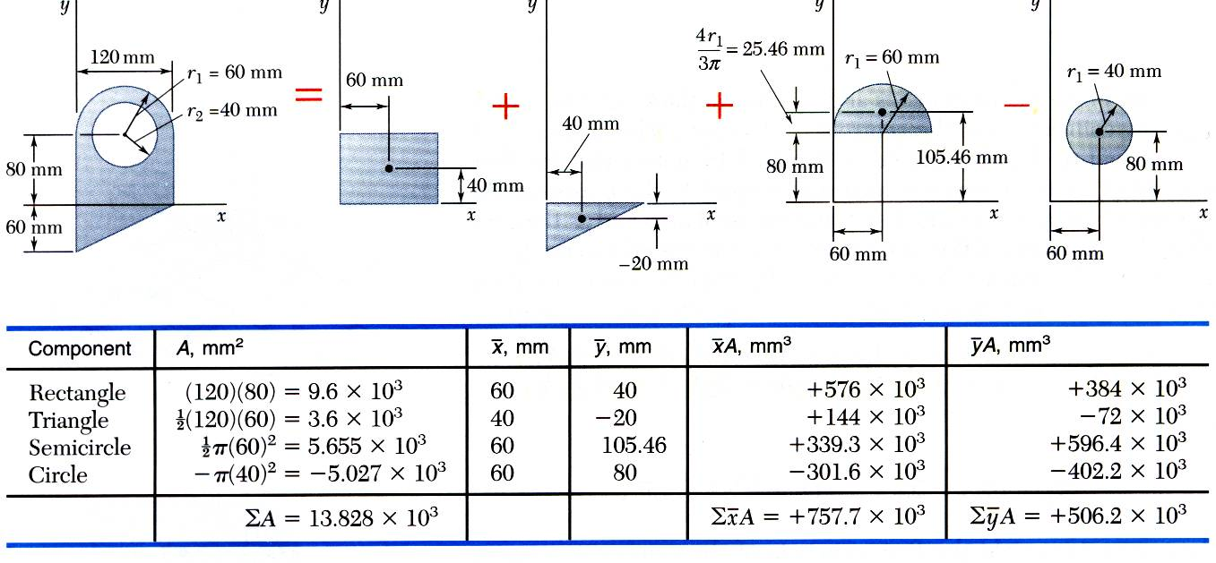
Sample Problem 1 - Continued
ENGINEERING MECHANICS : STATICS
Subtract the area of circular cutout section.
First Moments of the Area

Slide 24
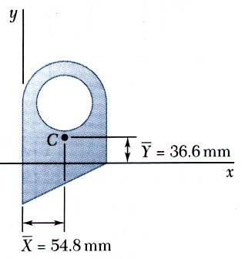
Sample Problem 1 - Continued
ENGINEERING MECHANICS : STATICS
Compute the coordinates of the centroid by dividing the first moments of areas by the total area as below:

Slide 25
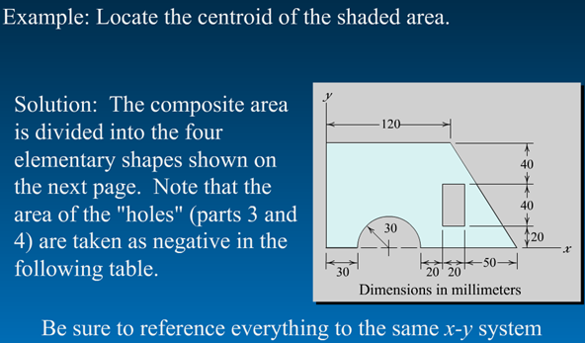
Sample Problem 2
ENGINEERING MECHANICS : STATICS
5 - 25

Slide 26
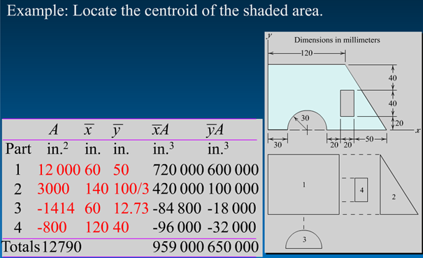
Sample Problem 2 - Continued
ENGINEERING MECHANICS : STATICS
Part mm² mm mm mm³ mm³
5 - 26

Slide 27
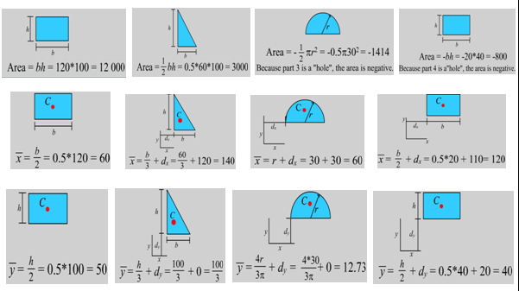
Sample Problem 2 - Continued
ENGINEERING MECHANICS : STATICS
Part1
Part2
Part3
Part4
Part1
Part2
Part3
Part4
Part1
Part2
Part3
Part4
5 - 27

Slide 28
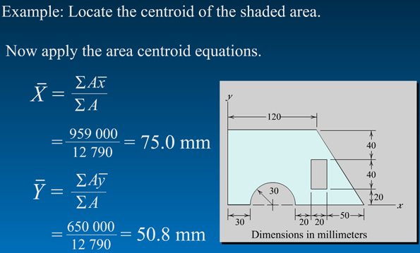
Sample Problem 2 - Continued
ENGINEERING MECHANICS : STATICS
5 - 28

Slide 29
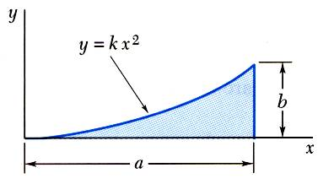
Sample Problem 3
ENGINEERING MECHANICS : STATICS
SOLUTION:
Determine the constant k.
Evaluate the total area.
Using either vertical or horizontal strips, perform a single integration to find the first moments.
Determine by direct integration the location of the centroid of a parabolic spandrel shown.
Evaluate the centroid coordinates.

Slide 30
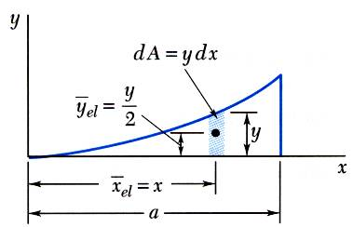
Sample Problem 3 - Continued
ENGINEERING MECHANICS : STATICS
SOLUTION:
Determine the constant k.
Evaluate the total area.

Slide 31
Sample Problem 3 - Continued
ENGINEERING MECHANICS : STATICS
Using vertical strips, perform a single integration to find the first moments.

Slide 32
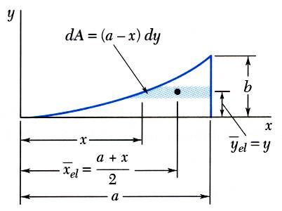
Sample Problem 3 - Continued
ENGINEERING MECHANICS : STATICS
Or, using horizontal strips, perform a single integration to find the first moments.

Slide 33



Sample Problem 3 - Continued
Evaluate the coordinates of centroid.
dA
dy
dx
Alternatively; if we take any differential element dA=dx.dy
Q_{y}=∫ ∫x.dx.dy=∫ [ ∫dy ].x.dx
Q_{y}=
a
0
0
a
Q_{x}=∫ ∫y.dx.dy=∫ [ ∫y.dy ].dx
Q_{x}=
0
0
5 - 33

Slide 34
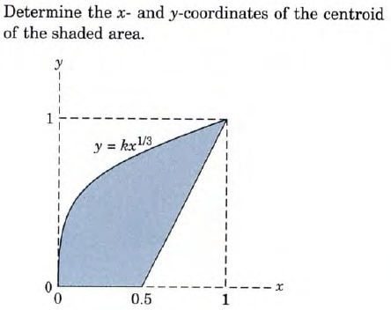
Sample Problem 4
5 - 34

Slide 35
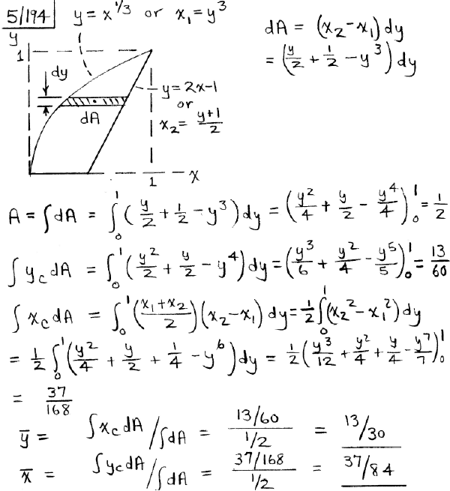


Sample Problem 4 - Continued
y_{el}=y_{c}= y
x_{el}=x_{c}= x₁+(x₂-x₁)/2 = (x₁+x₂)/2
5 - 35

Slide 36
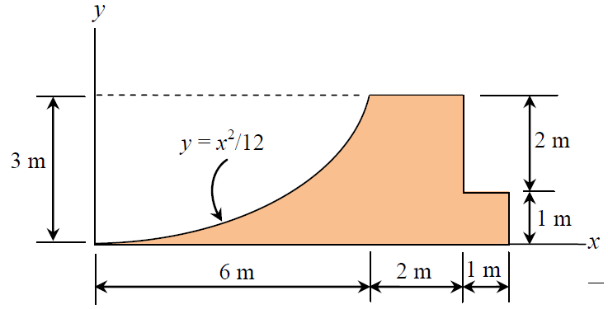

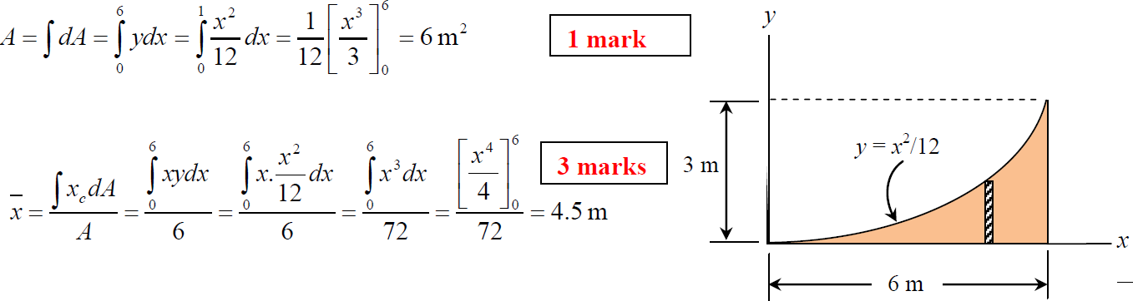
Sample Problem 5
ENGINEERING MECHANICS : STATICS
5 - 36

Slide 37
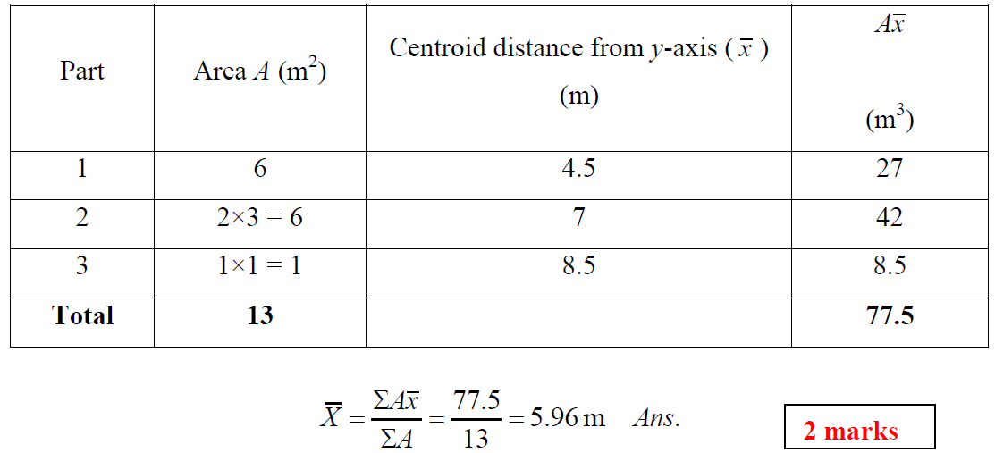
Sample Problem 5 - Continued
ENGINEERING MECHANICS : STATICS
2
1
3
5 - 37

