Slide 1
Chapter 5
Logical Database Design for the Relational Model
Pearson Education © 2009

Slide 2
Chapter 5 - Objectives
How to derive a set of relations from a conceptual data model.
To create relations for the logical data model to represent the entities, relationships, and attributes that have been identified.
Pearson Education © 2009

Slide 3
Build Logical Data Model
Pearson Education © 2009

Slide 4
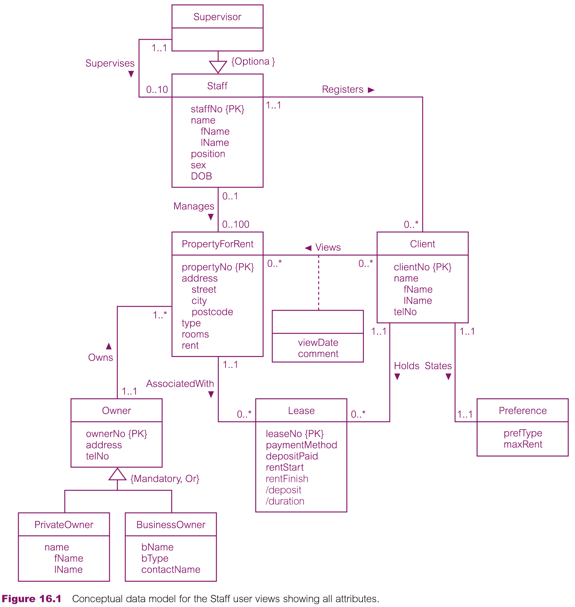
Conceptual data model for Staff view showing all attributes
Pearson Education © 2009

Slide 5
Derive relations for logical data model
(1) Strong entity types
For each strong entity in the data model, create a relation that includes all the simple attributes of that entity. For composite attributes, include only the constituent simple attributes.
Weak entity types
For each weak entity in the data model, create a relation that includes all the simple attributes of that entity.
A weak entity must include its Partial key and its owner entity type PK as a FK. The combination of the two keys form the PK of the weak entity.
Pearson Education © 2009

Slide 6
Example
Employee
Emp_NO{PK} Name Fname Mname Lname Sex Salary
Partial Key of Week entity
Dep NO
Dependent
Name Sex Relationship
1..1
Dependents of
0..*
Employee (Emp_NO, Fname,Mname ,Lname, Sex, Salary)
Primary Key Emp_NO
DEPENDENT (DepNo, EmpNo, Name, Sex, Relationship )
Primary Key DepNo, EmpNo
Foreign Key EMpNo refrences Employee (Emp_NO)
Pearson Education © 2009

Slide 7
Derive relations for logical data model
(3) One-to-many (1:*) binary relationship types
For each 1:* binary relationship, the entity on the ‘one side’ of the relationship is designated as the parent entity and the entity on the ‘many side’ is designated as the child entity. To represent this relationship, post a copy of the Primary Key attribute(s) of parent entity into the relation representing the child entity, to act as a foreign key.
OR
Entity with many cardinality in relationship is designated as parent entity, and entity with one cardinality is designated as child entity.
Pearson Education © 2009

Slide 8
Example
Child entity
Employee
Emp_NO{PK} Name Sex Salary
Parent entity
1..*
Branch
Branch_No {PK} Branch Name
Allocates
0..1
Employee (Emp_NO, Name, Sex, Salary,BranchNo)
Primary Key Emp_NO
Foreign Key BranchNo refrences Branch (Branch_No)
Branch (Branch_No, Branch Name)
Primary Key Branch_No
Pearson Education © 2009

Slide 9
Derive relations for logical data model
(4) One-to-one (1:1) binary relationship types
Creating relations to represent a 1:1 relationship is more complex as the cardinality cannot be used to identify the parent and child entities in a relationship. Instead, the participation constraints are used to decide whether it is best to represent the relationship by combining the entities involved into one relation or by creating two relations and posting a copy of the Primary Key from one relation to the other.
Consider the following
(a) mandatory participation on both sides of 1:1 relationship;
(b) mandatory participation on one side of 1:1 relationship;
(c) optional participation on both sides of 1:1 relationship.
Pearson Education © 2009

Slide 10
Derive relations for logical data model
(a) Mandatory participation on both sides of 1:1 relationship
Combine entities involved into one relation and choose one of the primary keys of original entities to be Primary Key of the new relation, while the other (if one exists) is used as an alternate key.
Pearson Education © 2009

Slide 11
Example
Employee
SSN{PK} Name Fname Mname Lname
Employee Info
Emp_NO{PK} Sex Salary DOB
1..1
has
1..1
Employee (Emp_NO, SSN, Fname,Mname,Lname, Sex, Salary, DOB)
Primary Key Emp_NO
Alternate key SSN
OR
Employee (SSN , Emp_NO, Fname,Mname ,Lname, Sex, Salary,DOB)
Primary Key SSN
Alternate key Emp_NO
Pearson Education © 2009

Slide 12
Derive relations for logical data model
(b) Mandatory participation on one side of a 1:1 relationship
Identify parent and child entities using participation constraints. Entity with optional participation in relationship is designated as parent entity, and entity with mandatory participation is designated as child entity. A copy of Primary Key of the parent entity is placed in the relation representing the child entity. If the relationship has one or more attributes, these attributes should follow the posting of the Primary Key to the child relation.
Pearson Education © 2009

Slide 13
Example
Parent entity
Employee
Emp_NO{PK} Name Sex Salary
Child entity
1..1
Branch
Branch_No {PK} Branch Name
Sdate Edate
Manages
0..1
Employee (Emp_NO, Name, Sex, Salary)
Primary Key Emp_NO
Branch(Branch_No, Branch Name,Emp_NO, Sdate,Edate)
Primary Key Branch_No
Foreign key Emp_No refrences Employee (Emp_NO)
Pearson Education © 2009

Slide 14
Derive relations for logical data model
(c) Optional participation on both sides of a 1:1 relationship
In this case, the designation of the parent and child entities is arbitrary unless we can find out more about the relationship that can help a decision to be made one way or the other.
Pearson Education © 2009

Slide 15
Example
Parent entity
Operation
Op_NO{PK}
Child entity
Child entity
0..1
Parent entity
We have the choice to post a copy of the Primary Key of Operation
entity to Surgery_Material entity or vice versa.
Surgery_Material
SM_No {PK} Statues
Uses
0..1
Operation(Op_NO, ……)
Surgery_Material(SM_No, Statues,Op_NO)
Operation(Op_NO, ……, SM_No)
Surgery_Material(SM_No, Statues)
Pearson Education © 2009

Slide 16
Example
Parent entity
Employee
Emp_NO{PK} Name Sex Salary
Child entity
0..1
If we assume the majority of cars but not all , are used by employee and that minority of employee use cars.
Therefore:
- The care entity is closer to begin mandatory than employee entity.
Car
Car_No {PK} Statues
Uses
0..1
Employee (Emp_NO, Name, Sex, Salary)
Primary Key Emp_NO
Car (Car_NO, Statues, Emp_NO)
Primary Key Car_NO
Pearson Education © 2009

Slide 17
(5)Recursive relationships Mapping conclusion
One-to-one (1:1) recursive relationships Single relation with two copies for the primary key with different names.
One-to-many (1:*) recursive relationships Single relation with two copies for the primary key with different names.
Many-to-many (*:*) recursive relationships Tow relations
One relation for the entity type.
And create a new relation to represent the relationship. The new relation would only have two attributes, both copies of the primary key.

Slide 18
Example a) One-to-one (1:1) recursive relationships
Business rule:
Each project must contain anther project, no more.
This case occurs rarely in real life applications.
Contains
Main
1..1
Project
Pro_No {PK} Statues
Sub
1..1
Project(Pro_No,SubPro_No, Statues)
OR
Project(Pro_No,MainPro_No, Statues)
Pearson Education © 2009

Slide 19
Example a) One-to-one (1:1) recursive relationships
Business rule:
Each project may contain anther project, no more.
Contains
Main
1..1
Project
Pro_No {PK} Statues
Sub
0..1
Project(Pro_No,MainPro_No, Statues)
Pearson Education © 2009

Slide 20
Example b)
One-to-many (1:*) recursive relationships
Has
Parts
1..*
Item
Item No{PK} Size
Base
1..1
Item(Item_No,Base_No, Size)
20
Pearson Education © 2009

Slide 21
Example c)
Many-to-many (*:*) recursive relationships
Contains
Parts
1..*
Item
Item No{PK} Size
Base
1..*
Item(Item_No, Size)
Parts(Item_No, Parts_No )
21
Pearson Education © 2009

Slide 22
Derive relations for logical data model
(6) Many-to-many (*:*) binary relationship types
Create a relation to represent the relationship and include any attributes that are part of the relationship. We post a copy of the Primary Key attribute(s) of the entities that participate in the relationship into the new relation, to act as foreign keys. These foreign keys will also form the Primary Key of the new relation, possibly in combination with some of the attributes of the relationship.
Pearson Education © 2009

Slide 23
Example
Employee
Emp_NO{PK} Name Sex Salary
1..*
Project
Proj_No {PK} Project Name
Hours
Works on
0..*
Employee (Emp_NO, Name, Sex, Salary, Branch No)
Primary Key Emp_NO
Project (Proj_No, ProjectName)
Primary Key Proj_No
Work-on(EmpNo,ProjNo, hours)
Primary Key Emp_NO Proj_No,
Pearson Education © 2009

Slide 24
Derive relations for logical data model
(7) Complex relationship types
Create a relation to represent the relationship and include any attributes that are part of the relationship. Post a copy of the Primary Key attribute(s) of the entities that participate in the complex relationship into the new relation, to act as foreign keys. Any foreign keys that represent a ‘many’ relationship (for example, 1..*, 0..*) generally will also form the Primary Key of this new relation, possibly in combination with some of the attributes of the relationship.
Pearson Education © 2009

Slide 25
Example
Sdate Edate
Business
BizNo {PK}
Supplier
SupNo {PK}
Contracts
Lawyer
LawNo, {PK}
Business (BizNo., ……)
Supplier(SupNo, ……..)
Lawyer(LawNo,…….…)
Contract(BizNo, SupNo, LawNo, StDate, EDate)
Pearson Education © 2009

Slide 26
Derive relations for logical data model
(8) Multi-valued attributes
Create a new relation to represent multi-valued attribute and include Primary Key of entity in new relation, to act as a foreign key. Unless the multi-valued attribute is itself an alternate key of the entity, the Primary Key of the new relation is the combination of the multi-valued attribute and the Primary Key of the entity.
Pearson Education © 2009

Slide 27
Example
The Primary Key of new relation:
- the multi-valued attribute if itself an alternate key. ( e.g. we sure that there are no duplicated tel_nos for employees ).
-OR the combination of the multi-valued attribute and the Primary Key of the entity. ( e.g. 2 brothers work in same company).
Employee
Emp_NO{PK} Name Sex Salary Tel_no [1..*]
Employee (Emp_NO, Name, Sex, Salary)
Primary Key Emp_NO
Telephone(Tel_no, EmpNo)
Primary Key Tel_no
OR
Telephone(Tel_no, EmpNo)
Primary Key Tel_no, EmpNo
Pearson Education © 2009

Slide 28
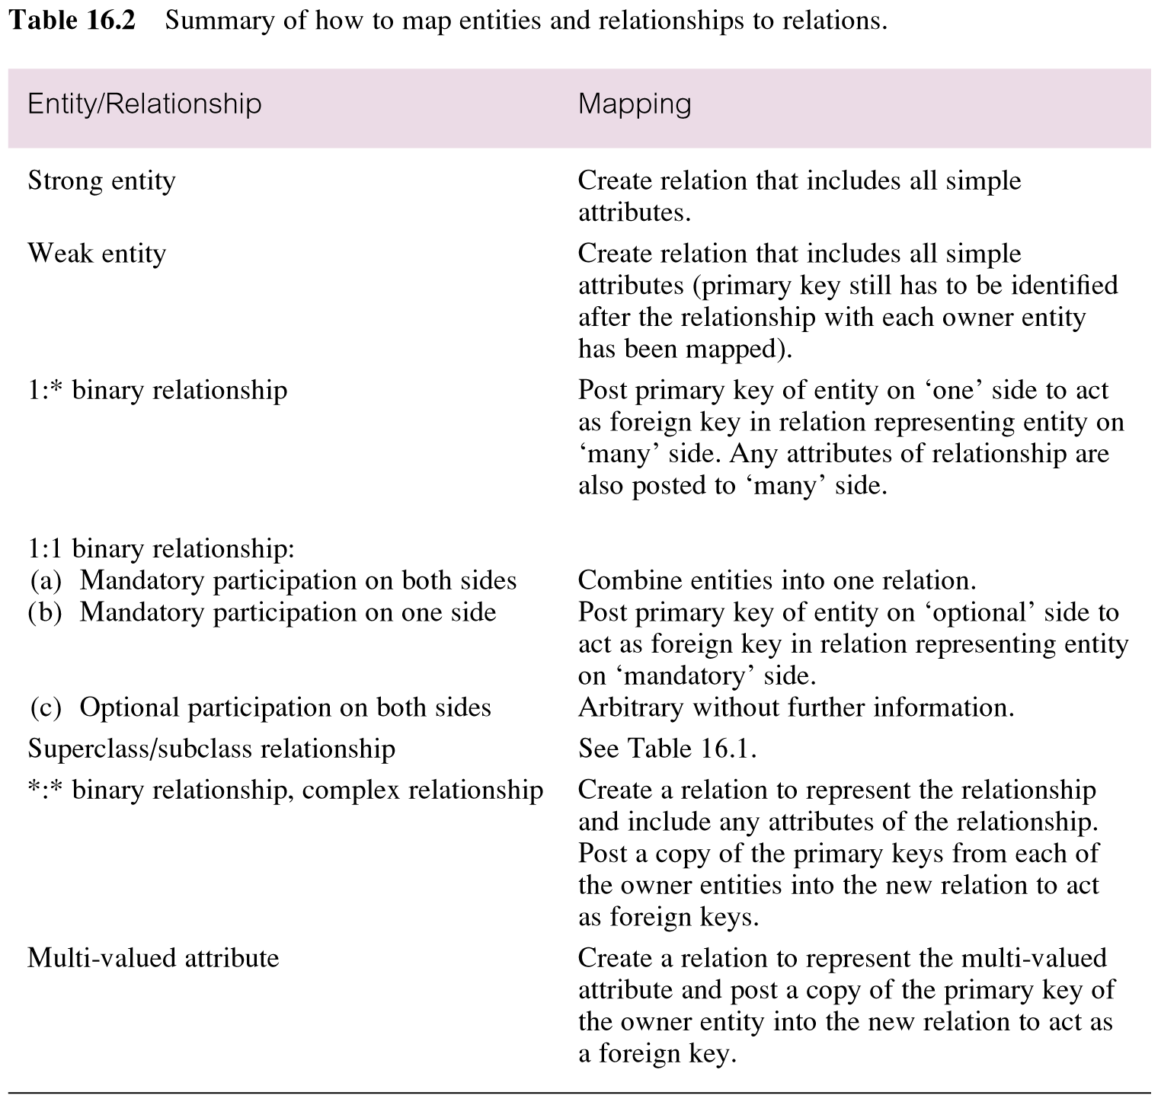
Summary of how to map entities and relationships to relations
Pearson Education © 2009

