Slide 1
GC 211:Data Structures Algorithm Analysis Tools
Slides are borrowed from Mr. Mohammad Alqahtani

Slide 2
Algorithm Analysis: Motivation
A problem can be solved in many different ways
Single problem, many algorithms
Which of the several algorithms should I choose?
We use algorithm analysis to answer this question
Writing a working program is not good enough
The program may be inefficient!
If the program runs on a large data set, then the running time becomes an issue

Slide 3
What is Algorithm Analysis?
A methodology to predict the resources that the algorithm requires
Computer memory
Computational time
We’ll focus on computational time
It does not mean memory is not important
Generally, there is a trade-off between the two factors
Space-time trade-off is a common term

Slide 4
How to Analyse Algorithms?
Experimental Approach
Implement algorithms as programs and run them on computers
Not a good approach, though!
Results only for a limited set of test inputs
Difficult comparisons due to the experiment environments (need the same computers, same operating systems, etc.)
Full implementation and execution of an algorithm
We need an approach which allows us to avoid experimental study

Slide 5
How to Analyse Algorithms?
Theoretical Approach
General methodology for analysing the running time
Considers all possible inputs
Evaluates algorithms in a way that is independent from the hardware and software environments
Analyses an algorithm without implementing it
Count only primitive operations used in an algorithm
Associate each algorithm with a function f(n) that characterises the running time of the algorithm as a function of the input size n
A good approximation of the total number of primitive operations

Slide 6
Primitive Operations
Basic computations performed by an algorithm
Each operation corresponding to a low-level instruction with a constant execution time
Largely independent from the programming language
Examples
Evaluating an expression (x + y)
Assigning a value to a variable (x ←5)
Comparing two numbers (x < y)
Indexing into an array (A[i])
Calling a method (mycalculator.sum())
Returning from a method (return result)

Slide 7
Counting Primitive Operations
Total number of primitive operations executed
is the running time of an algorithms
is a function of the input size
Example
Algorithm ArrayMax(A, n) # operations
currentMax ←A[0] 2: (1 +1)
for i←1;i<n; i←i+1 do 3n-1: (1 + n+2(n- 1))
if A[i]>currentMax then 2(n − 1)
currentMax ←A[i] 2(n − 1)
endif
endfor
return currentMax 1
Total: 7n − 2

Slide 8
Example 2
for(i = 1; i < n+1; i++){
sum = sum + i;prod = prod*(i);
}
1. i = 1 // 1 operation
2. if i <n+1 //n+1 operations
3. sum = sum + I //2n operations
4. prod = prod*(i) //2n operations
5. i++ // 2n operations
T(n)=7n+2

Slide 9
Algorithm Efficiency: Growth Rate
An algorithm’s time requirements can be expressed as a function of (problem) input size
Problem size depends on the particular problem:
For a search problem, the problem size is the number of elements in the search space
For a sorting problem, the problem size is the number of elements in the given list
How quickly the time of an algorithm grows as a function of problem size -- this is often called an algorithm’s growth rate

Slide 10
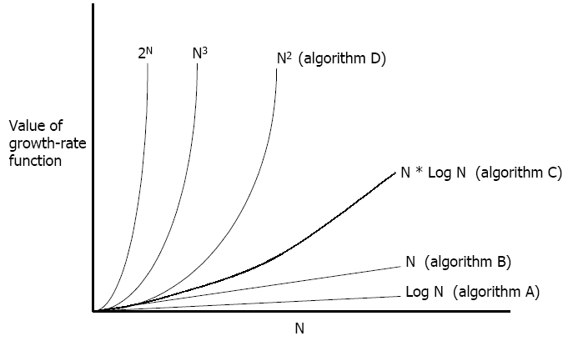
Algorithm Growth Rate
Which algorithm is the most efficient? [The one with the growth rate Log N.]

Slide 11
Algorithmic Time Complexity
Rather than counting the exact number of primitive operations, we approximate the runtime of an algorithm as a function of data size – time complexity
Algorithms A, B, C and D (previous slide) belong to different complexity classes
We’ll not cover complexity classes in detail
We’ll briefly discuss seven basic functions which are often used in complexity analysis

Slide 12
Seven Basic Function
Constant function f(n) = c
Linear function f(n) = n
Quadratic function f(n) = n²
Cubic function f(n) = n³
Log function f(n) = log n
Log linear function f(n) = n log n
Exponential function f(n) = 2^{n}

Slide 13
Algorithmic Runtime
Worst-case running time
measures the maximum number of primitive operations executed
The worst case can occur fairly often
e.g. in searching a database for a particular piece of information
Best-case running time
measures the minimum number of primitive operations executed
Finding a value in a list, where the value is at the first position
Sorting a list of values, where values are already in desired order
Average-case running time
the efficiency averaged on all possible inputs
maybe difficult to define what “average” means

Slide 14
Complexity Classes
Suppose the execution time of algorithm A is a quadratic function of n (i.e. an² + bn + c)
Suppose the execution time of algorithm B is a linear function of n (i.e. an + b)
Suppose the execution time of algorithm C is a an exponential function of n (i.e. a2^{n})
For large problems higher order terms dominate the rest
These three algorithms belong to three different “complexity classes”

Slide 15
Big-O and Function Growth Rate
We use a convention O-notation (also called Big-Oh) to represent different complexity classes
The statement “f(n) is O(g(n))” means that the growth rate of f(n) is no more than the growth rate of g(n)
g(n) is an upper bound on f(n), i.e. maximum number of primitive operations
We can use the big-O notation to rank functions according to their growth rate

Slide 16
Big-O: Functions Ranking
BETTER
WORSE
O(1) constant time
O(log n) log time
O(n) linear time
O(n log n) log linear time
O(n²) quadratic time
O(n³) cubic time
O(2^{n}) exponential time

Slide 17
Big Oh: Some Examples
n³ – 3n = O(n³)
1 + 4n = O(n)
7n² + 10n + 3 = O(n²)
2^{n} + 10n + 3 = O(2^{n})

Slide 18
Asymptotic Algorithm Analysis
Determines the running time in big-O notation
Asymptotic analysis
find the worst-case number of primitives
operations executed as a function of the input size
express this function with big-O notation
Example:
algorithm arrayMax executes at most 7n − 2primitive operations
algorithm arrayMax runs in O(n) time

Slide 19
Practice:
Express the following functions in terms of Big-O notation (a, b and c are constants)
f(n) = an² + bn + c
f(n) = 2^{n} + n log n + c
f(n) = n log n + b log n + c

