Slide 1
GC211Data Structure
Lecture2
Sara Alhajjam

Slide 2
Prerequisites
Variables and expressions.
Methods (functions or procedures ).
Decision structures( like if-statements and switch-statements).
Iteration structures (for-loops and while-loops).
Classes and objects

Slide 3
What is data structure?
A particular way of storing and organizing data in a computer so that it can be used efficiently and effectively.
Data structure is the logical or mathematical model of a particular organization of data.
A group of data elements grouped together under one name.
For example, an array of integers

Slide 4
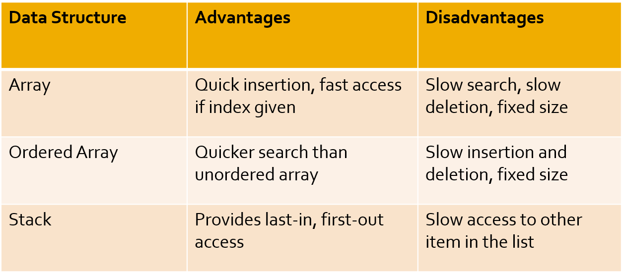
Types of data structures
Types of data structures and its strength and weaknesses

Slide 5
Types of data structures

Slide 6
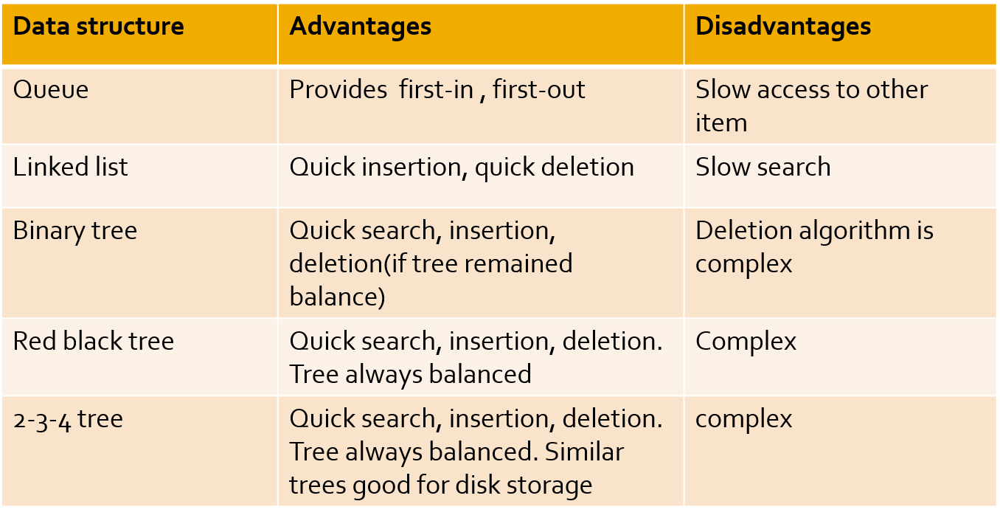
Types of data structures

Slide 7
Types of data structures
Array
Linked List
Queue
Stack
Tree
There are many, but we named a few. We’ll learn these data structures in great detail!

Slide 8
The Need for Data Structures
Goal: to organize data
Criteria: to facilitate efficient
storage of data
retrieval of data
manipulation of data
Design Issue:
select and design appropriate data types (This is the main motivation to learn and understand data structures)

Slide 9
Data Structure Operations
Searching
Finding the location of the data element (key) in the structure
Insertion
Adding a new data element to the structure
Deletion
Removing a data element from the structure
Sorting
Arrange the data elements in a logical order (ascending/descending)
Merging
Combining data elements from two or more data structures into one

Slide 10
Programming phases
A typical programming task can be divided into 2 phases:
Problem solving phase
produce an ordered sequence of steps that describe a solution of the problem
this sequence of steps is called an algorithm
Implementation/Programming phase
implement the program in some programming language

Slide 11
What is algorithm?
A finite set of instructions which accomplish a particular task
A method or process to solve a problem
Transforms input of a problem to output
Algorithm = Input + Process + Output
Algorithm development is an art – it needs practice, practice and only practice!

Slide 12
What Is A Good Algorithm?
It must be correct
It must be finite (in terms of time and size)
It must terminate
It must be unambiguous
A program is an instance of an algorithm, written in some specific programming language

Slide 13
A Simple Algorithm
Problem: Find maximum of a, b, c
Algorithm
Input = a, b, c
Output = max
Process
Let max = a
If b > max then
max = b
If c > max then
max = c
Display max
Order is very important!!!

Slide 14
Algorithm development: Basics
Clearly identify:
what is the input?
what output is required?
What steps are required to transform input into output
Needs problem solving skills
A problem can be solved in many different ways
Which solution, among the different possible solutions is optimal?

Slide 15
How to express an algorithm?
A sequence of steps to solve a problem
We need a way to express this sequence of steps
Natural language (NL) is an obvious choice, but not a good choice. Why?
NLs are ambiguous (unclear)
Programming language (PL) is another choice, but again not a good choice. Why?
Algorithm should be PL independent
We need some balance
We need PL independence
We need clarity
Pseudo-code provides the right balance

Slide 16
What is Pseudo-code?
Pseudo-code is a short hand way of describing a computer program
Rather than using the specific syntax of a computer language, more general wording is used
It is a mixture of NL and PL expressions, in a systematic way
Using pseudo-code, it is easier for a non-programmer to understand the general workings of the program

Slide 17
Pseudo-code: General Guidelines
Use PLs construct that are consistent with modern high level languages, e.g. C++, Java, ...
Use appropriate comments for clarity
Be simple and precise

Slide 18
Components of Pseudo-code
Expressions
Standard mathematical symbols are used
Left arrow sign (←) as the assignment operator in assignment statements (equivalent to the = operator in Java)
Equal sign (=) as the equality relation in Boolean expressions (equivalent to the "= =" relation in Java)
For example
Sum ← 0
Sum ← Sum + 5
What is the final value of sum?

Slide 19
Components of Pseudo-code (cont.)
Decision structures (if-then-else logic)
if condition then true-actions [else false-actions]
We use indentation to indicate what actions should be included in the true-actions and false-actions
For example
if marks > 50 then
print “Congratulation, you are passed!”
else
print “Sorry, you are failed!”
end if
What will be the output if marks are equal to 75?

Slide 20
Components of Pseudo-code (cont.)
Loops (Repetition)
Pre-condition loops
While loops
while condition do actions
We use indentation to indicate what actions should be included in the loop actions
For example
while counter < 5 do
print “Welcome to CS204!”
counter ← counter + 1
end while
What will be the output if counter is initialized to 0?

Slide 21
Components of Pseudo-code (cont.)
Loops (Repetition)
Pre-condition loops
For loops
for variable-increment-definition do actions
For example
for counter ← 0; counter < 5; counter ← counter + 2 do
print “Welcome to CS204!”
end for
What will be the output?

Slide 22
Components of Pseudo-code (cont.)
Loops (Repetition)
Post-condition loops
Do loops
do actions while condition
For example
do
print “Welcome to CS204!”
counter ← counter + 1
while counter < 5
What will be the output, if counter was initialized to 10?
The body of a post-condition loop must execute at least once

Slide 23
Components of Pseudo-code (cont.)
Method declarations
Return_type method_name (parameter_list) method_body
For example
integer sum ( integer num1, integer num2)
start
result ← num1 + num2
end
Method calls
object.method (args)
For example
mycalculator.sum(num1, num2)

Slide 24
Components of Pseudo-code (cont.)
Method returns
return value
For example
integer sum ( integer num1, integer num2)
start
result ← num1 + num2
return result
end

Slide 25
Components of Pseudo-code (cont.)
Comments
/* Multiple line comments go here. */
// Single line comments go here
Some people prefer braces {}, for comments
Arrays
A[i] represents the ith cell in the array A.
The cells of an n-celled array A are indexed from A[0] to A[n − 1] (consistent with Java).

Slide 26
Algorithm Design: Practice
Example: Determining even/odd number
A number divisible by 2 is considered an even number, while a number which is not divisible by 2 is considered an odd number. Write pseudo-code to display odd/even numbers in a given range.

Slide 27
Even/Odd Numbers
Input range
for num←0; num<=range; num←num+1 do
if num % 2 = 0 then
print num is even
else
print num is odd
endif
endfor

