Slide 1
Ethics

Slide 2
Ethics
Analyze an argument to identify premises and conclusion using ethical theories
Understand the use of ethical theories in ethical arguments
Detect basic logical fallacies in an argument
Articulate the ethical tradeoffs in a technical decision
Understand the role of professional codes of ethics

Slide 3
Premises & Conclusion using Ethical Theories
Athenian court sentenced Socrates to death for going around Athens asking its citizens the ultimate questions of human existence
“The unexamined life is not worth living”, Socrates
He believed in a science that represents rational over meaningless existence
Socrates’s pursuit was due to Greeks’ curiosity and the desire to learn about themselves, human life and Society
This led to the examination of all human life and philosophers termed it as Ethics
Ethics can also be defined as a theoretical examination of morality or “theory of morals”

Slide 4
Definition of Ethics as a set of Theories
The word ethics comes from the ancient Greek word eché, which means character
Robert C. Solomon, defines ethics as a set of “theories of value, virtue, or of right (valuable) action”
O.J. Johnson, defines ethics as a set of theories “that provide general rules or principles to be used in making moral decisions and, unlike ordinary intuitions, provides a justification for those rules”
Every human society practices ethics in some way because, every society attaches a value of good to bad to an individual’s actions according to where the actions fall within the domain of that society’s rules

Slide 5
Definition of Ethics
Ethics
Set of beliefs about right and wrong behavior
Moral principles that govern a person's behaviour or the conducting of an activity.
Virtues
Habits that incline people to do what is acceptable
Vices
Habits of unacceptable behavior
Virtues and vices define a personal value system
Scheme of moral values

Slide 6
The Role of Ethics
The role of ethics is to help societies distinguish between right and wrong
A basis for justifying the judgment of human actions in a society
Ethics is, therefore, a field of inquiry whose subject is human actions, collectively called human conduct, that are taken consciously, willfully, and for which one can be held responsible
According to Fr. Austin Fagothey, such acts must have knowledge and have freedom to signify the presence of free choice to act or not to act

Slide 7
The Purpose of Ethics
Purpose is to interpret human conduct, acknowledging and distinguishing between right and wrong
The interpretation is based on a system which uses a mixture of induction and deduction
In most cases, these arguments are based on historical schools of thought called ethical theories
There are many different kinds of ethical theories, and within each theory there may be different versions of that theory

Slide 8
Ethical Theories
Human actions are judged good or bad, right or wrong based on theories or systems of justice
Such theories are commonly known as ethical theories
An ethical theory determines if an action or set of actions is morally right or wrong and the codes of ethics are based on ethical theories
Ethical theories fall into two categories:
those based on one choosing his or her action based on the expected maximum value or values as a consequence of the action and
those based on one choosing his or her action based on one’s obligation or requirements of duty
The Greeks called the first category of theories telos, meaning purpose or aim. We now call these teleological or consequentialist theories
The Greeks called the second category of theories deon, meaning binding or necessary. Today, we call them deontological theories

Slide 9
Consequentialist Theories
Right action → good consequences
Those who subscribe to this position are called consequentialists.
Consequentialist theories judge human actions as good or bad, right or wrong, based on the best attainable results of such actions—a desirable result denotes a good action, and vice versa
Richard T. Hull, consequentialist theories “have three parts: a theory of value, a principle of utility, and a decision procedure”

Slide 10
Consequentialist Theories
For example, in the theory of value there are several other theories held by consequentialists including:
Hedonism, which equates good with pleasure, bad or evil with pain
Eudamonism, which equates good with happiness, bad or evil with unhappiness
Agathism, which views good as an indefinable, intrinsic feature of various situations and states
Agapeism, which equates good with love, bad with hate
Values pluralism, which holds that there are many kinds of good, including pleasure and happiness, but also knowledge, friendship, love, and so forth

Slide 11
Deontological Theories
The theory of deontological reason does not concern itself with the consequences of the action but rather with the will of the action
An action is good or bad depending on the will inherent in it
According to deontological theory, an act is considered good if the individual committing it had a good reason to do so
For example, we know that hitting is bad, but if an armed intruder enters your house and you hurt him in self defense, your action is good, according to deontologists. You did it because you had a duty to protect your family and property

Slide 12
Types of Deontological theories
Deontologists fall into two categories: act deontologists and rule deontologists
Act deontologists consider every judgment of moral obligation to be based on its own merit. We decide separately in each particular situation what is the right thing to do
Rule deontologists consider that one’s duty in any situation is to act within rules

Slide 13
Layers of Reasoning
The process of ethical reasoning takes several steps before one can justify to someone else the goodness or badness, rightness or wrongness of one’s action
For example, if you want to convince someone to own a corporate insurance, you need to explain that person why is it beneficial
In such an exercise, you may start by explaining that we are living in difficult times and that it is usually not safe
Then the person will ask why it is not safe, to which you might reply…

Slide 14
The Spectrum of Human Actions
Human actions are wide-ranging, from simple, traditional and easy to understand actions like happiness or sadness, to complex and abstract ones like hacking, mobile phone scanning
On one side, the inputs have straight output value judgments
The other end of the spectrum, however, has inputs that cannot be easily mapped into the same output value judgments and the actions of this side are created as a result of computer technology
It is at this end, therefore, that we need an updated definition of ethics—a functional definition

Slide 15
Codes of Ethics
The main domains in which ethics is defined are governed by particular guidelines called codes of ethics
These rules, guidelines, canons, advisories, are usually followed by members of the respective domains
For example, your family has an ethical set of rules that every member of the family must observe
Your University has a set of conduct rules that all students, staff and faculty must observe that govern the use of computers and Internet Services

Slide 16
Codes of Ethics (Contd)
So depending on the domain, ethical codes can take any of the following forms:
principles, which may act as guidelines, references, or bases for some document;
public policies, which may include aspects of acceptable behavior,
norms, and practices of a society or group;
codes of conduct, which may include ethical principles; and
legal instruments, which enforce good conduct through courts
Although the use of ethical codes is still limited to professions and high visibility institutions and businesses, there is a growing movement toward widespread use

Slide 17
Professional Code of Ethics
Some codes are written purposely for the public, others target employees, and yet others are for professionals only
For Example, Association of Computing Machinery (ACM) and the Institute of Electric and Electronics Engineers’ Computer Society (IEEE Computer), both professional organizations
Codes for the ACM can be found at www.acm.org/code-of-ethics
IEEE Computer at www.ieee.org

Slide 18
ACM Code of Ethics and Professional Conduct
GENERAL ETHICAL PRINCIPLES
Contribute to society and to human well-being, acknowledging that all people are stakeholders in computing
Avoid harm
Be honest and trustworthy
Be fair and take action not to discriminate
Respect the work required to produce new ideas, inventions, creative works, and computing artifacts
Respect privacy
Honor confidentiality

Slide 19
ACM Code of Ethics and Professional Conduct
PROFESSIONAL RESPONSIBILITIES
Strive to achieve high quality in both the processes and products of professional work
Maintain high standards of professional competence, conduct, and ethical practice
Know and respect existing rules pertaining to professional work
Accept and provide appropriate professional review
Give comprehensive and thorough evaluations of computer systems and their impacts, including analysis of possible risks
Perform work only in areas of competence
Foster public awareness and understanding of computing, related technologies, and their consequences
Access computing and communication resources only when authorized or when compelled by the public good
Design and implement systems that are robustly and usably secure

Slide 20
ACM Code of Ethics and Professional Conduct
PROFESSIONAL LEADERSHIP PRINCIPLES
Ensure that the public good is the central concern during all professional computing work
Articulate, encourage acceptance of, and evaluate fulfillment of social responsibilities by members of the organization or group
Manage personnel and resources to enhance the quality of working life
Articulate, apply, and support policies and processes that reflect the principles of the Code
Create opportunities for members of the organization or group to grow as professionals
Use care when modifying or retiring systems
Recognize and take special care of systems that become integrated into the infrastructure of society

Slide 21
ACM Code of Ethics and Professional Conduct
COMPLIANCE WITH THE CODE
Uphold, promote, and respect the principles of the Code
Treat violations of the Code as inconsistent with membership in the ACM

Slide 22
Objectives of Codes of Ethics
Different domains and groups of people formulate different codes of ethics, but they all have the following objectives:
Disciplinary: By instilling discipline, the group or profession ensures professionalism and integrity of its members
Advisory: Codes are usually a good source of tips for members, offering advice and guidance in areas where moral issues are fuzzy
Educational: Ethical codes are good educational tools for members of the domain, especially new members who have to learn the dos and don’ts of the profession
Inspirational: Besides being disciplinary, advisory, and educational, codes should also carry subliminal messages to those using them to inspire them to be good
Publicity: One way for professions to create a good clientele is to show that they have a strong code of ethics and, therefore, their members are committed to basic values and are responsible

Slide 23
The Relevancy of Ethics to Modern Life
Socrates, “the unexamined life is not worth living” before the Athens court in 399 BC, human life was the same as it is today in almost every aspect except quality
Not much has changed in the essence of life since Socrates’s time and now
We still struggle for the meaning of life, we work to improve the quality of life and we do not rest unless we have love, justice and happiness for all
Socrates spent time questioning the people of Athens so that they, together with him, could examine their individual lives to find “What I Individually Ought to Do” and “To Improve the Lot of Humankind”
Many philosophers and those not so schooled believe that this is the purpose of ethics
The purpose of ethics has been and continues to be, to promote the achievement of the “The Best,” over the long- term

Slide 24
The Difference Between Morals, Ethics, and Laws
Morals: one’s personal beliefs about right and wrong
Ethics: standards or codes of behavior expected of an individual by a group
Law: system of rules that tells us what we can and cannot do
Laws are enforced by a set of institutions
Legal acts conform to the law
Moral acts conform to what an individual believes is the right belief of right and wrong

Slide 25
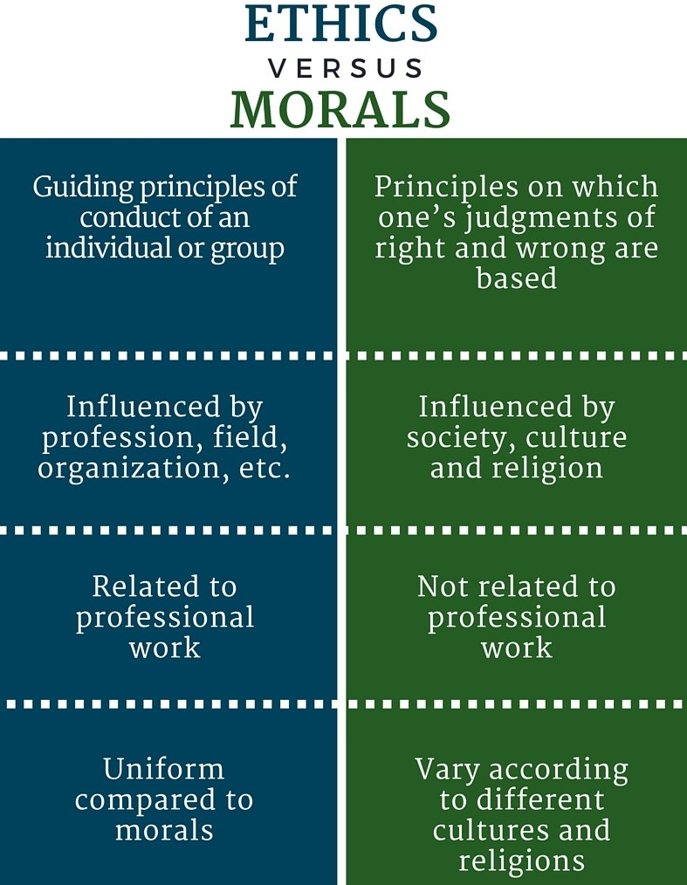
Difference between Ethics and Morality

Slide 26
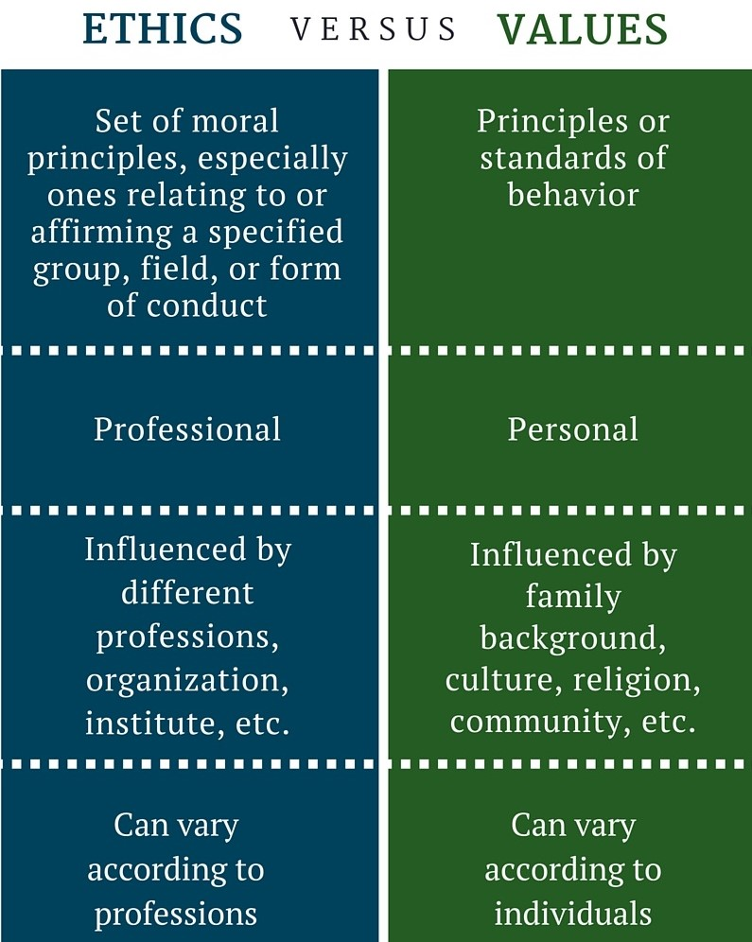
Contrast of Ethics and Moral Values

Slide 27
Next Week
Morality, Technology and Value:
Identify assumptions and values embedded in a particular computer product design including those of a cultural nature
Understand the moral value of technology
Understand the role morality plays in decision making
Describe positive and negative ways in which computing alters the way decisions are made by different people
Explain why computing/network access is restricted in some countries
Analyze the role and risks of computing in the implementation of public policy and government
Articulate the impact of the input deficit from diverse populations in the computing profession

