Slide 1
Experiment : Quantitative determination of glucose 6-phosphat dehydrogenase deficiency hemolysed RBC sample
Experiment : Qualitative determination of hemoglobin S
(HbS) in blood.
Experiment : Quantitative determination of iron in serum

Slide 2
Experiment :
Quantitative determination of glucose 6-phosphate dehydrogenase deficiency hemolysed RBC sample

Slide 3
Objective:
Quantitative determination of glucose 6-phosphate dehydrogenase (G6P-DH) activity in erythrocytes (hemolysate).
Introduction:
G6PD is the enzyme responsible for the initial deviation of glucose into pentose phosphate pathway to form 6-phosphogluconate.
Most of the interest of G6P-DH on its role in the erythrocyte. it functions to maintain NADPH in its reduced form. An adequate concentration of NADPH is required to regenerate sulfhydryl-containing proteins, such as glutathione, from the oxidized to the reduced state. Glutathione in the reduced form, in turn, protects hemoglobin from oxidation by agents that may be present in the cell.

Slide 4
deficiency of G6P-DH consequently results in an inadequate supply of NADPH and, in the end, the inability to maintain reduced glutathione levels. When erythrocytes are exposed to oxidizing agents, hemolysis occurs because of oxidation of hemoglobin and to damage of the cell membrane.
G6P-DH deficiency is an inherited (X)Sex-linked recessive trait.
The disorder can results in several different clinical manifestations, one of which is drug-induced hemolytic anemia. When exposed to an oxidant drug such as anti-malarial drug,
G6P-DH deficiency is most common in African Americans,

Slide 5
Principle:
Glucose + NADP⁺ ^{G6P-DH} 6-Phosphogluconate + NADPH + H⁺
The enzyme G6PD is catalyses the dehydrogenation of glucose 6-phosphate as the first step in pentose phosphate pathway. NADP⁺, the electron acceptor, is reduced to NADPH in the reaction. The pH optimum for the G6P-DH reaction is 8.3 for the enzyme from yeast or blood cells. The rate of formation of NADPH is a measure of the G6P-DH activity and it can be followed by means of the increase in extinction at 340 nm .
Method:
A red cell hemolysate is used to assay for deficiency of the enzyme
By using the kit.

Slide 6
Procesure:
Pipette into clean and dry test tubes
3 ml | G6P-DH Buffer
100 µl | NADP reagent
50 µl | Hemolysate
50 µl | G6P-DH Substrate
Mix and after 30 seconds read initial absorbance at 340 nm against distilled water. Repeat absorbance reading every min for 3 min and calculate ΔA/min

Slide 7
Calculations
G6P-DH Activity in mU/erythrocytes/ml of blood( P)= ΔA/min X 30868=
If the erythrocytes count per ml of blood is 4.5 X 10⁹
Then the G6P-DH activity in mU/ 10⁹ cells = P/4.5
Abnormal value= 0- 11 mU/ 10⁹ cells.

Slide 8
Experiment :
Qualitative determination of hemoglobin S
(HbS) in blood.

Slide 9
Objective:
Qualitative determination of hemoglobin S (HbS) in blood using a phosphate solubility method.
Introduction:
There are hundreds of hemoglobin variants , and the most common an important are:
Hemoglobin A. This is normal hemoglobin that exists after birth.
It consist of (α2β2). In normal adult 95% of Hb is present as HbA
• Hemoglobin A2. This is a minor component of the hemoglobin found in red cells after birth
and consists of (α2δ2) , less than 3% of the total red cell hemoglobin.
• Hemoglobin F. Hemoglobin F is the predominant hemoglobin during fetal development. (α2γ2).

Slide 10
Clinically Significant Variant Hemoglobins:(abnormal Hb):
• Hemoglobin S. The alpha chain is normal. The disease-producing mutation exists in the beta chain, giving the molecule the structure, α2βS2.
Hb S can inherited in the homozygous state (S/S) result in sickle cell anemia or heterozygous state (A/S) is usually benign (sickle cell trail)

Slide 11
point mutation in the Hb β gene is responsible for the sickling of RBCs seen in sickle cell anemia .
The abnormality is due to Substitution of non polar valine for a charged Glutamic acid in position 6 in the β chain .
Hb S will appear in Sickle cell anemia patients and in sickle cell trail(carrier)

Slide 12
Individuals with Hb-S will be at high risk when exposed to conditions of low oxygen tension such as surgery, high altitude or athletics which may results in serious and fatal clinical complications. In order to avoid or minimize these clinical complications, it is important to screen the individuals for the presence of Hb-S.

Slide 13
Method:
By kit , this test is a simple and rapid method for determination of the presence of HbS
Principle:
Erythrocytes are lysed (by saponin) and the released hemoglobin is reduced (by dithionite) in phosphate buffer. Reduced HbS is characterized by ites very low solubility . So that in the presence of HbS or non-S sickling Hb the system become turbid.

Slide 14
Procedure:
test
2 ml | Sickling solution
0.02 ml (20 µl) | Patient sample (whole blopd)
Mix by inversion and allow stand at room temperature for 5 to 10 min
Read the test by holding the test tube approximately 3 cm in front of a lined scale on the card.
Pipette into clean dry test tube
HbS was present, the solution is turbid and the lines behind the test tube will not be visible while, if no sickling hemoglobin was present the clear solution will permit the lines to be seen through the test tubes

Slide 15
Experiment :
Quantitative determination of iron in serum
Quantitative determination of iron , unsaturated iron binding capacity (UIBC) and total iron binding capacity (TIBC) in serum using a colorimetric method.

Slide 16
Objective:
To determine the normal level of serum iron.
And use this test in diagnosis of anemia.(iron deficiency)
Introduction:
Iron is the metal component of hemoglobin, myoglobin cytochromes and some proteins of the electron transport chain. The total iron of an adult male is 4-5g and of a female 3-4g. of this 65% is as hemoglobin, 25% as stored iron ( ferritin and hemosiderin ),10% as other forms ( myoglobin, cytochromes etc. ) and only 0.1 %as serum iron.
Iron is carried in Fe3+ state bound to a specific iron transport protein known as transferrin.
Transferrins : are iron-binding blood plasma glycoproteins that control the level of free iron in biological fluids (When iron stores become low, transferrin levels will increase. When there is too much iron, transferrin levels are low) . it contains two specific high-affinity Fe(III) Ferric binding sites. It has high affinity to bind with Fe(III).

Slide 17
Transferrin distributes iron to those tissues which have a demand for its utilization.
Individuals who lack transferrin show severe hypochromic anemia and are also susceptible to bacterial and viral infections.
Total iron-binding capacity (TIBC) is a medical laboratory test that measures the blood's capacity to bind iron with transferrin , it is measuring the maximum amount of iron that it can carry,( which indirectly measures transferrin since transferrin)

Slide 18
TIBC calculated by adding serum iron and UIBC .
Total iron-binding capacity (TIBC) is most frequently used along with a serum iron test to evaluate people suspected of having either iron deficiency anemia or iron overload (hemochromatosis)
Defect in Serum iron
Serum iron is low in iron deficiency anemia whether due to insufficient intake, malabsorption or blood loss.
Low values are also found with anemia of most chronic infections.
Serum iron concentration is high when marrow cannot utilize iron as in pernicious anemia, in thalassemia and hemolysis. High values are also found in severe hepatitis due to release from liver cells. In patients with anemia,

Slide 19
Defect in Iron binding capacity (Saturated and unsaturated)
increase in iron deficient anemia
Decrease in hemochromatosis , malignant or rheumatic fever .
Normal range of serum iron :
50-160μg/dl
Normal range of TIBC :
250 – 450 µg/dl

Slide 20
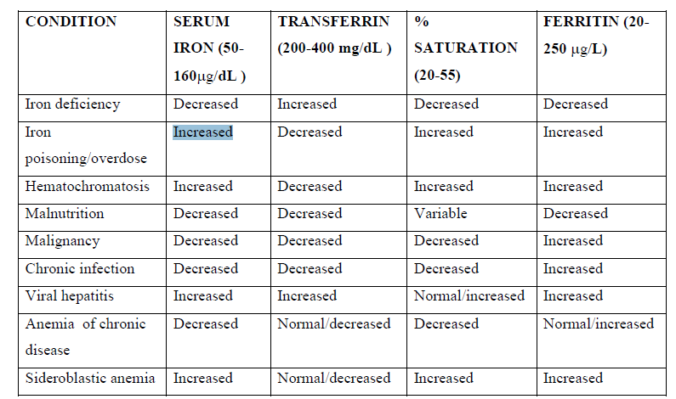

Slide 21
Method: By kit
Principle:
Serum iron : the iron dissociated from its Fe-III-transferrin complex by addition of acidic buffer containing hydroxylamine which reduces the Fe(III) to Fe(II) . Then the chromogenic agent (PDTS)form a highly colored Fe(II) complex that is measure spectrophotometric at 565nm .
UIBC: determined by adding Fe(II) to serum so that bind to unsaturated iron binding site on transferrin . The excess Fe(II) are reacted with PDTS to form color complex which is measured spectrphotometric . The difference between the amount of Fe(II) added and the amount of Fe(II) measured represent the UIBC
TIBC is determined by adding serum iron to UIBC value.
Notes:
PDTS :3-(2-Pyridyl)5, 6-Diphenyl-1, 2, 4-Triazine-p, p'-Disulfonic Acid Disodium Salt Trihydrate.

Slide 22
Procedure:
UIBC |  |  | IRON
TEST | STD | BLANK | TEST | STD | BLANK
- | - | - | 2.5 ml | 2.5 ml | 2.5 ml | IRON BUFFER
2 ml | 2 ml | 2 ml | - | - | - | UIBC BUFFER
0.2 ml | 0.2 ml | - | - | 0.2 ml | - | IRON STD
0.2 ml | - | - | 0.2 ml | - | - | SAMPLE
- | 0.2 ml | 0.4 ml | - | - | 0.2 ml | WATER
Mix and read the absorbance of std and test (iron) at 565 nm against blank. Also read the absorbance of std and test (UIBC) against blank
0.05 ml | 0.05 ml | 0.05ml | 0.05 ml | 0.05 ml | 0.05 ml | Iron reagent color
Mix and incubate at 37c for 10 min Mix and read the absorbance of std and test (iron) at 565 nm against blank. Also read the absorbance of std and test (UIBC) against blank

Slide 23
Calculation
Iron concentration µg/dl= (Abs. of test/Abs. of std) X Std conc. =
if you know the Std Conc. = 500 µg/dl
SERUM IRON + SERUM UIBC = SERUM TIBC)
(μg/dL) (μg/dL) (μg/dL)
Transferring saturation %= serum iron concentration . 100
TIBC

