Slide 1
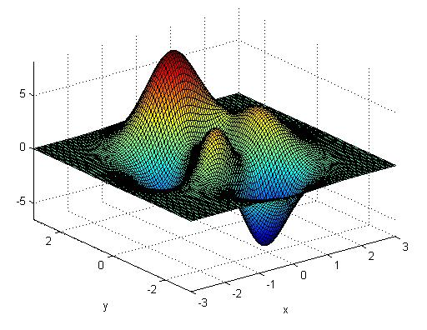
CHAPTER 5
How to PLOT?
Minimum Required: | 5-1-1 to 5-1-3 5-2 5-3-2 to 5-3-6 5-4-1 5-5 5-6 5-7

Slide 2
Why graphs?
Identify trends (increasing, decreasing, high/low points, outliers,missing data…etc)

Slide 3
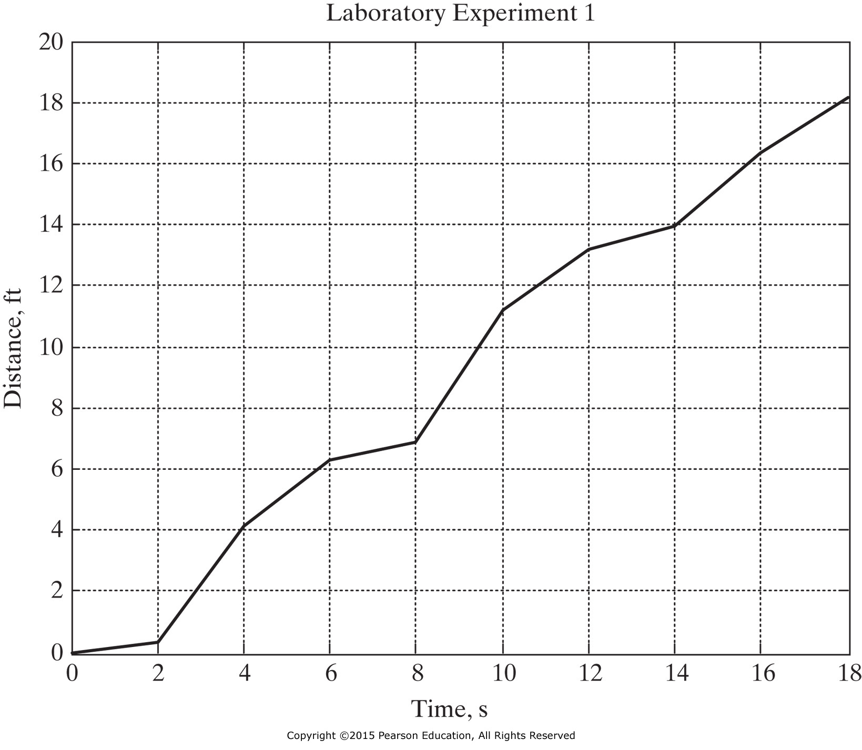
x = [0:2:18];
y = [0, 0.33, 4.13, 6.29, 6.85, 11.19, 13.19, 13.96, 16.33, 18.17];
plot(x,y), title('Laboratory Experiment 1’)
xlabel('Time, s'), ylabel('Distance, ft'), grid on
plot command must precede title and labels
title
ylabel
xlabel

Slide 4
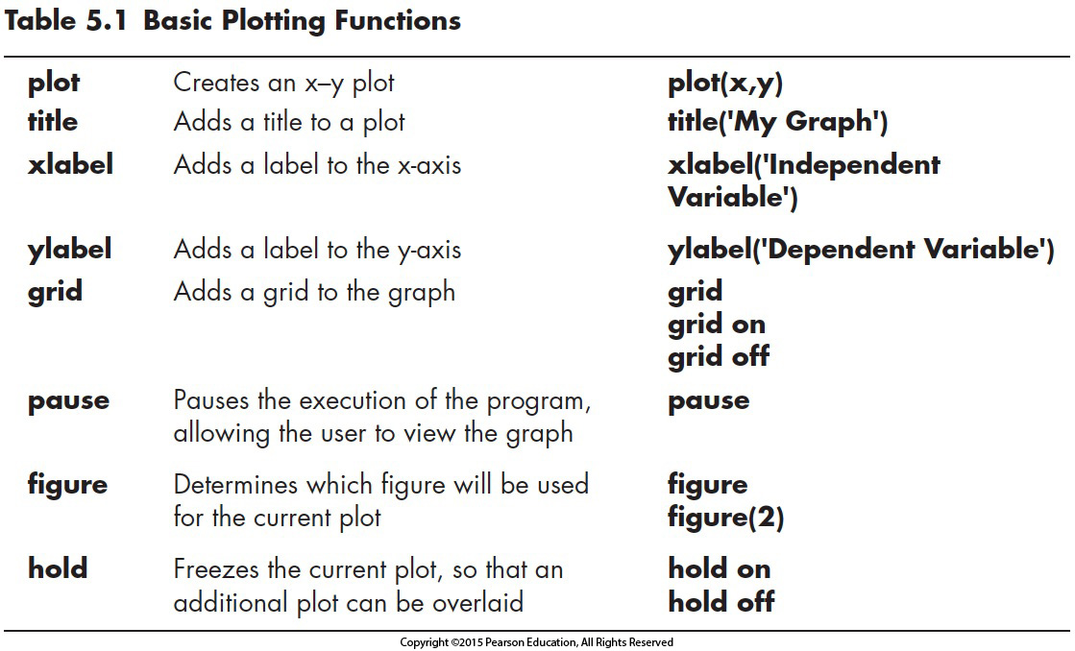
area(x,y)
String
pop up
Xlable&ylabel&tile: after creating the graph

Slide 5
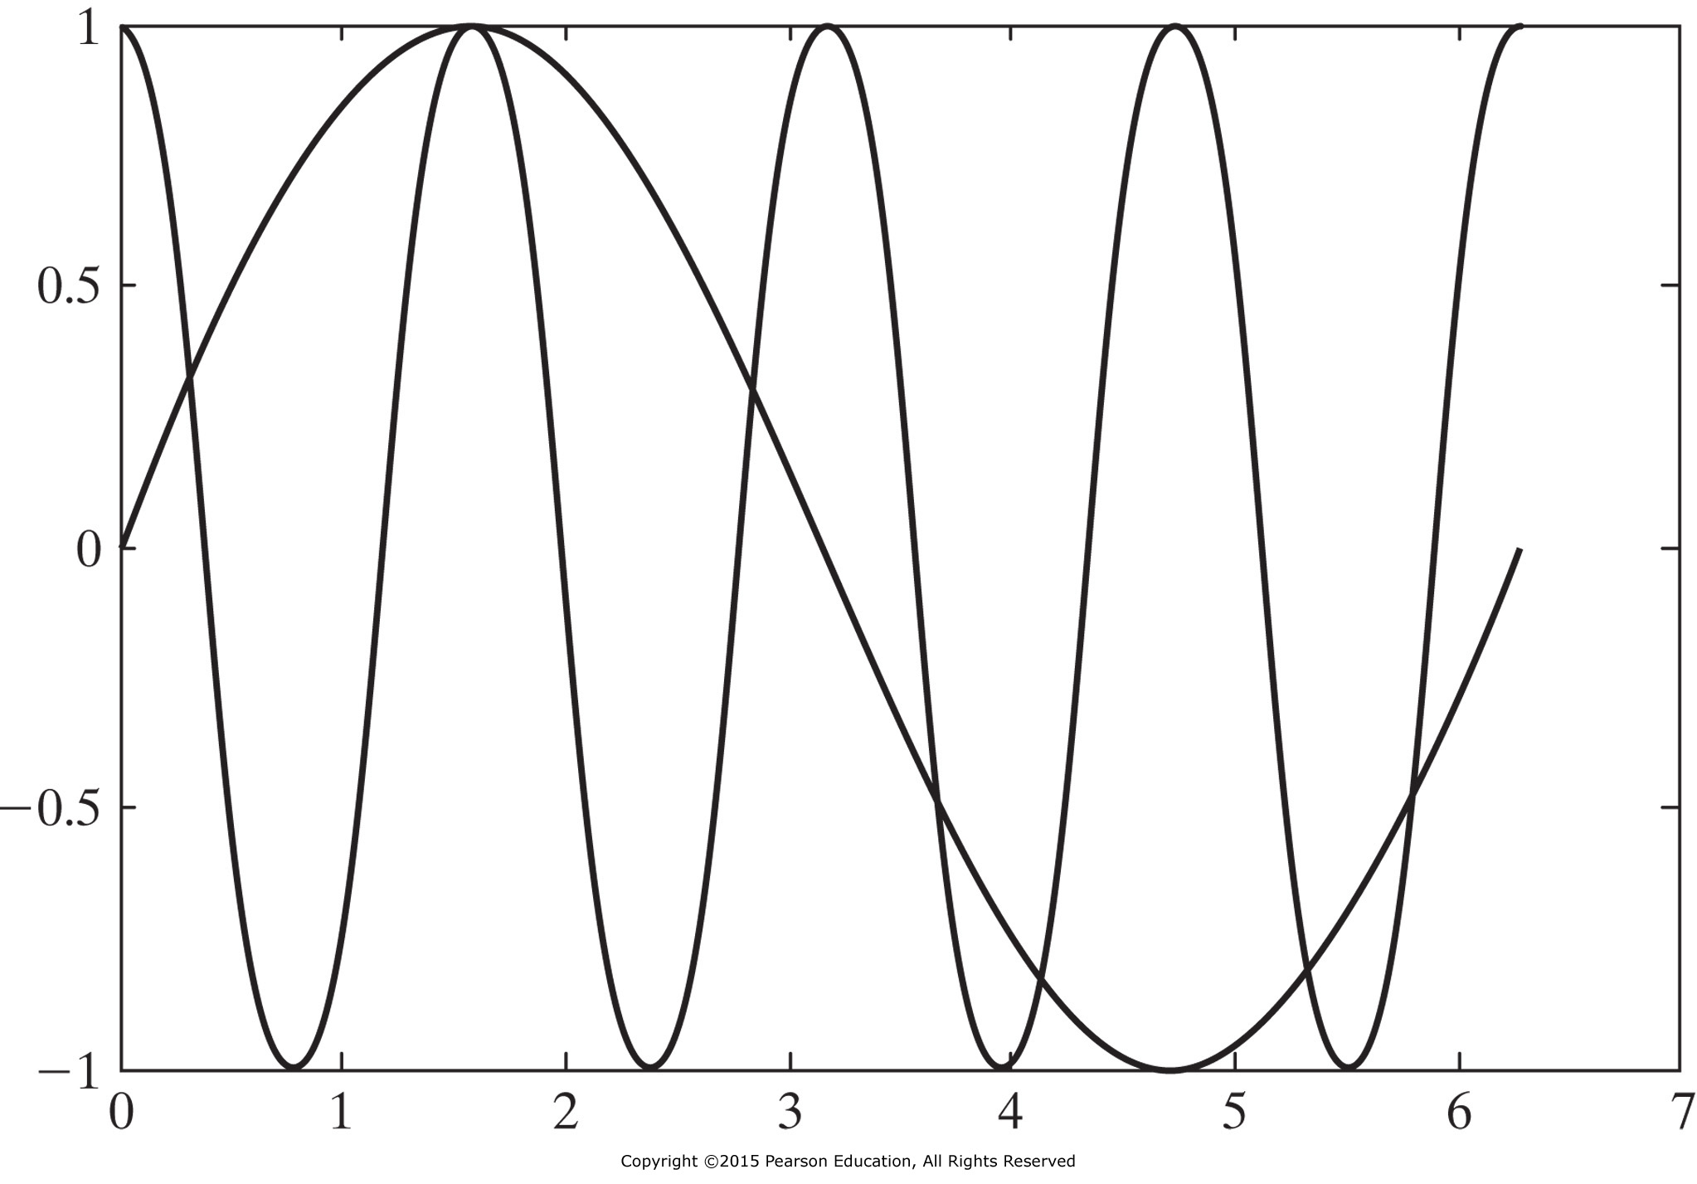


MATLAB command figure command opens a new figure window. For example, figure(2) opens a window named “Figure 2”. This window will be used for subsequent plotting.
However, executing figure command without an input parameter causes a new window to open, numbered consecutively one up from the current window. For example, if the current figure window is named “Figure 2,” executing figure will cause “Figure 3” to open.
x = 0:pi/100:2*pi;
y1 = cos(x*4);
plot(x,y1)
y2 = sin(x);
hold on;
plot(x, y2)
hold on command layers plots onto the same figure
Use hold off command to stop layering
$$sin⁡(x)$$
$$cos(4x)$$

Slide 6
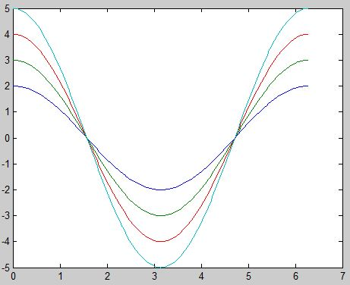
x = 0:pi/100:2*pi;
y1 = cos(x*4);
plot(x,y1)
y2 = sin(x);
hold on;
plot(x, y2)
x = 0:pi/100:2*pi;
y1 = cos(x*4);
y2 = sin(x);
plot(x,y1, x, y2)
Note difference in the color of two plots
X = 0:pi/100:2*pi;
Y1 = cos(X)*2; Y2 = cos(X)*3;
Y3 = cos(X)*4; Y4 = cos(X)*5;
plot(X, Y1, X, Y2, X, Y3, X, Y4)
X = 0:pi/100:2*pi;
Y1 = cos(X)*2; Y2 = cos(X)*3;
Y3 = cos(X)*4; Y4 = cos(X)*5;
Z = [Y1; Y2; Y3; Y4];
plot(X, Z)

Slide 7
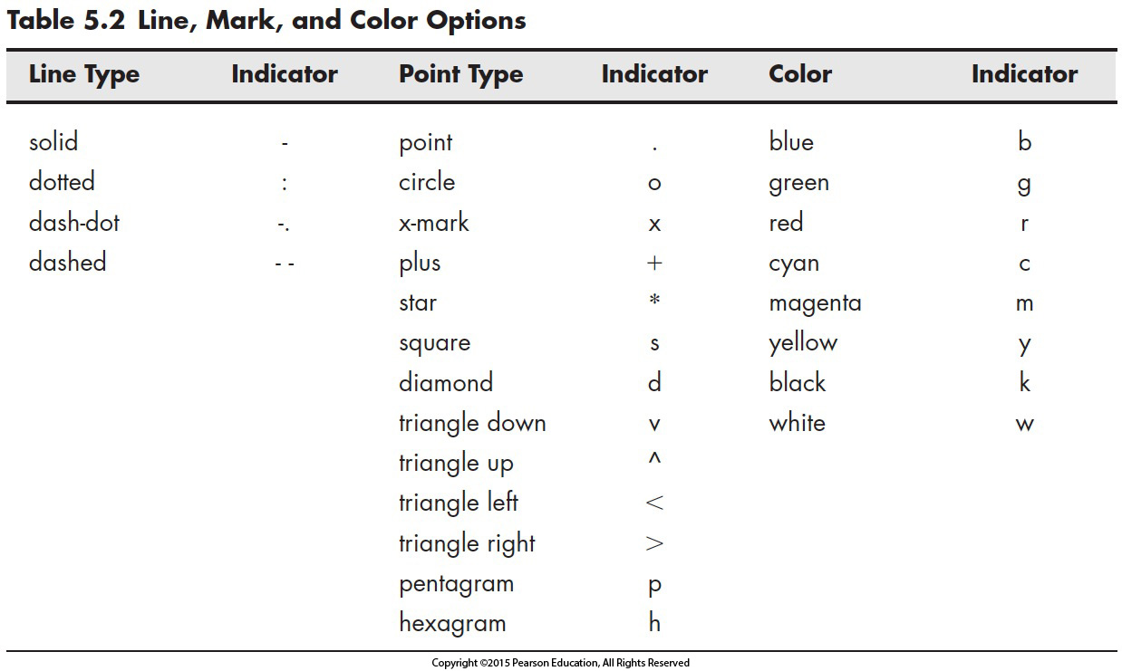
5.1.2 Line, Color, and Mark Style

Slide 8
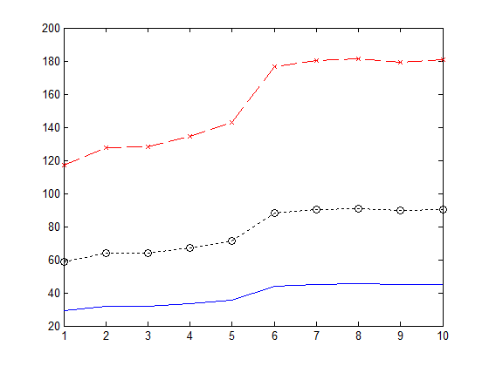
x = [1:10];
y = [58.5, 63.8, 64.2, 67.3, 71.5, 88.3, 90.1, 90.6, 89.5, 90.4];
plot(x,y,':ok',x,y*2,'--xr',x,y/2,'-b')
clf command clears a figure. To close active figure window, use the close command, and to close all open figure windows use close all

Slide 9
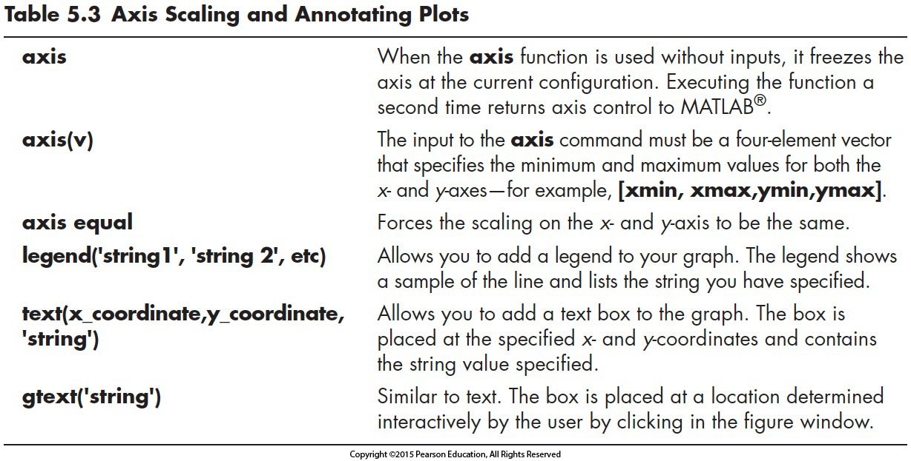
5.1.3 Axis Scaling and Annotating Plots
axis([x_min, x_max, y_min, y_max]) % defines limits to x and y axes
For example, axis([-2, 3, 0, 10])
fixes x-axis from -2 to 3 and y-axis from 0 to 10.

Slide 10
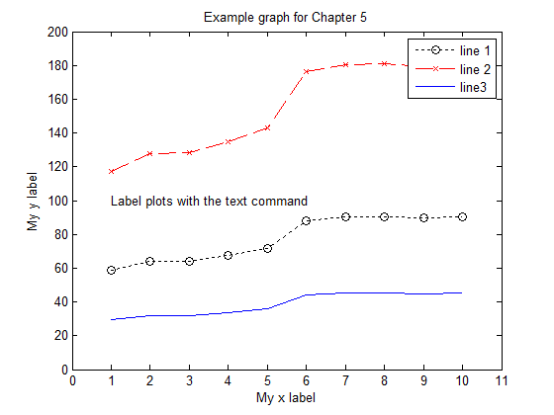
x = [1:10];
y = [58.5, 63.8, 64.2, 67.3, 71.5, 88.3, 90.1, 90.6, 89.5, 90.4];
plot(x,y,':ok',x,y*2,'--xr',x,y/2,'-b')
legend('line 1', 'line 2', 'line3'),
text(1,100,'Label plots with the text command')
xlabel('My x label'), ylabel('My y label'),
title('Example graph for Chapter 5‘)
axis([0,11,0,200])
legends
text
xlabel
ylabel

Slide 11
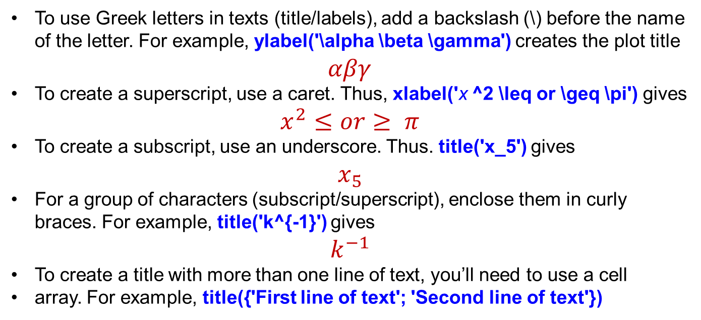
To use Greek letters in texts (title/labels), add a backslash (\) before the name of the letter. For example, ylabel('\alpha \beta \gamma') creates the plot title
$$αβγ$$
To create a superscript, use a caret. Thus, xlabel('x ^2 \leq or \geq \pi') gives
$$x^{2}≤or≥ π$$
To create a subscript, use an underscore. Thus. title('x_5') gives
$$x_{5}$$
For a group of characters (subscript/superscript), enclose them in curly braces. For example, title('k^{-1}') gives
$$k^{−1}$$
To create a title with more than one line of text, you’ll need to use a cell
array. For example, title({'First line of text'; 'Second line of text'})

Slide 12
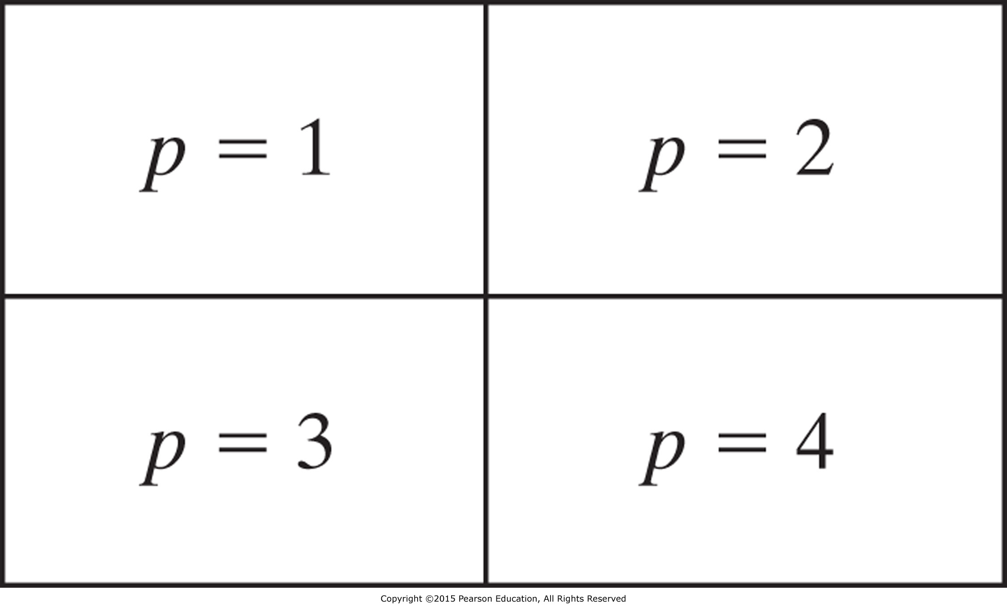
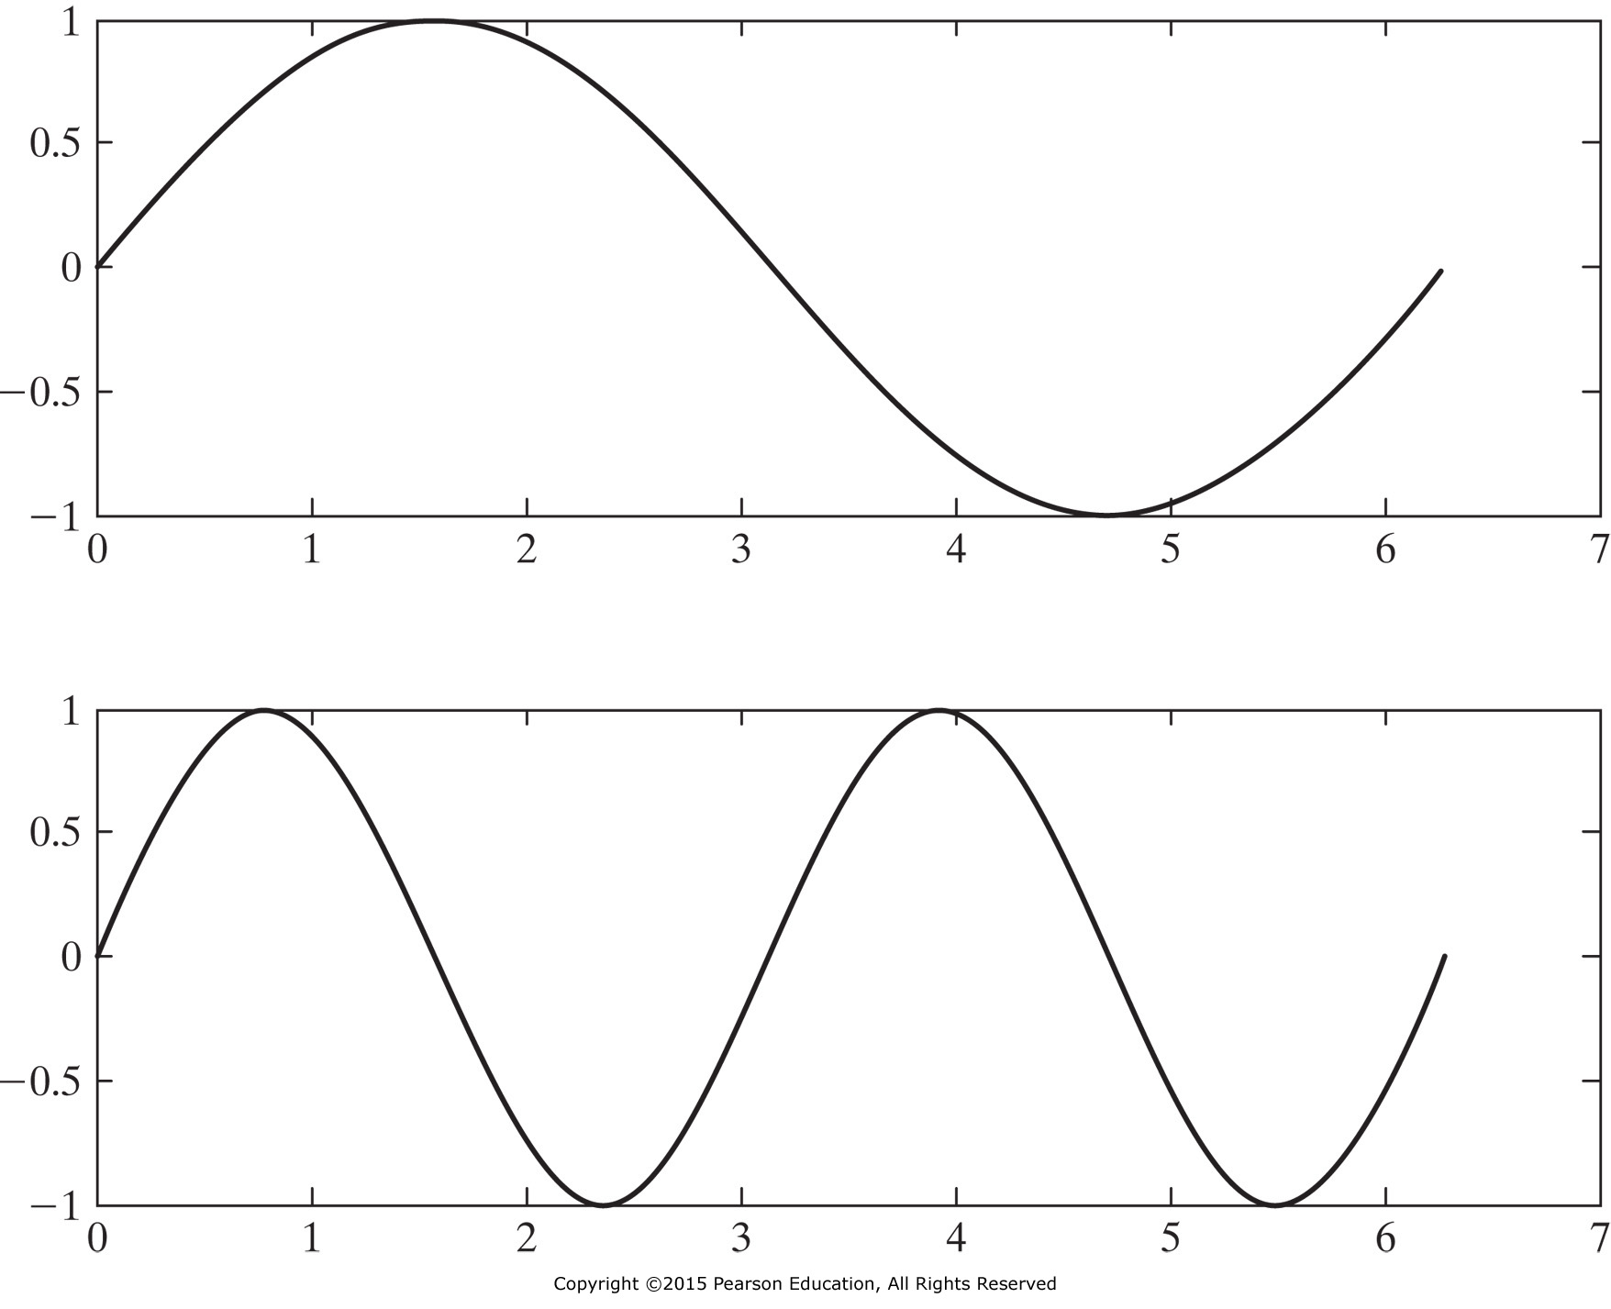
5.2 SUBPLOTS
Subplots commands subdivide the figure
window into an m×n
matrix.
subplot(m,n,p)
x = 0:pi/20:2*pi;
subplot(2,1,1)
plot(x,sin(x))
subplot(2,1,2)
plot(x,sin(2*x)

Slide 13
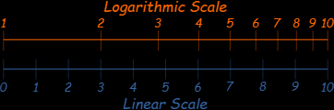
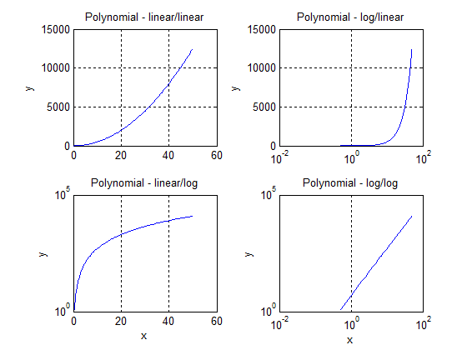
5.3.2 Logarithmic Plots
x = 0:0.5:50;
y = 5*x.^2;
subplot(2,2,1)
plot(x,y)
title('Polynomial - linear/linear')
ylabel('y'), grid
subplot(2,2,2)
semilogx(x,y)
title('Polynomial - log/linear')
ylabel('y'), grid
subplot(2,2,3)
semilogy(x,y)
title('Polynomial - linear/log')
xlabel('x'), ylabel('y'), grid
subplot(2,2,4)
loglog(x,y)
title('Polynomial - log/log')
xlabel('x'), ylabel('y'), grid
Appendix B

Slide 14
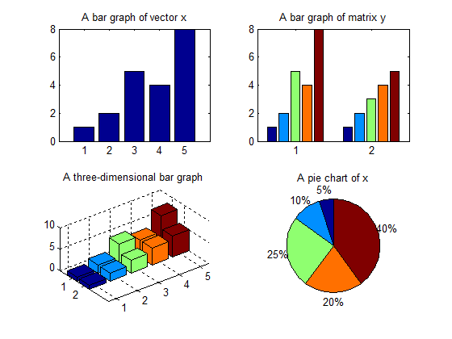
5.3.3 Bar Graphs and Pie Charts
clear, clc
x = [1,2,5,4,8]; y = [x;1:5];
subplot(2,2,1), bar(x), title('A bar graph of vector x')
subplot(2,2,2), bar(y), title('A bar graph of matrix y')
subplot(2,2,3), bar3(y), title('A three-dimensional bar graph')
subplot(2,2,4), pie(x), title('A pie chart of x')

Slide 15
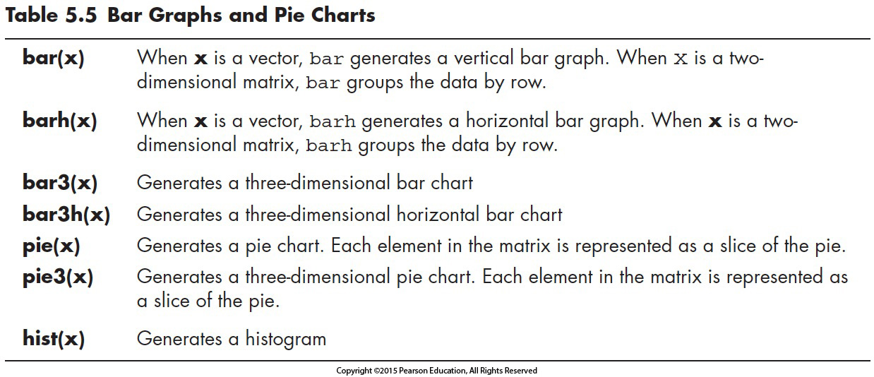

Slide 16
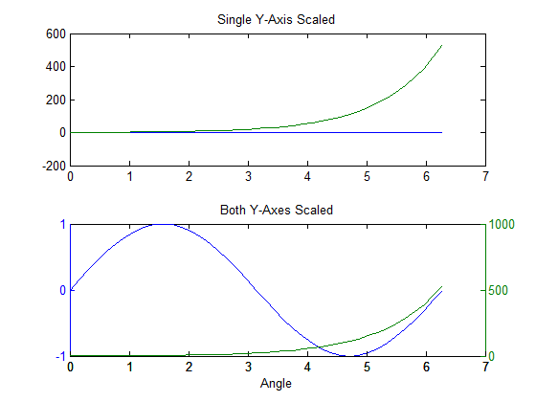
5.3.5 X–Y Graphs with Two Y-Axes
x = 0:pi/20:2*pi;
y1 = sin(x);
y2 = exp(x);
subplot(2,1,1)
plot(x,y1,x,y2)
title(‘Single Y-Axis Scaled’)
subplot(2,1,2)
plotyy(x,y1,x,y2)
title(‘Both Y-Axes Scaled’)
xlabel(‘Angle’)
One scale for both functions; y1, y2
Different y-scales for different functions; y1 (on the left), y2 (on the right)

Slide 17
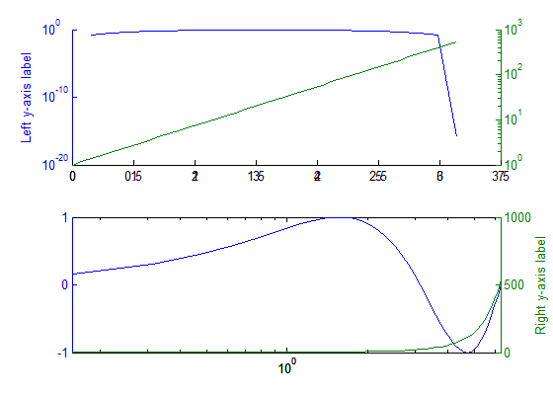
clf
x = 0:pi/20:2*pi;
y1 = sin(x);
y2 = exp(x);
subplot(2,1,1)
plotyy(x,y1,x,y2, 'semilogy')
ylabel('Left y-axis label')
subplot(2,1,2)
a = plotyy(x,y1,x,y2,'semilogx');
ylabel(a(2),'Right y-axis label')

Slide 18
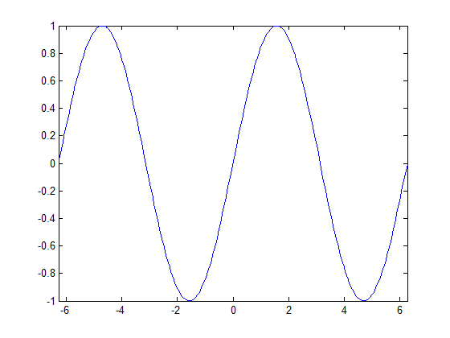
5.3.6 Function Plots
Use fplot for plotting a function without defining x- and y- values a priori. For example,
fplot('sin(x)',[-2*pi,2*pi])
creates a plot of x versus sin(x) for x -values from - 2π to 2π.
First argument (y-values) is a string containing the function
Second argument is an array of x-values
Generates automatically
Smooth curve

Slide 19
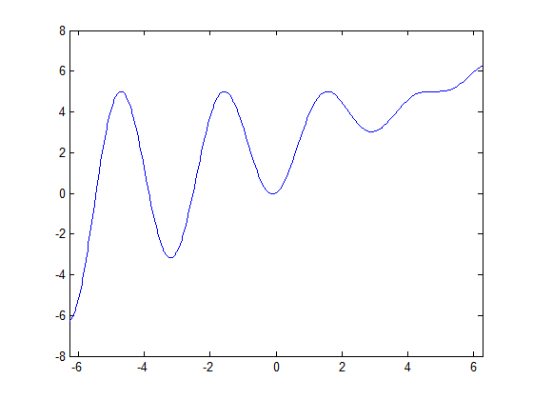
Ex. 5.5
fplot('5*sin(t).^2 + t.*cos(t).^2',[-2*pi,2*pi])

Slide 20
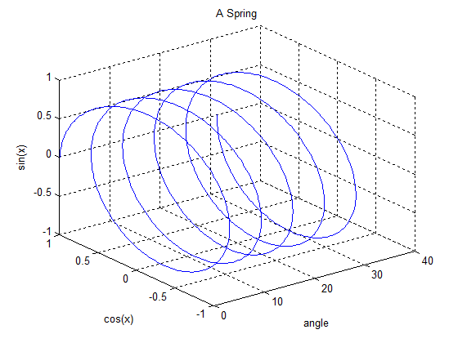
5.4.1 Three-Dimensional Line Plot
clear, clc
x = linspace(0,10*pi,1000);
y = cos(x); z = sin(x);
plot3(x,y,z) %Creates a three-dimensional line plot
grid
xlabel('angle'), ylabel('cos(x)'), zlabel('sin(x)')
title('A Spring')

Slide 21
5.5 EDITING PLOTS FROM THE MENU BAR
clear, clc
x = linspace(0,10*pi,1000);
y = cos(x); z = sin(x);
plot3(x,y,z) %Creates a three-dimensional line plot
grid
xlabel('angle'), ylabel('cos(x)'), zlabel('sin(x)')
title('A Spring')

Slide 22
5.5 EDITING PLOTS FROM THE MENU BAR
Select Edit (Axes Properties) from the menu toolbar.
From the Property Editor—Axes window ,
select More Properties : Data Aspect Ratio Mode
Set the mode to manual
Need to practice in the lab to develop expertise with this feature of the MATLAB
Similarly, labels, a title, and a color bar can be interactively added or modified using the Property Editor to fine-tune the figure.
Can't be repeated

Slide 23
5.6 CREATING PLOTS FROM THE WORKSPACE WINDOW
Plots can be interactively created from the workspace window as follows:
Select appropriate variables
Select drop-down menu
Plotting options are listed
Select the appropriate option
Plot is created in the current figure window
Try a few examples in your lab session

Slide 24
5.7 HOW TO SAVE PLOTS
Use the Save As . . . Option from the figure window with many choices:
Using the extension of .fig will save the figure in MATLAB ® -specific format.
Different standard graphics formats, such as jpeg ( .jpg ) and enhanced metafile ( .emf ) are also available fort he saving the file.
Edit from the menu bar of figure can also used by selecting the copy figure from the menu options, and pasting the figure into another document.
Generate codes automatically

Slide 25
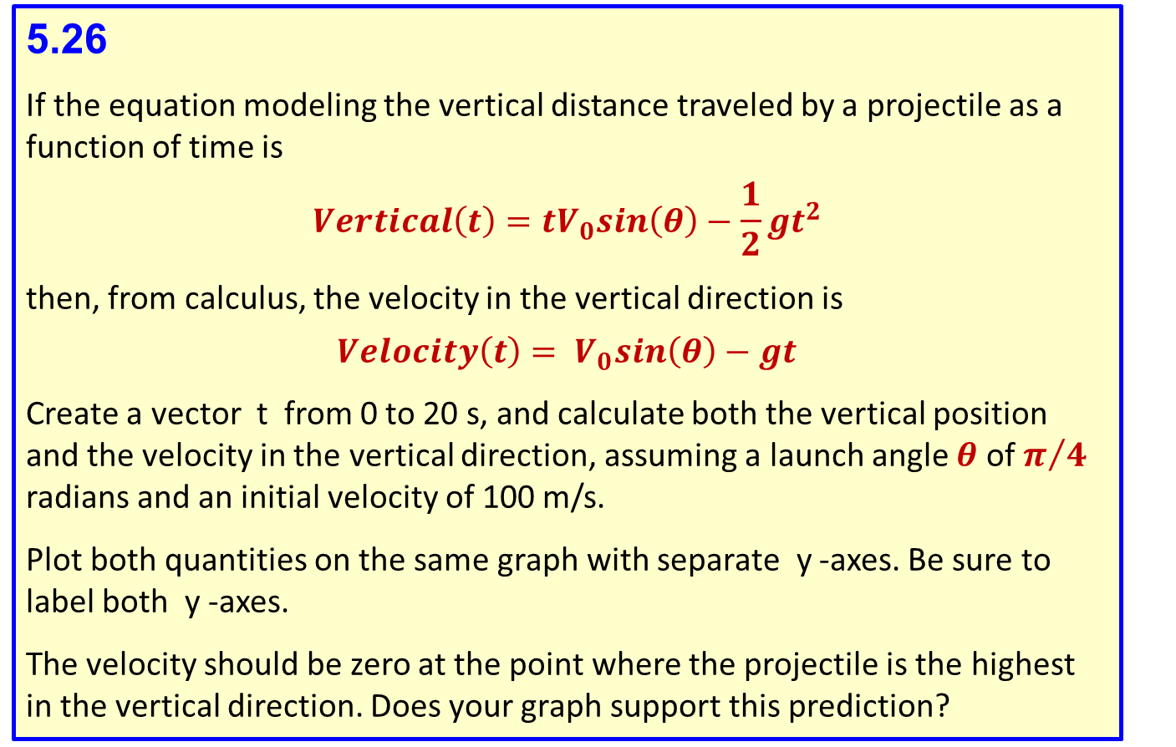
5.26
If the equation modeling the vertical distance traveled by a projectile as a function of time is
$$Vertical\left(t\right)=tV_{0}sin\left(θ\right)−\frac{1}{2}gt^{2}$$
then, from calculus, the velocity in the vertical direction is
$$Velocity\left(t\right)= V_{0}sin\left(θ\right)−gt$$
Create a vector t from 0 to 20 s, and calculate both the vertical position and the velocity in the vertical direction, assuming a launch angle $θ$ of $π/4$ radians and an initial velocity of 100 m/s.
Plot both quantities on the same graph with separate y -axes. Be sure to label both y -axes.
The velocity should be zero at the point where the projectile is the highest in the vertical direction. Does your graph support this prediction?

Slide 26
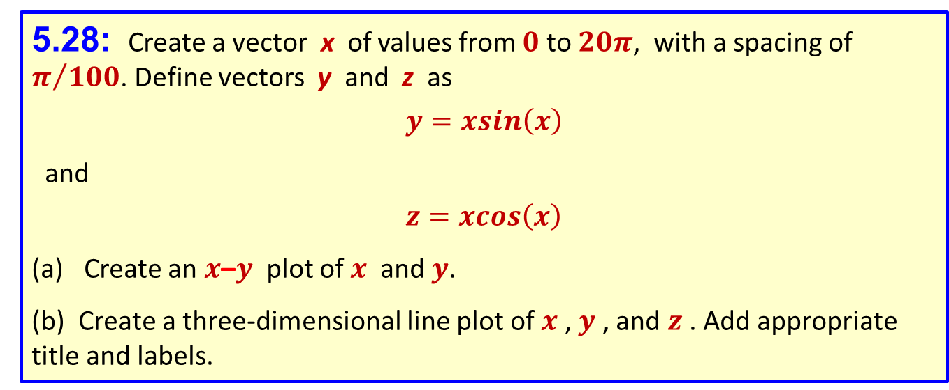
5.27: For many metals, deformation changes their physical properties. In a process called cold work , metal is intentionally deformed to make it stronger. The following data tabulate both the strength and ductility of a metal that has been cold worked to different degrees:
USE DATA GIVEN IN THE BOOK
Plot these data on a single x – y plot with two y -axes. Be sure to label both y -axes.
5.28: Create a vector x of values from $0$ to $20π$, with a spacing of $π/{100}$. Define vectors y and z as
$$y=xsin\left(x\right)$$
and
$$z=xcos\left(x\right)$$
Create an $x$–$y$ plot of $x$ and $y$.
(b) Create a three-dimensional line plot of $x$ , $y$ , and $z$ . Add appropriate title and labels.

Slide 27
In the engineering class there are 2 A’s; 4 B’s; 8 C’s; 4 D’s; 2 E’s. Create a vector of the grade distribution grades [2, 4, 8, 4, 2], make a pie chart from the grades vector. Add a legend listing the grade names (A, B, C, etc.):
The inventory of a certain type of screw in and plot the data in a bar graph
Month | 2009 | 2010
January | 2345 | 2343
February | 4363 | 5766
March | 3212 | 4534
April | 4565 | 4719

