Slide 1
CHAPTER-12 Symbolic Mathematics
Create and manipulate symbolic variables
Factor and simplify mathematical expressions
Solve symbolic expressions
Solve systems of equations
Determine the symbolic derivative of an expression
Integrate an expression

Slide 2
Introduction
MATLAB ® ’s symbolic capability is based on the MuPad software, originally produced by SciFace Software (based on research done at the University of Paderborn, Germany)
There are two ways to use MuPad inside the MATLAB ® software. You can access it directly and create a MuPad notebook by typing
$$mupad$$
at the command prompt. The MuPad notebook interface opens as a MATLAB ® figure window, as shown in Figure 12.1
Mupad can also be used to create symbolic objects inside MATLAB ® itself. This offers the advantage of a familiar interface, and the ability to interact with MATLAB ® ’s other functions

Slide 3
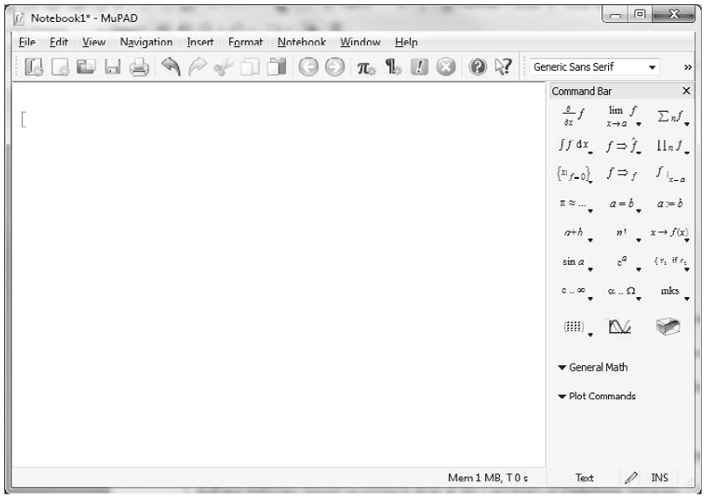
Introduction
MATLAB ® ’s symbolic toolbox allows us to manipulate symbolic expressions to simplify them, to solve them symbolically, and to evaluate them numerically. It also allows us to take derivatives, to integrate, and to perform linear algebraic manipulations. More advanced features include LaPlace transforms, Fourier transforms, and variable-precision arithmetic.

Slide 4
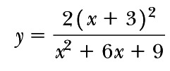
12.1 Symbolic Algebra
Symbolic mathematics is used regularly in math, engineering, and science classes. It is often preferable to manipulate equations symbolically before you substitute values for variables. For example, consider the equation
You can simplify the equation to
MATLAB ® ’s symbolic algebra capabilities allow you to perform this simplification or to manipulate the numerator and denominator separately.

Slide 5
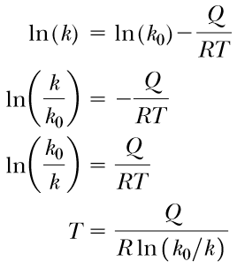
12.1 Symbolic Algebra
Relationships are not always constituted in forms that are so easy to solve. For instance, consider the equation
If we know the values of k0, Q , R , and T , it’s easy to solve for k . It’s not so easy if we want to find T and we know the values of k , k0, R , and Q. We have to manipulate the relationship to get T on the left-hand side of the equation:
Although solving for T was awkward manually, it’s easy with MATLAB ® ’s symbolic capabilities!

Slide 6
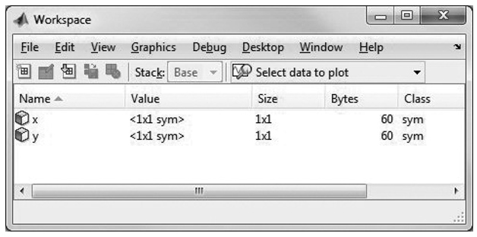
12.1.1 Creating Symbolic Variables
Before we can solve any equations, we need to create some symbolic variables. Simple symbolic variables can be created in two ways. For example, to create the symbolic variable x , type either
x = sym('x' )
or
syms x
Both techniques set the character 'x' equal to the symbolic variable x . More complicated variables can be created by using existing symbolic variables, as in the expression
y = 2*(x + 3)^2/(x^2 + 6*x + 9)
Note: both x and y are listed as symbolic variables and that the array size for each is 1 X1.

Slide 7
12.1.1 Creating Symbolic Variables
It can also be used to create multiple symbolic variables at the same time, as with the command
syms Q R T k0
These variables could be combined mathematically to create another symbolic variable, k :
k = k0*exp(-Q/(R*T)) %expression
Notice that in both examples we used the standard algebraic operators, not the array operators, such as .* or .^ . This makes sense when we observe that array operators specify that corresponding elements in arrays are used in the associated calculations—a situation that does not apply here.
The sym function can also be used to create either an entire expression or an entire equation. For example,
E = str2sym('m*c^2’) %expression
Note: The input to sym was a character string, identified by the single quotes inside the function.

Slide 8
12.1.1 Creating Symbolic Variables
We can also create an entire equation and give it a name. For example, we can define the ideal gas law
ideal_gas_law = str2sym('P*V = n*R*Temp’) %equation
Or
syms P V n R Temp
ideal_gas_law = P*V == n*R*Temp %equation

Slide 9
12.1.2 Manipulating Symbolic Expressions and Symbolic Equation
First, we need to remind ourselves how expressions and equations differ. Equations are set equal to something; expressions are not. The variable ideal_gas_law has been set equal to an equation (type ideal_gas_law and k)
MATLAB ® has a number of functions designed to manipulate symbolic variables, including functions to separate an expression into its numerator and denominator, to expand or factor expressions, and to simplify expressions in a number of ways.
1. Extracting Numerators and Denominators
The numden function extracts the numerator and denominator from an expression. For example, if you’ve defined y as
y = 2*(x+3)^2/(x^2+6*x+9)
then you can extract the numerator and denominator with
[num,den] = numden(y)
Notes:
y=str2sym('2*(x+3+x)^2/(x^2+6*x+9)')

Slide 10
12.1.2 Manipulating Symbolic Expressions and Symbolic Equation
MATLAB ® creates two new variables, num and den (of course, you could name them whatever you please):
num = 2*(x+3)^2, den = x^2+6*x+9
We can recombine these expressions or any symbolic expressions by using standard algebraic operators: num*den
ans = 2*(x+3)^2*(x^2+6*x+9)
2. Expanding Expressions, Factoring Expressions, and Collecting Terms We can use the expressions we have defined to demonstrate the use of the expand, factor, and collect functions. Thus,
expand(num) returns ans = 2*x^2+12*x+18
and
factor(den) ans = (x+3)^2
The collect function collects like terms and is similar to the expand function:
collect(num) ans = 2*x^2 + 12*x + 18

Slide 11
12.1.2 Manipulating Symbolic Expressions and Symbolic Equation
This works regardless of whether each individual variable in an expression has or has not been defined as a symbolic variable. Define a new variable z:
z = str2sym('3*a-(a+3)*(a-3)^2')
In this case, both expand and factor give the same result:
factor(z)
ans = -a^3 + 3*a^2 + 12*a – 27
or
[ -1, a^3 - 3*a^2 - 12*a + 27]
expand(z)
ans = -a^3 + 3*a^2 + 12*a – 27
The result obtained by using collect is also the same:
collect(z)
ans = -27-a^3+3*a^2+12*a

Slide 12
12.1.2 Manipulating Symbolic Expressions and Symbolic Equation
You can use both collect and expand with equations as well as with expressions. The factor function requires an expression. With equations, each side of the equation is treated as a separate expression. To illustrate, we can define an equation w :
w = str2sym('x^3-1 = (x-3)*(x+3)')
expand(w)
ans = x^3-1 = x^2-9
collect(w)
ans = (x-1)*(x^2+x+1) = (x-3)*(x+3)
factor(w)
??? Error using ==> mupadmex
Note that an error was generated when we tried to use the factor function with w, because w is an equation, not an expression.
Factor VS collect

Slide 13
12.1.2 Manipulating Symbolic Expressions and Symbolic Equation
3. Simplification Functions
We can think of the expand, factor, and collect functions as ways to simplify an expression or equation. However, what constitutes a “simple” equation is not always obvious. The simplify function simplifies each part of an expression or equation, using MuPad’s built-in simplification rules. For example, assume again that z has been defined as
z = str2sym('3*a-(a+3)*(a-3)^2')
Then, the command
simplify(z)
returns
ans = 3*a-(a-3)^2*(a+3)
If the equation w has been defined as
w = str2sym('x^3-1 = (x-3)*(x+3)')
then
simplify(w)
returns
ans = x^3 + 8 = x^2

Slide 14
12.1.2 Manipulating Symbolic Expressions and Symbolic Equation
Simplification Functions
The simple function is slightly different. It tries a number of different simplification techniques and reports the result that is shortest. All the attempts are reported to the screen. For example,
simple(w)

Slide 15
z = sym('3*a-(a+3)*(a-3)^2') ; simplify(z)
ans =
3*a-(a-3)^2*(a+3)
w = sym('x^3-1 = (x-3)*(x+3)'); simplify(w)
ans =
x^3 + 8 = x^2

Slide 17
12.2 SOLVING EXPRESSIONS AND EQUATIONS
A highly useful function in the symbolic toolbox is solve. It can be used to determine the roots of expressions, to find numerical answers when there is a single variable, and to solve for an unknown symbolically. The solve function can also solve systems of equations, both linear and nonlinear. When paired with the substitution function ( subs ), the solve function allows the user to find analytical solutions to a variety of problems.
12.2.1 The Solve Function
When used with an expression, the solve function sets the expression equal to zero and solves for the roots. For example, if E1 = x-3 then
syms x
solve (E1)
returns
ans = 3
Solve can be used either with an expression name or by creating a symbolic expression directly in the solve function. Thus,
solve(x^2-9)
returns
ans = -3 3

Slide 18
12.2 SOLVING EXPRESSIONS AND EQUATIONS
You can readily solve symbolic expressions with more than one variable. For example, for the quadratic expression
$ax^{2}+bx+c$,
syms x a b c
solve(a*x^2+b*x +c)
returns
ans = -(b + (b^2-4*a*c)^(1/2))/(2*a) -(b - (b^2-4*a*c)^(1/2))/(2*a)
Note: MATLAB ® preferentially solves for x. If there is no x in the expression, MATLAB ® finds the variable closest to x. If you want to specify the variable to solve for, just include it in the second field. For instance, to solve the quadratic expression for a , the command solve(a*x^2+b*x +c, a)
To solve an expression set equal to something besides zero, you must use one of two approaches (1) If the equation is simple, you can transform it into an expression by subtracting the right-hand side from the left-hand side (2) If the equation is more complicated, you may prefer to define a new equation:
$5x^{2}+6x+3=10$ to $e2=5x^{2}+6x+7=0$
e2= $5x^{2}+6x+3==10$

Slide 19
12.2 SOLVING EXPRESSIONS AND EQUATIONS
Notice that in both cases the results are expressed as simply as possible, using fractions (i.e., rational numbers). In the workspace, ans is listed as a
2 X1 symbolic matrix. You can use the double function to convert a symbolic representation to a double-precision floating-point number:
double(ans)
The solve function is particularly useful with symbolic expressions having multiple variables:
syms P P0 r t
E3 = P == P0*exp(r*t)
solve(E3,t)
ans = log(P/P0)/r
It is often useful to redefine a variable, such as t, in terms of the other variables:
t = solve(E3,t)
t = log(P/P0)/r

Slide 20
12.2 SOLVING SYSTEMS OF EQUATIONS
Not only can the solve function solve single equations or expressions for any of the included variables, it can also solve systems of equations. Take, for example, these three symbolic equations:
one =3*x + 2*y -z == 10;
two = -x + 3*y + 2*z == 5;
three = x - y - z == -1;
To solve for the three embedded variables x , y, and z, simply list all three equations in the solve function:
answer = solve(one,two,three)
answer =
x: [1x1 sym]
y: [1x1 sym]
z: [1x1 sym]
To access the actual values, you’ll need to use the structure array syntax:
answer.x ans = -2
answer.y ans = 5
answer.z ans = -6

Slide 21
12.2 SOLVING SYSTEMS OF EQUATIONS
To force the results to be displayed without using a structure array and the associated syntax, we must assign names to the individual variables. Thus, for our example, we have
[x,y,z] = solve(one,two,three)
x = -2 y = 5 z = -6
The results are assigned alphabetically. For instance, if the variables used in your symbolic expressions are q,x, and p, the results will be returned in the order p, q, and x, independently of the names you have assigned for the results.
Notice in our example that x, y, and z are still listed as symbolic variables s, even though the results are numbers. The result of the solve function is a symbolic variable, either ans or a user-defined name. If you want to use that result in a MATLAB ® expression requiring a double-precision floating-point input, you can change the variable type with the double function. For example,
double(x) changes x from a symbolic variable to a corresponding numeric variable.

Slide 22
12.2 SOLVING SYSTEMS OF EQUATIONS

Slide 23
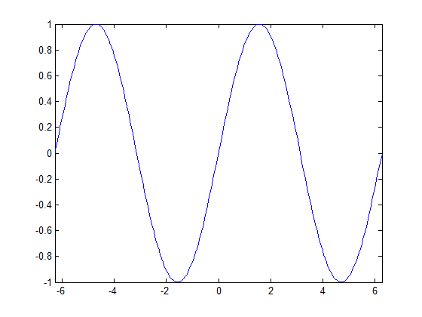
5.3.6 Function Plots (from Ch 5)
Use fplot for plotting a function without defining x- and y- values a priori. For example,
fplot('sin(x)',[-2*pi,2*pi]) or fplot('sin(x)')
creates a plot of x versus sin(x) for x -values from - 2π to 2π.
First argument (y-values) is a string containing the function
Second argument is an array of x-values
Generates automatically
Smooth curve

Slide 24
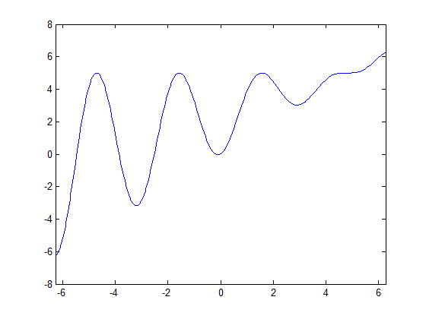
(from Ch 5)
Ex. 5.5
fplot('5*sin(t).^2 + t.*cos(t).^2',[-2*pi,2*pi])

Slide 25
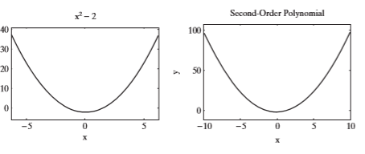
12.3 SYMBOLIC PLOTTING
The symbolic toolbox includes a group of functions that allow you to plot symbolic functions.
12.3.1 The fplot Function (or ezplot)
Consider a simple function of x , such
as syms x
y = x^2-2
To plot this function, use fplot(y)
The resulting graph is shown in the Figure. The fplot function defaults to an x range from -5 to +5. MATLAB ® created this plot by choosing values of
x and calculating corresponding values of y, so that a smooth curve is produced.
The user who does not want to accept the default values can specify the minimum and maximum values of x in the second field of the fplot function:
fplot(y,[-10,10])
ezplot(y,[-10,10])
The values are enclosed in square brackets, indicating that they are elements in the array that defi nes the plot extremes. You can also specify titles, axis labels, and annotations, just as you do for other MATLAB ® plots. For example, to add a title and labels to the plot, use

Slide 26
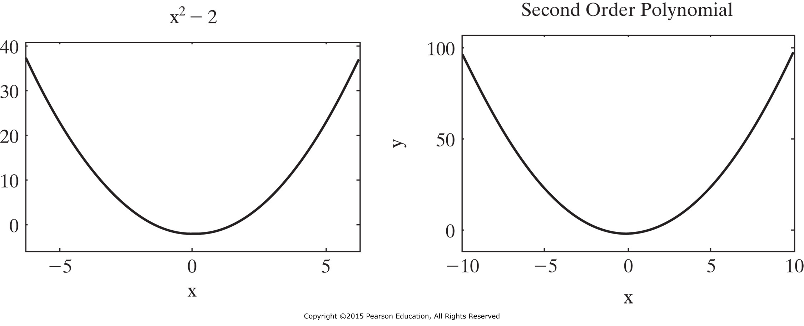
12.3 SYMBOLIC PLOTTING
The fplot Function
y = sym('x^2-2'); fplot(y) % Note: default x-axis range id from -5 to +5
fplot(y,[-10,10]); title('Second Order Polynomial'); xlabel('x'); ylabel('y')

Slide 27
12.3 SYMBOLIC PLOTTING
We still can use the same functions that we used in the plotting chapter:
Title, xlabel, ylabel, axis, hold on/off, (change color, font)…
The fimplicit function allows you to plot implicit functions of x and y. For instance, consider the implicit equation
$$x^{2}+y^{2}=1$$
syms x y
fimlicit (x^2 +y^2 ==1, [-1.5,1.5])
Or
fimlicit (x^2 +y^2-1, [-1.5,1.5])
and
z = x^2 + y^2 -1
fimplicit(z,[-1.5,1.5])
OR by defining separate equations (parametrically)
x= sin(t)
y= cos (t)
To plot,
syms t fplot(sin(t),cos(t)) axis ([-1.5,1.5,-1.5,1.5])

Slide 28
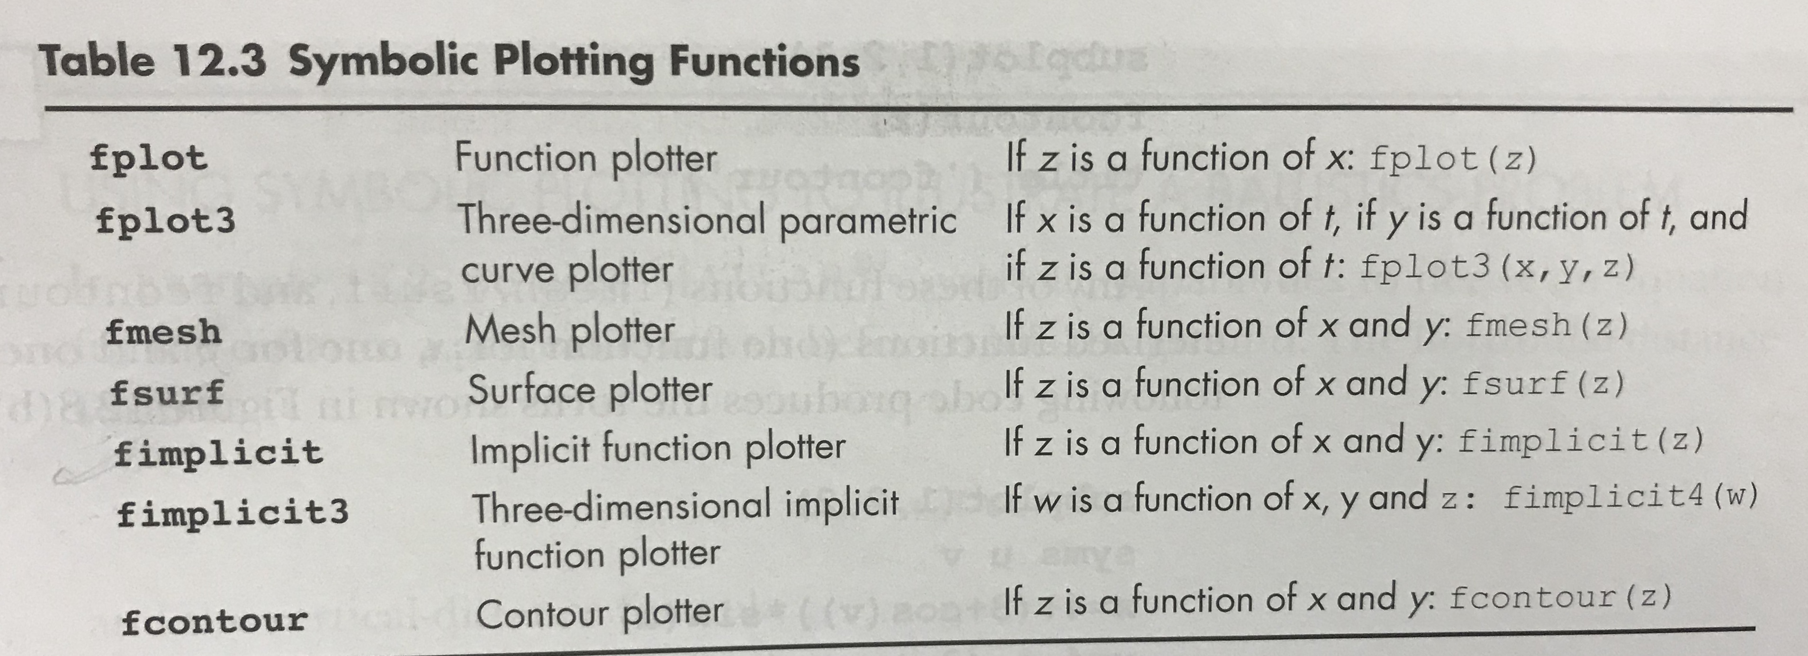
12.3.2 SYMBOLIC PLOTTING
12.3.2 Additional Symbolic Plots
Notice that no “dot” operators are used in the expressions, since they are all symbolic: syms x y
z1 = 3*(1-x)^2*exp(-(x^2) - (y+1)^2)
z2 = - 10*(x/5 - x^3 - y^5)*exp(-x^2-y^2)
z3 = - 1/3*exp(-(x+1)^2 - y^2)
z = z1+z2+z3

Slide 29
12.4 CALCULUS
MATLAB ® ’s symbolic toolbox allows the user to differentiate symbolically and to perform integrations. This makes it possible to find analytical solutions, instead of numeric approximations, for many problems.
12.4.1 Differentiation
Differential calculus is studied extensively in first-semester calculus. The derivative can be thought of as the slope of a function or as the rate of change of the function. For example, consider a race car. The velocity of the car can be approximated by the change in distance divided by the change in time.

Slide 30
12.4.1 Differentiation
The acceleration is the first derivative of the velocity and the second derivative of the position. MATLAB ® offers several slightly different techniques to find both first derivatives and nth derivatives (see Table12.4 ).
If we have a more complicated equation with multiple variables, such as
y = str2sym('x^2+t-3*z^3')
MATLAB ® will calculate the derivative with respect to x , the default variable:
diff(y) ans = 2*x . Our result is the rate of change of y as x changes (if we keep all the other variables constant). This is usually depicted as $ꝺy/ꝺx$ and is called a partial derivative. If we want to see how y changes with respect to another variable, such as t , we must specify it in the diff function
diff(y,'t')
ans = 1
Similarly, to see how y changes with z when everything else is kept constant, we
use diff(y,'z') ans = -9*z^2

Slide 31
12.4.2 Differentiation

Slide 32
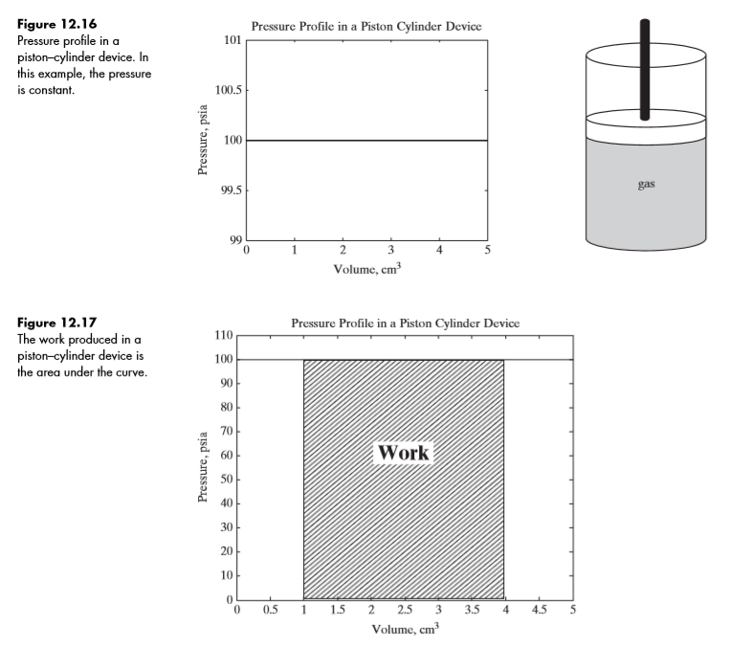
12.4.2 Integration
Integration can be thought of as the opposite of differentiation (finding a derivative) and is even sometimes called the antiderivative. It is commonly visualized as the area under a curve. For example, work done by a piston–cylinder device as it moves up or down can be calculated by taking the integral of P with respect to V — that i

Slide 33
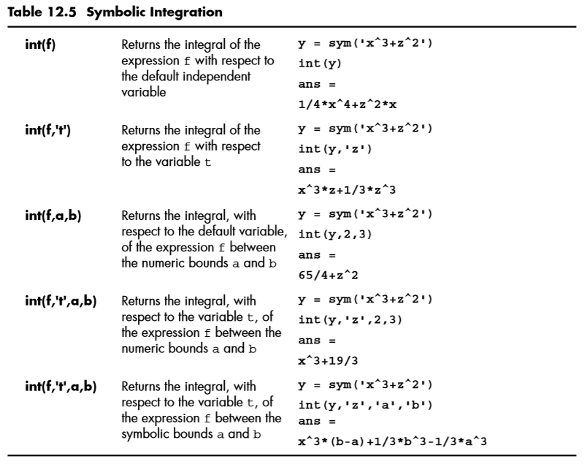
12.4.1 Differentiation

