Slide 1
212 Zoo
Demonstrator: Moudy Bin Saleh
Revised by : Dr. Sawsan Omar

Slide 2
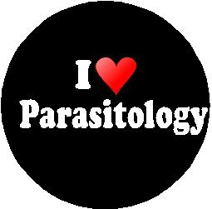
What is a Parasitology?
Parasitology is the study of parasites, their hosts, and the relationship between them.

Slide 3
What is Parasitism?
It is a form of relationship between two species which one benefits at the expense of the other in metabolic dependency ( developmental stimuli, nutritional dependence ,digestive enzymes , control of maturation) sometimes without killing it.

Slide 4
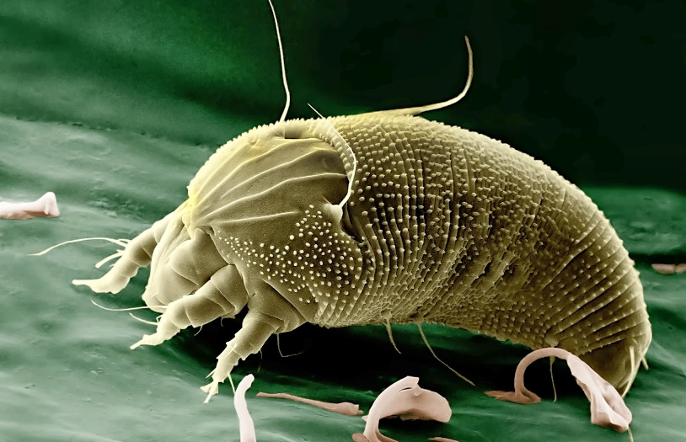
Terms of Parasitology
Parasite:
It is the benefited partner. It is an animal organism which lives in or on the host in order to obtain nourishment and shelter from the host.

Slide 5
Terms of Parasitology
Host:
In parasitism, it supplies the parasite with nourishment and shelter .

Slide 6
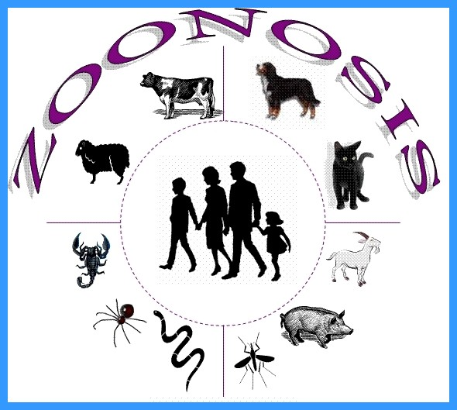
Terms of Parasitology
Zoonosis :
refers to animal’s diseases which can be transmitted to man. (These animals infected with parasites are called reservoir hosts).

Slide 7
Major Parasite Groups
Protozoa
Sarcomastigophora
Apicomplexa
Ciliophora
1
Helminths
Flat Worms
Round Worms
2
Arthropods
Insects
Ticks & mites
3

Slide 8
Taxonomic classification of protozoa
Sub Kingdom
Phylum
Sub-phylum
Genus- examples
Species- examples
Sarcodina- move by pseudopodia
Entamoeba
E. histolytica
Protozoa
Sarcomastigo-phora
further divided into
Mastigo-
phora
move by flagella
Giardia
G. lamblia
P.falciparum,
P. vivax,
P. malariae,
P. ovale
Plasmodium
Apicomplexa
no organelle of
locomotion
Ciliophora
move by cillia
Balantidium
B. coli
Enterocyto-
zoa
E. bienusi
Microspora
Spore-forming

Slide 9
Taxonomic classification of helminths
Sub Kingdom
Phylum
Class
Species- examples
Nematodes
Round worms; appear round in cross section, they have body cavities, a straight alimentary canal and an anus
- Ascaris (roundworm)
- Trichuris (whipworm)
- Ancylostoma (hookworm)
- Necator (hookworm)
- Enterobius (pinworm or threadworm)
- Strongyloides
Metazoa
Cestodes
Adult tapeworms are found in the intestine of their host
They have a head (scolex) with sucking organs, a segmented body but no alimentary canal
Platyhelminthes
Flat worms; dorsoventrally flattened, no body cavity and, if present, the alimentary canal is blind ending
-Taenia (tapeworm)
Trematodes
Non-segmented, usually leaf-shaped, with two suckers but no distinct head . They have an alimentary canal and are usually hermaphrodite.
-Fasciola hepatica (liver fluke)
-Schistosoma

Slide 10
Types of Parasites
Ectoparasite: Parasites that live on the surface of the host.
Temporary parasite : An organism accidentally ingested that survives briefly in the intestine or the parasite can lives free of its host during part of its life cycle..
Permanent parasite : Parasite that lives its entire adult life within or on a host.
Obligatory parasite : An organism that is entirely dependent upon a host for its survival.

Slide 11
Types of Parasites cont.
Facultative parasite : Parasite can exist free living in soil or water or as parasite .
Accidental parasite : one that parasitize an organism other than the usual host.
Opportunistic parasite : An organism that is not typically a parasite or Parasite inert (without symptoms) but may become parasitic under specific conditions.

Slide 12
Terms of Parasitology Life cycle
Life cycle is the process of a parasite’s growth, development and reproduction, which proceeds in one or more different hosts depending on the species of parasites.
Infective Stage is a stage when a parasite can invade human body and live in it .

Slide 13
Terms of Parasitology Life cycle
Definitive (final) host : harbors adult or sexually reproductive stage of a parasite.
Reservoir hosts are the vertebrate hosts which harbor the same species of parasite at same stage as a human host. They are an important source of infection in epidemiology.
Intermediate host:
harbors larval or asexually reproductive stage of a parasite, according to priority they are classified into first intermediate host, second intermediate host, third intermediate host.

Slide 14
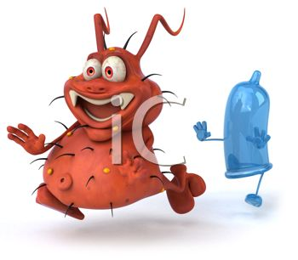
Transmission
Mechanical Transmission:
Arthropods are passive carriers, i.e play a role of the transportation of pathogens, which is not obligatory for the disease transmission, such as flies carry typhoid bacilli, ascarid eggs and amoebic cysts.
Biological Transmission: Arthropods are obligatory vectors. Pathogens have to spend a part of their life cycle in the vector arthropods in which they multiply or develop into the infective stage and then invade the human body under the help of the arthropod, such as Anopheles mosquitoes transmit malaria.

Slide 15
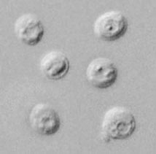
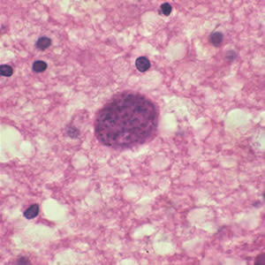
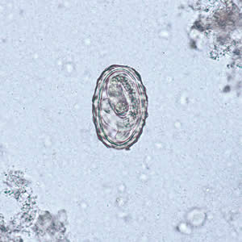
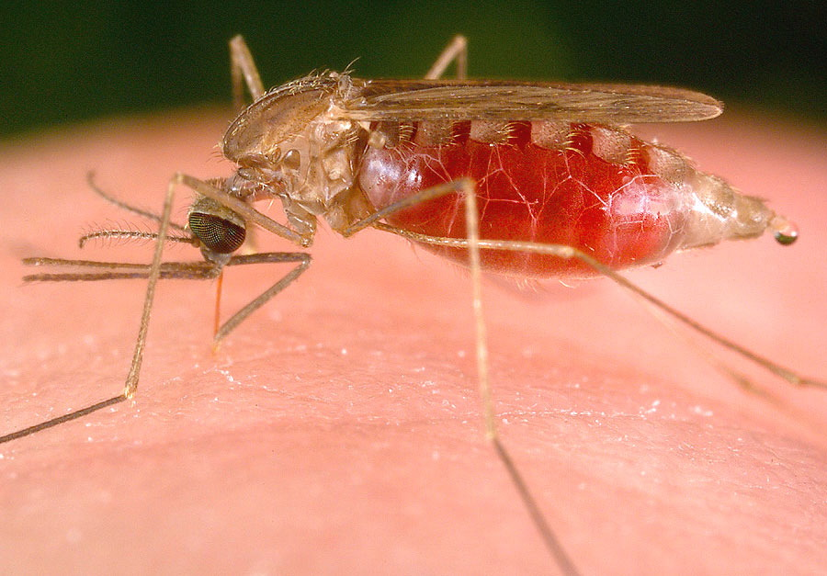
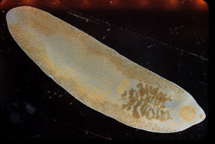
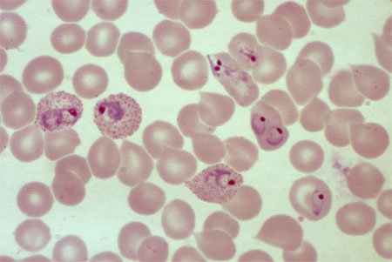
Examples of Parasites..
Cryptosporidium parvum oocysts
Mature egg of Ascaris lumbricoides
Larvae of Ascaris lumbricoides
Cysts of Toxoplasma gondii
Fasciolopsis buski
Anopheles
P. vivax parasites.
...

Slide 16
Thank you…

