Slide 1
M – 107 Linear Algebra and Vector Calculus and Calculus of several Variables

Slide 2
Details of the Course M - 107
Math - 107
Vectors and Matrices (3+0) credit-hours.
1438– 1439 H

Slide 3
Dr.Khawaja Zafar Elahi
Office 2 A 138 Building 4
Office Phone 467-6482
Office Hours
12:00 to 14:00 except on Monday

Slide 4
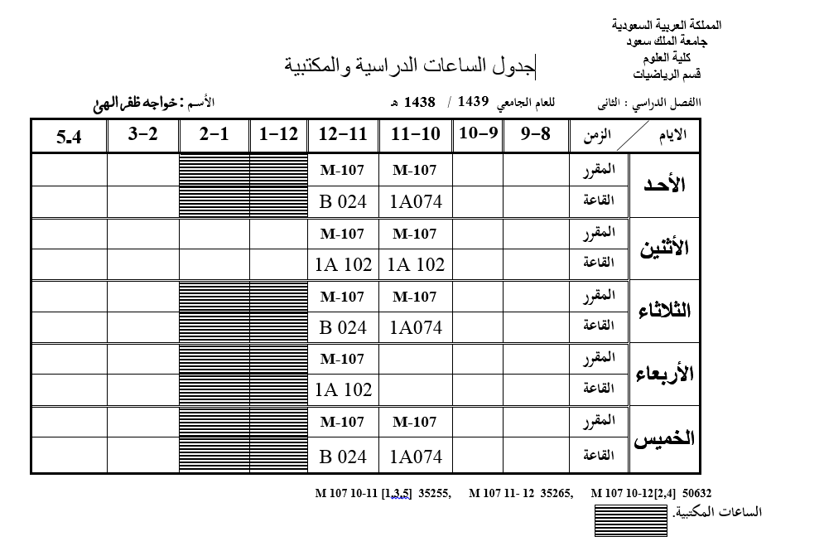

Slide 5
Linear Algebra by H. Anton
http://www2.warwick.ac.uk/fac/sci/maths/undergrad/ughandbook/content/ma106/elementary_linear_algebra_10th_edition.pdf

Slide 6
Weekly Course Details
Linear Algebra
WEEK 1,2
System of Linear Equations
WEEK 3
Matrices
WEEK 4
Determinants
WEEK 5
Minor and cofactors, Inverse by cofactors and
Crammer’ Rule

Slide 7
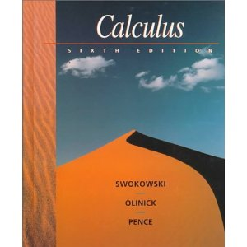
Calculus by Swokowski, Olinick and Pence, 6th Ed, PWS publishing Co.

Slide 8
Vector Calculus and Calculus of Several Variables
WEEK 6, 7, 8
Vectors , dot and cross products,
Equations of line and plane and surfaces,
WEEK 9, 10
Vector-Valued Functions.
WEEK 11,12,13
Functions of Several Variables and Differentiation. WEEK 14 Extrema of Functions of Several Variables , Constrained Optimization and Lagrange Multipliers.
WEEK 15
Revision WEEK

Slide 9
Textbook(s)/ Additional Material
Linear Algebra by H. Anton ( any book on Linear Algebra from Library 512. 5 )
Calculus by Swokowski, Olinick and Pence, 6th E
( any book on Calculus from Library 515.15 )
Additional Material:
Lecture Notes on M 107
Linear Algebra, Vector and Several Variables Calculus by Khawaja Zafar Elahi

Slide 10
Examinations
Midterm Examination I: 25 marks
Material covered in 1st to 7th week
Date 29.06.1439 Saturday 12:30 to 2:00 pm
Midterm Examination II: 25 marks
Material covered in 8th to 14th week
Date 28.07.1439 Saturday 12:30 to 02:00 am
Final Exam: 40 marks
Date 24.08.1439 (08.04.2018) Thursday 8:00 to 11:00 am

Slide 12
Web page
For announcement regarding course and for previous Exam papers, …
check web page
http://faculty.ksu.edu.sa/khawaja/default.aspx

Slide 13
HOW TO SUCCEED IN Math 107 with Excellent Grade
Come to every class and in time.
Never be late!
Arrive early, get yourself settled, spend a few minutes looking at your notes from the previous class, and have you materials ready when class starts.
Read each section before it is discussed in class
Do some math every day.
Start preparing for the tests at least a week in advance.
Take advantage of tutors and office hours, extra help can make a big difference.
Do not miss your tutorial class

Slide 14
HOW TO SUCCEED IN Math 107 with Excellent Grade
Late coming is not appreciated
Never take your mobile out in the class
100% attentiveness is required
Participate in the class discussion
Bring you learning material, pen and Notebook, always with you

