Slide 1
Medical mycology
First lecture
Introductions
Terms:
Mycology = Mykes = mushrom = fungi (It is drive from a Latin word)
Kingdom: myceteae or mycota
(Fungus) is singular term where (fungi) are pleural term.
Mycology: the science of fungi.
Fungi are a group of heterotrophic eucaryotes that are widely distributed in nature. They are classified into separate kingdom distinct from that of plants or animals. Fungi are considered to be saprophytes because they obtain their nutrients from dead organic matter.

Slide 2
Mycology
Divison : Mycota
Subdivision Mycotina
Class: mycetes
Subclass :mycetidae
Order: ales
Family: aceae
Mykes=mushroom=fungi
Logos+study of=study of fungi
Kingdom mycetes (=K. fungi)

Slide 3
Molecular identification
DNa were discovered by Friedrich Miescher. In 1869
1919, Phoebus Levene identified the component of nucleic acid and coind the terms nucleotides for the individuate bases Adenine, guanine Pyramiding thymine and cytocine. Addinin will pair with thymidine and Guanine with cytosine.
The PCR technique is amplification of a part of the DNA which is present in a low concentration.
The principle of molecular phylogeny is that species are understood to have arise from mother species (their accentors) during the process of as speciation.
The two closely related species from two closely related organisms should have more unique polymorphism. As a results of mutation or recombination.
So when you compare the same piesce ofDNA sequences between different species so it is possible to infer between different species based on the polymorphism that are present.
One of the most used region for the Dan is the regions of DNA is the ribosomal DNA Operone which is consist of the small subunits (SSU), 18s rRNA genus the 5.8S rRNA gene AND THE LARG SUBUNITES (lsu ) GET INFORMATION FROM THE THESIS

Slide 4
THIS OPERON IS PRESENT IN THE FUGNAL genom as a large number of copies (50-100).
The internal transcribed spacer (ITS1 and ITS2 are found between SSU and the 5.8S rRNA gene. And the between the 5.8S r RNA gene and LSU respectively. The SSU and LSU evolve relatively slowly and are frequently used (50-100).
The ssu and LSU evolve relatively slowly and are frequently used to study higher orders relationship foe examples between families or order. Where as the ITS1 and Its2 and 5.8S rRNA gene region (often abbreviation to ITS 9s frequently used for species level phylogeny because of the high evolutionary rate if the internal transcribed spacers.
The IGS is found at the end of LSU and start of the SSU sequence and sometimes used for the inter or intra species variation studies
Some other species which his involve other gene sequences such as B tubuline and or hailstone H3. To sovel species and species complexity.
To use more than one gene by using multilocus sequencing to comply with the genealogical concordance phylogeniatic species recognition
The kingdom fungi is they form a kingdom which is part from plant kingdom. And animals and closer to the later.

Slide 5
Structure of fungi
Unicellular yeasts
True yeses cell retain individuality
Yeasts like cell attached to each other side by side forming pseudohyphae
Filamentous mold hyphae-hyphae-septum
Septate hayphae
Nonspetate hyphae coneocytic hyphae
Inrerwoven hyphae =Mycelium
Dimorphic:have to forms depending on changes in the environment factor like temp, medium and cultures Vs host
Monomorphic only one forms regardless of environment.

Slide 6
Characterization distinguishing features
All eukaryotic Organism
Heterotrophic-don’t have chlorphyll (Acrophylous)
Saprobic
Symbiotic
Parastic
The cell is surrounded by rigid cell wall made up of chitin and complex charbohydrates (chitonsan, mannan,glucan, galacotmannan)
Have simple structure most of them is microscopic
Reproduced by spore formation sexually or asexually
The ITS sequencing

Slide 7
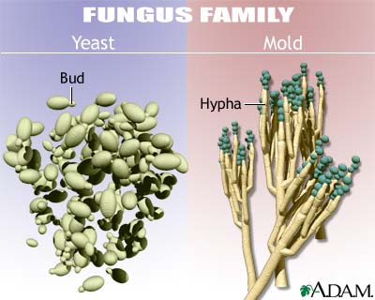
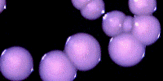
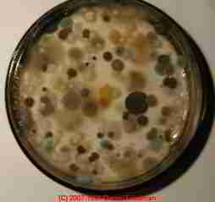

Slide 8
Kingdoms
Animilia: (eukaryotic cells) these eukaryotes are multi-cellular organisms include worms, arthropods, and animals.
Plantae: (eukaryotic cells)
Protoctista: eukarotic single cell like protozoa and algae
Monera: (prokaryotic) single cell like bacteria, actinomycetes and blue-green algae
Fungi: eukaryotic non-motile include yeasts, mold, and mushroom.

Slide 9
Main Characteristic of Fungi:
Features distinguish them from bacteria:
 | Fungi ( Eukaryotic) | Bacteria (Prokaryotic)
Nucleus | True nucleus | Prenucleus
Nuclear membrane | define nuclear membrane 2 | no well define nuclear membrane (the nuclear material is diffused in the cytoplasm)
Cytoplasmic structures | membrane bound organelles (Endoplasmic reticulum , golgi apparatus…etc) | no membrane bound organelles
size | 1 um in size or wider it is larger than bacteria | 1 um in size or less, smaller than fungi.
Cell wall | Composed of chitin and other polysaccharides | Composed of peptidoglycan
Replication | Mitosis and Meiosis | Simple binary fission

Slide 10
Features Distinguish Them From Plant:
 | Fungi | Planta
Nutrition | Hetrotrophic (achlorophllous) Saprobic (saprophytic) Symbiotic Parasitic | Autotrophic (photosynthesis)

Slide 11
Features Distinguish Them From Animilia:
 | Fungi | Animailia
Cell wall | Rigid cell wall mad up of chitin and other polysaccharides (manna, glucan) | No cell wall

Slide 12
Fungi are
Fungi are saprophytic, aerobic, nucleated, achlorophyllous organisms, which typically reproduce sexually and\or asexually. These organism usually filamentous-branched somatic structures are surrounded by true cell wall.
They comprise two groups of organisms known as yeasts and molds.
Structure of fungi:
Yeasts:
Unicellular, produced in two phase either budding yeasts cells or elongated cells attached to each other and forming pseudohyphae
Culture: yeasts form colonies that resemble those of bacteria
Example: Candida albicans
Saccharomyces cerviseae
Cryptococcus neoformance

Slide 13
Molds (filamentous)
Molds (Mould): classified as moniliaceous (white in color) or dematiaceous (dark in color).
hyphae (singular, hypha), long, slender, branching tubes. If hyphae have cross walls, the fungus is said to be Septate. If cross-walls are not present, the fungus is said to be non-septate (coenocytic). Interwoven hyphae known as mycelium
Example of mold:
Aspergillus sp
Rhizopus sp
Penicillium sp
Spores and conidia are the results of asexual or sexual reproduction; they are used for the identification of the mold based on their shapes, sizes and relationship to the parent hyphae.
Culture: it grows on the surface of the plates as one colony. The visible surface growth assumes a fluffy character known as mycelium.
Dimorphic fungi: are mold at room temperature and yeasts at 37 ºc.
Example: Coccidioides imitis
Histoplasma capsulatum

Slide 14
Reproduction in Fungi
1. Asexually
2. Sexually
Asexually: asexual reproduction occurs strictly by the process of mitosis (akaryogamy)
somatic
spore formation
The manner in which spores are produced is important in identification of fungi. Their size shape and arrangements help in the identification of fungi.
  Spores born in a sac-like structure called a sporangium (sporangia, pleural), and the spores know as sporangiospore.
  Conidia which are produced on the tip or sides of hyphae are called conidia (conidium) -it is produced on a specialized structure called conidiophore.
Types of conidia
Chlamydospore
Blastospore
Arthrospore
Aleurospore

Slide 15
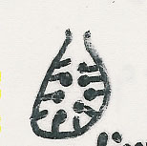
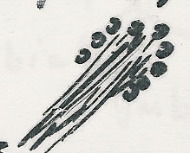
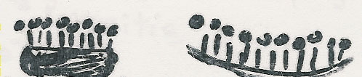
Asexual reproductive structures:
Conidiophore
Conidium
Pycnidium
Synnema
Sporodochium
Acervulus
Imperfect fungi = Deuteromycetes: Do not reproduce sexually or their sexual reproduction not known
e.g. Aspergillus, Fusarium, Candida
4

Slide 16

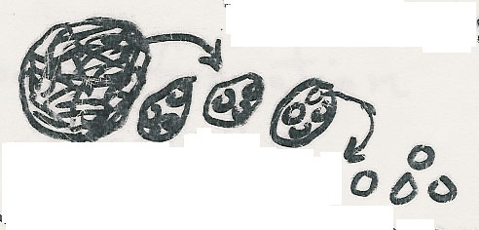


II) Sexual: Fusion, mitosis, meiosis
Sexual spores: Oospore, Zygospore, Ascospore, Basidiospore
Zygospore
Zygomycetes
e.g. Rhizopus, Mucor
Ascocarp
Ascus
Ascospore
Ascomycetes
e.g. Truffles
Terfezia & Termania
Basidiomycetes
e.g. Mushrooms & Podaxis pistillaris
(Agaricus campestris)

Slide 17
Classification of Fungi
Kingdom Myceteae
1- Div. Gymnomycota: naked (No cell wall), phagotrophic
Myxamoeba, slime molds
Class Acrasiomycetes, Cl. Protosteliomycetes
Cl. Myxomycetes – e.g. Dictyostelium
2- Div. Mastigomycota: flagillated, motile
Cell wall, absorptive nutrition, if mold nonseptate hyphae
Chytridiomycetes, Hyphochytridiomycetes
Plasmodiophoromycetes, Oomycetes – e.g. Phythium, Phytophthora
3- Div. Amastigomycota: Non flagellated, Non-motile
Yeasts & molds: Septate hyphae & non-septate
Cl. Zygomycetes, Trichomycetes, Ascomycetes, Basidiomycetes
Deuteromycetes (Fungi Imperfecti = Imperfect fungi)
e.g. Aspergillus, Penicillium, Fusarium, Candida
8
Old terms: Phycomycetes, Aquatic, Lower fungi, Higher fungi

