Slide 1
Filter Camera RAW
بثينة عبدالله الكثيري- 433925671

Slide 2
Outlines
Importance filter RAW for digital Photographers.
Installation.
Basic.
Spot Removal.
Noise Reduction.
Snapshots.
Presets.

Slide 3
Most midrange to high-end digital cameras can capture images as raw data files. That's beneficial because it gives you image-editing flexibility. For example, a photo that seems too dark may actually have detail in the shadows that you can bring out in processing.
Before the release of Photoshop CC, you had to run Adobe Camera Raw in a separate window, but now it's also a filter inside Photoshop CC. This change has two key advantages:
You can use the Camera Raw filter on all image file types, not just raw/DNG, TIFF, or JPEG files. Any layer in a Photoshop file is a candidate for the Camera Raw filter.
You can use the Camera Raw filter on images that are already open in Photoshop. Now you no longer have to close an image in Photoshop just to make edits in Adobe Camera Raw.
[1]

Slide 4
Windows
Exit from your Adobe applications.
Double-click the downloaded CameraRaw_8_7_1.zip to unzip it. Windows might unzip the file for you.
Double-click the resulting CameraRaw_8_7.1.exe file to start the installer.
Follow the onscreen instructions.
Restart your Adobe applications.
https://helpx.adobe.com/content/help/en/x-productkb/multi/camera-raw-plug-in-installer/_jcr_content/main-pars/download/file.res/CameraRaw_8_7_1.zip [2]

Slide 5
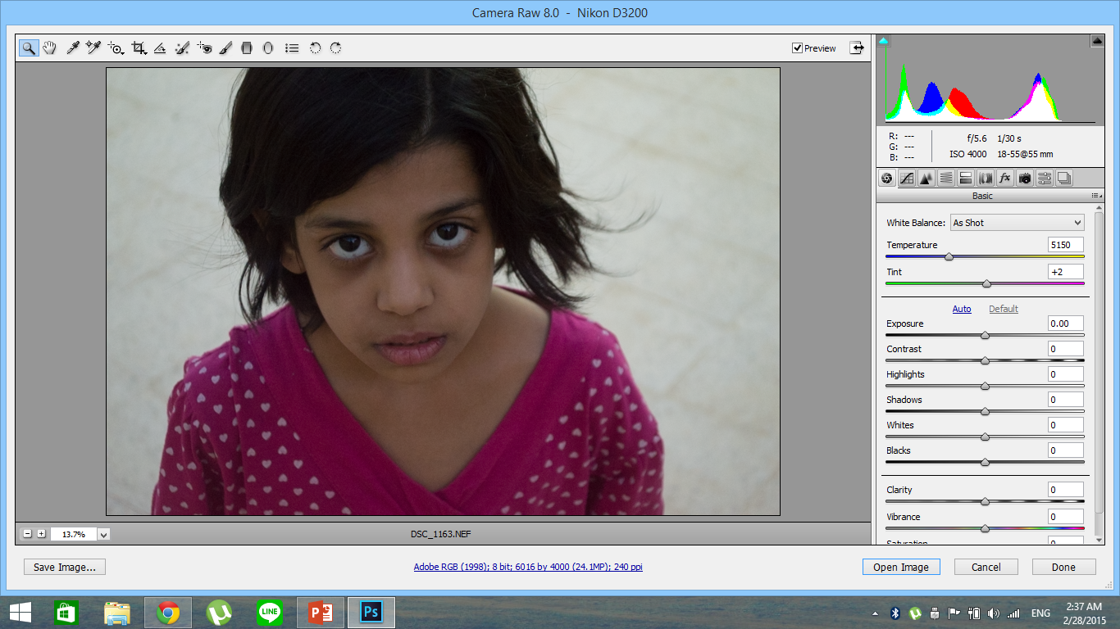

Slide 6
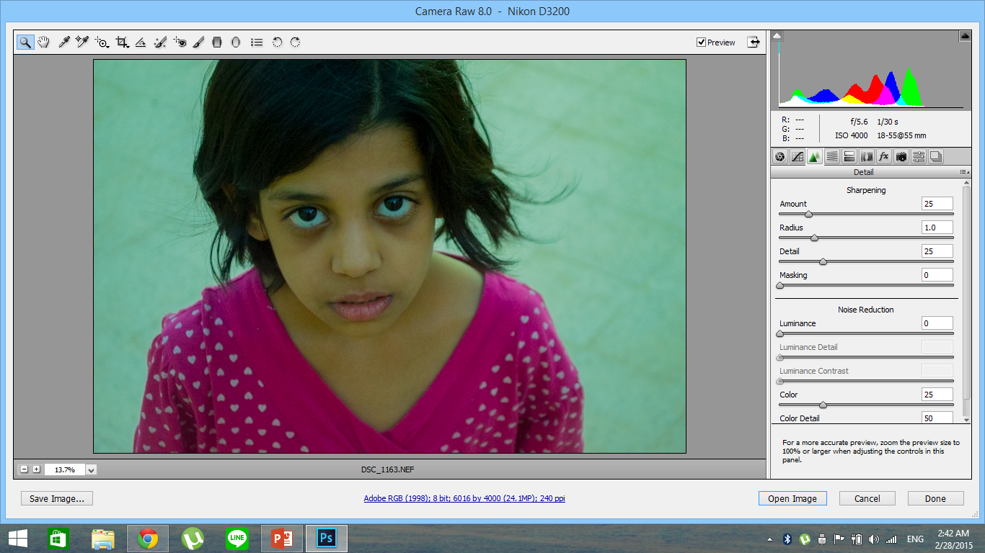
Noise Reduction.
Adjustment Brush
Spot Removal.
Noise Reduction.
Detail
Snapshots
Basic.
Presets

Slide 7

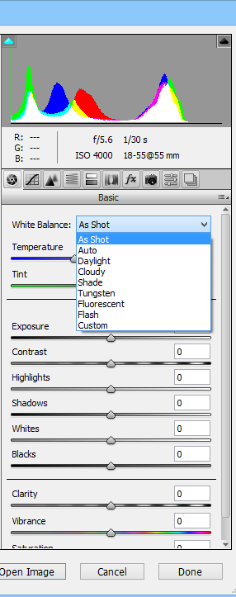

Slide 8


Slide 9
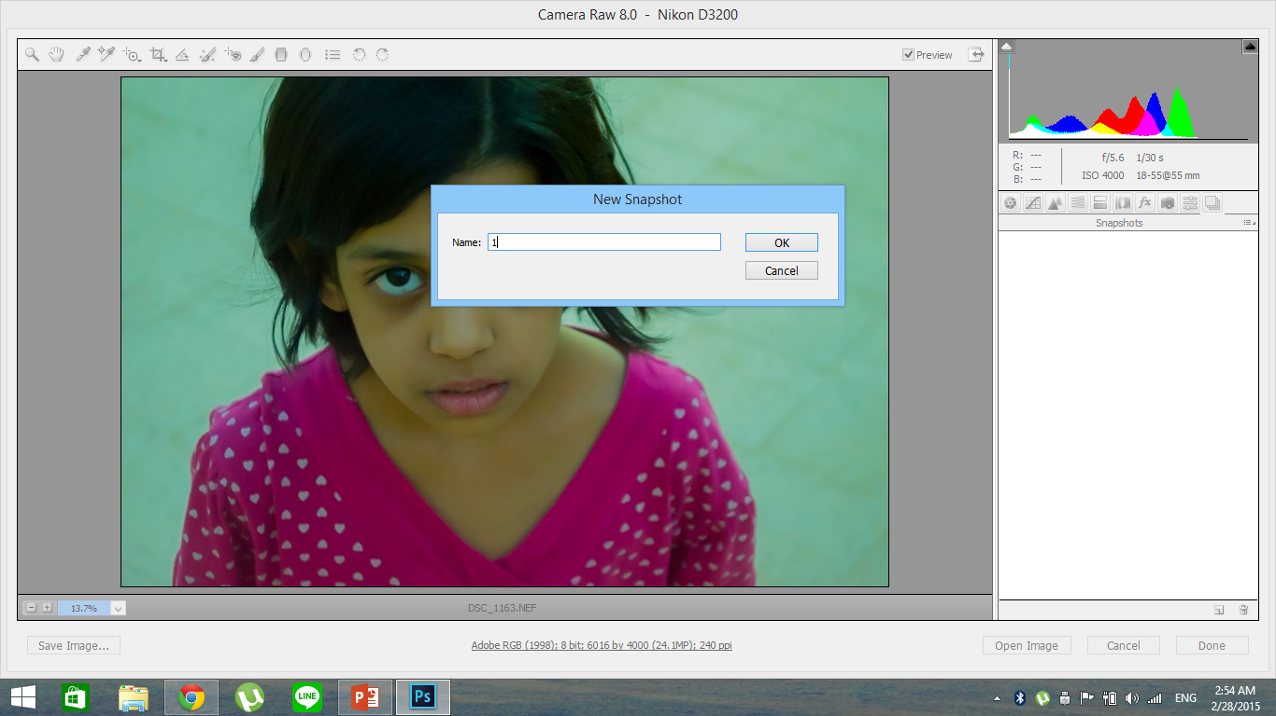

Slide 10
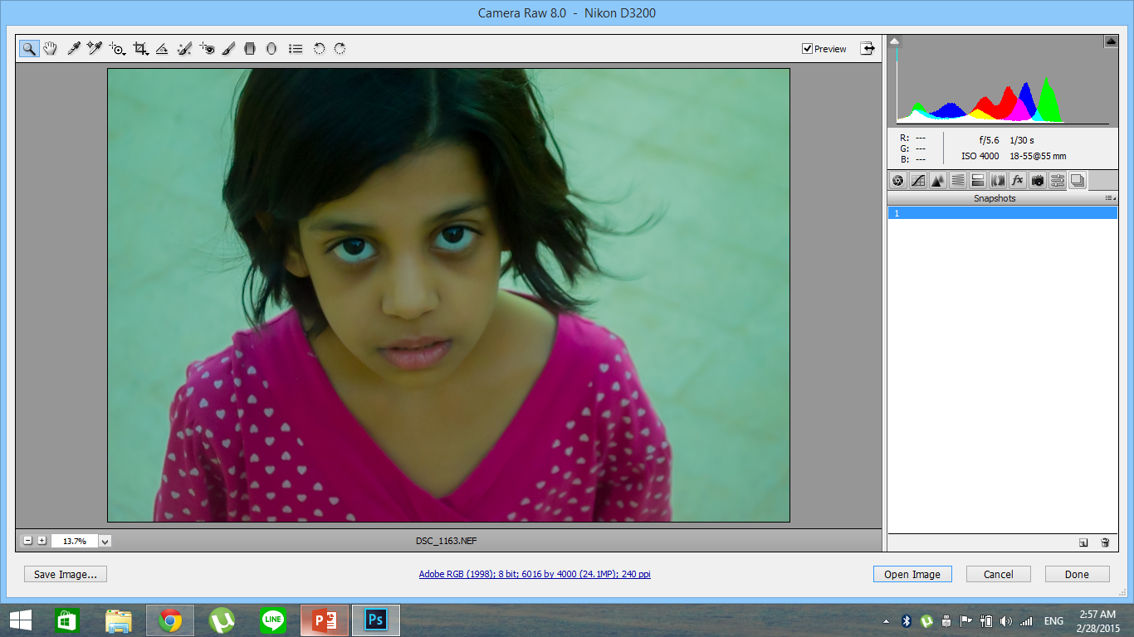

Slide 11
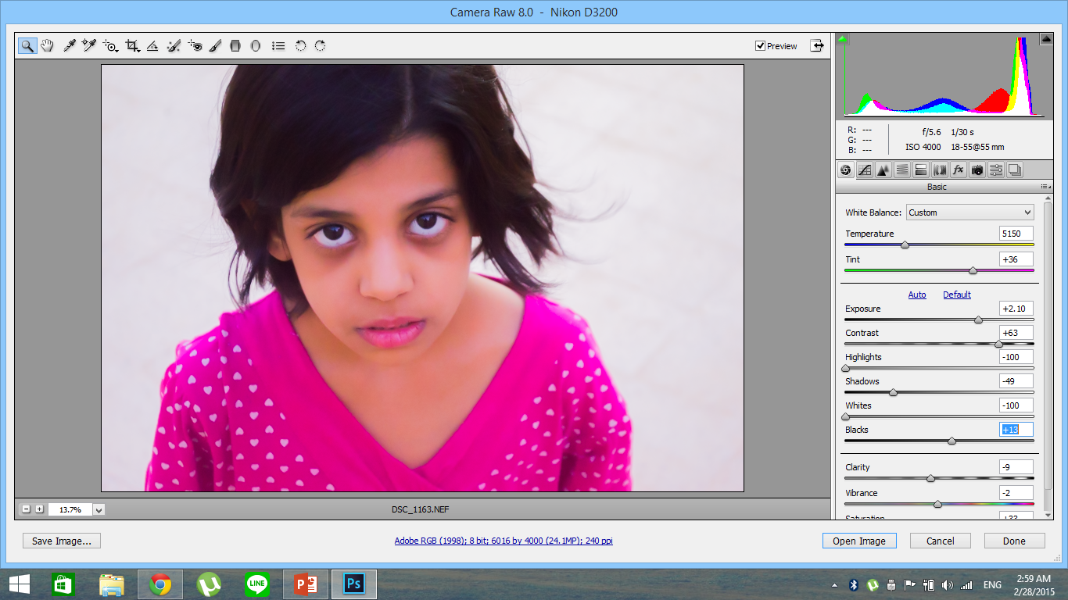

Slide 12
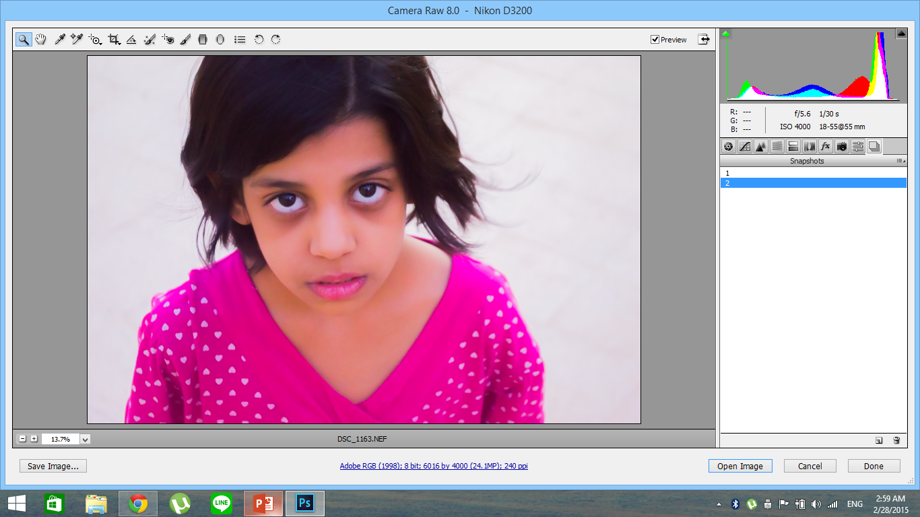

Slide 13
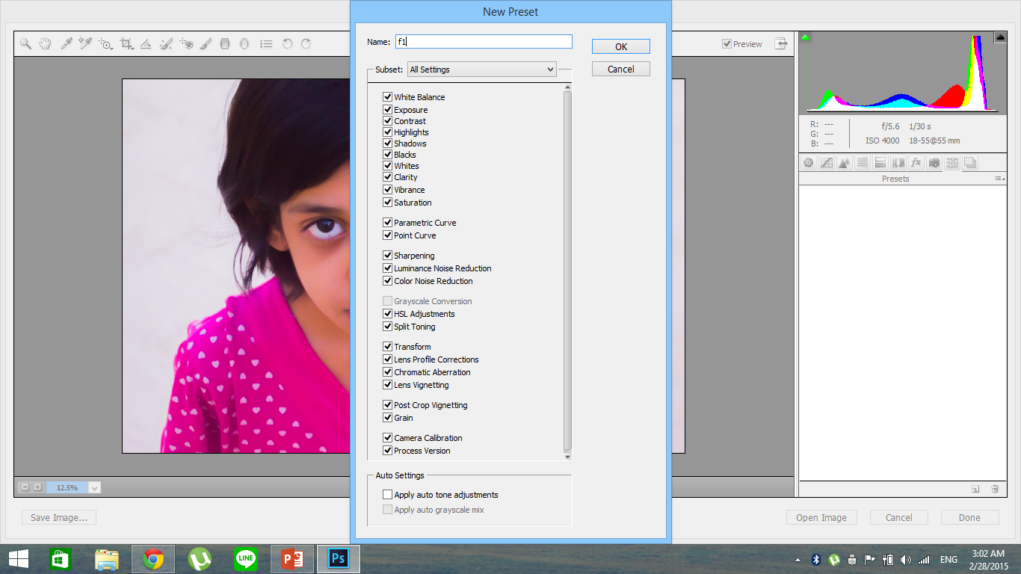

Slide 14
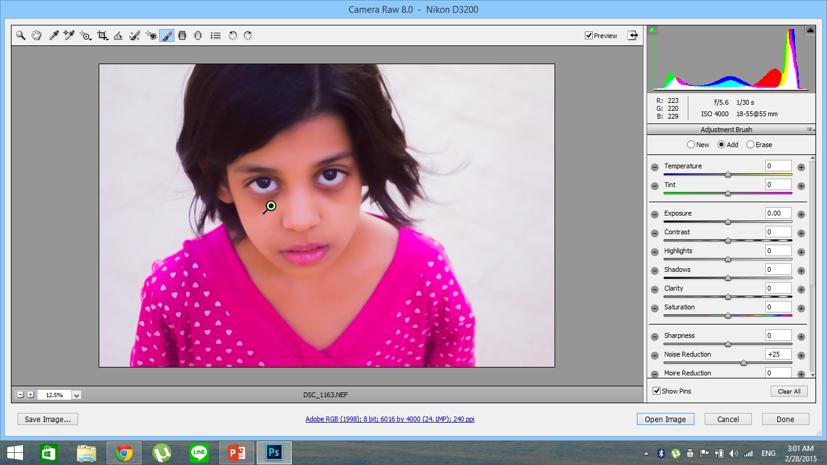

Slide 15
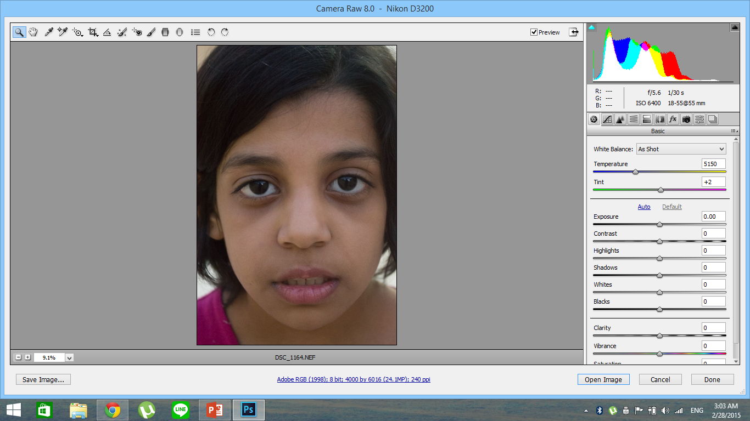

Slide 16
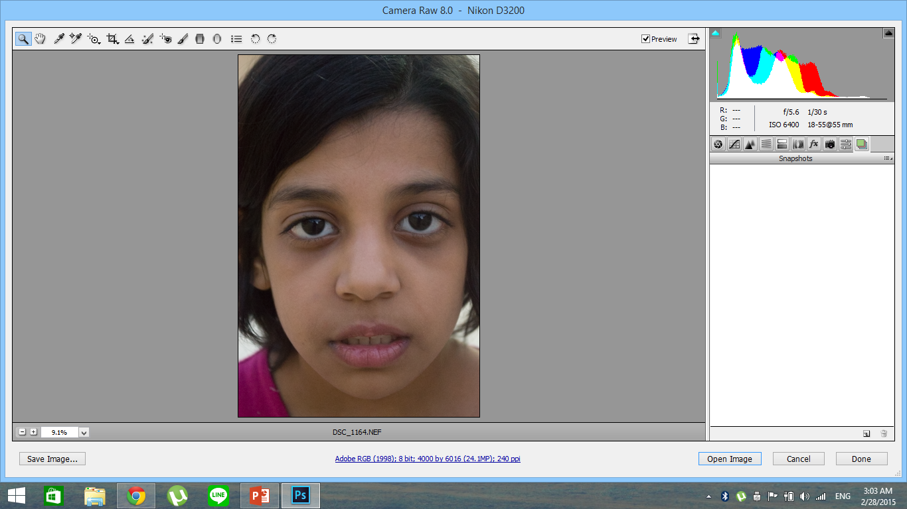

Slide 17


Slide 18
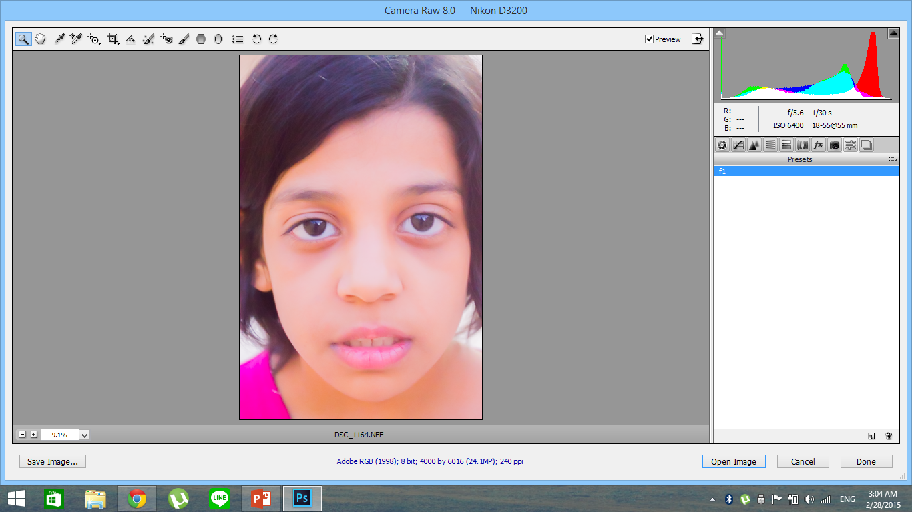

Slide 19
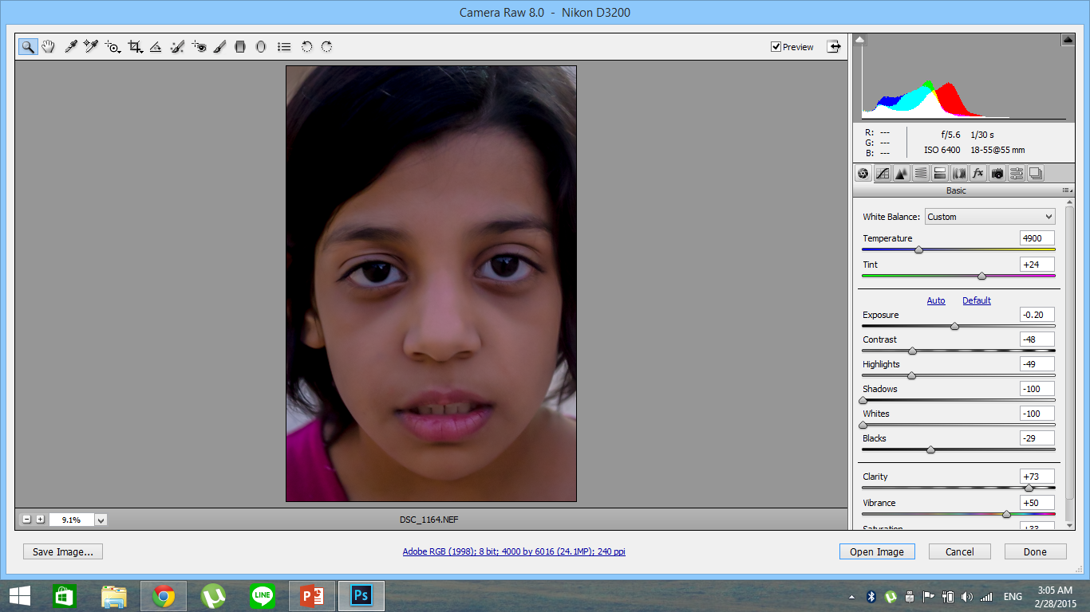

Slide 20
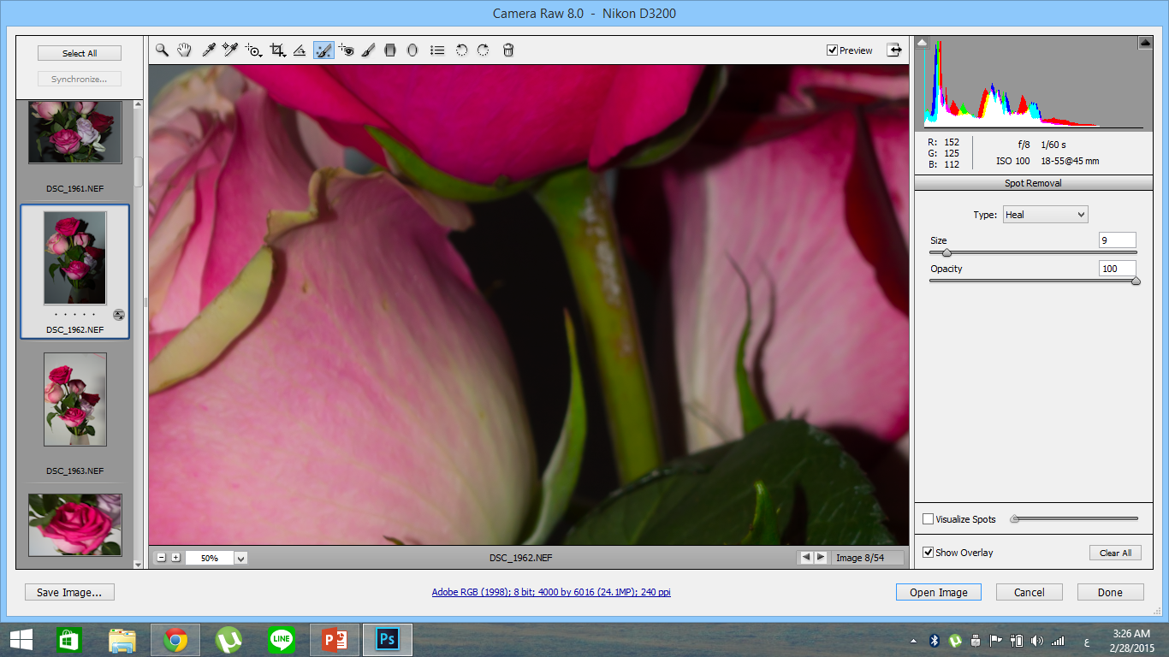

Slide 21


Slide 22


Slide 23
References
http://www.adobe.com/inspire/2013/09/camera-raw-filter-photoshop.html [1]
https://helpx.adobe.com/x-productkb/multi/camera-raw-plug-in-installer.html [2]

