Slide 1
Visual Basic and File Streaming
Monerah Alawadh

Slide 2
Visual Basic And File Streaming
Microsoft Visual Studio

Slide 3
Visual Basic And File Streaming
Easy To link?!

Slide 4
Visual Basic And File Streaming
Read a specific file in our computer (Ex. on the desktop)

Slide 5
How to do it? 2 steps only
Create your file where ever you want (Ex. on your desktop), copy it’s location by write clicking into it > proprieties > copy the path (Note when you paste it on your code add \ then file name).
Write your code that read that file (See next slide).

Slide 6
Visual Basic And File Streaming

Slide 7
What is Freefile() method

Slide 8
Public Class Form1
Private Sub Button1_Click(sender As Object, e As EventArgs) Handles Button1.Click
Dim FileNum As Integer = FreeFile()
Dim TempS As String = ""
Dim TempL As String
FileOpen(FileNum, "C:\Users\mohamed\Desktop\Monnerah.txt", OpenMode.Input)
Do Until EOF(FileNum)
TempL = LineInput(FileNum)
TempS += TempL + vbCrLf
Loop
FileClose(FileNum)
Label1.Text = TempS
End Sub
End Class
File Name+ Location in your PC

Slide 9
What Is EOF Method

Slide 10
What Is VbCrLf Variable

Slide 11
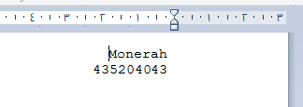
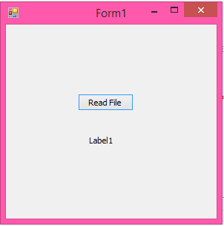
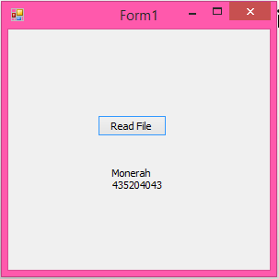
Run

Slide 12
END….

