Slide 1
Customers, Segmentation, and Target Marketing

Slide 2
Segmentation and Target Marketing
Concerned with the individuals, institutions, or groups of individuals or institutions that have similar needs that can be met by a particular product offering
The goal is to identify specific customer needs, then design a marketing program that can satisfy those needs.
The firm must have a comprehensive understanding of its current and potential customers, including their motivations, behaviors, needs, and wants.
Segmentation is critical to the success of most firms and has helped improve our standard of living.

Slide 3
Buyer Behavior in Consumer Markets
Often irrational and unpredictable
Can progress through five stages (see next slide)
Does not always follow these stages in sequence
Strong brand loyalty can move consumers directly from need to purchase.
Includes parallel decisions
“What” to buy
“Where” to buy

Slide 4
The Consumer Buying Process (Exhibit 5.1)
Need Recognition
Information Search
Evaluation of Alternatives
Purchase Decision
Postpurchase Evaluation

Slide 5
The Consumer Buying Process: Need Recognition
Need
Occurs when the consumer’s existing level of satisfaction does not equal their desired level of satisfaction
Want
A consumer’s desire for a specific product that will satisfy the need
Demand
Occurs when a consumer’s ability and willingness to purchase a specific product backs up their want for the product

Slide 6
Many people criticize marketing as being manipulative based on the argument that marketing activities create needs where none previously existed. Given what you now know about the differences between needs and wants, do you agree with these critics? Explain.

Slide 7
The Consumer Buying Process: Information Search
Marketing activities can stimulate a desire for information
Passive information search
Active information search
Sources of information
Internal sources
External sources

Slide 8
The Consumer Buying Process: Information Search (continued)
The amount of time, effort, and expense dedicated to information search depends on:
Degree of risk involved in the purchase (financial risk, social risk, emotional risk, personal risk)
Amount of expertise with the product category
Actual cost of the search (time and money)
Evoked set
A narrowed down set of alternatives that the customer is considering

Slide 9
The Consumer Buying Process: Evaluation of Alternatives
Consumers evaluate products as bundles of attributes, each having a different level of importance (e.g., brand attributes, product features, aesthetic attributes, price)
Important considerations
Products must be in the evoked set
Consumers’ choice criteria must be understood
Marketing programs must be designed to:
Change the priority of choice criteria
Change consumers’ opinions about product or brand image

Slide 10
The Consumer Buying Process: Purchase Decision
The intention to purchase and the act of buying are distinct concepts. Potential intervening factors (car example):
Unforeseen circumstances
Angered by the salesperson or sales manager
Unable to obtain financing
Customer changes mind
Marketers overcome these factors by reducing the risk of purchase, making purchase easy, or finding creative solutions to unexpected problems.
Key issues in the purchase decision stage
Product availability
Possession utility

Slide 11
The Consumer Buying Process: Postpurchase Evaluation
The connection between the buying process and developing long-term customer relationships
Four possible outcomes
Delight
Satisfaction
Dissatisfaction
Cognitive dissonance (postpurchase doubt)
Cognitive dissonance is more likely to occur when:
Dollar value of the purchase increases
Opportunity costs of rejected alternatives are high
Purchase decision is emotionally involving

Slide 12
Factors Affecting the Consumer Buying Process
Decision-Making Complexity
The primary reason for variations in the buying process
Individual Influences
Demographics, perceptions, motives, interests, attitudes, opinions, lifestyles, etc.
Social Influences
Culture, subculture, social class, reference groups, opinion leaders, etc.
Situational Influences
Affect the amount of time and effort devoted to the purchase task

Slide 13
Common Situational Influences (Exhibit 5.2)
Physical and Spatial Influences
Social and Interpersonal Influences
Temporal (Time) Influences
Purchase Task or Product Usage Influences
Consumer Dispositional Influences

Slide 14
Buyer Behavior in Business Markets
Four Types of Business Markets
Commercial markets
Reseller markets
Government markets
Institutional markets
Unique Characteristics of Business Markets
The Buying Center
Hard and Soft Costs
Reciprocity
Mutual Dependence

Slide 15
The Business Buying Process
Problem Recognition
Develop Product Specifications
Vendor Identification and Qualification
Solicitation of Proposals or Bids
Vendor Selection
Order Processing
Vendor Performance Review

Slide 16
Market Segmentation
The process of dividing the total market for a particular product or product category into relatively homogeneous segments or groups
Should create groups where members are similar to each other but dissimilar to other groups
Involves the fundamental decision of whether to segment at all
Typically allows firms to be more successful

Slide 17
Traditional Segmentation: Mass Marketing
Involves no segmentation whatsoever
Is an undifferentiated approach
Works best when the needs of an entire market are homogeneous
Is efficient from a production standpoint
Results in lower marketing costs
Is inherently risky and vulnerable to competitors

Slide 18
Traditional Segmentation: Differentiated Marketing
Involves dividing the total market into groups of customers having relatively common or homogenous needs and developing a strategy to pursue one or more of these groups
Multisegment Approach
Attracting buyers in more than one segment by offering a variety of products that appeal to different needs
Market Concentration
Focusing on a single market segment and attempting to gain maximum share in that segment

Slide 19
Traditional Segmentation: Niche Marketing
Focuses marketing efforts on one small, well-defined market segment or niche that has a unique, specific set of needs
Requires that firms understand and meet the needs of target customers so completely that the firm’s substantial share of the segment makes it highly profitable

Slide 20
Individualized Segmentation Approaches
One-to-One Marketing
Involves creating an entirely unique product offering for each customer
Mass Customization
An extension of one-to-one marketing
Refers to providing unique solutions to individual customers on a mass scale
Permission Marketing
Customers choose to become a member of the firm’s target market
Key advantage: Customers are already interested in the product offering

Slide 21
Many consumers and consumer advocates are critical of individualized segmentation approaches due to personal privacy concerns. Where do you stand on this issue? What are the benefits and risks associated with individualized segmentation?

Slide 22
Identifying Market Segments
Involves selecting the most relevant characteristics to identify and define the target market or market segment
Successful market segments must fulfill five criteria
Identifiable and measurable
Substantial
Accessible
Responsive
Viable and sustainable
Avoid ethically sensitive, but legal, segments
Avoid segments that do not match the firm’s expertise

Slide 23
Market Segmentation in Consumer and Business Markets
Segmenting Consumer Markets (see Exhibit 5.3)
Behavioral segmentation
Demographic segmentation
Psychographic segmentation
Geographic segmentation
Segmenting Business Markets
Type of organization
Organizational characteristics
Benefits sought or buying process
Personal and psychological characteristics
Relationship intensity

Slide 24
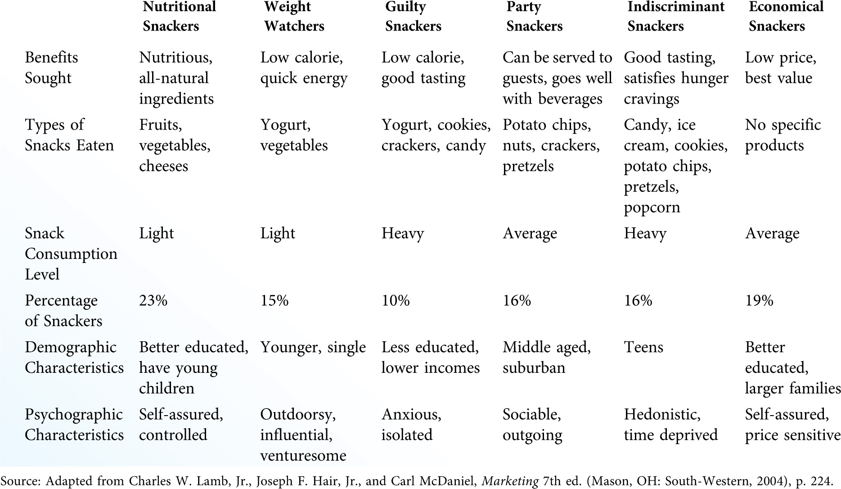
Benefit Segmentation of the Snack Food Market (Exhibit 5.4)

Slide 25
VALS Consumer Profiles (Exhibit 5.5)
Innovators
Thinkers
Achievers
Experiencers
Believers
Strivers
Makers
Survivors

Slide 26
Target Marketing Strategies (Exhibit 5.6)

Slide 27
Targeting Noncustomers
The key to targeting noncustomers lies in understanding the reasons why they do not buy, and then finding ways to remove these obstacles.
Removing obstacles to purchase, whether they exist in product design, affordability, distribution convenience, or product awareness, is a major strategic issue in developing an effective marketing program.

Slide 28
The size of the consuming population over the age of 50 continues to grow. What are some of the current ethical issues involved in targeting this age group? As this group gets older, will these issues become more or less important? Explain.

