Slide 1
Temperature dependence of photosynthesis and thylakoid lipid composition in the red snow alga Chlamydomonas cf.nivalis (Chlorophyceae), 2016
Fatima Salem Alkhulaifi
Dr. Sara
571 Mic

Slide 2
Abstract
Here, we report an effect of short acclimation to a wide span of temperatures on photosynthetic electron transfer, lipid and fatty acid composition in the snow alga Chlamydomonas cf. nivalis. The growth and oxygen evolution capacity were low at 2 °C yet progressively enhanced at 10 °C and were significantly higher at temperatures from 5 to 15 °C in comparison with the mesophilic control Chlamydomonas reinhardtii. In search of the molecular mechanisms responsible for the adaptation of photosynthesis to low temperatures, we have found unprecedented high rates of Q_{A} to Q_{B} electron transfer. The thermodynamics of the process revealed the existence of an increased structural flexibility that we explain with the amino acid changes in the D1 protein combined with the physico-chemical characteristics of the thylakoid membrane composed of > 80% negatively charged phosphatidylglycerol.

Slide 3
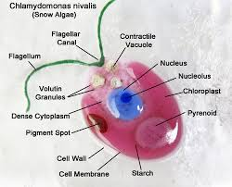
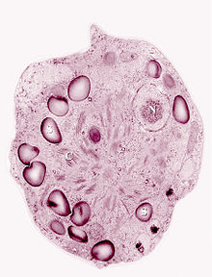
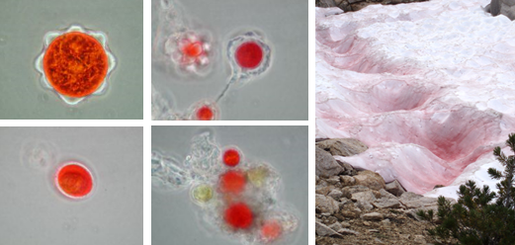
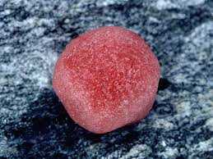
Chlamydomonas nivalis
Watermelon snow, also called snow algae, pink snow, red snow, or blood snow, is Chlamydomonas nivalis, a species of green algae containing a secondary red carotenoid pigment (astaxanthin) in addition to chlorophyll. Unlike most species of
fresh-water algae, it is cryophilic (cold-loving) and thrives in freezing water. Its specific epithet, nivalis, is from Latin and refers to snow.

Slide 4
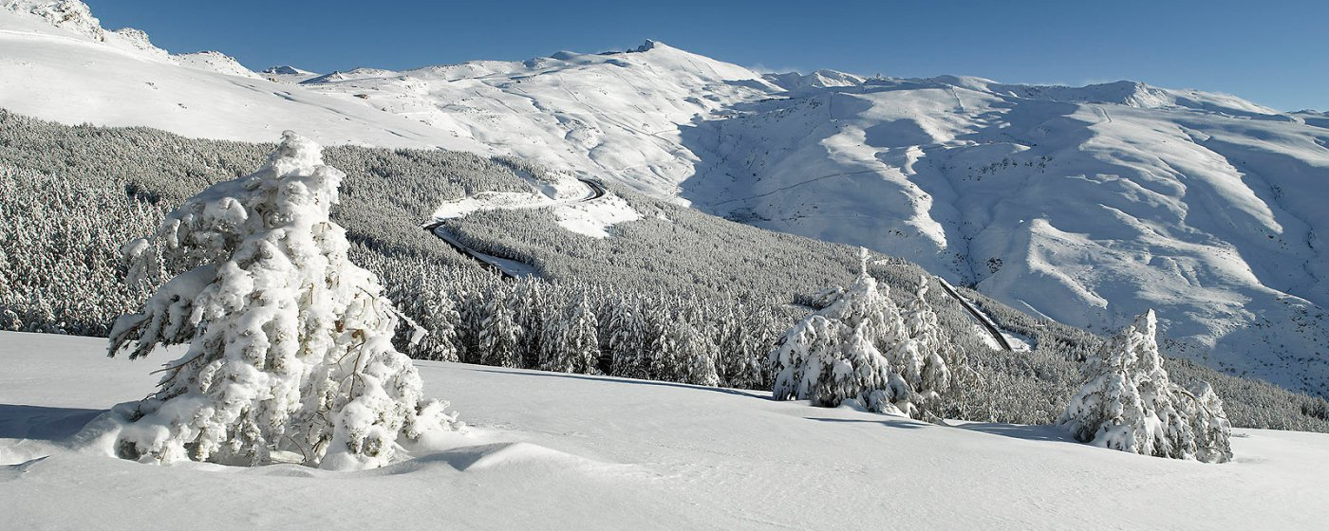
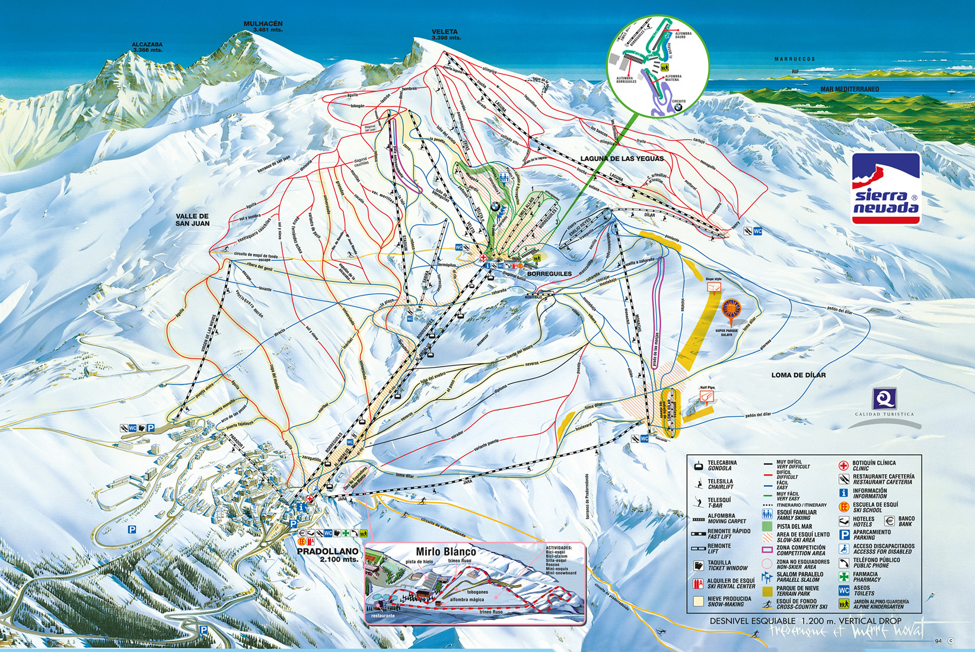
Chlamydomonas nivalis
This type of snow is common during the summer in alpine and coastal polar regions worldwide, such as the Sierra Nevada of California.

Slide 5
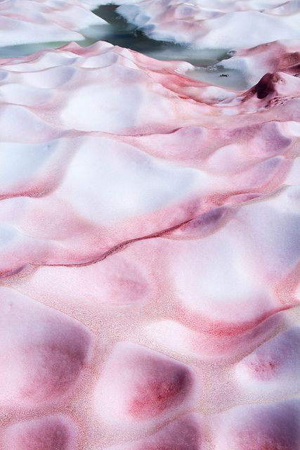
Red Snow
- A phenomenon happens every year. Spores of Snow Algae cause the snow to turn a dark red.
- Snow Algae are single-celled organisms that live in the snow under extreme conditions. In the spring, they have a vibrant green color. They awaken and proliferate…first causing the snow to become green.
- In the winter, the Snow Algae turn to red colour because the nutrient level is restricted, and start to produce carotenoids and other metabolites.

Slide 6
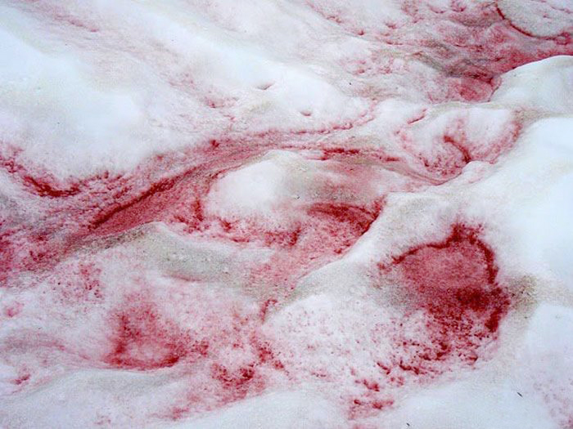

Slide 7
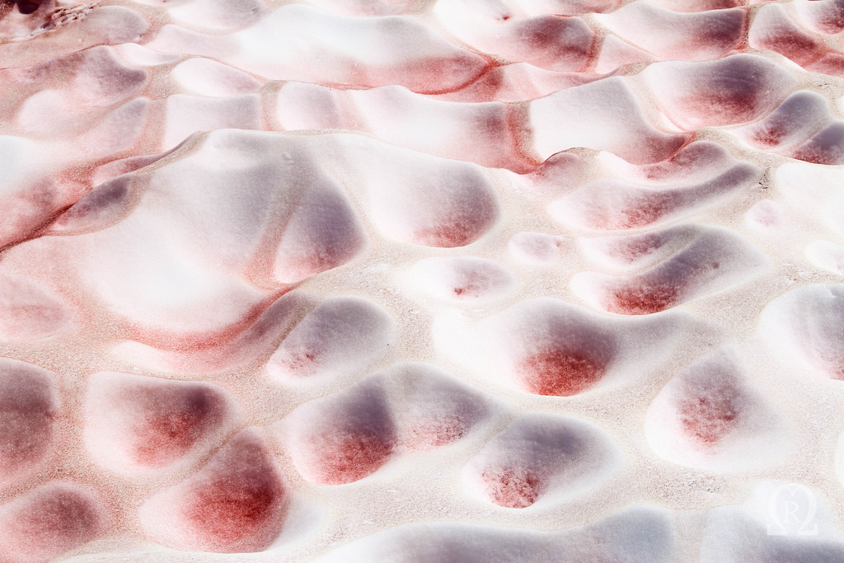

Slide 8
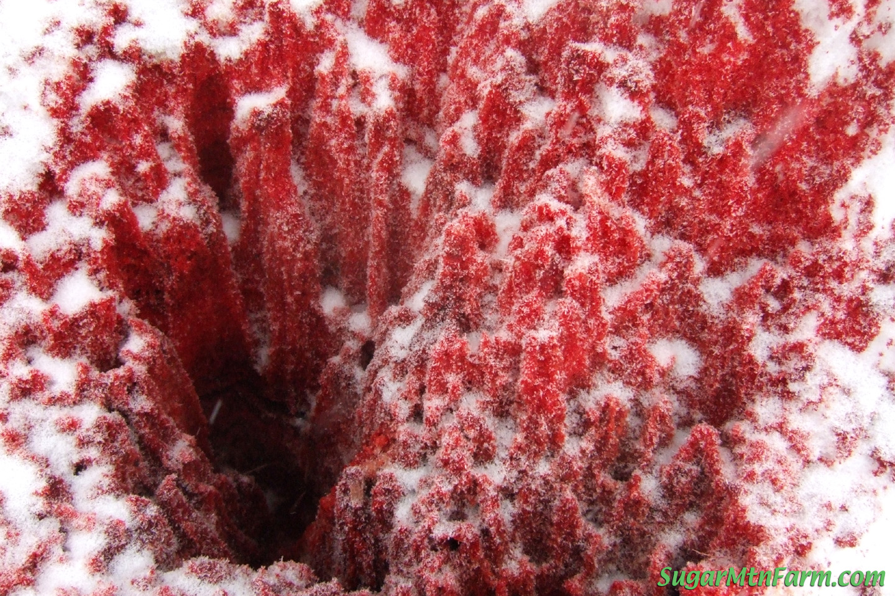

Slide 9
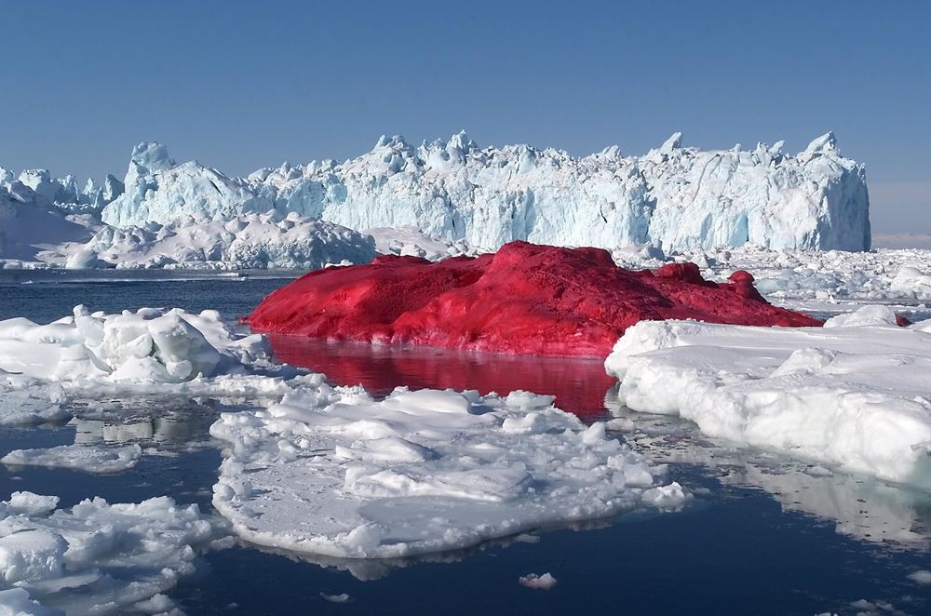

Slide 10
The Importance of Research
INDIRECT
High secretion of carotenoids and other metabolites, Plays a critical role as an Antioxidant substances
Direct
Antioxidant
The Next Fountain of Youth
Activate Longevity genes KL (Klotho).
Cellular energy enzyme AMPK
(adenosine monophosphate-activated protein kinase).
Antiaging
Both of these mechanisms help faciliate DNA repair

Slide 11
The Problem of Research
The carotenoids and metabolites turn the Red Snow Algae into a veritable “Revive Aging Skin” for the skin. At this point, the algae is:
1- Extracted.
2- Dried
3- Turned into Red Snow Algae powder.
The plant stem cells derived from powder
Drink this powder with water as a supplement
Use it in anti-aging skin care products
The best time and condition of temperature to extract snow algae

Slide 12
Materials & Methods
1
Organisms and growth conditions
2
11
Oxygen evolution
Statistical analysis
3
C. cf. nivalis
C. reinhardtii
10
Electron transfer rate measurements
Alignment of gene coding D1 protein
BBM medium
Contain 16 chemical compounds
4
9
2 C
10 C
5 – 15 C
(72 hr using thermostat)
Fluorescence temperature curve
Amplification of gene coding D1 protein
5
8
Isolation of thylakoid membranes
6
DNA isolation
7
Extraction of lipids
Lipid and fatty acid analysis

Slide 13
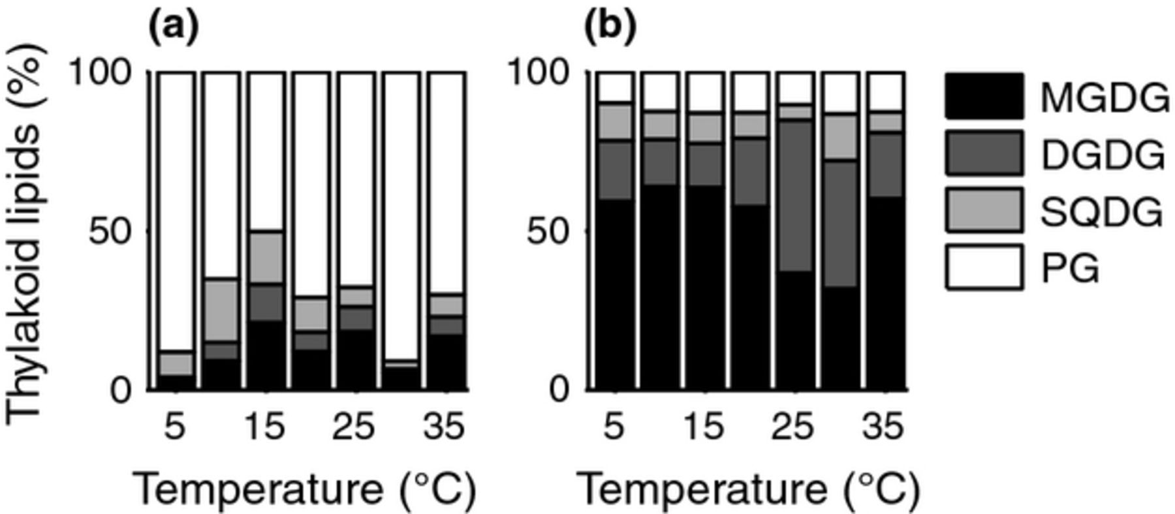
Results & Discussion
What molecular mechanisms are employed to yield the snow alga this rather broad thermal tolerance?
It is important to note that our strain of C. nivalis acclimated to 2.5 °C exhibits significantly faster growth (at 5–15 °C) and oxygen evolution rate (at 5–20 °C) in comparison with the mesophilic control.
Snow-forming C.cf. nivalis cannot be regarded as cryophilic but rather a cryotolerant species with very good photosynthetic performance at low temperatures.

Slide 14
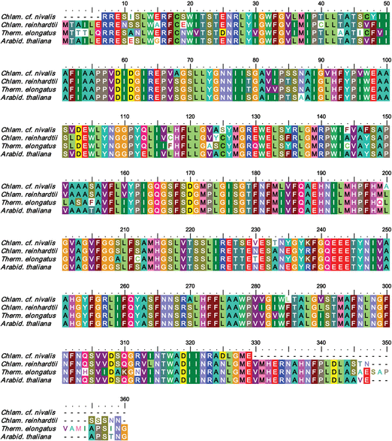
Results & Discussion
Moreover, our analysis of control samples taken from cells grown for 3, 5 and 10 days showed that all the changes in the fatty acid content occurred within a time span shorter than 3 days. This fact documents cells’ potential to quickly acclimate their fatty acid composition regardless of the temperature outside its growth optimum
Oxygen evolution rates of the snow alga surpass the mesophilic control within the range of 5 to c.20 °C even when the two strains were pregrown at identical temperature of 24 °C. The important role of lipids as mediators of thermal acclimation of membrane proteins

Slide 15
Summary
The growth and oxygen evolution capacity were low at 2 °C yet progressively enhanced at 10 °C and were significantly higher at temperatures from 5 to 15 °C in comparison with the mesophilic control Chlamydomonas reinhardtii. In search of the molecular mechanisms responsible for the adaptation of photosynthesis to low temperatures, we have found unprecedented high rates of QA to QB electron transfer. The thermodynamics of the process revealed the existence of an increased structural flexibility that we explain with the amino acid changes in the D1 protein combined with the physico-chemical characteristics of the thylakoid membrane composed of > 80% negatively charged phosphatidylglycerol.

Slide 16
The End
Thanks for pay Intention

