Slide 1
what is an object?
An object represents an individual, identifiable item, unit, or entity, either real or abstract, with a well-defined role in the problem domain.
An object is anything to which a concept applies.
An object is a “noun”

Slide 2
How to define an object?
An object is defined by:
Attributes (also called fields)
Behaviour---what it can do? (also called methods)
Example
A man can be defined by:
Attributes: name, age, job, address,..etc
Behaviour: talk, walk, eat, work, study,...etc
How to define a bird? A car? A flight?

Slide 3
Classes
Objects of the real world may be classified into types: Cars, Cell-Phones, employee, etc.
Objects of the same type have the same characteristics and are manufactured using the same template.
A class is an outline or Template from which objects of the same type are created.
A class describes a set of objects having the same characteristics and offering the same services.

Slide 4
Class
A class represents a template for several objects and describes how these objects are structured internally
Objects of the same class have the same definition both for their operations and their information structure
Classes are types of things

Slide 5
Class vs. Object
Class People
objects : John , George, Sara . They are instantiated from the people class
Class Vehicle
objects :Bus, car, train (instances of the vehicle class)
Class Car
objects : The blue Nissan, the red Vauxhall, my uncle’s car (instances of the car class)

Slide 6
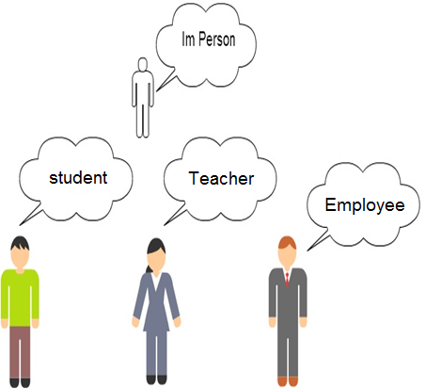
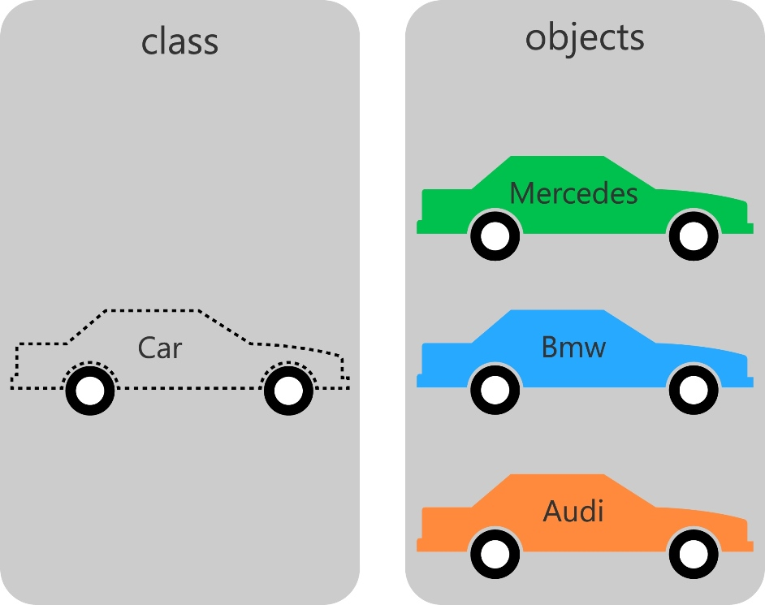
Class vs. Object

Slide 7
Class vs. Object (cont.)
Find a class to represent the following items:
dog, cat, lion, tiger
chair, table, wardrobe
banana, orange, apple
breakfast, lunch, dinner
Provide examples of objects that can be instantiated from the following classes
Students, Courses, Modules

Slide 8
Instance
An instance is an object created from a class
A class describes the behavior and information structure of an instance, while the current state of the instance is defined by the operations performed on the instance
System’s behavior is performed via the interactions between instances

Slide 9
Object-oriented Basics
Fields/attributes
Classes define fields (e.g. a Person class could contain fields name, age, gender, etc.)
Objects have attributes, which are values stored in fields (e.g. person_1 has attributes “John Smith”, 25, Male)
An object’s state is defined by its attributes
Methods
Classes define methods, which can access or change attributes
Objects communicate by calling (invoking) each others’ methods
Parameters
Methods can have parameters to pass additional information during execution
Notes:
9

Slide 10
Summary – OO Basics
Fundamental concepts
Object, Class, Field/attribute, Method, Parameter
Objects
Represent “things” from the real world, or from some problem domain (e.g. “the red car in the car park”)
Classes
Objects are created from classes
Represent all objects of a kind (e.g. all “cars”)
Notes:
10

Slide 11
Access Modifiers (cont.)
Accessibilities options
public – Accessible to all
private – Accessible to containing class
protected – Accessible to containing or derived classes (will be described in CSC113)
In most cases: fields are private or protected, and methods are public.

Slide 12
UML Representation of a Class
UML represents a class with a rectangle having 3 compartments stacked vertically.
The top compartment shows the class's name.
The middle compartment lists the attributes.
The bottom compartment lists the operations: methods or services.
Links between different classes define relationships (will be covered in CSC113)
ClassName
att₁: dataType₁
…
att_{i}: dataType_{i}
Attributes
+ m₁(…): dataType₁
+ ...
+ m_{j}(…): dataType_{j}
Methods (Services)

Slide 13
UML Representation of a Class (UML Class Diagram)
UML uses three symbols to represent the visibility of the class’ members.
+ : mentions that the member is public.
- : mentions that the member is private.
# : introduced in the CSC 113.
These are the Access Modifiers
ClassName
att₁: dataType₁
…
att_{i}: dataType_{i}
Attributes
+ m₁(…): dataType₁
+ ...
+ m_{j}(…): dataType_{j}
Methods (Services)

Slide 14
Ex: UML Class Diagram
Problem Statement:
Write a program to input the length and width of the rectangle, and calculate and print the perimeter and area of rectangle.
Nouns :
length , width, rectangle, perimeter , area
Verbs :
print , calculate
Notes:
Now we will address the problem as OOP

Slide 15
UML Example
Rectangle
width: double
length : double
Attributes
+ calcuArea():double
+ calcuPerimeter()double
_{+ print () void}
Methods (Operation)

Slide 16
public class Rectangle
{
// Attributes
private double width;
private double length;
// Methods (Operation)
public double calcArea(){
return height*width;}
public double calcPerimeter(){
return 2*(height + width);}
public void print()
{
System.out.print(“The Area is ”+calcArea());
System.out.print(“The Perimeter is ”+calcPerimeter());
}
}
Declared as any variable
Rectangle
width: double
length : double
+ calcuArea():double
+ calcuPerimeter()double
_{+ print () void}
Method access attribute directly

Slide 17
Object vs. class
Cell phone
Brand:string Price:double
+addcontant():void
Class
Obj1
Obj 2
Obj 3
Brand
Price
Iphone
Brand
Price
Samsung
Brand
Price
LG
2400.0
2000.0
1900.0
Objects

Slide 18
Practical hint
Class Course will not execute by itself
It does not have method main
CourseRegistration uses the class Course.
CourseRegistration, which has method main, creates instances of the class Course and uses them.

Slide 19
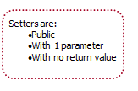
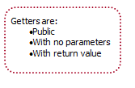
Get method :
Set method :

Slide 20
Example
Create a Java class called Account based on the following UML :
The class should:
Have a default constructor that initializes the attributes to default values , and another constructor that initializes the date attributes to given values.
Method deposit will add to balance
Method withdraw will reduce the balance
Provide set() and get() methods for each attributes.
In the main() method of the class TestAccount write statements that will call both constructors and test class Accounts capabilities.
Account
- number :int - balance : double
+deposit (double amount):void +withdraw(double amount) : void

Slide 21
Class Account
public class Account
{
// definition of attributes (data)
private int number;
private double balance;
// constructor
public Account () {
number=0;
balance=0;
}
public Account (int n , double b) {
number=n;
balance=b;
}
// definition of operations (methods)
public void deposit (double amount) {
balance = balance + amount;
} //end of deposit
public void withdraw(double amount) {
if (balance >= amount)
balance = balance – amount;
} //end of withdraw
public void setNumber (int n) {
number = n;
} //end of setNumber
public void setBalance (double b) {
balance=b;
} //end of setBalance
public int getNumber() {
return number ;
} //end of getNumber
public double getBalance() {
return balance;
} //end of getBalance
} //end of class

Slide 22
Class TestAccount
public class TestAccount
{
public static void main(String[] args) {
Account Account1=new Account();
Account Account2=new Account(1,6200);
Account1. setNumber (2) ;
Account1. setBalance (4300) ;
Account2. deposit (550) ;
Account1. withdraw(200);
System.out.println(Account1. getBalance() + "-" +Account2. getBalance() );
}
}

