Slide 1
Determination of bicarbonate in blood

Slide 2
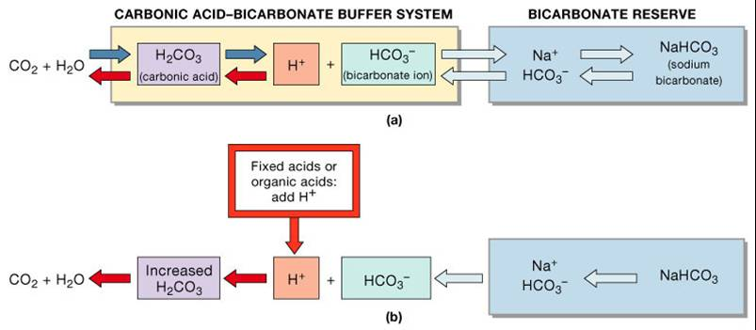
Introduction:

Slide 3
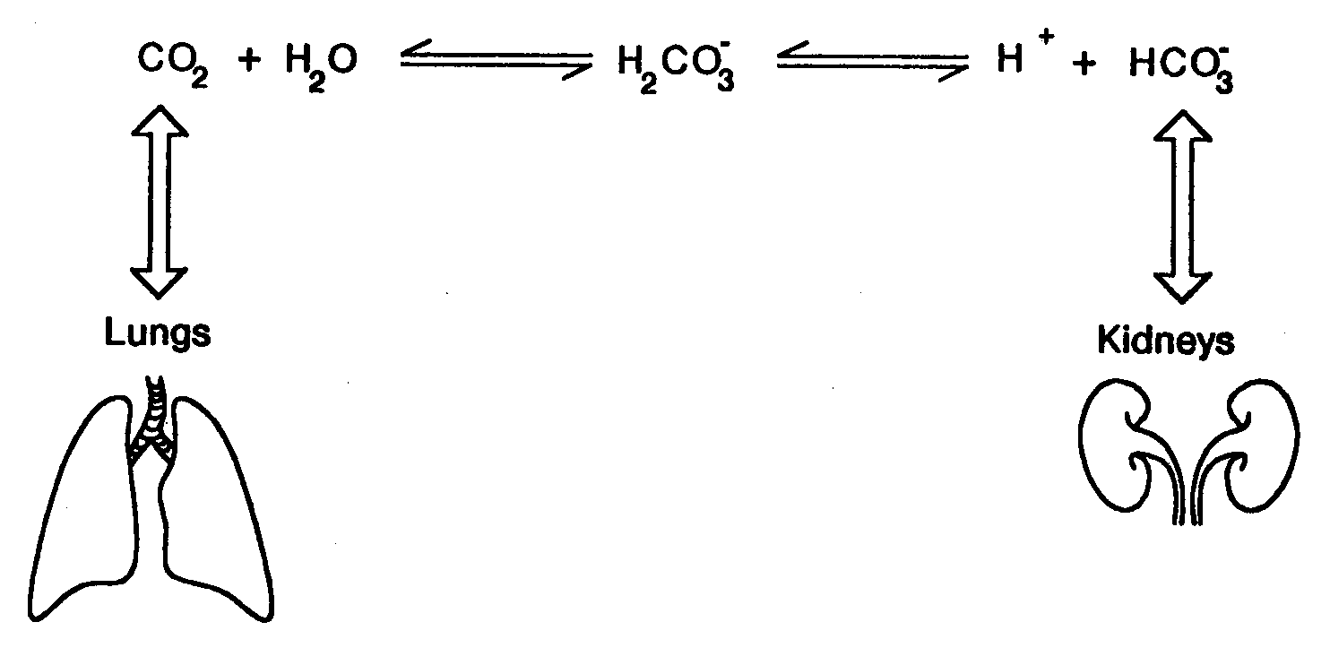
Introduction:

Slide 4
Back titration
is an analytical chemistry technique that allows the user to Determine the concentration of an analyte by reacting it with a known number of moles of excess reagent. The excess reagent is then titrated with a second reagent.
The concentration of the analyte in the original solution is then related to the amount of reagent consumed.

Slide 5
purposes of using back titration
Back titration is designed to resolve some of the problems encountered with forward or direct titration. Possible reasons for devising back titration technique are :
1- The analyte may be in solid form .
2- The analyte may contain impurities which may interfere with direct titration.
3- The analyte reacts slowly with titrant in direct or forward titration.
4- Weak acid – weak base reactions can be subjected to back titration for analysis of solution of unknown concentration.

Slide 6
Advantages of doing back titration
1- Useful if the endpoint of the reverse titration is easier to identify than the endpoint of the normal titration.
2- Useful when trying to work out the amount of an acid or base in a non-soluble solid.

Slide 7
Disadvantages of back titration
1- Needs skill and practice for effective results
2- Instruments have to be properly calibrated since it will give affected the final result.
3- Reactivity of the elements to be titrated should be well researched since this may affect the end point.
4- Time consuming if done manually.

Slide 8
Principle
The HCO3¯ concentration is determined by :
1- Adding an excess of 0.001M HCL, to volatilize the HCO3 ( Weak Base) as CO2, swirling to allow the CO2 to escape.
2- Back-titrating the excess HCL (strong Acid) with 0.001M NaOH (Strong Base).

Slide 9
Principle
HCO₃¯ + excess HCL H₂O + CO₂ + CL¯
Excess HCL + NaOH NaCL + H₂O ( back titration)

Slide 10
Procedure
A) Comparison Solution:
1- In Erlenmeyer flask mix the following:
6 ml 1% saline
0.1 ml sample (NaHCO₃)
2 drops phenol red
Important (Shake after each addition).
2- rotate gently to mix the contents until get pink color (end point) .
N.B.: if you use blood sample , the transition range of this indicator is pH 8.4-6.7 (yellow to red).

Slide 11
B) Titration of the Sample :
A) First reaction:
1- In Erlenmeyer flask mix the following:
4 ml 1% saline .
0.1 ml sample (NaHCO₃).
10 ml HCL (0.001 M) (excess)
2- Shake after each addition to allow the (CO2) to escape.
3- add 2 drops phenol red .

Slide 12
B) Second reaction:
1) Titrate with NaOH (0.001 M) until you get pink color (end point).
2) Record the volume used.

Slide 13
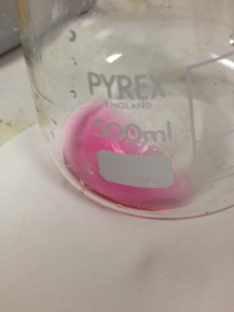
Comparison solution

Slide 14
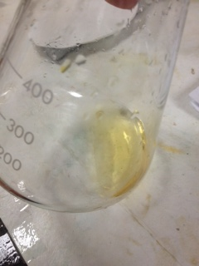
First step before titration

Slide 15
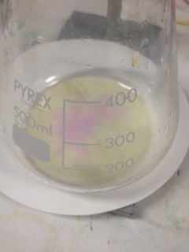
After addition of thefirst drop of NaOH

Slide 16
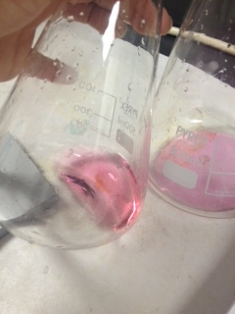
End point

Slide 17
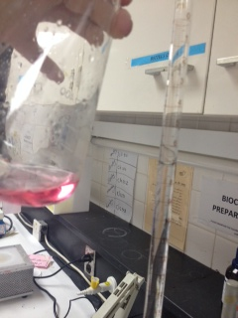
Result

Slide 18
Calculation
1- HCO3- = {(M= ?) , (V=0.1 ml)}.
HCO3- + Excess HCL (known molarity,known volume) H2O + CO2 + CL- .
Remember ! Weak Base + acid = No great pH = hard to detect end point.
HCO3- + ( Excess HCL = strong acid)
titrated with NaOH (strong base) = sharp end point .

Slide 19
How to work out HCO3- Concentration?
HCL + NaOH NaCL + H2O
0.001 M 0.001 M
ml = ? 7 ml
Number of moles of NaoH = Number of moles of Hcl
C _{Hcl} X V _{Hcl} = C _{NaOH} X V _{NaOH}
V _{Hcl} = (0.001X7)/ 0.001 = 7 ml.

Slide 20
HCL (Supplied) – HCL (Left over) = HCL (reacted).
10 ml – 7 ml = 3 ml reacted with HCO3-.
HCO3- + HCL H2O + CO2 +CL-.
= 0.1 ml, ? M + 3 ml , 0.001 M.
Number of moles of HCO₃⁻ = Number of moles of Hcl
C _{HCO3} X V _{HCO3}= C _{Hcl} X V _{Hcl}
C _{HCO3} = 0.001 X 3/0.1=0.03 M

