Slide 1
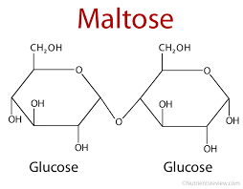
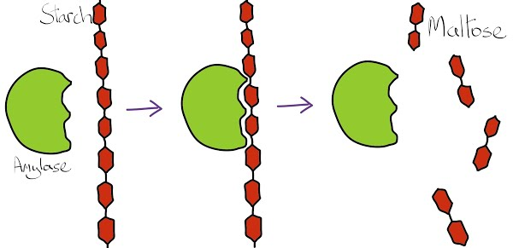
EXP.2 (Quantitative determination of Amylase activity) CLS 282 Daheeya Alenazi

Slide 2
Introduction
The purpose of this experiment is to study:
To study the enzyme amylase which is found in saliva.
Amylase breaks down starch into the maltose as the end product.
To estimate the amount of maltose by using a standard curve.

Slide 3
Principle
Starch react with iodine to give a blue color and maltose react with alkaline dinitrosalicylic acid to give an orange color.
The former reaction is not stoichiometric (the intensity of blue color is not linearly proportional to starch conc. And it is only qualitative value)
The maltose assay on other hand is stoichiometric and is used to estimate the amount of maltose formed .
A standard curve for maltose constructed for working out the result

Slide 4
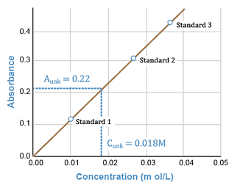
Beer's law states that the absorbance is directly proportional to the concentration of a solution. If you plot absorbance versus concentration, the resulting graph yields a straight line.
C1× V1 = C2 × V2
(Start reading) (final reading)

Slide 5
Principle
Amylase
1-Starch Maltose
2-Maltose + 3,5 dinitrosalicylic acid(Alkaline reagent)
Red Orange colour

Slide 6
Procedure steps
1-Construction of Maltose standard curve:
Use beer’s low to measure standards of Maltose.
2-Measure of unknown of maltose:
Compare results with standard curve.
3-Measure amount of Maltose formed per ml of saliva
Using data from step 2

Slide 7
Part 1: Construction of maltose std. Curve:
Read the Abs at 520 nm.
 |  | blank |  | Std.1 | Std.2 | Std.3 | Std.4
Maltose (1mg/ml) |  | - |  | 0.1 | 0.5 | 1.5 | 2
H2O |  | 2 ml |  | 1.9 | 1.5 | 0.5 | ---
DNS Rgt (ml) |  | 2 |  | 2 | 2 | 2 | 2
10 mins., boiling water bath. And cool,
H2O (ml) | 6 |  | 6 |  | 6 | 6 | 6

Slide 8
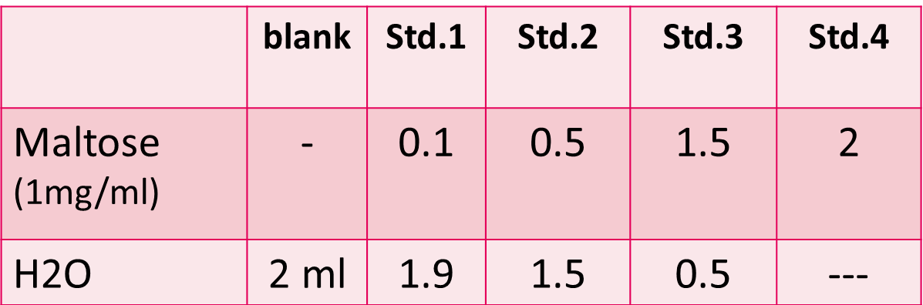
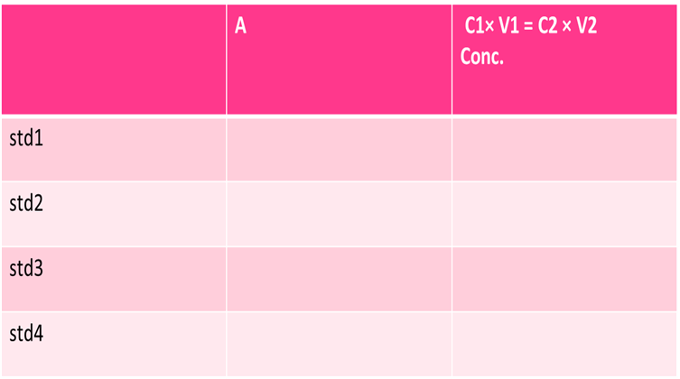
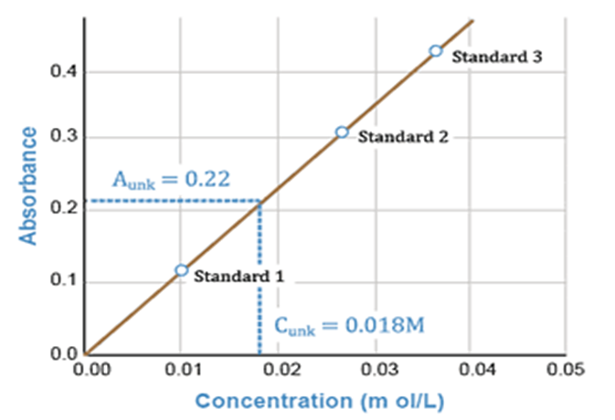
Calculation of part 1
1-C1× V1 = C2 × V2 :
C1= 1 mg/ml
V1=0.1,0.5,1.5,2
V2=2ml
C2=……?
2-Create The Result Table.
Read Abs. on 520 nm.
3-Draw The Curve

Slide 9
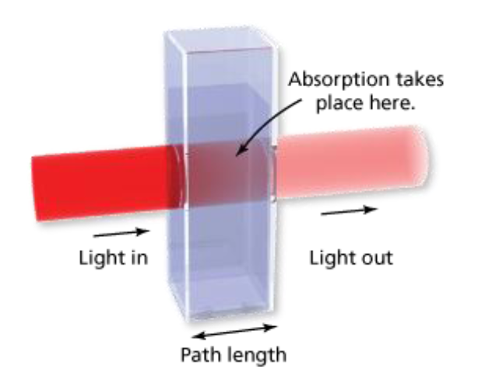
Spectrophotometer
http://teaching.shu.ac.uk/hwb/chemistry/tutorials/molspec/beers1.htm

Slide 10
Reagents used
1-Alkaline reagent (1gm of 3,5 dinitrosalicylic acid )+ 1gm of sodium potassium tartarate + 30gm sodium hydroxide + 1L D .W)
2-1% Maltose
3-o.1M Phosphate buffer, PH=7
4-Buffered starch substrate.
5-1%NaCl
6-2N NaoH

Slide 11
Part (2): Measure unknown of Maltose
 | Tube1 (Blank) | Tube2 (Test) | Tube3 (zero time control)
Phosphate buffer | 2.5 ml | 2.5 ml | 2.5 ml
Starch solution | 2.5 ml | 2.5 ml | 2.5 ml
NaCl (1%) | 1 | 1 | 1
Mix, incubate 10 mins at 37⁰c
H2O ml | 1 | 0.5 | 0.5
Diluted saliva (1:20) | --- | 0.5 | 0.5
NaOH | ---- | ---- | 0.5
1&2 incubation15 mins, 37⁰c
NaoH | 0.5 | 0.5 | ----
Reagent DNS | 0.5 | 0.5 | 0.5
Mix, Heat In Boiling Water For 5 mins. Cool It at R.T
Add 2 ml H2O, Read Abs at 520nm

Slide 12
Calculation steps
A/calculate The Correct Absorbance
=final Abs-initial Abs
=Tube 2 – Tube 3 then,
B/Compare result with Maltose standard curve. (previous curve)
C/Calculate the amount of Maltose formed per ml of saliva... ( Enzyme Activity)…

Slide 13
Part(3):Measure amount of maltose formed by Saliva
Amount of maltose formed in mg/min/1ml of saliva=
X x Amount of saliva x 2 x Dilution factor x 1000
M.wt of maltose x Time
X= Conc. of maltose
Amount of saliva = 0.5
Dilution factor = 20
M.wt of maltose=342 g/mol
Time=15 min

