Slide 1
Exp#1 the hydrolytic activity of salivary amylase on starch
CLS 282
Haifa Altwijri –Daheeya Alenazi
1442 H

Slide 2
introduction
In our bodies, there are organic and inorganic compounds.
Organic compounds include protein, fat, carbohydrates, and nucleic acids. Which are the major classes in human body…
Compound metabolism needs regulation by enzymes…
Some enzymes help to break down large nutrient molecules…

Slide 3
Introduction:
Enzymes: are biological molecules that catalyze (i.e., increase the rates) of chemical reactions.
An enzyme is a protein formed by the body that acts as a catalyst to cause a certain reaction. Enzymes are very specific. Each enzyme is designed to initiate a specific response with a specific result.
Enzyme Activity is affected by temperature, pressure, chemical environment (e.g., PH), and the concentration of substrate

Slide 4
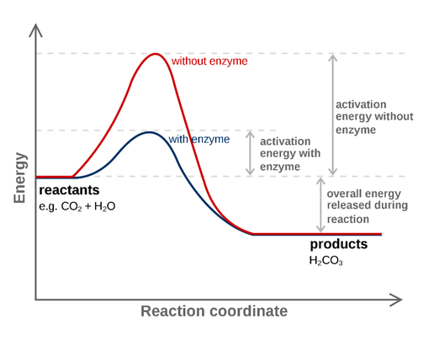
The lower the activation energy for a reaction, the faster the rate. Thus enzymes speed up reactions by lowering activation energy

Slide 5
Amylase:
a hydrolytic enzyme which breaks down many polysaccharides (starch) which is a polymer of D- glucose units linked by α-1,4 glycosidic bonds.
Source of amylase:
1- Pancreas
2- Salivary gland
What is the end product of starch hydrolysis reaction by amylase?
What are the intermediate products ?

Slide 6
2 types of amylase:
 | α-amylase | β-amylase
Source | Animal-plant-microbs | Plants-microbs
tissue | Saliva-Pancreas | Seeds-fruit
Cleavage Site | Random α-1,4 glycosidic bond | Second α-1,4 glycosidic bond
Reaction products | Maltose-Dextrin | Maltose

Slide 7
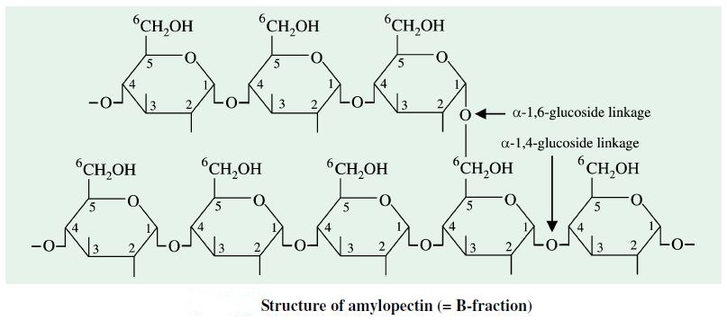

Slide 8
In the assay:
The rate of the reaction can be known by:
1. measuring the amount of substrates.
2. measuring the amount of products.
Starch(substrate) & maltose(product) are colorless.
Starch+ iodine blue
Maltose + iodine clear( colorless)
Maltose + Dextrin orange

Slide 9
The principle
At a pH of about 6-7 and in the presence of chloride ions (NaCl), α amylases catalyses the hydrolysis of starch → to form maltose with the intermediate formation of various dextrin.
Dextrin are polysaccharide produced by the hydrolysis of starch

Slide 10
Steps of the reaction:
1. Starch Higher dextrin blue colour
2. Intermediated dextrins reddish brown colour
3. Lower dextrins & maltose colourless
α-amylase

Slide 11
Materials:
1. phosphate buffer PH =6.7
2. iodine solution
3. sodium chloride. (accelerate the reaction).
4. glass rods.
5. spotting plate.
6. water bath (37 & 95 ⁰c).

Slide 12
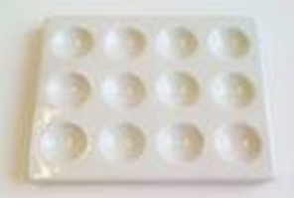
Method
saliva sample (use student saliva) & put in small beaker.
2.Make dilution mixture (1:40) i.e.(1ml saliva +39ml of D.w)
3. put drop of iodine in all spots of spots plate.
*Divide plate into test and control.

Slide 13
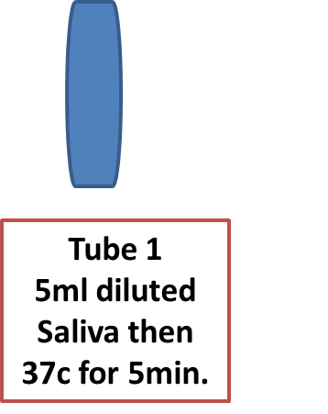
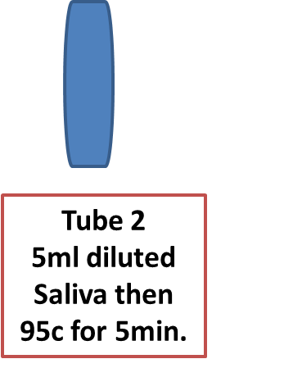
4.Take 5ml from diluted mixture in each tubes 1&2.
this step to study temperature effect.

Slide 14
5.Take another tubes (3 test)&(4 control) and put this contents:
6.add 1ml from tube(1) to the tube (3test) & 1ml from tube(2) to tube (4 control).
Test
Control
Tube 3
5ml starch
2ml buffer
1 ml NaCl
37c for 5 min.
Tube 4
5ml starch
2ml buffer
1 ml NaCl
37c for 5 min.

Slide 15
7. add one drop from tube (3 test) mixture to the iodine spot in the plate, mix with wooden stick.
8. At the same time, add one drop from tube (4 control) mixture to the iodine spot in the plate, mix with wooden stick.
12.repeat it with 1 min intervals.
Observe the change in color.

Slide 16
Interpret your results
Achromic point: The point in time during the action of amylase on starch at which the reaction mixture no longer gives a colour with iodine.
Result:
Colorless takes →4- 40 min accepted (normal)
>40 ……..zero activity
<4………. Dilute the sample.

