Slide 1
Relational model
Constraints AND Examples

Slide 2
OBJECTIVES
Relational Integrity Constraint
mapping exercises to convert ER model – chen and UML notation – to relational model.

Slide 3
Relational Integrity Constraint
Constraints are conditions that must hold on all valid relation states .
There are three main types of constraints in the relational models :
Key constraints
Entity integrity constraint
Referential integrity constraint

Slide 4
1. Key constraint
Relational schema may have more than one key , each key is called candidate key.
If a relation has several candidate keys , one is chosen to be the primary key
- the primary key attribute is underlined
Ex : CAR( State,Reg#,SerialNO, Make , Model , Year )
The primary key value is used to uniquely identify each tuple in a relation

Slide 5
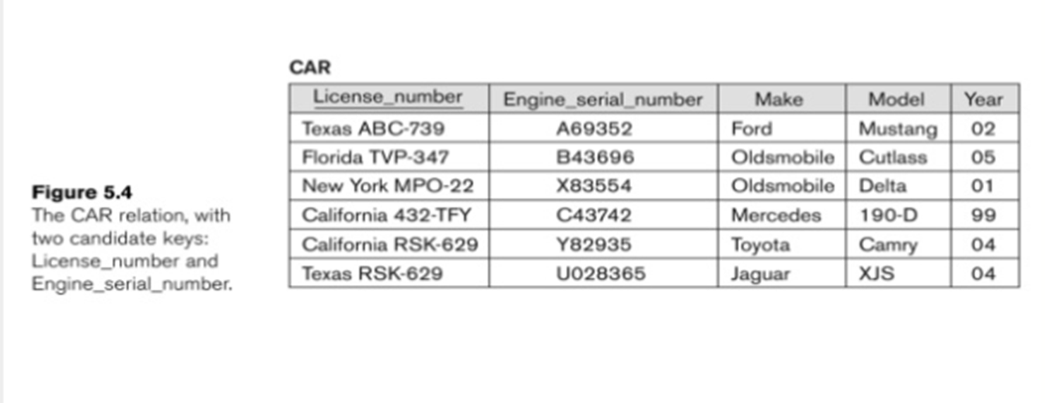

Slide 6
2. Entity integrity
the primary key attributes PK of each relation schema R in S cannot have null values in any tuple.
- if PK has several attributes , null is not allowed in any of these attributes .
This constraint involve a single relation.

Slide 7
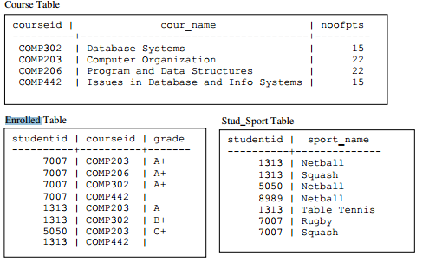
What is the PK?

Slide 8
3. Referential integrity
Used to specify a relationship among tuples in two relations.
Tuples in the referencing relation R1 have attributes called foreign key attributes FK that reference the PK attributes of the referenced relation R2
FK satisfies the following two rules:
The attributes in FK in R1 have the same domain as the Primary key attributes of R2
A value of FK in tuple t1 ether occurs as a value of PK for some tuple t2 or is null .
A foreign key ( referential integrity ) constraints is displayed in relational database schema as directed arc ( arrow ) from the FK attributes to the referenced relation ( can also point to the PK for clarity )

Slide 9
4. Other types of constraint
Example : “ the max no. of hours per employee for all projects he or she works on is 56 hrs per week
Based on application semantics and cannot be expressed by the model
A constraint specification language may have to be used to express these

Slide 10
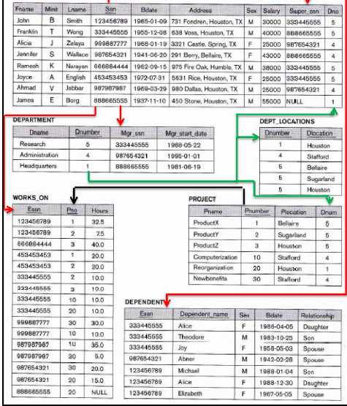

Slide 11
Mapping exercises
Present the relational schemas mapped from ER model shown in each exercise.

Slide 12
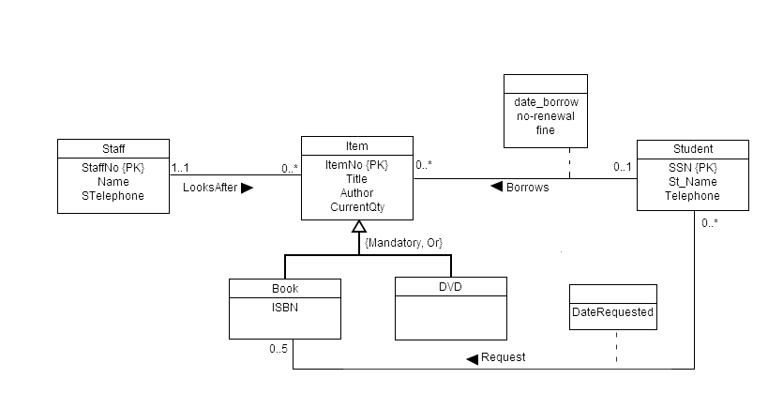
Exercise 1 ( UML notation )
2
1
3

Slide 13
Exercise 1 ANSWER
STUDENT(SSN, ST_ name , telephone )
STAFF(SNO , S_ name , S_ telephone )
DVD(DItemNO , Title , Author , Current_qty , SNO , SSN , date_barrow , no_renwal , fine )
BOOK(BItemNO , ISBN , Title , Author , Current_qty , SNO , SSN , date_barrow , no_renwal , fine )
REQUESTED_BOOK (SSN, BitemNO date_ requested )

Slide 14
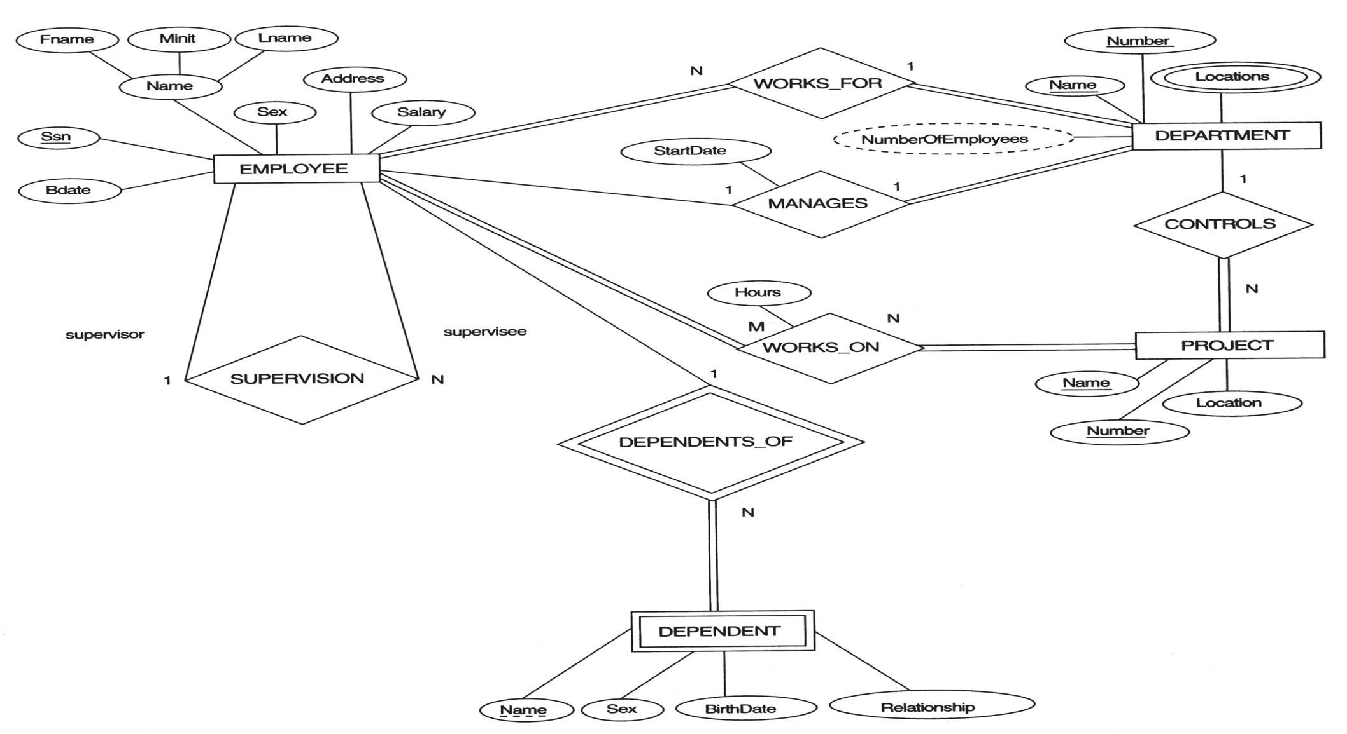
Exercise 2 ( chen notation )

Slide 15
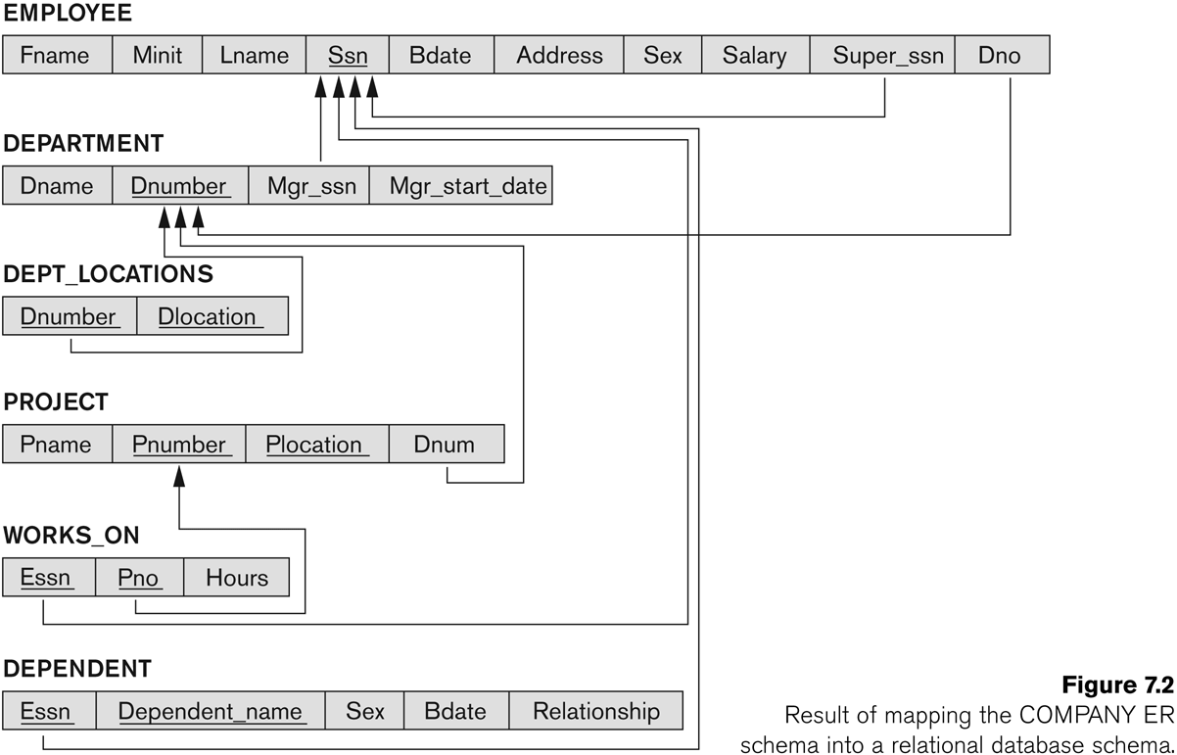
Exercise 2 ANSWER displaying referential integrity constraints

