Slide 1
Evaluation#3
MS Project 2010

Slide 2
Objectived
In this lab you will learn:
  how to add the resources into tasks.
  How to review resource assignment information
  How to level the recourses

Slide 3
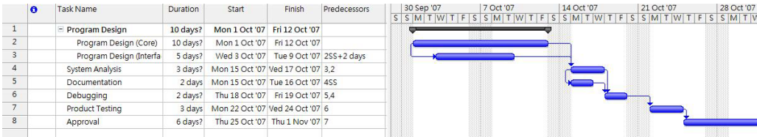
Example Used in this lab:
Please download the project named “ct1413Eval3.mpp” from the course website.
Initial scheduled Durations: 24 days (What is the critical path?)

Slide 4
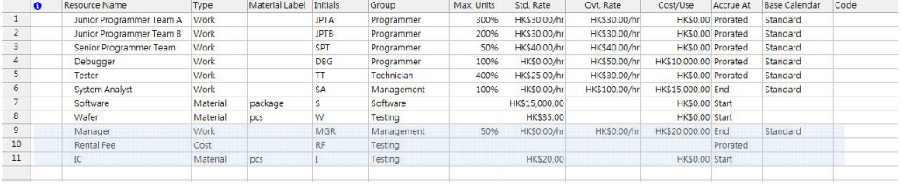
Resource sheet.
Type all the information in the Resource sheet.

Slide 5
Resource sheet.
Resources: People, equipment, and consumable items used to complete project tasks.
Resource Name: Assign the name of the resource. You will see this name beside the Gantt chart bar.
Resource Types: Work, Material, and Cost.
  -Work: (i) Human resource , equipment
  - Material: The supplies like computers, wires … (Counted by quantity)
  - Cost: It is the single expense of the project. (Counted by usage)
Material Label: Indentify the quantity of the material that will be consumed. This field is only workable if the type is chosen as “Material”.
Initials: Project will automatically generate it.

Slide 6
Resource sheet.
Group: Identify whether the resource belongs to a particular department.
Max. Units: Is a percentage that indicates the resource’s allocation in daily scheduled work time.
  Percentage Meaning
    100% (default) Single Person – Full time (40 hrs / week)
    <100% Single Person – Part time (Max. unit * 40 hrs / week)
    100% > A team – Max. unit * 40 hrs / week
Std. Rate: The amount shows how much cost is added to the project for each hour of work assigned for a material resource.

Slide 7
Resource sheet.
Ovt. Rate: Set the overtime (OT) for a work resource.
Cost/ Use: Set the charge of a material resource per use.
Accrue. At: Specifies how the Project accounts for the timing of resource costs in the budget for the project.
  Prorated (By default): Project adds in costs at the time when work is scheduled.
  Start: Cost is paid before the work starts.
  End: Cost is paid after the work ends.
Base Calendar: Set the type of the calendar, standard (by default), 24 hours or night shift.
Code: Identify the resources.

Slide 8
Change the working time
Define holidays for all people
  Step 1: Project → Change Working Time
  Step 2: For Calendar: Standard (Project Calendar)
  Step 3: Select the dates in the calendar. Now select 4/10/2007 – 5/10/2007.
  Step 4: In the “Exception” tab, type “Company holiday” in the Name field.
  Step 5: Press “tab” and click “OK”.

Slide 9
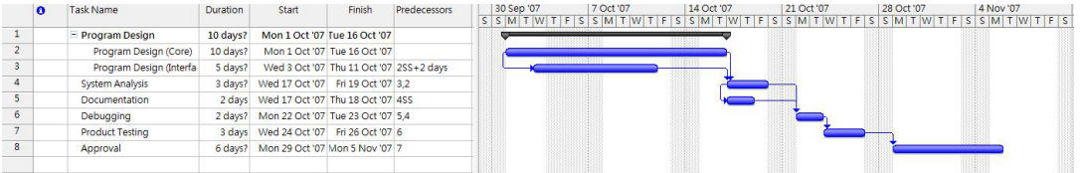

Slide 10
Define working days for specific person
Step 1: Tools → Change Working Time
Step 2: For Calendar: Manager
Step 3: In the “Work Weeks” tab, click “Details…”
Step 4: Select “Monday”, “Wednesday” and “Friday” by holding the “Ctrl” key.
Step 5: Select “Set days to nonworking time”. Then click OK.

Slide 11
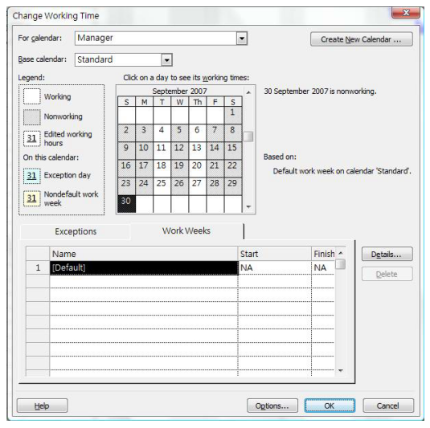

Slide 12

Assigning the Work Resources
Step 1: View → Gantt chart
Step 2: Select the task “Program Design (Core)” then click the button (Assign Resources button) in the recourses ribbon.
Step 3: In the Resource Name field, choose “Junior Programmer Team A” and then click “Assign” button.
Step 4: Change Units of “Junior Programmer Team A” to “300%”

Slide 13
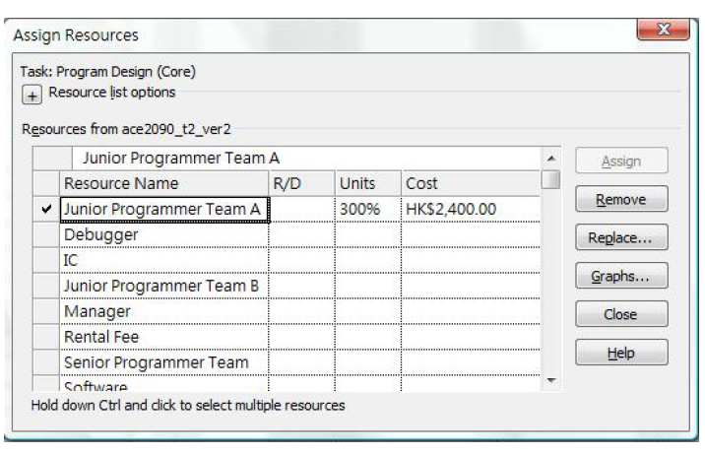

Slide 14
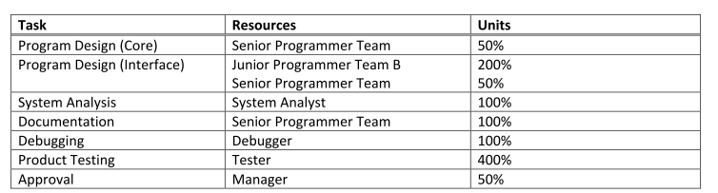
Now repeat Step 2 to 4 for the rest tasks according to the following table:

Slide 15
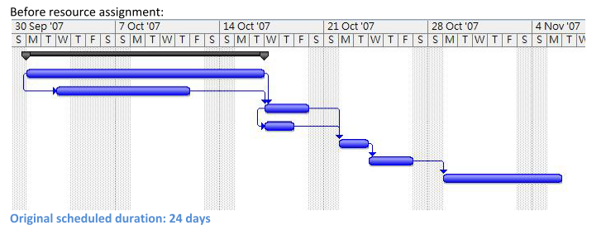
Original Schedule

Slide 16
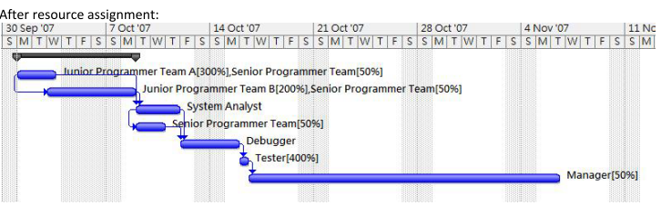
Schedule After Recourse assignment
Why?

Slide 17
Why?
It is because Project recalculates the duration of the tasks.
Effort-driven scheduling: If you apply more resources to a job, you can get it done more quickly.
    Equation: D = W / U, where
  D = Duration (the length of time between the Start and Finish of the task)
  W= Work (the number of person hours required to complete the task)
  U = Units (the resource’s assignment units for work on the task)

Slide 18
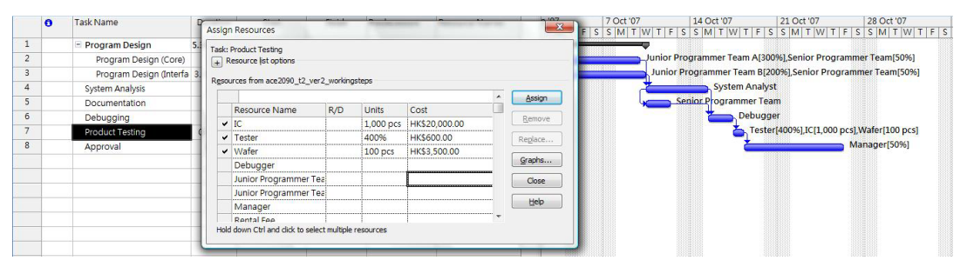
Assigning the Material Resource
Step 1: Select the task then click the button (Assign Resources)
Task | Resources | Units
Product Testing | IC | 1000pcs
 | Wafer | 100pcs

Slide 19
Assigning the Cost Resource
Step 1: Select the task “Product Testing” then click the button (Assign Resources).
Step 2: Assign “Rental Fee”. Click “Close” to close the dialog box.
Step 3: View → Task Usage
Step 4: Double-click the cost resource “Rental Fee”. The Assignment Information dialog box opens.
Step 5: In the General tab, type “HK$5000” in the cost field.
Step 6: Click OK.
Step 7: View → Gantt Chart

Slide 20
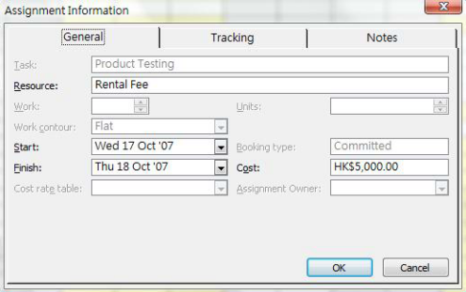


Slide 21
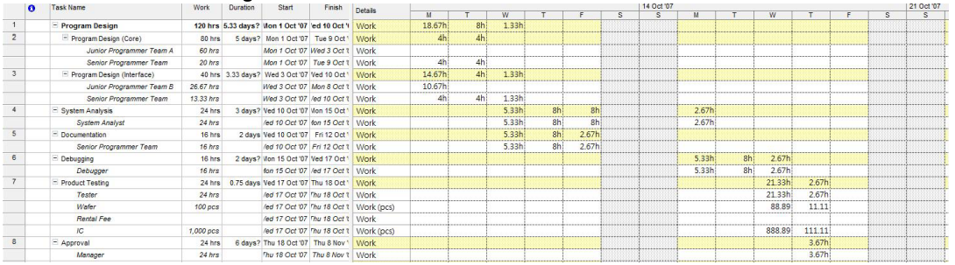
Review resource assignment information
View → Task Usage

Slide 22
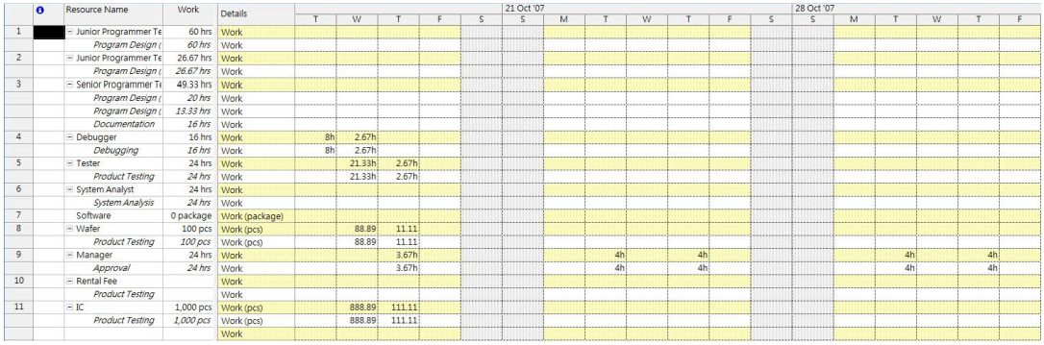
Review resource assignment information
View → Resource Usage

Slide 23
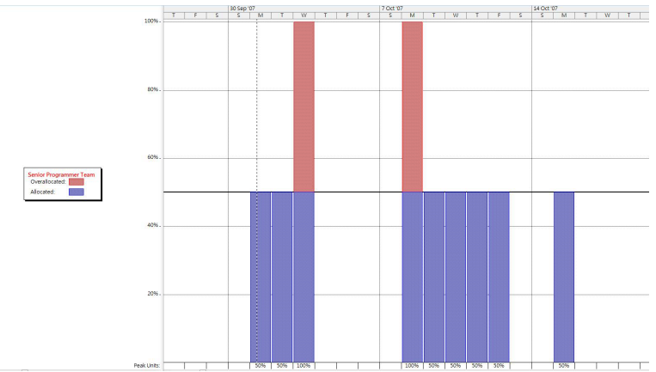
Review resource assignment information
View → Resource Graph (to check with the work over-allocation)

Slide 24
Resource leveling
Resource leveling removes an over allocation by either delaying a task to which the resource has been assigned or by splitting task.
From our example, “Senior Programmer Team” is over allocated.
  Step 1: View → Resource Sheet and select “Senior Programmer Team”
  Step 2: Resourse→ Level Resources
  Step 3: Keep all default parameters and click “Level Now”.
  Step 4: Click the “Selected resources” option, and then click OK.

Slide 25
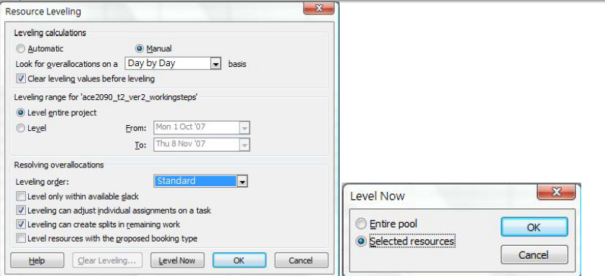

Slide 26
