Slide 1


Introduction
Classification of Review Criteria
Full Board
Expedite Tract
Exempt
Forms are subjected to the proposals for Full Board Review, having intervention, invasive procedures or administration of investigational drug, or medical device, stem cell research, or genetic testing etc.
Projects with non-invasive procedure/methodology, data collection, questionnaire based , etc
For Exempt from IRB review, Investigator will submit Cover letter with request of ‘Exemption’, IRB will determine, and if find feasible, will provide ‘Exemption Letter’ within short time-one to two week

Slide 2
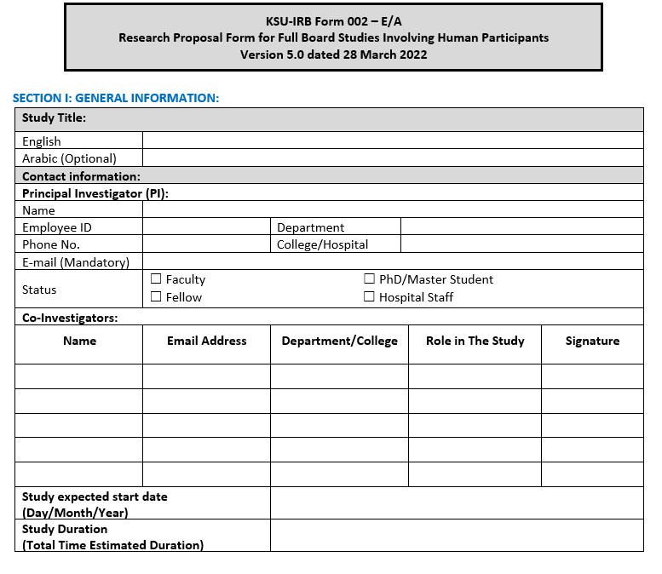

Slide 3
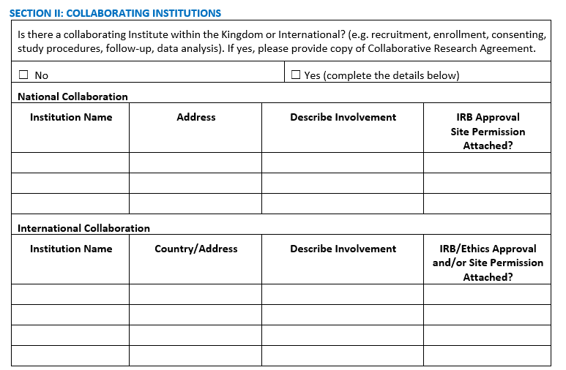

Slide 4
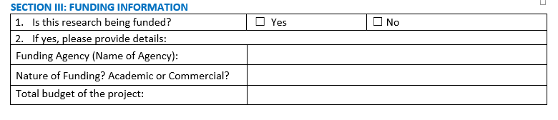

Slide 5
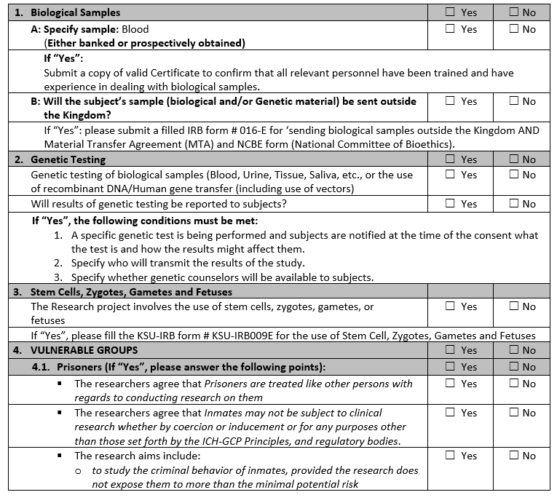

Slide 6
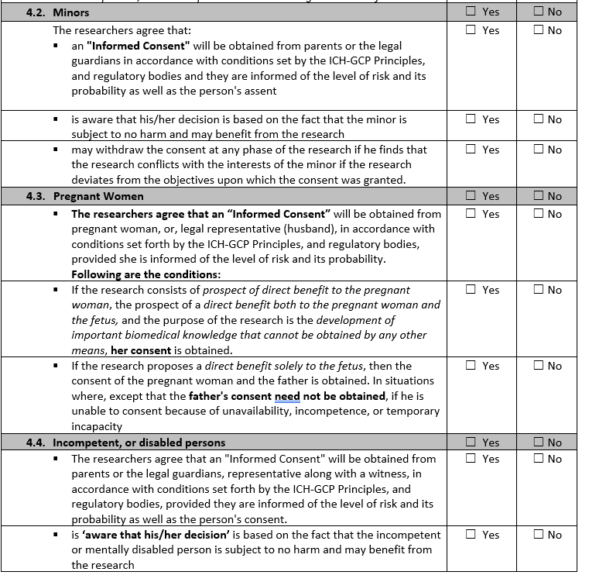

Slide 9
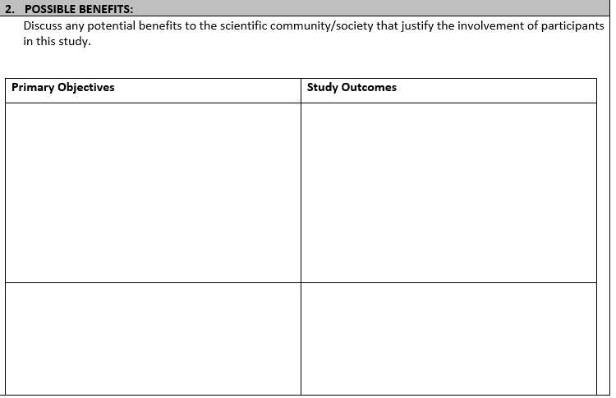

Slide 11
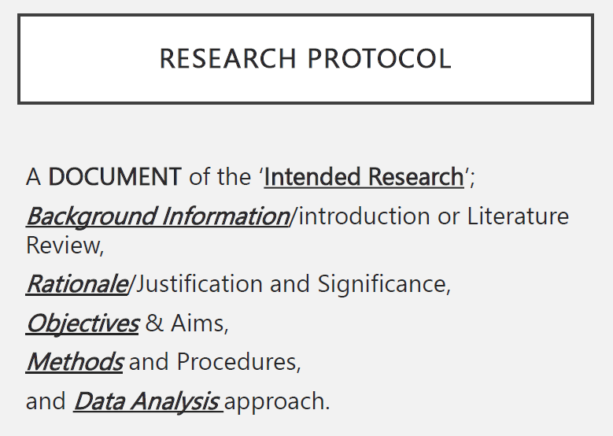
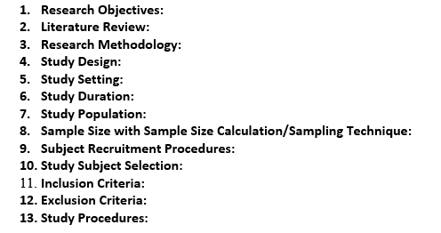
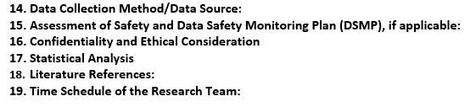

Slide 12
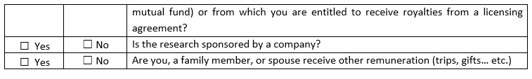
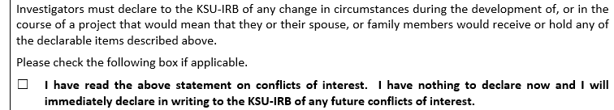

Slide 13
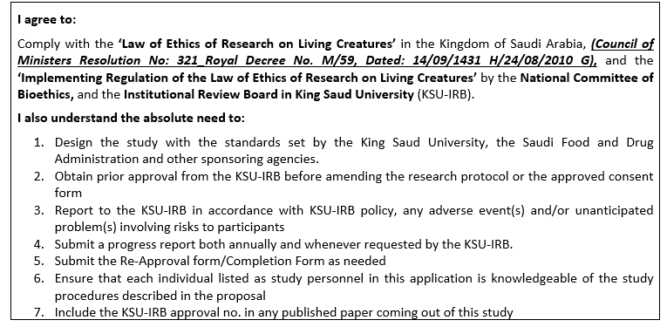

Slide 16
Contact persons for Full Board IRB
Ms. RubieDe Campio
Email: rdeocampo@ksu.edu.sa
Or
irb.medksu@hotmail.com
Ext: 91531,
Dr. Taha Inam
Email: tinam@ksu.edu.sa
Hotmail: dr_taha_inam@hotmail.com
Ext: 91530

Slide 17
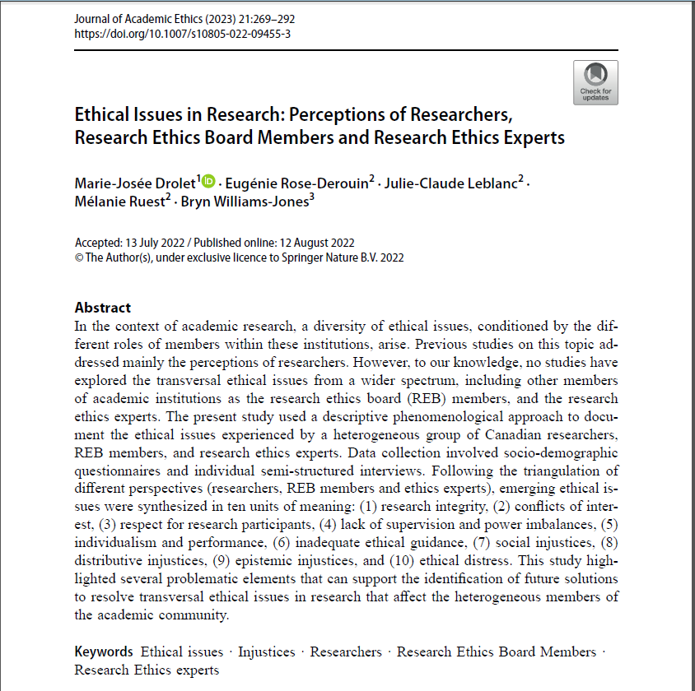

Slide 18
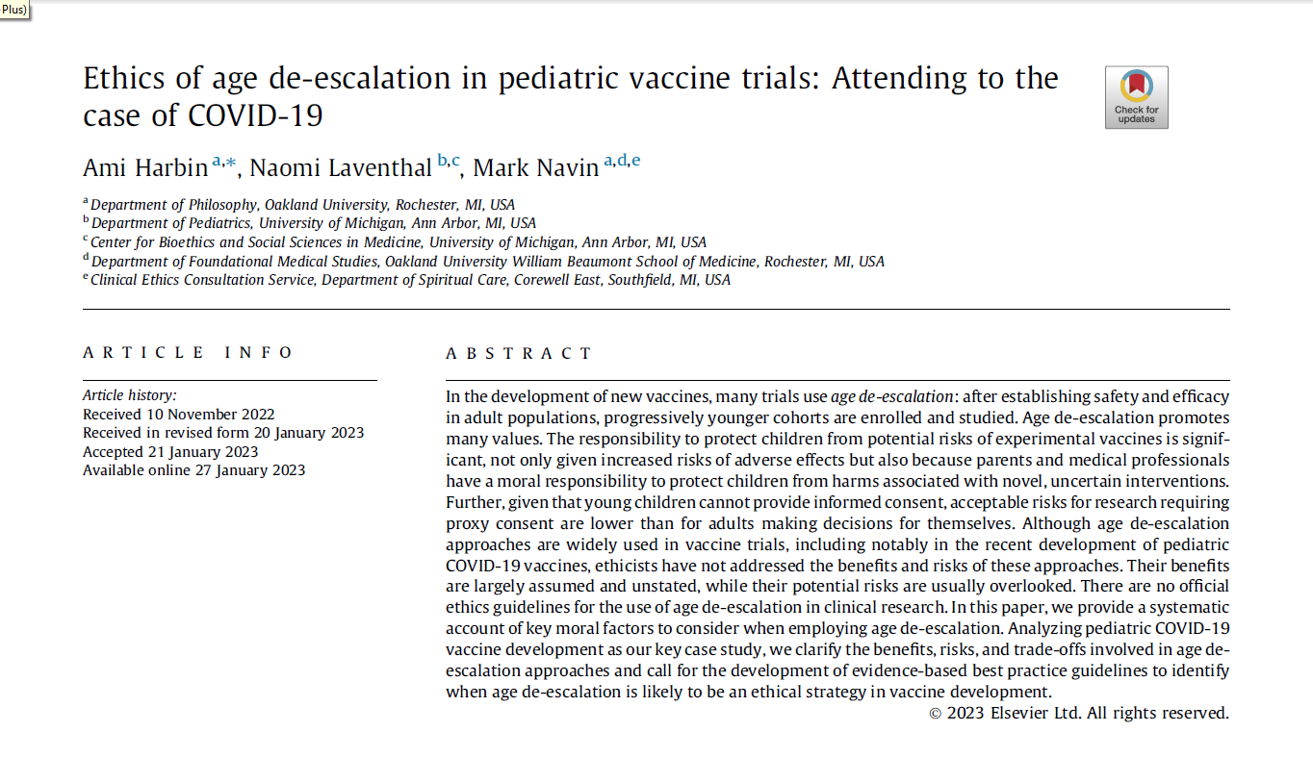

Slide 19
