Slide 1
Lab# 7
Estimation of Serum Bilirubin (Total & Direct)

Slide 2
Objectives:
1- To estimate the amount of bilirubin in serum.

Slide 3
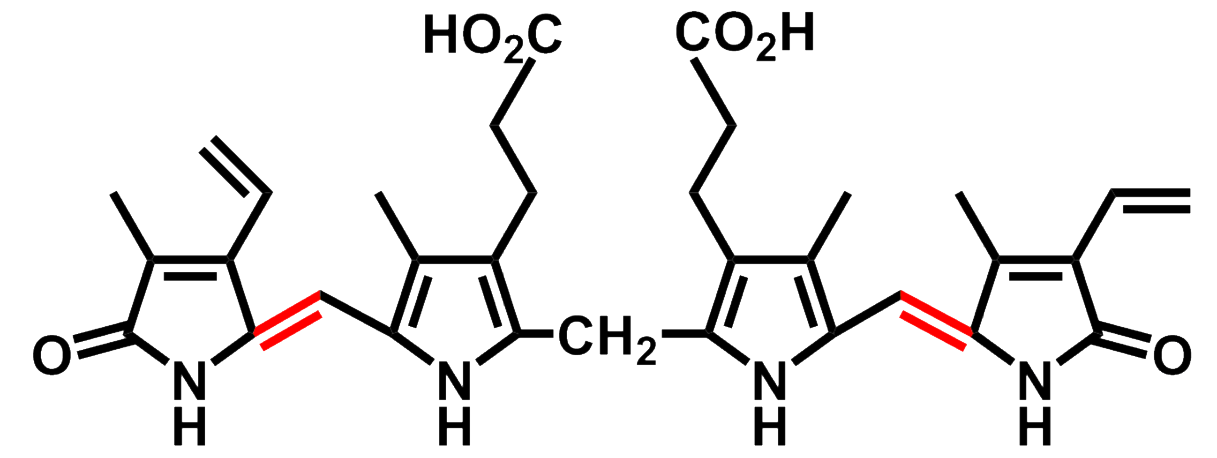
Bilirubin

Slide 4
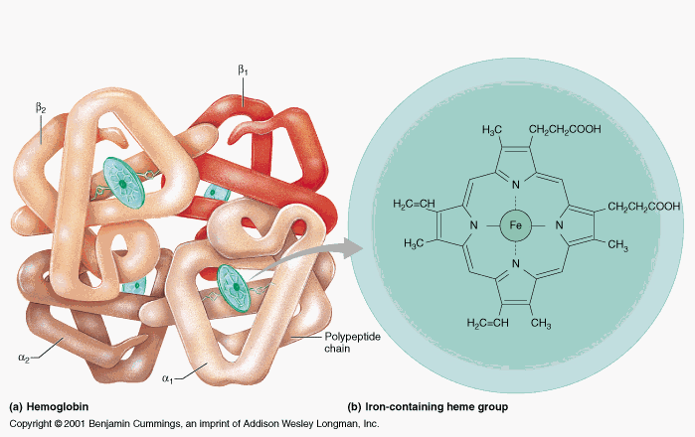
Bilirubin
a yellow compound that forms as a result of the breakdown of heme in the normal catabolic pathway.

Slide 5
3 phases of Bilirubin
Indirect bilirubin: unconjugated, insoluble in water
Direct bilirubin: Conjugated with glucoronic acid.
Total bilirubin: sum of the direct and indirect of bilirubin.
Notes:
-Disturbances in the powers of conjugated and/or excretion of the liver of this yellow compound will lead to raised levels in serum.

Slide 6
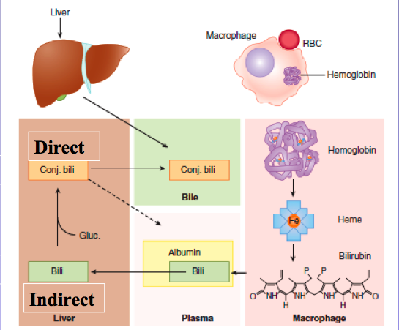
Above about 2 mg/dl in the blood, leads to disease called Jaundice.
Start

Slide 7
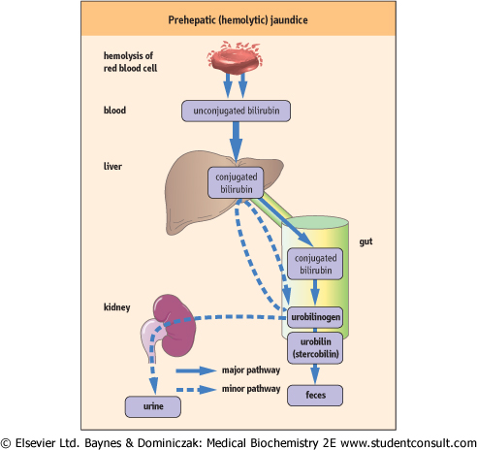

Slide 8
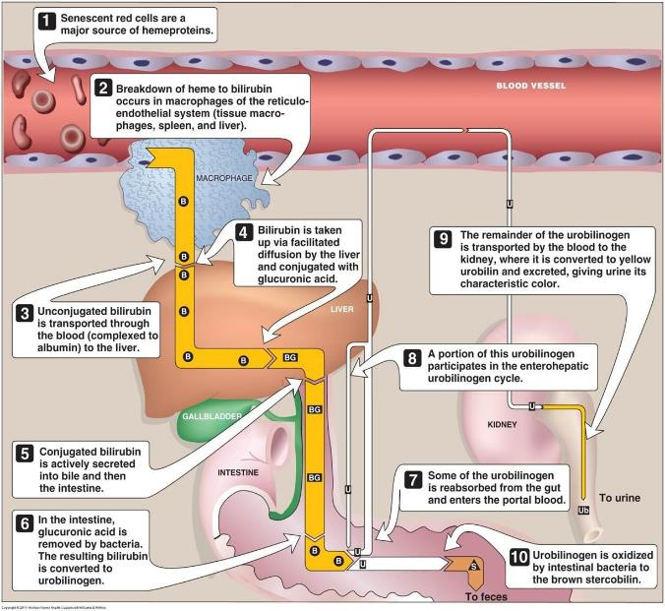
Bilirubin

Slide 9
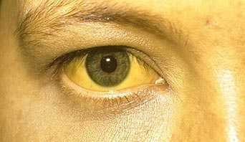
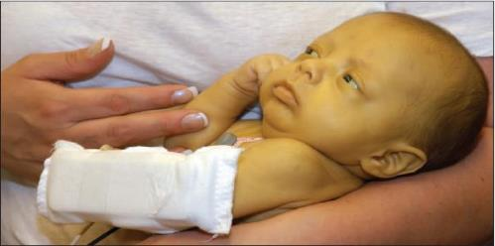
Bilirubin and jaundice
Jaundice is caused by a build-up of bilirubin (yellow color) in the blood and tissues of the body.
Jaundice is the discoloration of skin and sclera of the eye caused by high concentration of bilirubin.

Slide 10
The causes of jaundice may be classified as:
Types of jaundice
Pre-Hepatic Jaundice
Post-Hepatic Jaundice
Hepatic Jaundice
e.g. Hemolytic disease
-Cirrhosis of the liver
-Infective Hepatitis
-Neonatal Jaundice
e.g. Cholecystitis.

Slide 11
1-Pre-Hepatic Jaundice
Hemolytic disease (excess hemolysis)
-The production of un-conjugated bilirubin may exceed the conjugating capacity of the liver and hence the serum levels of indirect (and of total) bilirubin will be raised and that of direct in the upper normal range or just a little elevated.
-The other liver function tests will usually give normal results.

Slide 12
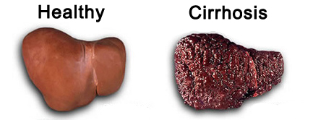
2-Hepatic Jaundice
Cirrhosis (in the absence of infection)
Destruction of liver cells will lead to a reduced conjugating capacity with a:
Raised serum level of indirect (and of total) bilirubin,
with a low level of direct bilirubin
and an abnormally high release, into the blood, of the enzymes: AST, ALT and ALP.

Slide 13
2-Hepatic Jaundice
Hepatitis (in the presence of infection)
The conjugative capacity of the liver is approximately normal, but there is the inability to transport the conjugated bilirubin from the liver cells to the biliary system, and it will be regurgitated back into the blood.
→ Hence:
The serum level of unconjugated bilirubin will be normal
and that of conjugated (and total) bilirubin will be raised.

Slide 14
2-Hepatic Jaundice
Neonatal Jaundice
Conjugating enzymes “glucuronyl transferase ” in the liver are often absent at birth.
→Hence:
Raised serum level of indirect (and total) bilirubin.
Low level of direct bilirubin.
The other liver functions are normal.
The indirect bilirubin level will rise for the first few days after birth until the conjugating enzymes begin to synthesize.
Notes:
If the conjugation process is delayed and the serum level of indirect bilirubin rises towards 20 mg/dl, an ultraviolet therapy or an exchange blood transfusion should be carried out owing to the danger of deposition of the insoluble unconjugated bilirubin in the basal ganglia of the brain leading permanent Brain Damage
glucuronyl transferase .

Slide 15
3-Post-Hepatic Jaundice
Cholecystitis
The bile duct is blocked.
→Hence:
The indirect bilirubin level is normal but conjugated bilirubin is regurgitated into the blood and excreted into the urine (raised conjugated and total bilirubin).
The other liver function tests are normal

Slide 16
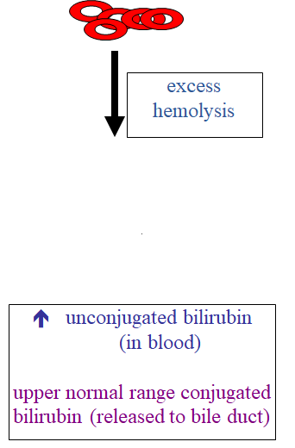
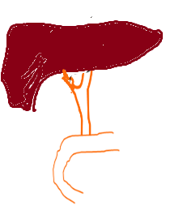
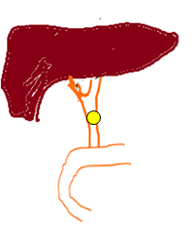
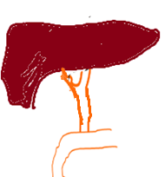
Normal unconjugated bilirubin (in blood)
⬆ conjugated bilirubin
(in blood)
Normal unconjugated bilirubin (in blood)
⬆ conjugated bilirubin
(in blood)
Hepatic Jaundice.
(Cirrhosis)
Post-Hepatic Jaundice
(Cholecystitis)
Pre-Hepatic, Hemolytic disease

