Slide 1
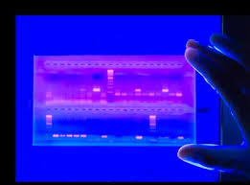
Estimation of Nucleic Acid
Nahla Bakhamis

Slide 2
Agarose Gel Electrophoresis:
Separation and analysing DNA of varying sizes, by moving –ve charge na through an agarose mixture in electric field;
To look at the DNA
Quantify it
Isolate particular band

Slide 3
Applications:
DNA quantity (size) & quality (contamination).
Estimation of DNA size.
Analysis pf PCR products.

Slide 4
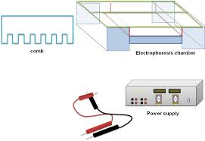
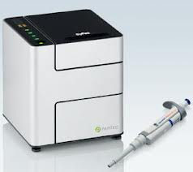
Equipment:
Electrophoresis chamber.
Power supply.
Gel casting tray
Sample combs to form sample wells
Running buffer
Loading buffer
Ethidium bromide
Trans illuminator

Slide 5
Agarose gel electrophoresis buffers:
Running buffer:
Depend on the size of DNA;
TAE (Tris Acitate EDTA) most common
TBE buffer (Tris Borate EDTA) for > 500bp
Loading buffer:
Bromophenol blue + sucrose + water
Gives colour & density to the samples

Slide 6
DNA markers (DNA ladder):
is a set of standards that are used to identify the approximate size of a sample run on a gel during electrophoresis.
Most common markers designed by the use of restriction enzymes and a recognized DNA sequence;
(Adv)Simple (dis Adv) size control
PCR
Good resolution for fragment size you expect.

Slide 7
Visualization:
Transiluminator (ultraviolet box)

Slide 8
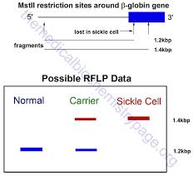
Analysis:
Eg.1 paternity testing eg.2 Sickle cell
Mother s1 s2 baby

Slide 9
Analysis:
Eg.3 criminal
crime scene
S1 S2 S3

Slide 10
2. Spectrophotometric method
To determine the concentration of DNA in a solution
To determine the purity (quality) of DNA
The more light absorb the higher the con
DNA & RNA absorption peak 260

Slide 11
Sample purity:
na could be contaminated by; Protein, phenol etc.
These molecule has their own absorption spectra
Their wavelengths is compared to 260 to ensure purity of DNA
260:280 ratio is used to assess the purity of protein

Slide 12
Analysis:
The ratio of 260:280 provides an estimation of the purity
Pure DNA ratio approximately 1.8; RNA is 2.0
Ratio < 1.8 means DNA is contaminated with protein
Ration > 2.0 DNA is contaminated with RNA

Slide 13
Questions?

