Slide 1
Lab 1
ER Modeling Case Studies

Slide 2
BanksDatabase :ER Case Study
Consider the following set of requirements for a Bank database that is used to keep track of Customer.
  Each bank has a unique name.
  Each branch has a number, name, address (number, street, city), and set of phones.
  Customer includes their name, set of address (P.O. Box, city, zip code, country), set of phones, and social security number.
  Accounts have numbers, types (e.g. saving, checking) and balance. Other branches might use the same designation for accounts. So to name an account uniquely, we need to give both the branch number to which this account belongs to and the account number.
  Not all bank customers must own accounts and a customer may have at most 5 accounts in the bank.
  An account must have only one customer.
  A customer may have many accounts in different branches.

Slide 3
Banks Database :ER Case Study
Design an ER schema for this application, and draw an ER diagram for that schema.
Specify key attributes of each entity type and structural constraints on each relationship type.
Note any unspecified requirements, and make appropriate assumptions to make the specification complete.

Slide 4
Banks Database :ER Case Study
Branch
Branch_NO{PK} Name Address Number Street City Phone[1..*]
0..*
⋅ has
Customer
SSN {PK} Name Address [1..*] P.O Box Code City Country Phone [1..*]
Account NO
1..1
1..1
Bank
Name {PK}
0..*
1..1
 Contains
Reason of chasm trap :
Note all customer should have an account .So we can not answer this question :
List all customer available on a specific branch?
Owns ➢
0..5
Account
Type Balance
0..*

Slide 5
Banks Database :ER Case Study
To avoid chasm trap we add this relationship
Branch
Branch_NO{PK} Name Address Number Street City Phone[1..*]
0..*
⋅ has
⋅ has
1..*
0..*
Customer
SSN {PK} Name Address [1..*] P.O Box Code City Country Phone [1..*]
Account NO
1..1
1..1
Bank
Name {PK}
0..*
1..1
 Contains
Owns ➢
0..5
Account
Type Balance
0..*

Slide 6
Primary key of account (Weak entity ):
Branch_No (PK of Strong entity) + accountNo (discriminator)

Slide 7
Organization :ER Case Study
Organization made up of various departments, each having a name, identifying no., and an employee who is the manager. A department may be located in different places. Information about employee includes name, identification number, birth date, address, sex, and salary. Each employee is assigned to one department. The date the manager is appointed to a department is also tracked. Employees may be directly supervised by another employee. Each project within the organization is controlled by a department. Employees (not necessarily from the controlling dept.) are assigned to projects. Information about projects includes project name, no., and location. Hours spent by employees on each project are also kept.

Slide 8
Organization :ER Case Study
draw an ER diagram to represent the data requirements as following:
  Identify the main entity types.
  Identify the main relationship types between the entity types.
  Identify attributes and associate them with entity or relationship types.
  Determine candidate and primary key attributes for each (strong) entity type.
  Determine the multiplicity constraints for each relationship .State any assumptions necessary to support your design.

Slide 9
Organization :ER Case Study
supervises ➢
1..*
Supervisee
Employee
NO{PK} Name Birthdate Sex Salary
Department
Dep_NO{PK} Name Location[1..*] \Total_of_employee
0..1
1..*
Employee
assigns to ➢
1..1
Supervisor
1..1
Manager
Manages ➢
0..1
1..*
Worker
Start Date
1..1
Works on ➢
Hours
1..*
 Controls
Project
Pro_NO{PK} Name Location
0..*

Slide 10
Hospital :ER Case Study
A General Hospital consists of a number of specialized wards (such as Radiology, Oncology, etc) .Information about ward includes unique name, total numbers of current patients. Each ward hosts a number of patients, who were admitted by a consultant (doctors) employed by the Hospital. On admission, the date and time are kept. The personal details of every patient includes name, Medical Recode Number (MRN), set of phone and one address (city, street, code). A separate register is to be held to store the information of the tests undertaken. Each test has unique episode No. , category and the final result of test. Number of tests may be conducted for each patient. Doctors are specialists in a specific ward and may be leading consultants for a number of patients. Each patient is assigned to one leading consultant but may be examined by other doctors, if required.

Slide 11
Hospital :ER Case Study
draw an ER diagram to represent the data requirements as following:
  Identify the main entity types.
  Identify the main relationship types between the entity types.
  Identify attributes and associate them with entity or relationship types.
  Determine candidate and primary key attributes for each (strong) entity type.
  Determine the multiplicity constraints for each relationship .State any assumptions necessary to support your design.

Slide 12
Hospital :ER Case Study
Ward
Name {PK} \Total_of_pat
Doctor
Doc_NO{PK}
1..1
⋅ Specializes in
0..*
Consultant
0..*
0..*
Examiner
0..*
Date Time
Admits
1..1
Leader
 Exams
0..*
0..*
Patient
MRN{PK} Name Phone [1..*] Address Code Street City
⋅ consults
0..*
Test
Ep _NO{PK} Category Result
1..1
conducts ➢
0..*

Slide 13
Department :ER Case Study
Identify the entities and relationships for the following description and draw an ER diagram.
Departments, identified by ID, operate a variety of printers, each located in a particular room in a particular building. Printers are supplied by a number of suppliers, identified by name, with each supplier charging a different price for a given printer, but also providing different delivery delays, measured in days. A given room can have any number of printers, including none.

Slide 14
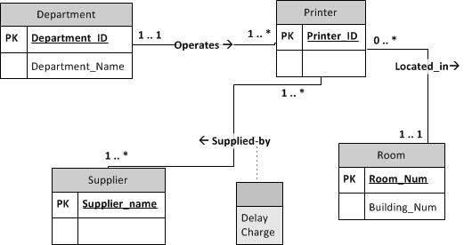
Department :ER Case Study

Slide 15
Journal :ER Case Study
Identify the entities and relationships for the following description and draw an ER diagram.
Persons, described by their name, SSN, and address, subscribe to various journals. Each journal, identified by a title and an ISBN, has a set of numbered volumes and each of these has a set of numbered issues. Subscribers have an initial subscription date and a termination date for each journal to which they subscribe.

Slide 16
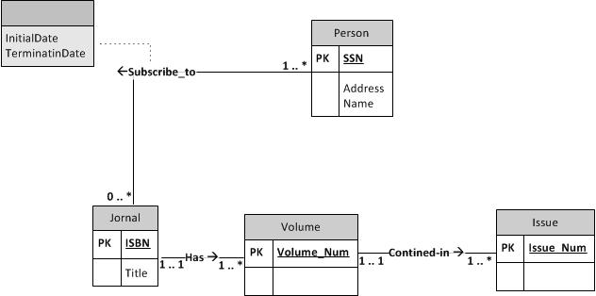
Journal :ER Case Study

