Slide 1
EPIDEMIOLOGY
KSU
College of Applied Medical Sciences
CHS 334
Epidemiology
Mohammed S. Alnaif, PhD
alnaif@ksu.edu.sa

Slide 2
Research Methodology
Research Methods is a systematic and principled way of obtaining evidence (data, information) for solving health care problems.

Slide 3
Research Methodology
METHODS AND KNOWLEDGE
Other methods of known used in the health science:
Authority
Rationalism
Intuition.

Slide 4
Research Methodology
Basis of scientific method:
Scepticism (open to doubt and analysis)
Determinism (events in the world occur according to regular laws and causes)
Empiricism (enquiry ought to be conducted through observation and experiments).

Slide 5
Research Methodology
Hypotheses are propositions about relationships between variables or differences between groups that are to be tested.

Slide 6
Epi Hypotheses
Studies must address clearly defined research hypotheses (“research questions”)
Hypotheses must based on sound causal mechanisms in specific terms that can be tested
Hypotheses are refinement as new information becomes available
Hypotheses are like nets; only he who casts will catch. -- Novalis

Slide 7
Research Methodology
Theories are sets of logically related or linked ideas (abstractions) about how the world or some process works.
The fundamental building blocks of theory are concepts. In other words theories consist of a series of statements (propositions) about a relationships between concepts.

Slide 8
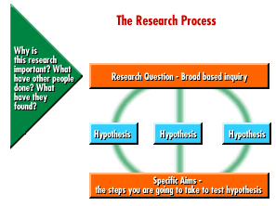
Hypothesis Statement

Slide 9
Selected elements of an epi research question
Source population
Exposure variable (E)
3. Disease variable (D)
Extraneous “confounding” variables (C₁, C₂,…, C_{k})
Dose-response
Time-response
Sample size

Slide 10
Research Methodology
A variable is simply a property that may vary from case to case. Example, a room temperature.

Slide 11
Research Methodology
Variables
Research question in general terms: Does exposure E cause disease D after considering the contributions of “potential confounders” C₁, C₂, …, C_{k}?
E → D
C₁─┘
C₂─┘
⁞ ⁞
C_{k}─┘
Flu → Virus
Age ────┘
Trauma──┘
⁞ ⁞
Surgery──┘

Slide 12
Research Methodology
Research Methodology
Design (experimental or observational)
Sampling (selecting a group of cases from a population)
Measures (Measurement refers to the procedure of attributing qualities or quantities to specific characteristics of objects, persons or events)
Intervention (if applicable)
Analysis.

Slide 13
Research Methodology
Main types of
epidemiologic studies
Observational Studies
Aggregate-level unit of observation
Ecological
Person-level unit of observation
Cross-Sectional
Longitudinal
Cohort
Case-Control
Experimental Studies
Community trials
Field trials
Clinical trials

Slide 14
Research Methodology
Design Elements
Experimental or Observational
EXPERMENTAL RESEARCH
In experimental studies the intervention is under the control of the researcher.

Slide 15
Research Methodology
EXPERMENTAL RESEARCH
Independent Variables: in an experiment an Independent Variable is the variable or condition manipulated or controlled by the researcher.
Dependent Variables: the outcome variables are termed Dependent Variables.

Slide 16
Research Methodology
EXPERMENTAL RESEARCH
The aim or goal is to determine how changes in the Independent variable affect some outcome the dependent variable.

Slide 17
Research Methodology
EXPERMENTAL RESEARCH
By controlling the timing or amount of the intervention or which subjects get it and which ones do not, the chances are minimized that other factors outside of the researcher's control could have affected the results.

Slide 18
Research Methodology
Observational Studies
By contrast the researcher does not control the intervention in observational studies but rather observes the effects of an experiment in nature.

Slide 19
Research Methodology
DATA GATHERING
Prospective studies that involve gathering data after the study have begun.
Retrospective studies the data have already been collected for other reasons at sometime in the past.

Slide 20
Prospective, Retrospective, Am-bidirectional
Based on proximity of data collection to actual events
Prospective = data collected near time of event
Retrospective = data are from the past (“historical data”)
Am-bidirectional - combination of prospective and retrospective data

Slide 21
Research Methodology
THE NEED FOR CONTROL OR COMPERISON GROUP
A control group consist of subjects that undergo exactly the same conditions as the group receiving the treatment, the casual effect of which being investigated. In field research in applied clinical setting we include control groups in the design to ensure internal validity.

Slide 22
Research Methodology
Internal Validity
In a study internal validity is the ability of the researcher to attribute differences in the groups or participants to the independent variable.

Slide 23
Research Methodology
SAMPLING
Definition of the population – researchers defines the population to which they wish to generalize the results.
A population is an entire set of persons, objects or events which the researcher intends to study.

Slide 24
Research Methodology
SAMPLING
A sample is a group of cases to be selected from a population.
A Cohort is a group of people who share some attribute.
Selection of the sample – using an appropriate sampling method, the sample is selected from the population.

Slide 25
Research Methodology
SAMPLING
A representative sample is a sample that accurately reflects the characteristics of the population from which it is drawn. Sometimes called “unbiased” sample.

Slide 26
Research Methodology
SAMPLING
A Biased sample is one that is not representative. It does not reflect the composition of the population to which the researcher is attempting to generalize.

Slide 27
Research Methodology
SAMPLING
Random sampling is one in which all members of the population have an equal chance of selection.

Slide 28
Research Methodology
SAMPLING
Random sampling The procedures for drawing a random sample involves two steps:
Construction of a list of all members of the population.
Using a method such as dice, coins or random number tables to select randomly from the list the number of members required for the sample.

Slide 29
Research Methodology
SAMPLING
Quota sampling involves a preset number of cases in each subcategory of a given population.
Stratified random sampling same as quota sampling except that each quota is filled by randomly sampling from each subgroup.

Slide 30
Research Methodology
SAMPLING
Area sampling is a sample taking on the basis of location of cases.
Systematic sampling is working through a list of the population and choosing, say, every 10th or 20th case for inclusion in the sample.

Slide 31
Research Methodology
SAMPLING
Incidental sampling, or Haphazard sampling, or convenience sampling is the cheapest and easiest sampling method to use. However, it not necessarily biased.

Slide 32
Research Methodology
SAMPLING
Optimal number of cases - Sampling error is reflected in the discrepancy between the true population parameter and the sample statistic.
The greater the sample size the smaller the probability of sampling error.

Slide 33
Research Methodology
Subject Allocation
Assignment of subjects into groups
Assignment procedures – using an assignment procedure, the participants are allocated to groups.

Slide 34
Research Methodology
Subject Allocation
Random Assignment to independent groups, all subjects have the same probability of being assigned to the experimental group or the control group.

Slide 35
Research Methodology
Assignment of subjects into groups
Matched groups
Matched subjects are formed, that a pair of experimental and control subjects are chosen to be similar as possible in terms of certain key variables, such as age, sex, race, socioeconomic status, number of hospital admissions, or diagnosis.

Slide 36
Research Methodology
Assignment of subjects into groups
Matched groups
Then one member of the pair is randomly assigned to one group and the other member to the other group. This ensures that the two groups have similar characteristics.

Slide 37
Research Methodology
Assignment of subjects into groups
Under matched groups
If they differ on some variable that is related to the outcome of the study.

Slide 38
Research Methodology
EXTERNAL VALIDITY OF EXPERMENTS
External validity refers to the extent to which the results of an investigation can be generalized to other samples or situations.

Slide 39
Research Methodology
THREATS TO VALIDITY
The purpose of any study is to tell us what is “really” happening in the world. Does streptokinase reduce cardiac mortality? What causes sudden infant death syndrome?

Slide 40
Research Methodology
THREATS TO INTERNAL VALIDITY
History
Maturation
Testing
Instrumentation
Regression to the mean
Selection or assignment errors
Mortality

Slide 41
Research Methodology
THREATS TO INTERNAL VALIDITY
History
This refer to events that intervene between the pre-test and post–test that do not form part of the treatment being investigated by the researcher

Slide 42
Research Methodology
THREATS TO INTERNAL VALIDITY
Maturation
In a study overtime, the patients may naturally mature. This is a particular problem with pediatric and geriatric populations.

Slide 43
Research Methodology
THREATS TO INTERNAL VALIDITY
Testing
The patient as a result of familiarity with the testing procedures, appear to improve spontaneously.

Slide 44
Research Methodology
THREATS TO INTERNAL VALIDITY
Instrumentation
During the time between measurements, the measuring instrument might change

Slide 45
Research Methodology
THREATS TO INTERNAL VALIDITY
Regression to the mean
Refers to the phenomenon whereby groups of subjects that are chosen because of extreme scores on any variable will have scores that are less extreme and closer to the mean value when they are retested.

Slide 46
Research Methodology
THREATS TO INTERNAL VALIDITY
Selection or Assignment Errors
The groups being compared may be different at the outset because of inadequate assignment or selection procedures, rather than as a result of any treatment effects.

Slide 47
Research Methodology
THREATS TO INTERNAL VALIDITY
Mortality
Mortality in a study refers to when a participant withdraws from the study before its completion.

Slide 48
Research Methodology
THREATS TO VALIDITY
We hope that the result of our sample can be generalized to the population at large so the our findings also hold true for similar people. Consequently it is disturbing, at the least, to find different studies coming to opposite conclusions.

Slide 49
Research Methodology
THREATS TO VALIDITY
Subject Selection Biases
Subject selection biases involves many factors that may result in the subjects in the sample being unrepresentative of the population.
Healthy workers Bias, Incident-Prevalence Volunteer Bias

Slide 50
Research Methodology
THREATS TO VALIDITY
Hawthorne Effect:
An effect which results in the improvement of subjects performances through being observed and/or social contact. It is the same as the Placebo effect.

Slide 51
The Hawthorne Effect
Improvements in behavior because subjects know they are being observed → effects unrelated to the intervention
Initially observed in industrial psychology experiments in the 1930
A comparable attention bias effect is seen in trials

Slide 52
The placebo effect
Improvements attributed to an inert intervention
Despite popular belief, placebos have no real effect False impressions of placebo effects can be explained by spontaneous improvement, fluctuation of symptoms, regression to the mean, additional treatment, conditional switching of placebo treatment, scaling bias, irrelevant response variables, answers of politeness, experimental subordination, conditioned answers, neurotic or psychotic misjudgment, psychosomatic phenomena, misquotation, etc (Kienle & Kiene, 1997 )

Slide 53
Research Methodology
THREATS TO VALIDITY
The Rosenthal effect:
The expectancy effects, the phenomenon where the expectation of the researchers in a study influence the outcome. It is the same as the Placebo effect.

Slide 54
Research Methodology
THREATS TO VALIDITY
Blind: The purpose of blinding is to prevent various biases from affecting the results.
A person is considered blind if he or she is unaware of the group to which a subject belongs.

Slide 55
Research Methodology
THREATS TO VALIDITY
Single Blinding: If only the subject is unaware but the experimenter knows, the study is called single blind.
Double Blinding: If both the subject and the researcher do not know the study is called double blind.

Slide 56
Research Methodology
EPIDEMIOLOGIC RESEARCH STRATEGIES
DESCIPTIVE OR ANALYTICAL DESIGNS
These are most appropriate when for one reason or another, experimental control over the independent variable is not feasible.

Slide 57
Research Methodology
EPIDEMIOLOGIC RESEARCH STRATEGIES
DESCIPTIVE OR ANALYTICAL DESIGNS
SURVEYS
Surveys are investigations aimed at describing accurately the characteristics of populations for specific variables.

Slide 58
Research Methodology
EPIDEMIOLOGIC RESEARCH STRATEGIES
DESCIPTIVE OR ANALYTICAL DESIGNS
When surveys are used in health care research
To establish the attitudes, opinions, or beliefs
To study characteristics of population on health related variables.
To collect information on the demographic characteristics (age, sex, income, etc.).

Slide 59
Research Methodology
EPIDEMIOLOGIC RESEARCH STRATEGIES
DESCIPTIVE OR ANALYTICAL DESIGNS
Naturalistic comparison study: a type of study in which naturally occurring groups are compared with one another.
There are extraneous variables which can be controlled in this type of investigation, such as ages, and educational background.

Slide 60
Research Methodology
EPIDEMIOLOGIC RESEARCH STRATEGIES
DESCIPTIVE OR ANALYTICAL DESIGNS
Correlational studies: Studies that are concerned with investigating the associations between variables.

Slide 61
Research Methodology
EPIDEMIOLOGIC RESEARCH STRATEGIES
QUASI-EXPERIMENTAL DESIGNS
Time-series designs: A series of measurements taken repeatedly from the same person or group of people, over time.

Slide 62
Research Methodology
EPIDEMIOLOGIC RESEARCH STRATEGIES
QUASI-EXPERIMENTAL DESIGNS
Multiple-group time-series designs: A type of research design where two groups or cases are repeatedly measured over time to produce a series of measurements. One group or case receives an intervention and the other does not. The effects of intervention may then be studied by comparing the two series.

Slide 63
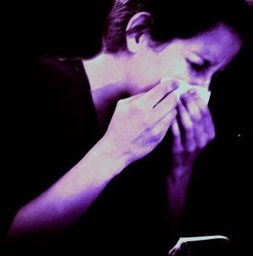
Experimentation
Did the protocol assign the exposure?
Question. Does vitamin C (the exposure) prevent colds (the disease outcome)?
Experimental Study. Assign vitamin C supplementation to some subjects (E+) and gives others a placebo (E-). Compare cold rates in the groups.
Observational Study. Classify people into those who take vitamin C (E+) and those who don’t (E−). Compare cold rates in the groups.

Slide 64
Randomized Experiment vs. Observational Cohort
Randomized Experiment
Observational cohort

Slide 65
Unit of Observation
Are data available on individuals?
Question. Does cigarettes smoking (the exposure) cause lung cancer (the disease outcome)?
Person-level data. Classify individuals as smokers or non-smokers. Assess & compare rates of Lung CA in exposed and none exposed groups.
Aggregate-level data. Classify level of smoking in various regions. Assess & compare rates of Lung CA according to regional smoking rates.

Slide 66
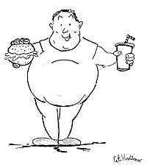
Longitudinal v X-sectional
Can you track individual experience over time?
Question. Does exercise (the exposure) prevent diabetes (the disease outcome)?
Longitudinal measurement. Identify exercisers (E+) & non-exercisers (E−) ⇒ track individuals experience over time to assess and compare incidence rates of diabetes.
Cross-sectional measurement. Assess current exercise habits to assess and compare prevalences of diabetes.

Slide 67
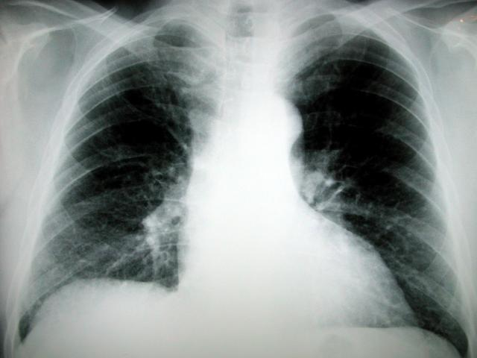
Case-Control vs. Cohort
Selection of subjects based on exposure (cohort) or disease (case-control) status?
Hypothesis. Does cigarette smoking cause lung cancer?
Cohort. Identify smokers (E+) and non-smokers (E-) ⇒ assess and compare lung cancer rates
Case-control sample. Identify lung cancer cases (D+) and non-cases (D-) ⇒ assess and compare smoking histories (E+/E-)

Slide 68
Case-Control vs. Cohort
Selection of subjects based on exposure (cohort) or disease (case-control) status?
odds of prior exposures

Slide 69
Case-Control Studies
Identify cases in a source population
Select at random non-cases from the same source population
Compare exposure histories in cases & controls
Cases
Exposure histories
Population
Odds Ratio
Sample non-cases
Exposure histories
Note: case-control samples do not permit the calculation of incidence or prevalence!

Slide 70
Research Methodology
EPIDEMIOLOGIC RESEARCH STRATEGIES
EXPERIMENTAL DESIGNS
Randomized Control Trial
Cross-Over Design similar to quasi-experimental design
These are called experimental design because the intervention is under the control of the investigator.

Slide 71
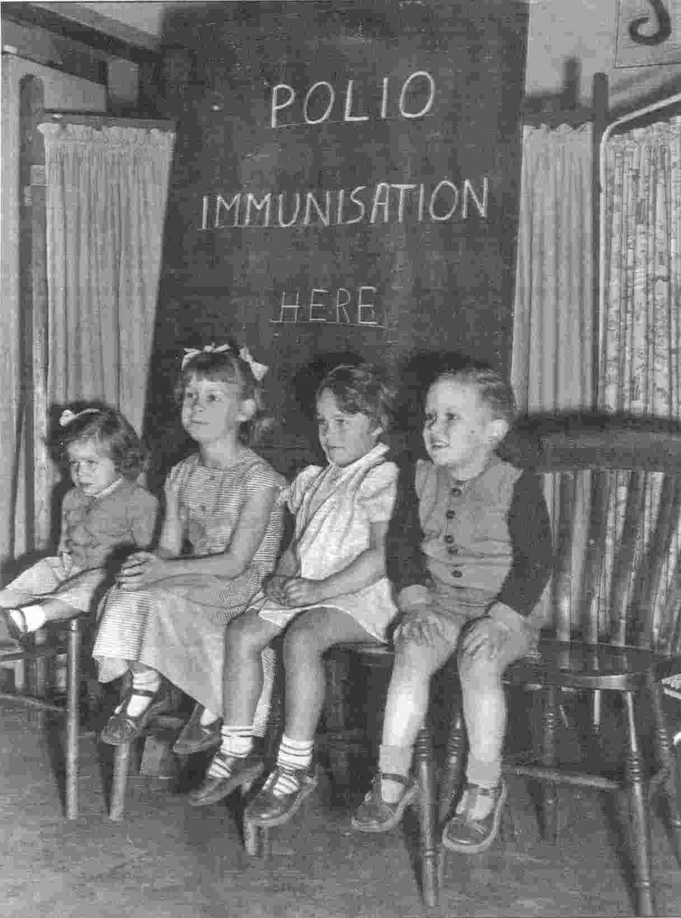
Epi Experiments (“Trials”)
Trials - from the French trier (to try)
Clinical trial – test therapeutic interventions applied to individuals (e.g., chemotherapy trial)
Field trial – test preventive interventions applied to individuals (e.g., vaccine trial)
Community trial – test interventions applied at the aggregate level (e.g., fluoridation of public water trial)

Slide 72
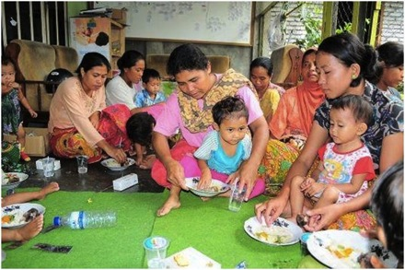
Illustrative Example Vitamin A Community Trial
450 Sumatran villages with high childhood mortality rates
Exposure = Vitamin A supplementation program vs. no intervention
Random allocation of intervention: 229 treatment villages, 221 control villages

Slide 73
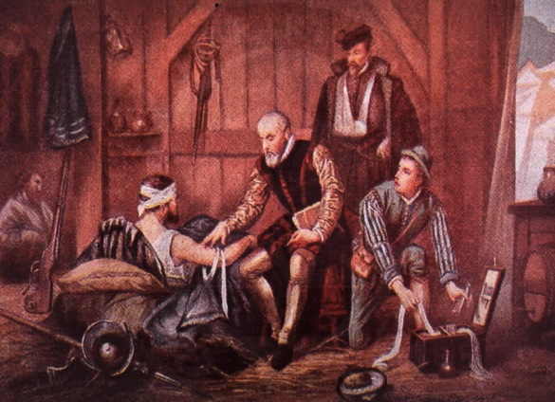
“Natural Experiments”
Natural conditions that mimic an experiment
Example: French surgeon Paré (1510–1590) ran out of boiling oil to treat wounds → forced to use an innocuous lotion for treatment → noticed vastly improved results
Not a true experiment because the intervention was not allocated by study protocol

Slide 74
Treatment Group & Control Group
The effects of an exposure can only be judged in comparison to what would happen in its absence
Treatment Group
Exposed to the intervention
Control Group
Not exposed to intervention

