Slide 1
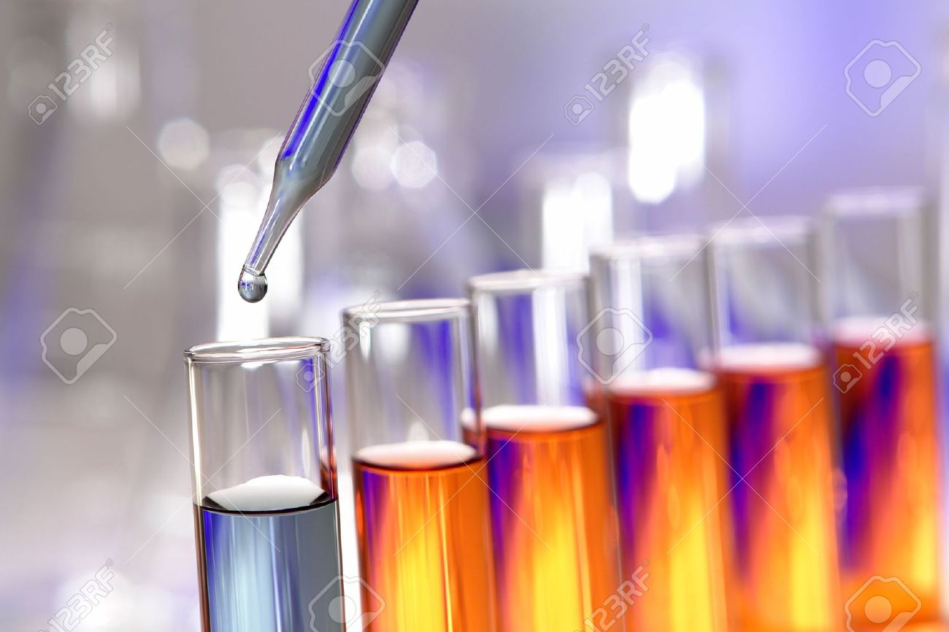
The Effect of Enzyme Concentration on the Rate of an Enzyme Catalyzed Reaction.

Slide 2
In this experiment, we will continue to study acid phosphatase kinetics.
Acid phosphatase kinetics
Time
Enzyme concentration
Substrate concentration
Effect of temperature
Effect of pH
Effect of inhibitor

Slide 3
Objective:
To establish the relationship between enzyme concentration and the rate of an enzyme catalyzed reaction.

Slide 4
The effect of enzyme concentration on velocity
The reaction rate will increase as the concentration of enzymes is increased but there must be a large excess of substrate
This is a linear relationship.
The initial rate of reaction is directly proportional to the enzyme concentration
V α [E]
More Enzyme molecule can react with more substrate molecules, so the initial rate will increase.

Slide 5
Principal of the enzyme assay in vitro
1
2
Under acid conditions, the enzyme catalyzes the hydrolysis of p-nitrophenyl phosphate (pNPP) to inorganic phosphate and p-nitrophenol.
Both p-nitrophenyl phosphate and p-nitrophenol are colorless at acidic pH values.Under alkaline conditions, p-nitrophenol is converted to a p-nitrophenolate (yellow color) and concentration can be measured at 405 nm.

Slide 6
Method:
We want to see the effect of enzyme concentration on the velocity, so every tube will have different enzyme concentration (dilution)
Place in a water bath maintained at 37 ºC for 5 minutes.
Blank
A
B
C
D
E
F
G
Add to each tube:
0.5 ml of buffer
0.5 ml of pNPP
0.5 ml MgCl₂
_{Water}
Place in a water bath maintained at 37 ºC for 5 minutes.
Place in a water bath maintained at 37 ºC for 5 minutes.
Place in a water bath maintained at 37 ºC for 5 minutes.
Place in a water bath maintained at 37 ºC for 5 minutes.
5.5 ml of dis. H₂O
5.3 ml of dis. H₂O
5.2 ml of dis. H₂O
5.1 ml of dis. H₂O
5 ml of dis. H₂O
4.9 ml of dis. H₂O
4.7 ml of dis. H₂O
4.5 ml of dis. H₂O
PS: Water volume will differ in each tube since each tube have different [E].
All the factors that affect enzyme kinetics are constant except enzyme concentration where it varies in each tube
Time = 5 min pH= 5.7 Temp= 37 ºC [S] = 0.05M

Slide 7
To start the reaction add the corresponding enzyme volume to each tube
To stop the reaction → add 0.5ml of KOH
Blank
A
B
C
D
E
F
G
All additions f E and KOH must be in 37 ⁰C water bath
Note that the blank do not contain any enzyme
0 ml of Enzyme
0.4 ml of Enzyme
0.6 ml of Enzyme
0.5 ml of Enzyme
0.8 ml of Enzyme
0.2 ml of Enzyme
1 ml of Enzyme
0.3 ml of Enzyme
Start at | 0 | 0 | 2 | 4 | 6 | 8 | 10 | 12
Stop at | 0 | 5 | 7 | 9 | 11 | 13 | 15 | 17
After all the reactions have been terminated, determine the absorbance at 405 nm for each sample against blank.

Slide 8
Tube | A | B | C | D | E | F | G
Start at | 0 | 2 | 4 | 6 | 8 | 10 | 12
Stop at | 5 | 7 | 9 | 11 | 13 | 15 | 17
To convert the time table to an easier way try the following

Slide 9
Results :
Velocity (µmole of PNP/min) | Absorbance 405 nm | Enzyme concentration (ml) | Tube
 |  | 0 | Blank
 |  | 0.2 | A
 |  | 0.3 | B
 |  | 0.4 | C
 |  | 0.5 | D
 |  | 0.6 | E
 |  | 0.8 | F
 |  | 1 | G

Slide 10
Calculations:
Velocity (V) = (A x 10⁶) /(E x time)= µmole of PNP/min
A= absorbance
E= extension coefficient=18.8 x 10³
Time = 5 min

Slide 11
The Effect of Enzyme Concentration on the Rate of an Enzyme Catalyzed Reaction.
Velocity
(µmole of PNP/min)
[E] (ml)
“Linear curve”

Slide 12
Discussion:
An introductory statement (In this experiment, we studied the effect of different enzyme concentrations on the rate of acid phosphatase catalyzed reaction.)
Principle
Describe the shape of curve you get.
Comment on the relationship between [E] and the rate of the reaction.

Slide 13
Question:
Assuming that there is a large excess of substrate. The rate of reaction will increase with increasing enzyme concentration. WHY?

