Slide 1
Entameoba spp.
By : t. moudy bin saleh

Slide 2
Classification Of Entameoba spp.
Phylum : Sarcomastigophora (having flagella or pseudopodia)
Subphylum : Sarcodina (pseudopodia present)
Order : Amoebida
Genus & species : Entameoba histolytica & Entameoba coli .

Slide 3
Introduction
- E. histolytica - is an important pathogenic parasite of humans : Amebiasis, amebic dysentery.
-The habitat of the E. histolytica trophozoites is the wall and lumen of the colon especially in the rectal regions.
- Entamoeba coli- is a non-pathogenic species of Entamoeba that frequently exists as a commensal parasite in the human gastrointestinal tract.

Slide 4
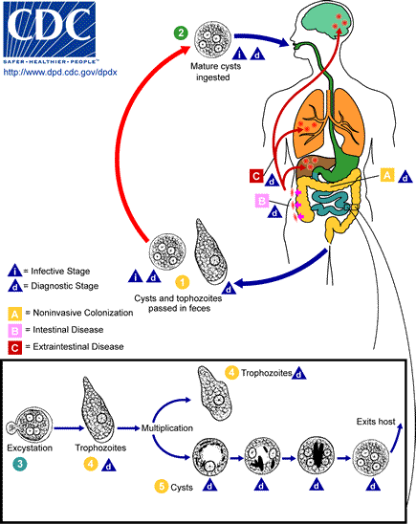
Life cycle Of Entamoeba histolytica.

Slide 5
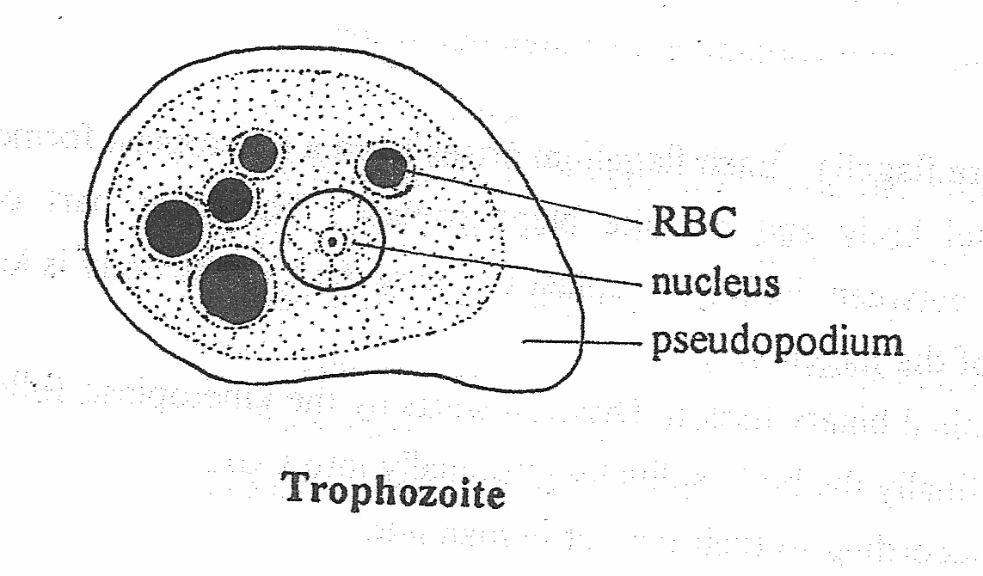
 | Entamoeba histolytica | Entamoeba coli
Habitat | Large Intestine | Large Intestine
Trophozoite
Size | 10 – 30 µ | 15 – 50 µ
Ectoplasm & endoplasm | Differentiated | Not differentiated
Nucleus Karyosome peripheral chromatin | 1 Small – central Fine granules of equal size and even distribution | 1 Big – eccentric Coarse granules of irregular size and distribution

Slide 6
 | Entamoeba histolytica | Entamoeba coli
Mature cyst
Size | 15 µ | 20 µ
Shape | Round
Glycogen vacuoles | In young cyst only
Chromatoid bodies | Often present (bar-like rods) | Sometimes present (splinter-like)
Nuclei: number | 4 | 8

Slide 7
Entamoeba coli | Entamoeba histolytica
Mature cysts 4-8 nuclei | 4 nuclei Mature cysts | Infective stage &Diagnostic stage
Nonpathogenic ameba reside in the large intestine | Pathogenic ameba | Pathogenicity
Ingestion of mature cysts in fecal contaminated food, water, or hands. |  | Mode of the infection

Slide 8
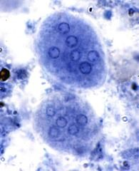
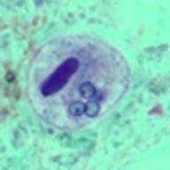
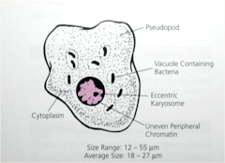
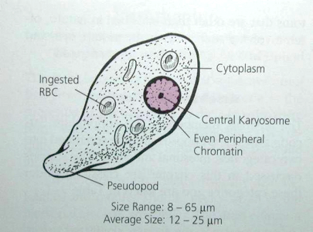
Entamoeba coli Mature cysts
Entamoeba histolytica Mature cysts
Entamoeba coli trophozoirte
Entamoeba histolytica trophozoirte

Slide 9
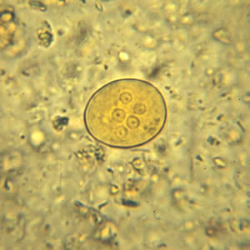
Cyst of E. coli in a concentrated wet mount stained with iodine. Five nuclei are visible in this focal plane.

