Slide 1
Enzyme-Linked Immunosorbent Assay [ELISA]
Lab#5
BCH 462[practical]

Slide 2
Antigens [Ag]:
A substance that when introduced into the body stimulates the production of an antibody. Antigens include toxins, bacteria, foreign blood cells, and the cells of transplanted organs.
Antibody [Ab]:
Antibodies are large Y-shaped glycoproteins. They are produced by the immune system to identify and neutralize foreign objects like bacteria and viruses or antigens in general.
The antibody recognizes a unique foreign target, called an antigen[ not normally found in the body] .
So, each antibody recognize specific antigen.

Slide 3
Immunoassay is : a test that uses antibody and antigen complexes[immuno-complexes]as a means of generating measurable results.
ELISA: method used in immunology and other scientific field, designed for detecting and quantitating substances such as:
peptides, proteins, hormones “antigens in general” .
antibodies.
Principle:
The basic principle of ELISA is to detect a specific antibody- antigen reaction by using an enzyme which can convert a colorless substrate to a color product indicating the presence of the antibody - antigen [Ab-Ag] binding.

Slide 4
Propose of ELISA:
-To determine the presence and the concentration of a particular Ag or Ab in a sample. Thus it can be run in a qualitative format.
-In qualitative ELISA, results provide a positive or negative result for a sample.
-In quantitative ELISA, the optical density or flurescent units of the sample is interpolated into a standard curve (obtained from serial dilutions of a standard).

Slide 5
Application of ELISA:
ELISA can be used in the field of medicine, food industry and in toxicology labs to evaluate the presence of a specific Ag or Ab in a sample.
They can be used for:
-screening donated blood for evidence of viral contamination.
-measuring hormones level.
-it can measure autoantibody in autoimmune disease Such as rheumatoid arthritis.

Slide 6
Types of ELISA:
Direct ELISA .(Sandwich ELISA.
Indirect ELISA.
Competitive ELISA.

Slide 7
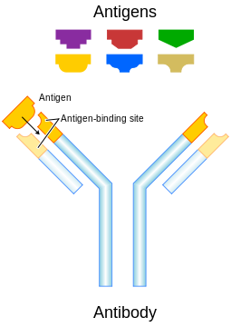
*

Slide 8
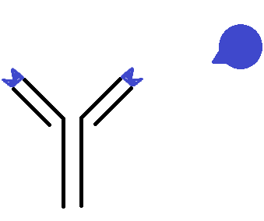
epitope
antigen
*
antibody

Slide 9
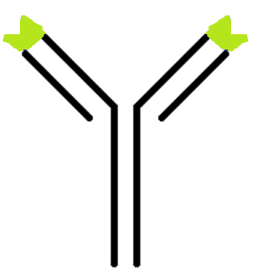
enzyme
Primary antibody
“antibody specified to specific antigen”
Secondary antibody
“antibody specified to Primary antibody”
The enzyme linked: will convert colorless substrate to colored product,
Indicate the presence of the antibody - antigen [Ab-Ag] binding complex.

Slide 10
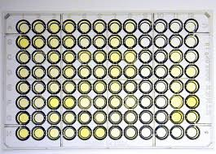
Direct ELISA: Sandwich ELISA
-It is used to detect the presence and the concentration of specific antigen in the sample.
-Test which is considered to be the simplest type of ELISA.
-The antigen “of interest” is adsorbed or fixed to a microtiter plate , an enzyme is linked to an antibody applied to the antigen. The enzyme-antibody, will bound to antigen of interest. By adding in the enzyme's substrate, the enzyme will convert colorless substrate to colored product. The color produced is proportional the amount of the antigen of interest .
-The name “direct ELISA” due to, that the antibody linked to the enzyme is directly bind to the protein of interest “antigen”.

Slide 11
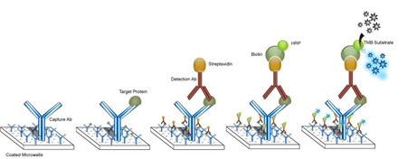
Direct ELISA

Slide 12
see the method that we discuss together during the lab

Slide 13
Indirect ELISA:
-Is used to detect the presence and the concentration of specific antibody.
This method differs than direct ELISA in that one more labeled secondary antibody is added in the reaction. The primary antibody added to the fixed antigen. Then labeled secondary antibody added that recognizes the primary antibody. The color or the signal produced as a result of addition of substrate is proportional to antibodies in the sample.
“antibody of interest “in the sample.
Do not forget:
1. The primary antibody [1ry antibody]: is not linked to an enzyme. And it is the antibody of interest. it is specific to the antigen.
2. The secondary antibody [2ry antibody]: is conjugated with an enzyme , and it is specific to 1ry antibody.

Slide 14
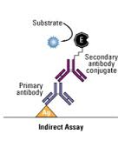
see the method that we discuss together during the lab
Indirect ELISA
The name Indirect ELISA, is due to that 2ry antibody bind indirectly to the antigen.

Slide 15
Competitive ELISA:
see the method that we discuss together during the lab

